Slide 1
SA5 OAM&P Exec Report
SA5#137e, 10 – 19 May,2021 e-meeting
Zou Lan, SA5 Vice-Chair, HUAWEI
Thomas Tovinger, SA5 Chair, ERICSSON
Mirko Cano Soveri, MCC

Slide 2
Incoming LSs
Tdoc | Title | Source | Decision | Reply In
S5-213021 | Resubmitted LS to SA5 on the details of logging forms reported by the gNB-CU-CP, gNB-CU-UP and gNB-DU under measurement pollution conditions | R3-211334 | replied to | S5-213499
S5-213022 | Resubmitted LS/r on work progress on M.resm-AI "Requirements for energy saving management of 5G RAN system with AI" (reply to 3GPP SA5-LS1225) | ITU-T SG2 | Noted.
S5-213023 | Resubmitted LS/r on methodology harmonization and REST-based network management framework (reply to 3GPP TSG SA5-S5-204647) | ITU-T SG2 | replied to | S5-213454
S5-213024 | LS ccSA5 on 5G capabilities exposure for factories of the future - revised | 5G Alliance for Connected Industries and Automation (5G-ACIA) | replied to | S5-213448
S5-213025 | LS on Information on the port number allocation solutions | C4-211806 | Noted
S5-213026 | LS ccSA5 on Requirement on Support of VxLAN Tunnelling | C4-211827 | Noted
S5-213027 | Ls on Broadband Forum Response to 3GPP/SA5 Liaison S5-193350 (LIAISE-293) | BBF | Noted
S5-213028 | LS on Multi-SDO Autonomous Networks (AN) Formal Liaison: 19th April 2021 Meeting Invitation, agenda, Bridge, and Meeting Schedule | TM Forum | replied to | S5-213444
S5-213029 | LS from GSMA Operator Platform Group on edge computing definition and integration. | GSMA | replied to | S5-213443
S5-213030 | Reply LS on QoE Measurement Collection for LTE | RP-210922 | Postponed
S5-213034 | Reply LS ccSA5 on propagation of user consent related information during Xn inter-PLMN handover | S3-211330 | Noted
S5-213035 | Reply LS on the user consent for trace reporting | S3-211338 | Noted
S5-213036 | LS on EDGEAPP | S6-210630 | replied to | S5-213445
S5-213037 | LS on slicing management aspects in relation to SEAL | S6-210709 | replied to | S5-213446
S5-213044 | LS ccSA5 on Requirement on Support of VxLAN Tunnelling | S2-2103236 | Noted
S5-213047 | Reply LS ccSA5 on Edge computing definition and integration | S6-210976 | Noted
S5-213048 | Reply LS to SA5 on network sharing with multiple SSBs in a carrier | R2-2104606 | replied to | S5-213680
S5-213051 | LS ccSA5 on Clarification on the API design principles | C3-212554 | Noted
S5-213098 | Response LS to SA5 on handover terminology | R2-2104358 | Noted
S5-213178 | Ls to SA5 on 3GPP Edge Computing coordination | S6-210978 | replied to | S5-213449
S5-213294 | LS reply to GSMA ccSA5 Operator Platform Group on edge computing definition and integration | ETSI ISG MEC | Noted
S5-213295 | LS on NG.116 support of service categories | GSMA | Noted
S5-213297 | LS reply to 3GPP SA5 on Network Slice EE KPIs | GSMA | Postponed
S5-213442 | LS on UPF support for multiple network slices | 3GPP CT4 | replied to | S5-213447

Slide 3
Outgoing LSs
Tdoc | Title | To | Cc | Reply To
S5-213499 | Reply LS on the details of logging forms reported by the gNB-CU-CP, gNB-CU-UP and gNB-DU under measurement pollution conditions | 3GPP RAN3 | 3GPP RAN2 | S5-213021
S5-213454 | LS on Methodology harmonization and REST-based network management framework | ITU-T Study Group 2 |  | S5-213023
S5-213448 | LS to SA for a coordinated reply to 5G ACIA on ‘5G capabilities exposure for factories of the future’ | SA |  | S5-213024
S5-213444 | LS S5-213028 on Multi-SDO Autonomous Networks (AN) Formal Liaison: 19th April 2021 Meeting Invitation, agenda, Bridge, and Meeting Schedule from TM Forum | TM Forum | 3GPP SA | S5-213028
S5-213443 | Reply LS on Edge computing definition and integration | 3GPP TSG SA | 3GPP TSG SA2, 3GPP TSG SA6 | S5-213029
S5-213445 | Reply LS on EDGEAPP | 3GPP TSG SA WG6 | 3GPP TSG SA, 3GPP TSG SA2 | S5-213036
S5-213446 | LS on Reply LS on slicing management aspects in relation to SEAL | SA6 | SA2 | S5-213037
S5-213447 | Reply LS on UPF support for multiple network slices | CT4 | SA2 | S5-213442
S5-213680 | Reply LS to RAN2 on network sharing with multiple SSBs in a carrier | RAN2 | RAN3 | S5-213048
S5-213449 | LS reply to SA on GSMA 3GPP Edge Computing coordination | 3GPP TSG SA, 3GPP TSG SA WG2, 3GPP TSG SA WG6 |  | S5-213178
S5-213683 | LS on Inclusive language for ANR | RAN3, RAN2 |  | new
S5-213522 | LS to TM Forum on Intent Management | TM Forum Autonomous Networks |  | new
S5-213689 | LS on using SA5 Performance Measurements and Trace for centralised PCI management | RAN2 |  | new
S5-213456 | LS on progress of study items for security on management aspect | SA3 |  | new

Slide 4
New or Revised Work Items / Study Items
Tdoc | Type | Release | Title | Source | Potential related groups
S5-213457 | New SID | Rel-17 | New SID on Management Aspects of 5G Network Sharing | China Unicom | RAN3
S5-213458 | New WID | Rel-17 | New WID on Edge Computing Management | Samsung, Intel | SA2, SA6, and ETSI NFV ISG
S5-213232 | Revised WID | Rel-17 | Revised WID on EMA5SLA | China Mobile

Slide 5
Documents endorsed by OA&M
TDoc | Title | Source | Potential related topics and related groups
S5-213088 | Living document of review of GSMA GST SA5#137e | Huawei, China Mobile | GSMA
S5-213136 | Discussion on enhansement of NRM definition for the NWDAF | Huawei | SA2
S5-213040 | Rel-17 SBMA versions for 28.622 and 28.623 | Ericsson Hungary Ltd
S5-213134 | DP tenant representation in 3GPP management system | Huawei
S5-213304 | Discussion on LS from GSMA on Network Slice EE KPI | Orange | GSMA
S5-213551 | Discussion Paper on Useful Output Measurement Solutions | China Telecom Corporation Ltd.
S5-213058 | Discussion on OAM providing eNA related input data to NWDAF | China Telecomunication Corp. | SA2
S5-213453 | Changing requirement methodology in SA5 | Ericsson

Slide 6
Overview of SA5 OAM ongoing WIs/SIs
Rel-17: 28 ongoing WIs/SIs, 3 finished SI, 1 WI and 1 SI for SA approval
20 ongoing WIs, 1 WI wait for SA approval
8 ongoing SIs, 3 finished SI, 1 SI wait for SA approval
 | Rel-17 Operations, Administration, Maintenance and Provisioning (OAM&P)
1 | Additional NRM features | adNRM | 870026
2 | Enhancements of 5G performance measurements and KPIs | ePM_KPI_5G | 880025
3 | Management of MDT enhancement in 5G | e_5GMDT | 870025
4 | Enhancement of QoE Measurement Collection | eQoE | 870027
5 | Management data collection control and discovery | MADCOL | 880028
6 | Management Aspects of 5G Network Sharing | MANS | 900021
7 | File Management | FIMA | 910030
8 | Autonomous network levels | ANL | 880027
9 | Intent driven management service for mobile networks | IDMS_MN | 810027
10 | Network policy management for 5G mobile networks | NPM | 860024
11 | Enhanced Closed loop SLS Assurance | eCOSLA | 870030
12 | Enhancements of Management Data Analytics Service | eMDAS | 850028
13 | Enhancements of Self-Organizing Networks (SON) for 5G networks | eSON_5G | 870028
14 | Generic Plug and connect | PACMAN | 910029
15 | Enhancement of Handover Optimization | E_HOO | 880029
16 | Enhancements on EE for 5G networks | EE5GPLUS | 870022
17 | Discovery of management services in 5G | 5GDMS | 820035
18 | Management of non-public networks | OAM_NPN | 870023
19 | Enhancement on Management Aspects of 5G Service-Level Agreement | EMA5SLA | 870024
20 | Management of the enhanced tenant concept | eMEMTANE | 880026
new | Edge Computing Management | ECM | Wait for SA approval
 | Rel-17 OAM&P Studies
1 | Study on new aspects of EE for 5G networks | FS_EE5G | 870021
2 | Study on YANG PUSH | FS_YANG | 890017
3 | Study on continuous integration continuous delivery support for 3GPP NFs | FS_CICDNS | 910028
4 | Study on enhancements of edge computing management | FS_eEDGE_Mgt | 870029
5 | Study on network slice management enhancements | FS_NSMEN | 860022
6 | Study on enhancement of service based management architecture | FS_eSBMA | 910031
7 | Study on access control for management service | FS_MNSAC | 890016
8 | Study on management aspects of network slice management capability exposure | FS_NSCE | 910026
new | Study on Management Aspects of 5G Network Sharing | FS_MANS | Wait for SA approval
9 | Study on autonomous network levels (finished) | FS_ANL | 850032
10 | Study on management and orchestration aspects with integrated satellite components in a 5G network | FS_5GSAT_MO | 830025
11 | Study on enhancement of Management Data Analytics Service | FS_eMDAS | 850028

Slide 7
OAM General Topics
Working Progress
The following general topics are discussed in the meeting:
Collection of useful endorsed document and external communication documents
TS 32.160 Update on template for requirement specifications
Update of forge process
Working procedure regarding stage 2 and stage 3 alignment

Slide 8
Rel-16/Rel-17 CRs
Working Progress
The following topics are discussed and agreed related CRs in the meeting.
TS 28.310: energy saving management services :
Rel-16 CR TS28.310 Update on energy saving management services
Rel-17 CR TS28.310 Update on energy saving management services
TS 28.310&28.313&28.541: C-SON and domain centralized SON (email)
Rel-16 28.541 Correction to definition for domain centralized SON
Rel-17 28.541 Correction to definition for domain centralized SON
TS 28.531: Clarify misleading information in network slicing use cases
Rel-15 CR 28.531 CR Clarify misleading information in network slicing use cases
Rel-16 CR 28.531 CR Clarify misleading information in network slicing use cases
TS 28.532
Rel-16 CR 28.532 Correct definitions for performance assurance (stage 2 and 3)
Rel-16 CR 28.532 Correct definitions for file management (stage 2, REST SS, OpenAPI definition)
Rel-16 CR TS 28.532 Update clause 11.2.2 Managed information for fault supervision management service
TS 28.535: Update lifecycle description
Remove description of communication service lifecycle
Update management control loops with lifecycle description
TS 28.541:
  Correct the description for GNBDUFunction and EP_NgC
  Rel-16 CR TS 28.541 Correct the description for GNBDUFunction and EP_NgC
  Rel-17 CR TS 28.541 Correct the description for GNBDUFunction and EP_NgC
  RRMPolicy:
  Rel17 CR 28.541 Add note for RRMPolicy
  network slice NRM
  Rel-16 CR 28.541 fix editorial issue of network slice NRM
  Rel-17 CR 28.541 fix editorial issue of network slice NRM
  Rel-16 CR 28.541 fix inheritance relation of network slice NRM
  Rel-17 CR 28.541 fix inheritance relation of network slice NRM
  Rel-17 CR 28.541 Correction of ServiceProfile attributes
  Yang Corrections of implementation errors
  Correct inconsistencies in definitions around network slice management
  TS 28.545
  Add missing Alarm Requirements and Use Cases
  TS 28.552
  Rel-16 CR 28.552 Fix definition of measurement Average delay DL on F1-U
  Rel-17 CR 28.552 Fix definition of measurement Average delay DL on F1-U
  TS 28.622&28.623&32.422
  Rel-16 CR 28.622 Addition, adaptation and cleanup of Trace/MDT related parameters (stage2)
  Rel-16 CR 28.623 Addition, adaptation and cleanup of Trace/MDT related parameters (stage 3)
  Rel-16 CR 28.623 Align Trace/MDT related parameters to TS 32.422 (OpenAPI definition)
  Rel-17 CR 32.422 Correction, alignment and cleanup of Trace/MDT related parameters
  TS 28.622&28.623
  Replace legacy IRPAgent with MnsAgent (email)
  Rel-16 CR 28.622 Replace legacy IRPAgent with MnsAgent (stage 2)
  Rel-16 CR 28.623 Replace legacy IRPAgent with MnsAgent (OpenAPI definition)
  Rel-16 CR 28.622 Clarify a subscription is required for notifyFileReady
  Rel-16 CR 28.622 Clarify definition of PerfMetricJob
  Rel-16 CR 28.622 Clarify the notification filter applies to all parameters of a notification
  Rel-16 CR 28.622 Correct common notifications table
  Rel-16 CR 28.623 Clean up regarding common data types (OpenAPI definition)
  Rel-16 CR 28.623 Correct definition of additionalInformation (YANG)
  TS 32.158
  Rel-16 CR 32.158 Correct definitions of resource creation
  Rel-16 CR 32.158 Correct definition of the REST SS specification template
  TS 32.160
  Rel-16 CR 32.160 Change format for NRM stage 3 definition rules from JSON to YAML
  TS 32.160&28.532&28.622
  Rel-16 CR 32.160 Align different (abbreviated) names for support qualifier to “S”
  Rel-16 CR 28.622 Align different (abbreviated) names for support qualifier to “S”
  Rel-16 CR 28.532 Align different (abbreviated) names for support qualifier to “S”
  TS 32.421&28.541
  CR TS 32.421 Update inclusive language
  Rel17 CR 28.541 Inclusive language review fixing
  Rel. 17 CR TS 28.313 Fix non-inclusive languages

Slide 9
Rel-17 WI MADCOL/ePM_KPI_5G/e_5GMDT/eQoE
WI code | WI Title | Completion rate | TS/TR | Tdoc reference | Target date | Rapporteur | Related groups | Related topic
MADCOL | Management data collection control and discovery | 10%->25%->30% | TS28.533/28.532/28.622/ 28.623 | SP-200465 | SA#93 (Sep. 2021) | Nokia | SA2/RAN2/RAN3
ePM_KPI_5G | Enhancements of 5G performance measurements and KPIs | 30%->40%->50% | TS28.552/32.425/28.554/32.426/32.450/32.451/32.455 | SP-200462 | SA#93 (Sep. 2021) | Intel | SA2/RAN2/RAN3
e_5GMDT | Management of MDT enhancement in 5G | 60%->70%->75% | TS32.421/32.422/32.423/28.622/28.623/28.523 | SP-200191 | SA#94 (Dec. 2021) | Ericsson | SA2/RAN2/RAN3
eQoE | Enhancement of QoE Measurement Collection | 10%->15%->20% | TS28.307/28.308/28.309/28.404/28.405/28.406/28.622/28.623/28.533 | SP-200193 | SA#93 (Sep. 2021)-> SA#95 (Mar. 2022) | Ericsson | RAN2/RAN3/SA4
Working Progress
MADCOL: The following topics are discussed but need more discussion.
Rel-17 Input to DraftCR 28.537 Add requirements for managing external management data
Rel-17 Input to DraftCR 28.622 Add solution for managing external management data
Rel-17 Input to DraftCR 28.622 Add data collection job to allow consumers without detailed knowledge of the network to request for data
Rel-17 Input to DraftCR 28.537 Add requirements for producing and reporting management data
Rel-17 Input to DraftCR 28.622 Add solution for storing management data
Rel-17 Input to DraftCR 28.622 Add solution for discovering management data
eQoE: The following topics are discussed and agreed
Signalling based QMC for UMTS and LTE are almost finished. The result are captured in a Draft CR.
For UMTS and LTE, there are some Rel-16 functionality that needs to be removed in SA5 TSs, due to that other WGs has not implemented them.
ePM_KPI_5G: Group discussed and agreed the
New performance measurements related to data record creation, data record deletion, data record update and data modification notification subscription for UDR, normally released calls (QCI1 E-RAB) initiated by MME in RLF detected conditions, attempted and successfully resumed DRBs, and inter-gNB successful and failed handover execution per beam pair;
New KPI on total DRB Accessibility for UE services, and updated KPI on the accessibility to cover RRC Resume.
Group also discussed the addition of Exception Reporting Support to PM XML File Schema, but could not reach consensus at this meeting.
e_5GMDT: Several CRs have been agreed
MDT measurement pollution indicator
Enhancement for GPB trace record format
Correction and clean up for trace/MDT related parameters

Slide 10
Rel-17 WI adNRM/MANS/FIMA
WI code | WI Title | Completion rate | TS/TR | Tdoc reference | Target date | Rapporteur | Related groups | Related topic
adNRM | Additional NRM features | 10%->15%->30% | TS28.540/28.541/28.622/ 28.623 | SP-200192 | SA#92 (Jun. 2021) -> SA#94 (Dec. 2021) | Nokia | SA2/RAN3
MANS | Management Aspects of 5G Network Sharing | 15%->20%->25% | TS 28.541/28.552/32.130 | SP-201080 | Sep 2021 (SA#93) | China Unicom | RAN2/RAN3
FIMA | New WID on File Management | 0%->25% | TS 28.537/28.622/28.623/28.532 | SP-210135 | SA#94 (Dec 2021) | Nokia
Working Progress
adNRM: Several TDs/CRs for 5GC NRM enhancement were discussed and some of them were agreed, proposals for restructure of NRM specifications were discussed but haven’t made consensus so far.
FIMA: Rel-17 Input to DraftCR 28.537 Add requirements for file upload is approved.
MANS: Currently we have done the objectives of specifying some information and parameters in configuration management with different authorities in TS 28.552, and updated the scope, background and some requirements of MOCN network sharing scenarios.

Slide 11
Rel-17 WI ANL/IDMS_MN/NPM/eCOSLA/eMDAS
WI code | WI Title | Completion rate | TS/TR | Tdoc reference | Target date | Rapporteur | Related groups | Related topic
ANL | Autonomous network levels | 40%->50%->70% | TS 28.100 | SP-200464 | SA#92 (Jun. 2021) -> SA#94 (Dec. 2021) | CMCC | TMF/SA2/RAN3/ZSM | Autonomous network
IDMS_MN | Intent driven management service for mobile networks | 65%->70%->70% | TR28.812/TS 28.312 | SP-180899 | SA#93 (Sep. 2021) -> SA#94 (Dec. 2021) | Huawei | SA2/RAN3/ZSM | Intent
NPM | Network policy management for 5G mobile networks based on NFV scenarios | 60%->65%->75% | TS 28.555/28.556 | SP-191211 | SA#95 (Mar. 2022) | CMCC | SA2/RAN2/RAN3 | Policy
eCOSLA | Enhanced Closed loop SLS Assurance | 20%->30%->50% | TS28.535/28.536/28.533/28.541/28.546/28.552/28.553 | SP-200196 | SA#93 (Sep. 2021) | Ericsson | ZSM/SA2/RAN3 | Closed loop interaction
eMDAS | Enhancements of Management Data Analytics Service | 0%->0% | TS 28.104 | SP-210132 | SA#94 (Dec. 2021) | Intel,NEC | SA2/RAN3 | Data analytics
Working Progress
ANL: Several pCRs regarding ANL concepts, framework approach, use case, generic requirements are approved
28.100 Update workflow for evaluating autonomous network levels
28.100 Update description and corresponding figures
28.100 Update or add generic requirements
28.100 Move contents from clause 6 to Annex A
NPM: The following CR topics are discussed and agreed.
28.555 add editorial improvements of Background
28.556 add introduction
28.556 add policy management procedure
28.556 add management operation for Policy
eMDAS: The following topics are discussed.
Comprehensive discussions were made on TS structure (related to how to define MDA data and services), ML support for MDA, common information elements of MDA reports, MDA capability for coverage issue analysis, TS scope, MDA functionality and service framework, MDA role in management loop, alarm incident analysis and MDA assisted Energy Saving.
However, due to different views on the TS structure could not be converged, all pCRs were not agreed in this meeting.
IDMS_MN: Several pCRs regarding intent concept, Intent model and intent workflow are discussed.
Following pCR is approved:
pCR TS 28.312 Update Clause 4.2 and Clause 4.4
Following pCRs are discussed and need further discussion:
Update intent information model
IntentExpectation Datatype definition
Add concrete IntentExpectation for network optimization
Add concrete IntentExpectation for radio network deployment and radio service deployment
Add state and procedure for intent management
Add procedure of subsequence after the intent MOI created
eCOSLA: The group has been working on new use cases and requirements, including enhancement of the Rel-16 descriptions. Main topics under discussion are new use case for loop co-ordination, loop supervision, location, incident resolution, reporting and policy in TS 28.535. Furthermore the group is discussing how these use cases could be solved by stage 2/3 solutions in TS 28.536.

Slide 12
Rel-17 WI eSON_5G/PACMAN/E_HOO/EE5GPLUS/5GDMS
WI code | WI Title | Completion rate | TS/TR | Tdoc reference | Target date | Rapporteur | Related groups | Related topic
eSON_5G | Enhancements of Self-Organizing Networks (SON) for 5G networks | 15%->15%->35% | TS 28.313/28.552/28.541/28.545 | SP-200194 | SA#92 (Jun. 2021) ->SA#94 (Dec. 2021) | Intel | RAN3 | SON
PACMAN | Generic Plug and connect | 0%->10% | TS 28.313/28.314/28.315/28.316 | SP-210260 | SA#96 (June 2022) | Ericsson
E_HOO | Enhancement of Handover Optimization | 10%->10%->30% | TS28.552/28.313/28.541 | SP-200466 | SA#95 (Mar. 2022) | Ericsson | RAN3 | SON
EE5GPLUS | Enhancements on EE for 5G networks | 20%->30%->55% | TS28.310/28.552/28.554/28.541 | SP-200188 | SA#93 (Sep. 2021) | Orange | SA2/RAN2/RAN3/ETSI EE/ITU-T/GSMA | Energy saving
5GDMS | Discovery of management services in 5G | 60%->70%->80% | TS 28.533/28.532/531 | SP-181072 | SA#93 (Sep-2021) | Huawei |  | Service based discovery
Working Progress
eSON_5G: The group agreed a CR to add use case, requirements, and potential solution for a C-SON function to optimize the RRM resources for each network slice instance, and a CR to fix the inclusive languages in TS 28.313 (pending on email approval).
EE5GPLUS: The following topics are discussed and agreed in this meeting
Rel-17 CR 28.310 Update on energy efficiency of URLLC network slice
Rel-17 CR 28.554 Update on energy efficiency of URLLC network slice
Discussion on LS from GSMA on Network Slice EE KPI
Rel-17 CR TS 28.541 Add Energy efficiency attribute
Rel-17 CR 28.541 Add energy efficiency to serviceprofile and sliceprofile
Rel-17 CR TS 28.554 Add Energy Consumption KPI pour 5G NF and 5G CN
Rel-17 CR TS 28.554 Add EE KPI for eMBB network slice based on RAN meas
Rel-17 CR TS28.310 Update of the EE KPIs Overview
PACMAN: The following topics are agreed.
PnC Concepts and Requirements
PnC Procedure flows
PnC Data formats
E_HOO: The following topic is agreed.
Rel-17 CR 28.552 CHO Measurements
5GDMS: The following topics are agreed.
Agreed a preliminary outline of Network Resource Model for registration of management services.
Improved the description of management service discovery in TS 28.533.
Added requirements to TS 28.537.

Slide 13
Rel-17 WI OAM_NPN/EMA5SLA/eMEMTANE
WI code | WI Title | Completion rate | TS/TR | Tdoc reference | Target date | Rapporteur | Related groups | Related topic
OAM_NPN | Management of non-public networks | 25%->35%->50% | TS28.557/28.541/28.531/28.533/28.552/28.554 | SP-200189 | SA#92 (Jun. 2021) -> SA#94 (Dec. 2021) | Huawei | SA2/RAN3 | NPN
EMA5SLA | Enhancement on Management Aspects of 5G Service-Level Agreement | 50%->60%->65% | TS28.531/28.541 | SP-200190 | SA#92 (Jun. 2021) ->SA#94 (Dec. 2021) | China Mobile | SA2/RAN3 | SLA
eMEMTANE | Management of the enhanced tenant concept | 5%->5%->15% | TS28.531/28.532/28.533/28.541 | SP-200463 | SA#94 (Dec. 2021) | Huawei | SA2 | Tenant
Working Progress
OAM_NPN: The following topics are discussed and agreed
NG-RAN related management aspects
Exposure of management capabilities related to NPN
Requirements to support management of CAG
Enhancement of management modes of NPN and deployment considerations on NPN management modes
eMEMTANE: DP tenant representation in 3GPP management system is endorsed.
EMA5SLA: several CRs has been agreed and approved
Update the existed NRM to support SLA management
OpenAPI changes of the related update stage 2 work
Corrections of existed use case and requirements to support SLA management.

Slide 14
Rel-17 SI FS_EE5G/FS_YANG/FS_CICDNS/FS_eEDGE_Mgt
WI code | WI Title | Completion rate | TS/TR | Tdoc reference | Target date | Rapporteur | Related groups | Related topic
FS_EE5G | Study on new aspects of EE for 5G networks | 50%->70%->75% | TR 28.813 | SP-200188 | SA#93 (Sep. 2021) | Orange | SA2/EE | Energy saving
FS_YANG | Study on YANG PUSH | 5%->5%->10% | TR 28.818 | SP-200765 | SA#93 (Sep. 2021) | Ericsson | ONAP | YANG
FS_CICDNS | continuous integration continuous delivery support for 3GPP NFs | 0%->15% | TR 28.819 | SP-210133 | SA#93 (Sep. 2021) | Lenovo, China Mobile | ETSI NFV
FS_eEDGE_Mgt | Study on management aspects of edge computing | 50%->75%->90% | TR 28.814 | SP-200195 | SA#90 (Dec. 2020) ->SA#93 (Sep. 2021) | Intel | SA6 | edge
Working Progress
FS_EE5G: The following topics are discussed and agreed in this meeting:
Discussion Paper on KPI of energy efficiency of URLLC type of network slice
pCR 28.813 on KPI of energy efficiency of URLLC type of network slice
pCR 28.813 New KI on Useful Output
Discussion Paper on Useful Output Measurement Solutions
pCR T 28.813 Reorganisation of Key Issue #2
pCR 28.813 Potential solution for Key Issue #6
pCR 28.813 Potential solution for Key Issue #7
pCR 28.813 New KI on EE KPI for 5GC on 5GC Resource Consumption Estimation
pCR TR 28.813 Conclusion for Key Issue No. 1
pCR TR 28.813 Conclusion to DV based EE KPI for 5GC key issue
The group agreed to send TR 28.813 for information.
FS_eEDGE_Mgt: The group agreed a solution evaluation pCR with a way forward to extend the provisioning MnS to support the asynchronous mode operations. The group also concluded TR 28.814 with recommendation to start the normative work of ECM where the WID has been approved. TR 28.814 is still open for contributions to support of SA2’s Rel. 17 WI eEDGE_5GC works.
FS_YANG: The following topics are discussed.
Functionality of YANG-Push
Using YANG-Push
YANG-Push Impact on Specifications
Comments on S5-213417rev1 pCR 28.818 Functionality of YANG-Push
FS_CICDNS: The following topics are discussed and agreed:
Initial Skeleton,scope,NGMN Background,Explanation for related work in ETSI
Roles relevant to the study,Scenario on Supplier NF delivery,Usecase and requirements for CI-CD,Explanation for Single and Multiple NF Suppliers CI-CD

Slide 15
Rel-17 SI FS_NSMEN/FS_eSBMA/FS_MNSAC/FS_NSCE
WI code | WI Title | Completion rate | TS/TR | Tdoc reference | Target date | Rapporteur | Related groups | Related topic
FS_NSMEN | Study on network slice management enhancements | 30%->40%->80% | TR 28.811 | SP-191192 | SA#92 (Jun. 2021) ->SA#93 (Sep. 2021) | Huawei, Nokia | SA2/RAN3 | SLA
FS_eSBMA | Enhancement of service based management architecture | 0%->10% | TR 28.925 | SP-210136 | SA#94 (Dec. 2021) | Huawei, Ericsson | ETSI ZSM | architecture
FS_MNSAC | Study on access control for management service | 30%->35%->80% | TR 28.817 | SP-200853 | SA#91 (Mar.2021) -> SA#93 (Sep. 2021) | Nokia | SA3 | security
FS_NSCE | Study on network slice management capability exposure | 0%->5% | TR 28.824 | SP-210131 | SA#94 (Dec. 2021) | Alibaba | SA3, SA, RAN | exposure
Working Progress
FS_NSMEN: The following topics are discussed and agreed
Added use case for network slice protection on N6 interface to TR 28.811. (depends on email approval S5-213576)
Added use case for network slice specific authentication to TR 28.811.
Added use case for isolation in network slice subnet to TR 28.811. (depends on email approval S5-213506)
Added possible solutions for multi-operator scenario to TR 28.811. (depends on email approval S5-213563)
Added requirements to TR 28.811.
Added conclusions and recommendations to TR 28.811.
FS_eSBMA: The following topics are discussed and agreed.
Add key issue SBMA supporting management of 5G SA and NSA scenarios
Add key issue SBMA supporting management architectures and frameworks in other SDOs
pCR R17 28.925 TS investigation
FS_MNSAC:
two more use cases for access control were agreed, including proposal for fine-grained access control polices definition based on MnS component type A, B and C. Send LS to SA3 to update them with the progress in SA5.
FS_NSCE: Several pCRs regarding TR skeleton, concepts, and use case are approved:
28.824 skeleton
28.824 External exposure via BSS
28.824 Exposure of MnS for monitoring QoS of video application
Several pCRs regarding concepts, and use case are under email approval:
28.824 Add Description of Concept and Roles to TR 28.824
28.824 Use case - network slice management capability exposure

Slide 16
List of latest DraftCRs
List of DraftCRs to be generated in THIS meeting:
Tdoc# | Title | Source Company | Rapporteur | Agenda
S5-213672 | DraftCR for eCOSLA - TS 28.536 | Ericsson | Jan Groenendijk | 6.4.12
NA | DraftCR for E-HOO - TS 28.313 | Ericsson | Per Elmdahl | 6.4.14
S5-213661 | DraftCR for 5GDMS - TS 28.533 | Huawei | Brendan | 6.4.16
S5-213659 | DraftCR for 5GDMS - TS 28.537 | Huawei | Brendan | 6.4.16
NA | DraftCR for 5GDMS - TS 28.622 | Huawei | Lei Zhu | 6.4.16
NA | DraftCR for 5GDMS - TS 28.623 | Huawei | Lei Zhu | 6.4.16
S5-213660 | DraftCR for eQoE - TS 28.405 | Ericsson | Robert Petersen | 6.4.5
NA | DraftCR for MADCOL TS 28.622 | Nokia | Olaf Pollakowski | 6.4.8
S5-213673 | DraftCR for MADCOL TS 28.537 | Nokia | Olaf Pollakowski | 6.4.8
S5-213451 | DraftCR for FIMA TS 28.537 | Nokia | Olaf Pollakowski | 6.4.20
List of approved DraftCRs to be used as baseline from history meetings:
Tdoc# | Title | Source Company | Rapporteur
S5-205279 | DraftCR for e_5GMDT - TS 32.441 | Ericsson | Zhulia Ayani
S5-205281 | DraftCR for eQoE - TS 28.404 | Ericsson | Robert Petersen
S5-205282-> S5-211355 | DraftCR for ePM_KPI_5G - TS 28.552 | Intel | Yizhi Yao
S5-206345->S5-211358 -> S5-212439 | DraftCR for eCOSLA - TS 28.535 | Ericsson | Jan Groenendijk
S5-206348-> S5-211069 | DraftCR for 5GDMS - TS 28.533 | Huawei | Brendan
S5-211487 | DraftCR for eSON_5G – TS 28.313 | Intel | Joey
S5-211510-> S5-212440 | DraftCR for eQoE - TS 28.405 | Ericsson LM | Robert Petersen
S5-212441 | DraftCR for FIMA/MADCOL TS 28.537 | Nokia | Olaf

Slide 17
Rapporteur calls (draft plan after SA5#137e)
Rapporteur calls | Date Time | Potential Topics
#137e.1 | Jun.3rd 14:00 CET~16:00 CET | eMDAS: (Yi Zhi, Brendan) 3039rev2 Add structure for TS 28.104 S5-213039rev1 pCR Add structure for TS 28.104_Huawei_comments FS_YANG
#137e.2 | Jun.17th 14:00 CET~16:00 CET | FS_NSCE, FS_MNSAC: Clarify the relation between FS_NSCE, FS_MNSAC (S5-213394/ S5-213429/ S5-213427) (Xiaobo, Ping Jing) FS_NSMEN: Resolve remaining issues which block the conclusion of FS_NSMEN study (Brendan)
#137e.3 | Jun.24th 15:00 CET~17:00 CET | IDMS_MN: Intent concepts (S5-213165/S5-213288/S5-213169) (Xuruiyue, Vlad) MADCOL (Olaf)
#137e.4 | Jul.1st 15:00 CET~17:00 CET | S5-213364 Rel-17 DP Specification methodology and TS restructuring for better readability (Olaf) Split of 28.541 (Balazs)
#137e.5 | Jul.15th 15:00 CET~17:00 CET | MANS (Xuruiyue, Zhuweihong)

Slide 18
TRs / TSs to be sent to SA#91e
Tdoc | Title | Source | Sent for
S5-213014 | Presentation of Spec 28.555 to SA for Approval | China Mobile Com. Corporation | Approval
S5-213513 | Presentation sheet of TR 28.813 for information | Orange | Information
S5-213212 | Presentation of TR 28.814 for information | Intel Corporation (UK) Ltd | Information

Slide 19
Exception to be sent to SA#91e
Tdoc | Title | Source

Slide 20
TRs / TSs to be sent to Edithelp
Title | Source

Slide 21
New action items from this meeting
Item | Description | Rel. | Owner | Status | Target
137e.1 | all TS rapporteurs to check in “your TS(s)” where any such terms (i.e. “master/slave” and “white/grey/black list”, as listed in the CR attachment in the LS and the latest version of 21.801 Annex Z) may exist, and prepare necessary Rel-17 CRs. | Rel-17 | Rapporteurs | Open “S5‑213224 CR TS 32.421 Update inclusive language S5‑213378 Rel17 CR 28.541 Inclusive language review fixing S5‑213213 Rel. 17 CR TS 28.313 Fix non-inclusive languages “ submitted to SA5#137e. | SA5#140
137e.2 | Check whether OAM could provide the measurements which needed by CH. (S5-213032) | Rel-17 | All | Open | SA5#138e
137e.3 | Consider to work on the addition of “it is enough to have one SS for a stage 2/3 contribution, when one SS is not provided, it is documented “ in the working procedures. (S5-213374) | Rel-17 | SA5 Leaders | Open | SA5#138e

Slide 22
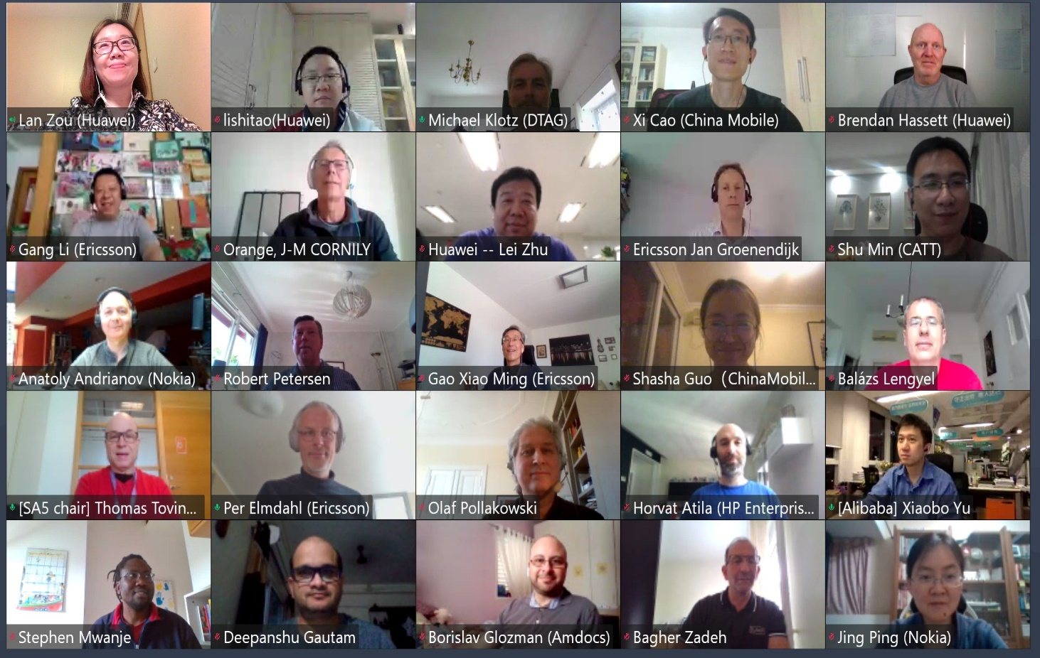
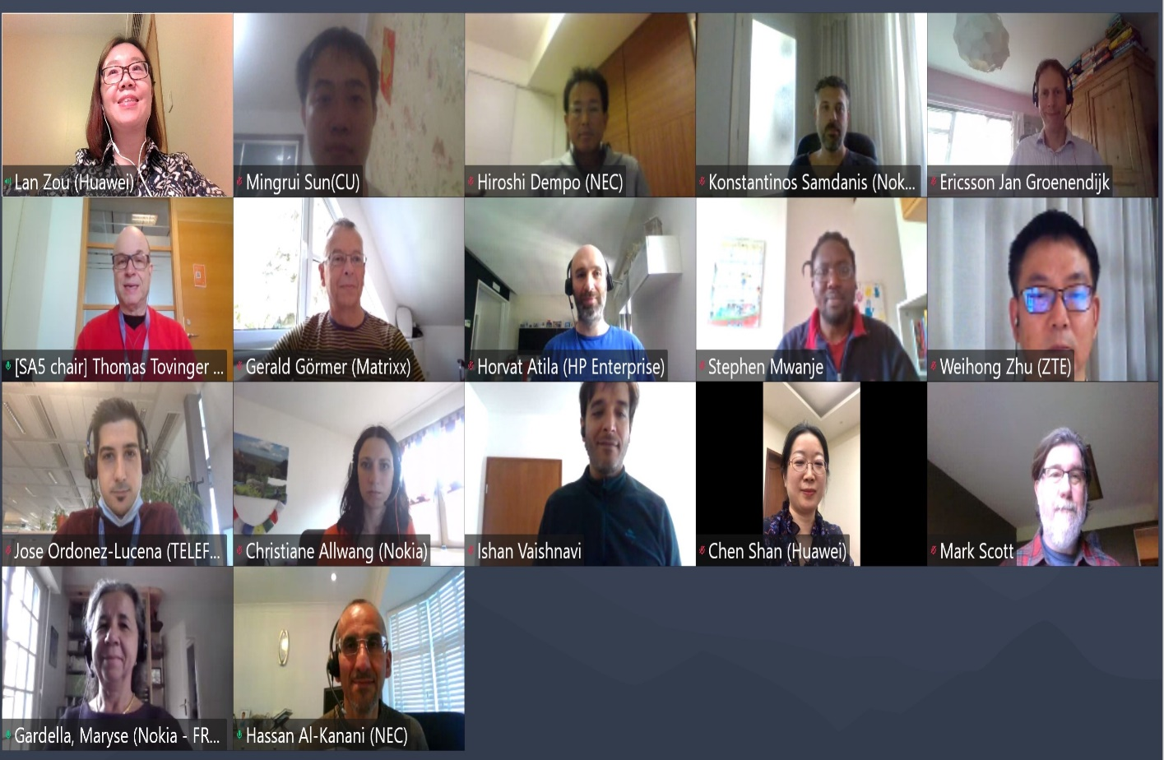
Thank you!

