Slide 1
3GPP SA5 Forge Tutorial
ETSI CTI
3GPP SA
30.04.2020

Slide 2
Agenda
  1. The basics of versioning files with Git
  2. Gitlab for 3GPP tool presentation
  3. User Management
  4. Log in and navigate projects, create a new group and project
  5. Subscribe to be notified to events on a project
  6. Navigate within the project (branches, tags, files)
  7. Contributions aka Merge requests, review and approval
  9. Where to find more documentation
  10. Legal framework
  11. Q&A

Slide 3
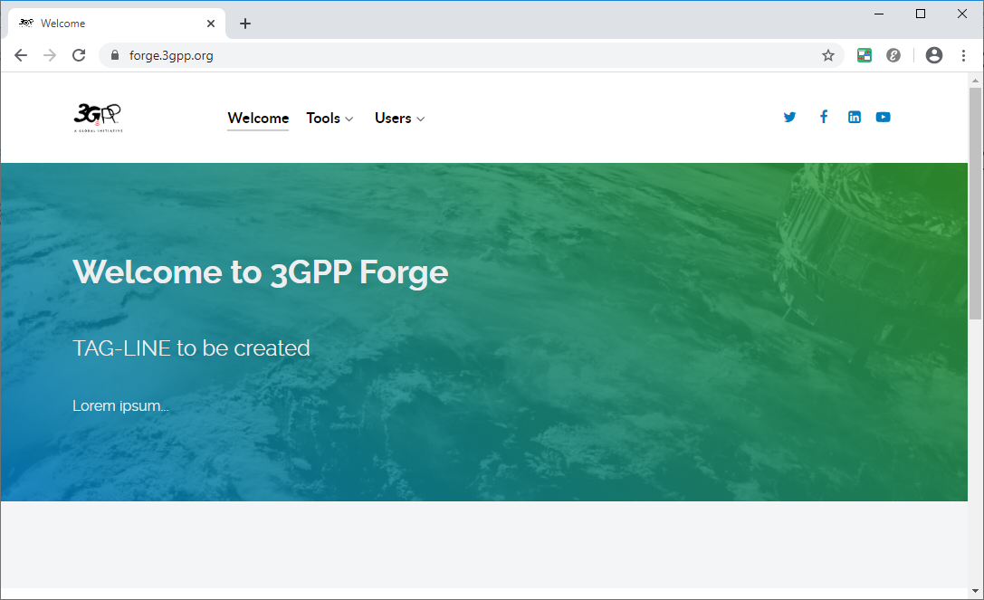
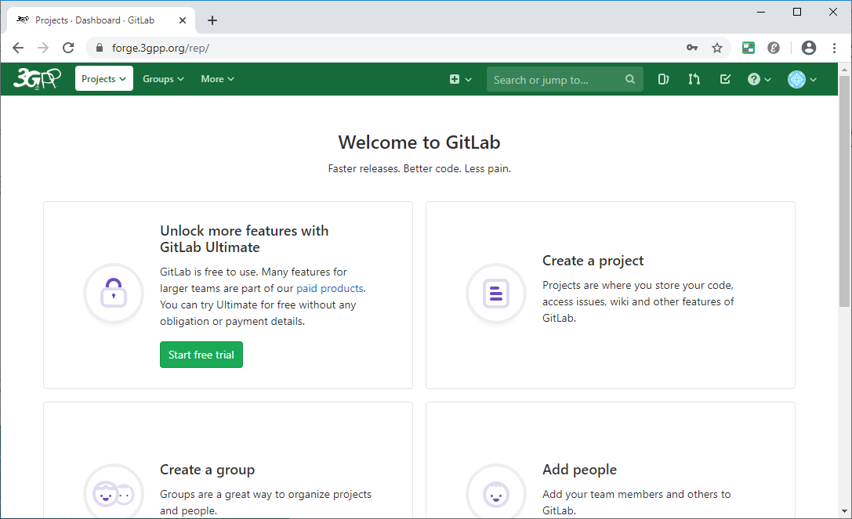
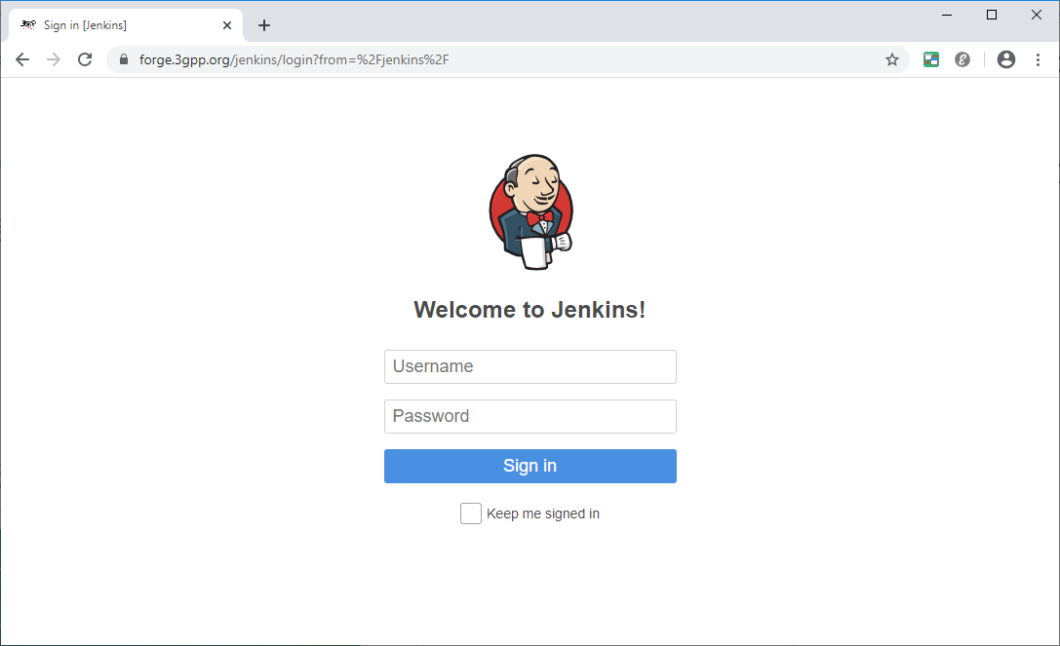
ETSI Forge
  Online tools to create, share, collect and publish machine readable content in a collaborative way
  Goal: accelerating the development processes and enhancing the quality of delivered content
  Available at: https://forge.etsi.org
  Coming soon: 3GPP dedicated Forge! Keep tuned…

Slide 4


Under the hood: Git versioning system
De facto standard
Multiplatform, many free tools available
  Standalone (CLI, Graphical)
  Integrated in your preferred editor/IDE

Slide 5
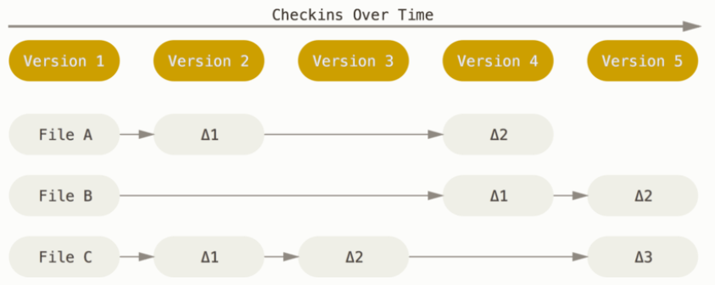
Git basics
  Git: a distributed version management system (like svn, cvs, bzr, etc.)
  Keeps tracks of modifications, who did them and when
  Distributed: Remote copies of the repositories can be edited in parallel and synchronized at any time
  A lot of documentation online!
    Start here to learn more

Slide 6

What is a repository: a set of files and their history
Git terminology
V2
Last agreed
c9
Latest version in development
Commit
Team approved
c8
Branch
c7
c6
c5
Tag
Time
c4
V1
Last agreed
Latest version in development
c3
c2
c1

Slide 7
User management
User management: EOL accounts
Any user with an EOL which is part of the 3GPP group (i.e. 3GPP member) can already log into ETSI Forge
  Log into ETSI Forge (Link)
Users in Gitlab are created upon the first login
  If the user is not present the user should log in once or can be invited by his/her email (EOL related)
Users and projects can be categorized in Groups
  Users need to request access
Permission levels : Developer, Maintainer (+others not applicable)
  Developer: May create new branches, upload contributions on them, create Merge Requests
  Maintainer: May manage “Protected” - i.e. common and shared - branches
  More here: https://docs.gitlab.com/ee/user/permissions.html

Slide 8
User management
User management: EOL accounts
Any user with an EOL which is part of the 3GPP group (i.e. 3GPP member) can already log into ETSI Forge
  Log into ETSI Forge (Link)
Users in Gitlab are created upon the first login
  If the user is not present the user should log in once or can be invited by his/her email (EOL related)
Users and projects can be categorized in Groups
  Users need to request access
Permission levels : Developer, Maintainer (+others not applicable)
  Developer: May create new branches, upload contributions on them, create Merge Requests
  Maintainer: May manage “Protected” - i.e. common and shared - branches
  More here: https://docs.gitlab.com/ee/user/permissions.html

Slide 9
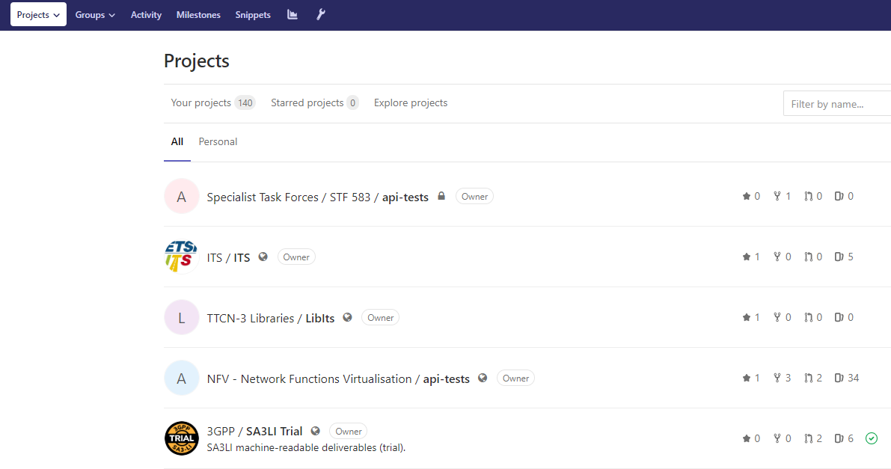
Log in and navigate projects
Filter by name and search bar available
Projects and groups visibility levels
Private: Only explicitly added users and Admins can see the projects
Internal: Users that can log in can see the projects, not the externals
Public: Everybody can discover the project, read the content and the history and download them
Navigates projects
Your projects
Others
  Log into ETSI Forge and navigate to the SA5 models project
Public or internal project are listed here
Projects are represented by name, group, description and logo

Slide 10

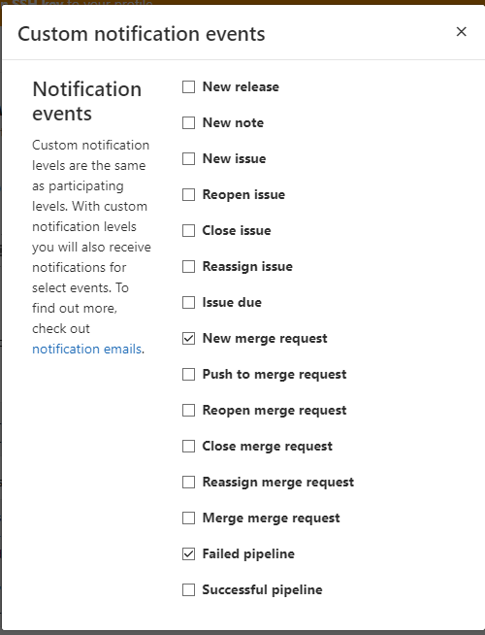
Subscribe to be notified for events on a project
1. Click the bell button (top right of the page)
  Subscribe to New Merge requests for the project SA5 Data Models
  (Link)
2. Click “Custom”
3. Select the events you want to subscribe to

Slide 11
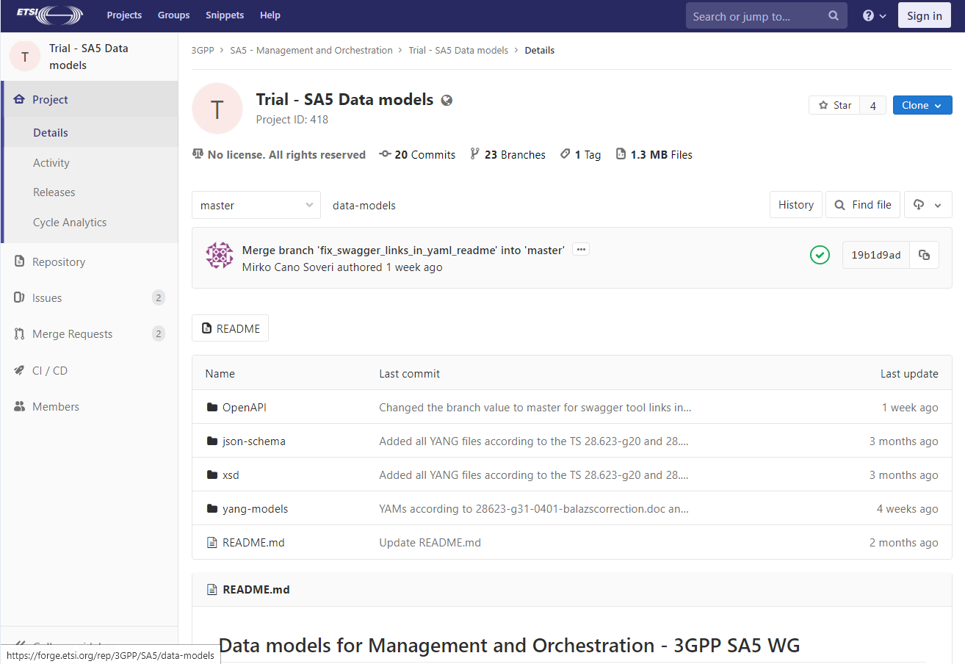
Navigate within the project
Project menu
Repository information
  Branches
  Tags
  History
Settings
  Including members of the project
Main information and main actions (clone, subscribe)
Files view on the current open version
Version selector (branchs/tags)
1
4
5
2
6
3
  Visit the ‘patch-1’ branch

Slide 12
CRs in Forge: Merge requests
  A tool to ask integration (merge) of a branch into another one
  Allows review and discussion before the changes are integrated
    The Merge Requests is “attached to a branch”
    If the branch evolves, the changes in the merge requests are updated
  MR may be “merged” or “closed” (i.e. discarded)
  Tutorial available from SA3 delegates
    https://forge.etsi.org/rep/3GPP/SA3LI/wikis/Making%20a%20CR

Slide 13
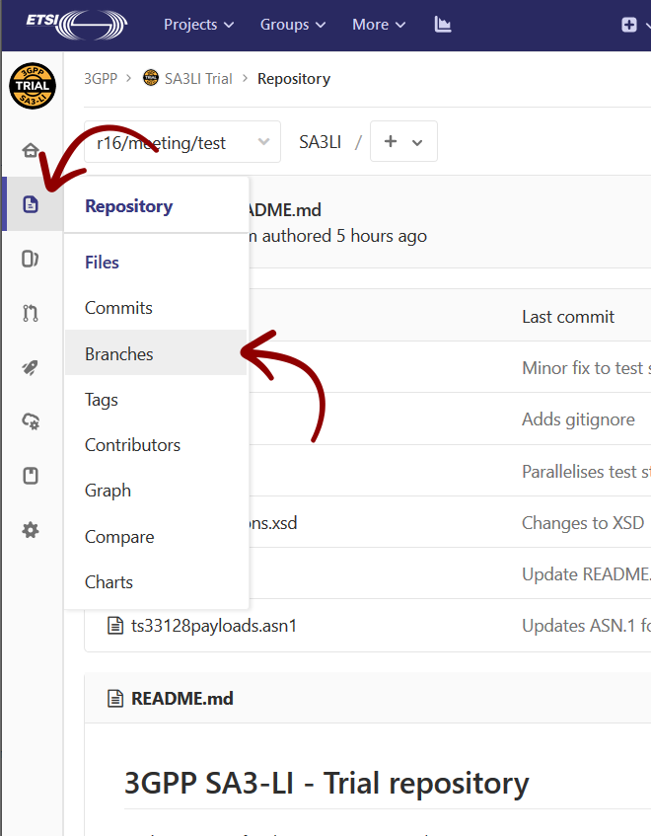
CRs: Step 2 - Go to the "Branches" page

Slide 14
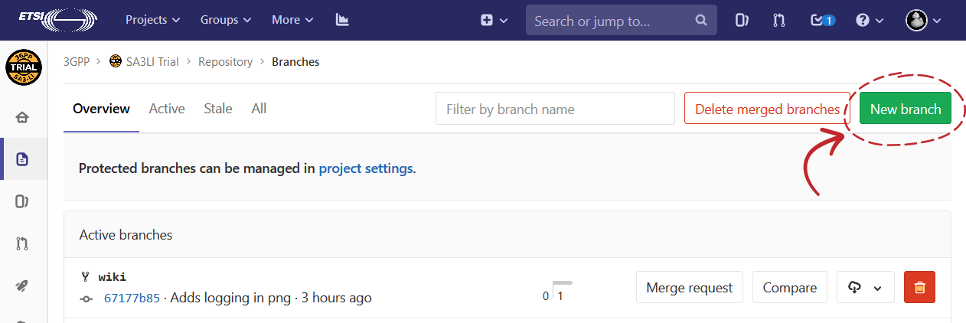
CRs: Step 3 - Make a new branch for your CR

Slide 15
CRs: Step 4 - Supply details for your new branch
  Branch name
    Shall be unique
    Should be clearly mapped onto the group’s work
    E.g. r15/cr/1234
  Create from
    The starting point for your work
    Shall be set correctly (e.g. you shall not use r15 as a basis for r16 CRs)
    E.g. use a meeting branch as a starting point for all CRs
      E.g. r15/meeting/123
    Contact Rapporteur or Technical Office if need help

Slide 16
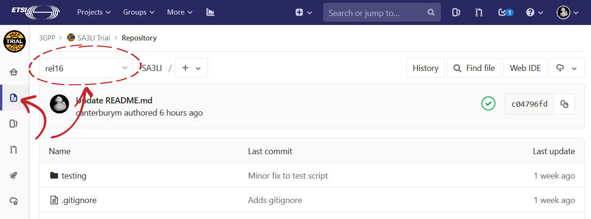
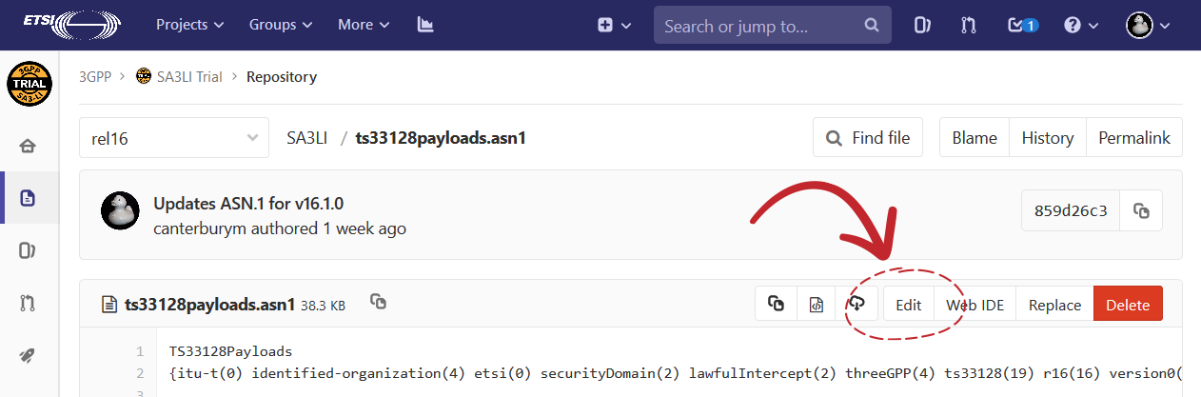
CRs: Step 5 - Make some changes!
  Different ways
    Locally and upload via git
    The Web Interface (easier)
  Via web interface
    Make sure you are on the newly create branch!
    Use either
      Edit button (easier)
      Web IDE

Slide 17
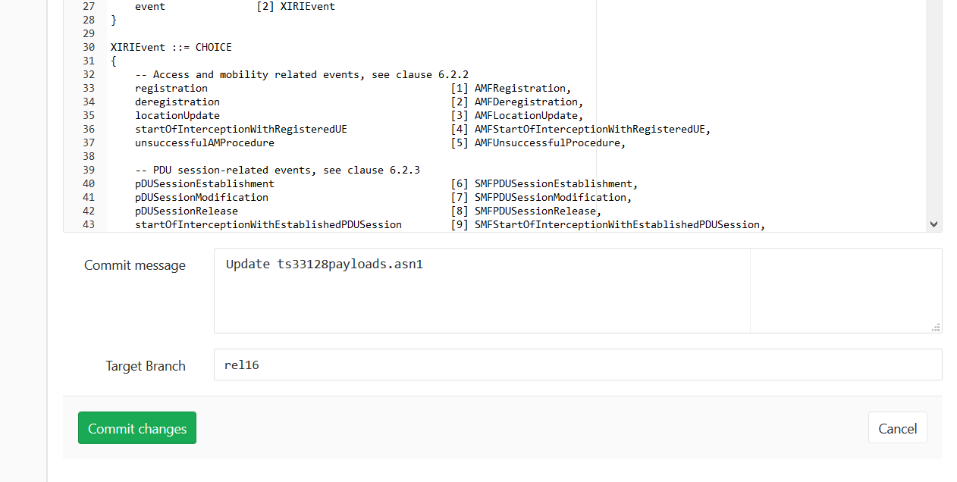
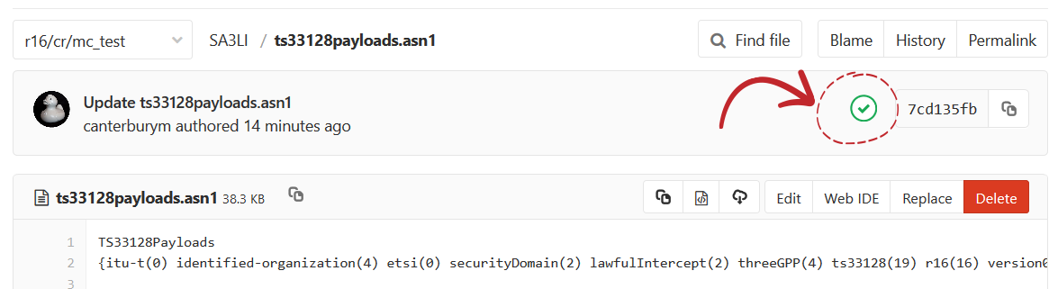
CRs: Step 6 - Commit your changes (via Edit Button)
  Important info to be provided
    Message
    Target Branch
  Validation
    Check that validation is ok
    If not, you may issue a new commit on the same branch to fix it

Slide 18
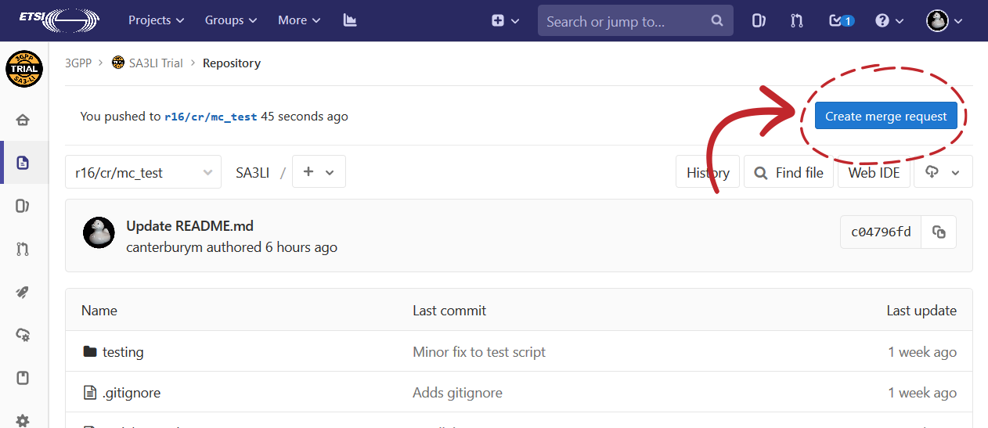
CRs: Step 7 - Create a Merge Request 1/3

Slide 19
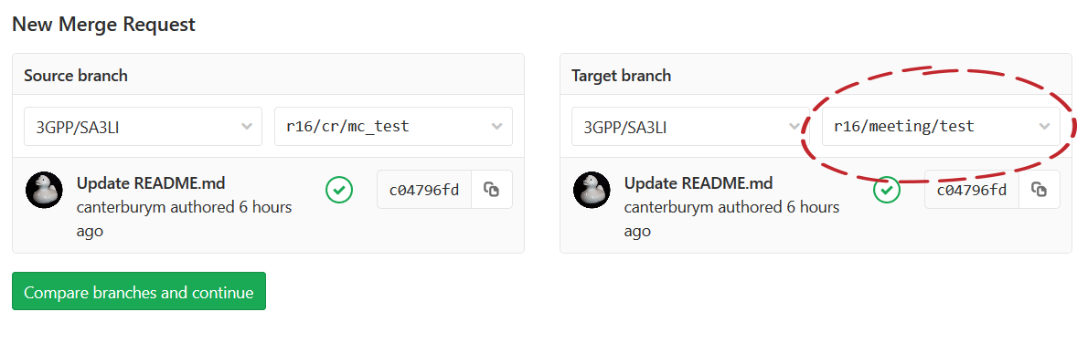
CRs: Step 7 - Create a Merge Request 2/3

Slide 20
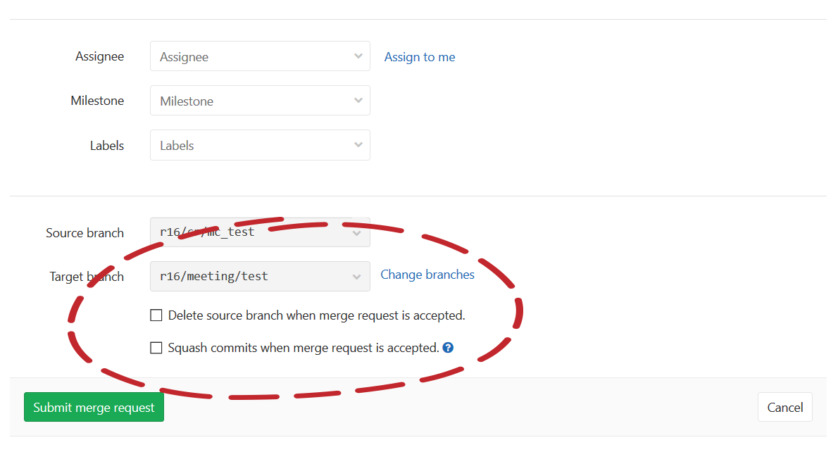
CRs: Step 7 - Create a Merge Request 3/3

Slide 21
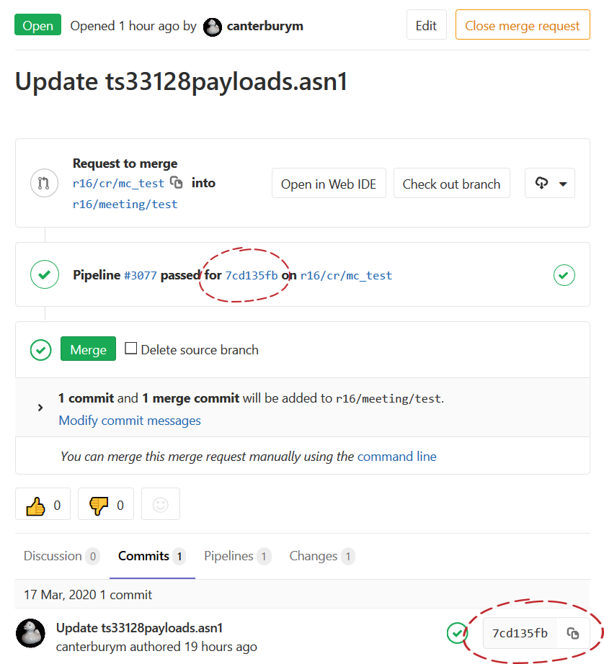
CRs: Step 8 - Draft the CR form
Title, status and contributor
Download the diff
Latest commit on branch
See introduced changes

Slide 22
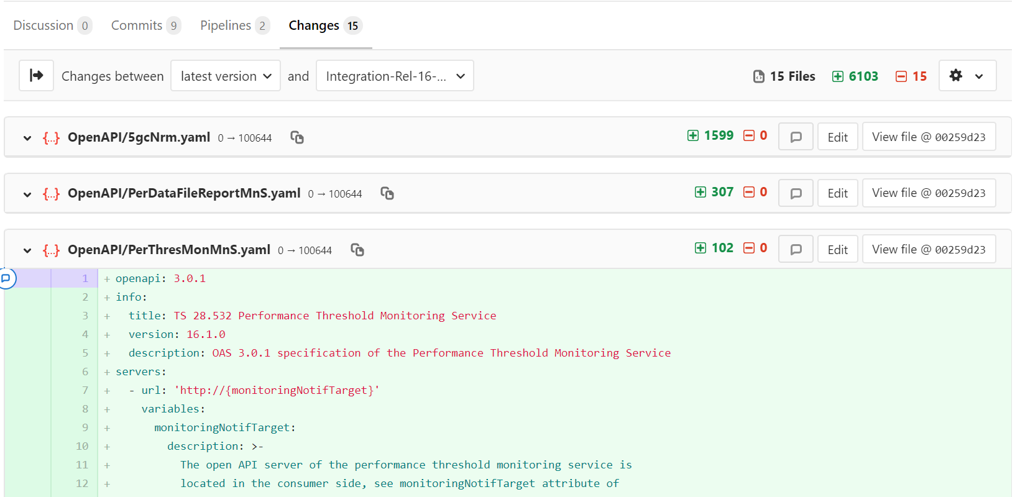
CRs: Review a merge request

Slide 23
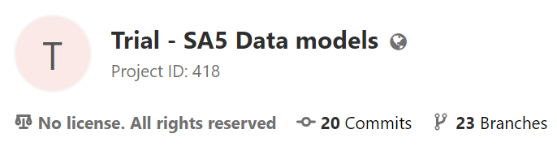
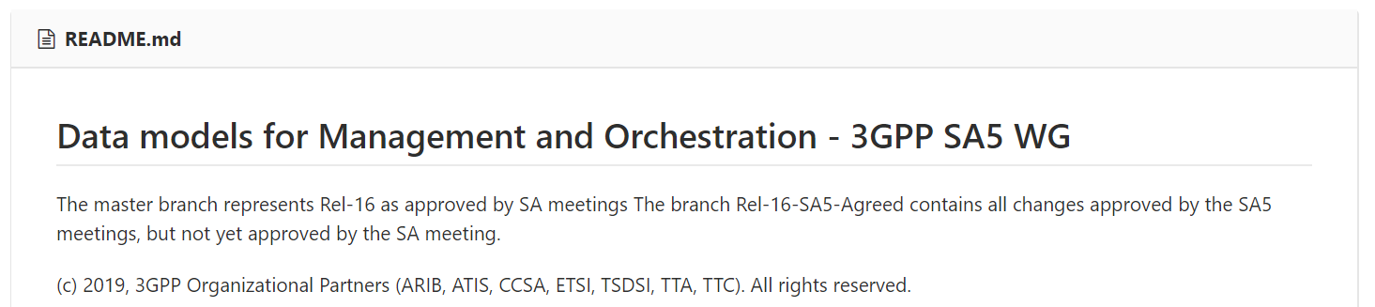
Legal framework
  IPR policy for the contributions is the same as for 3GPP specifications
  For users, 3GPP Copyright information is stated in the README and applies to all contents of the repository
    3GPP Copyright information may be added as well in the individual file
    3GPP reserves all copyrights

Slide 24
Find more documentation
Forge wiki
  Home
  ETSI_Forge_for_3GPP_APIs
  3GPP_Forge_FAQ
Forge
  Report issues with Forge and tools
Scripts and tools for 3GPP projects
  Validation scripts for CI
    Including SA5 YAN validation script
  User contributed tools for APIs
Gitlab documentation
  https://docs.gitlab.com/
Git Documentation available online
  Official
  Stack overflow

Slide 25
Q&A

Slide 26
Back up slides

Slide 27
OPEN API, YAML, YANG
Textual, formal languages to describe interfaces, data models and data structures
  SIMILARLY LIKE ASN.1
YAML (Wikipedia):
  A human-readable data-serialization language.
  Used to exchange structured data, like XML, JSON, CSV, etc.
OPENAPI (Wikipedia)
  Describes RESTful interfaces, based on resources and stateless protocols with uniform operations (Create, Read, Update, Delete a.k.a POST, GET, PUT, DELETE) .
  An example of RESTful interface: the WWW
YANG (Wikipedia)
  is a data modeling language for the definition of data sent over network management protocols such as the NETCONF and RESTCONF (originally developed by CISCO, then IETF standards).

Slide 28
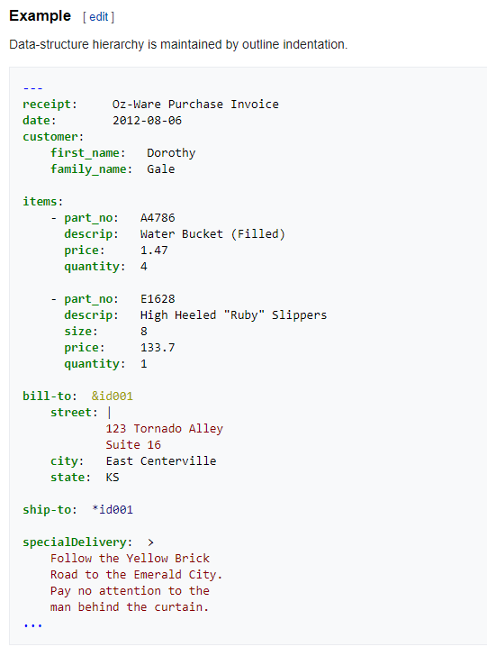
YAML: “YAML Ain't Markup Language”
1
Whitespace based
  One element is on a single line
  Scope is given by indentation
  Characters like ‘|’ and ‘>’ allow multiline text
Legenda
Header
Example of a dictionary data type
Example of an ordered list of dictionaries
2
3

Slide 29
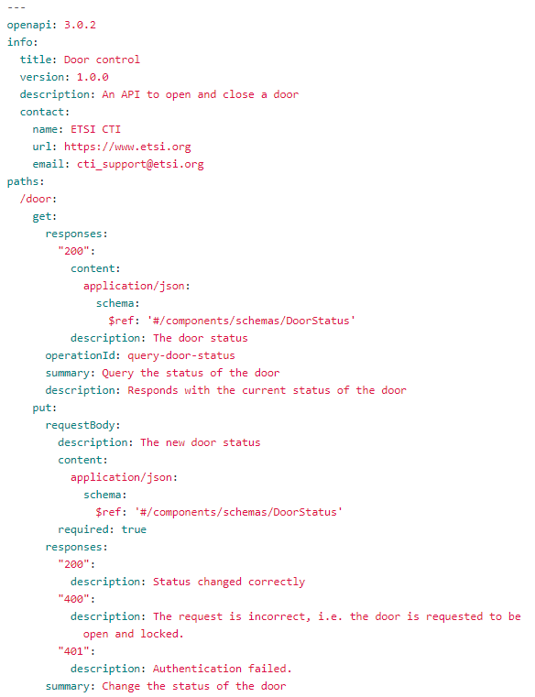
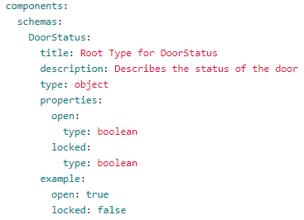
OPEN API Specification
1
Define a single API, under the same endpoint (i.e. HOST and port)
May be serialized in either YAML (as in the example here) or in JSON
Allows code (servers, clients, tests) and documentation, generation
See the API in the Swagger editor here
5
2
3
4
Legenda
API general information
The resources available in the API (paths)
A response to a GET request on the /doors resource
The data structure of the returned body

Slide 30
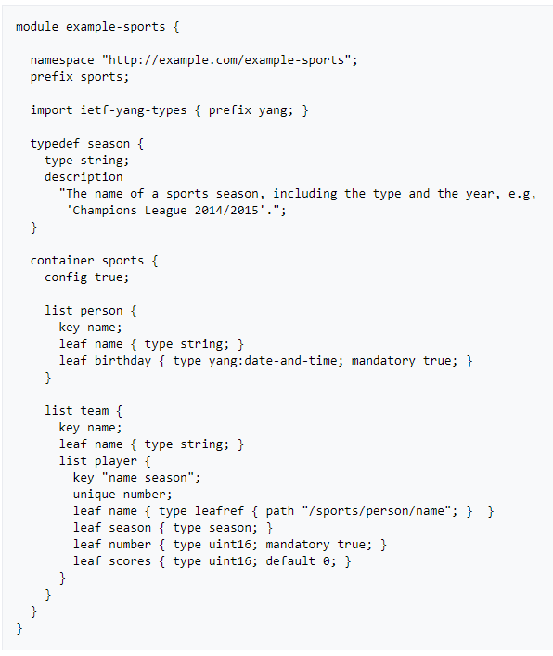
YANG “Yet Another Next Generation”
YANG is a modular language representing data structures in an XML tree format.
Can be used to model both configuration data as well as state data of network elements.
Can be used to define the format of event notifications emitted by network elements
It allows data modelers to define the signature of remote procedure calls that can be invoked on network elements via the NETCONF protocol.
Is protocol independent, can then be converted into any encoding format, e.g. XML or JSON, that the network configuration protocol supports.

Slide 31
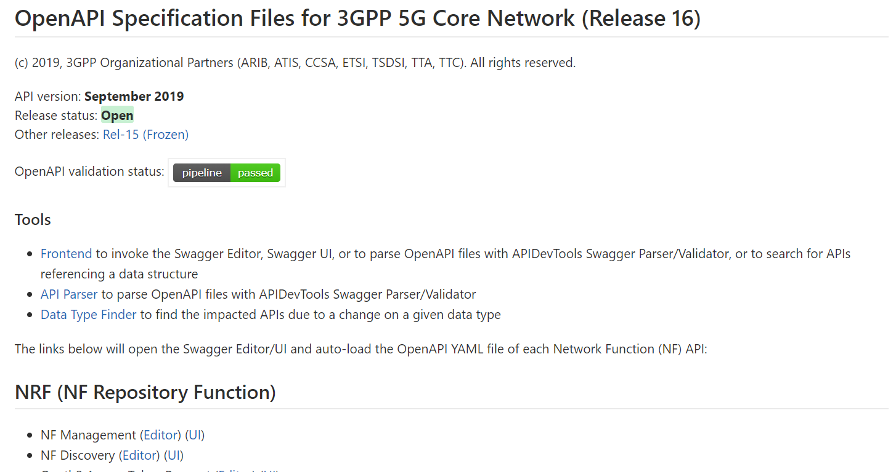
Human friendly documentation (see yourself)

Slide 32
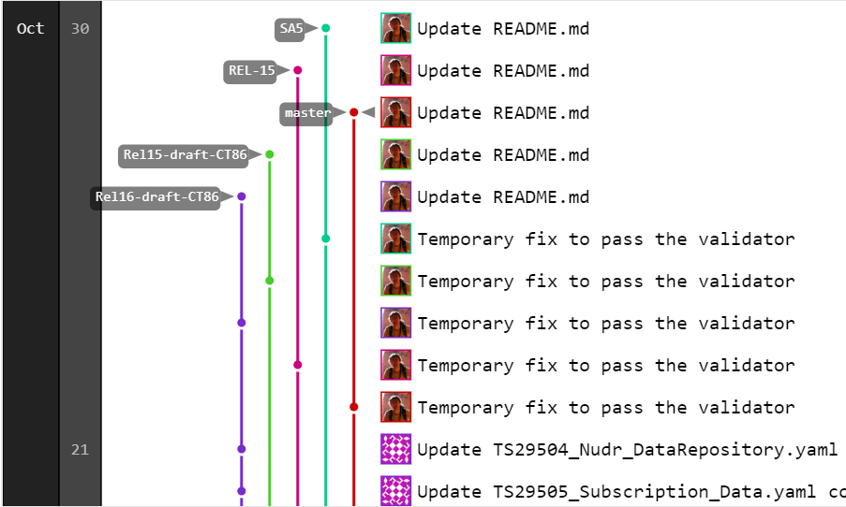
Version tracking and revision graph (see yourself)

Slide 33
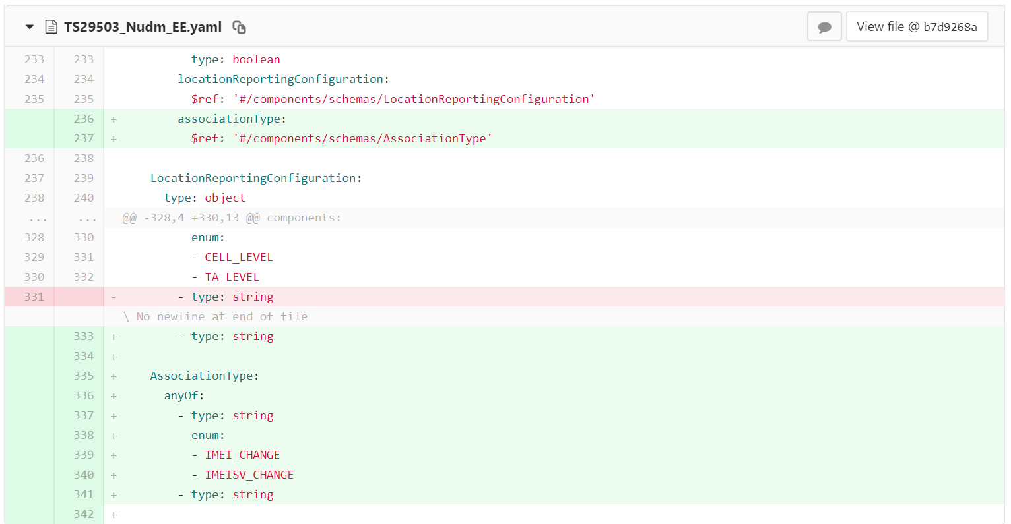
Automatic comparison between versions (see yourself)

Slide 34
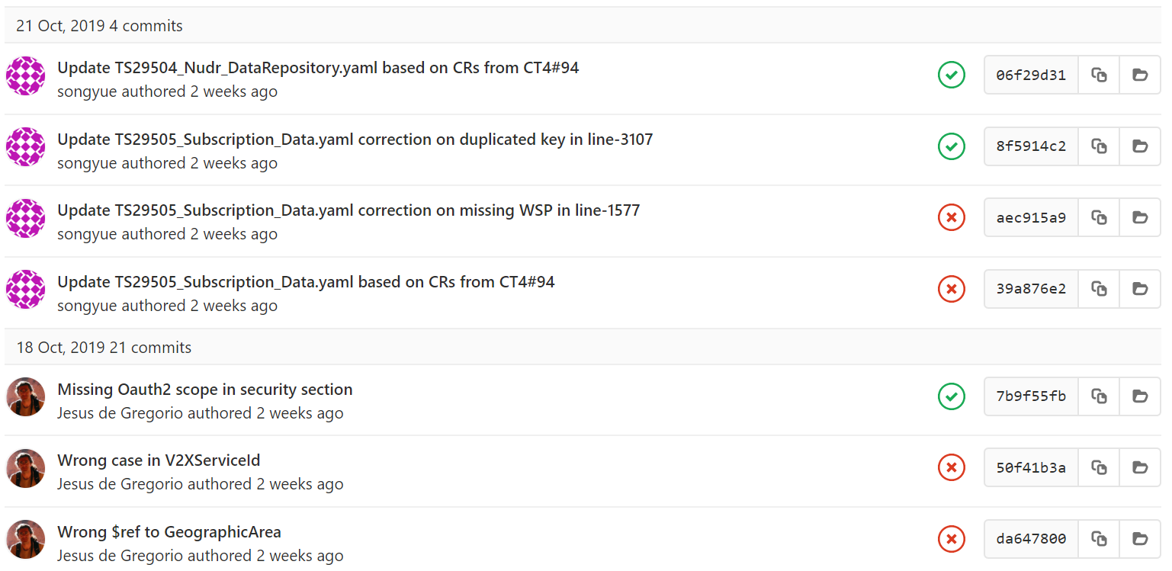
Validation of the OpenAPI syntax

Slide 35
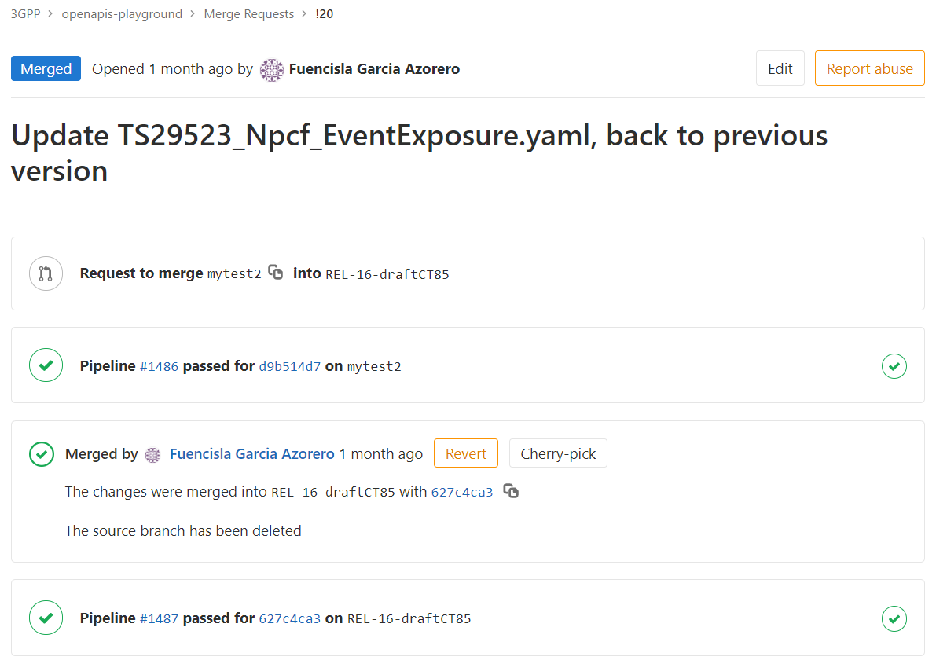
Merge requests (a.k.a. CRs for Git)

Slide 36
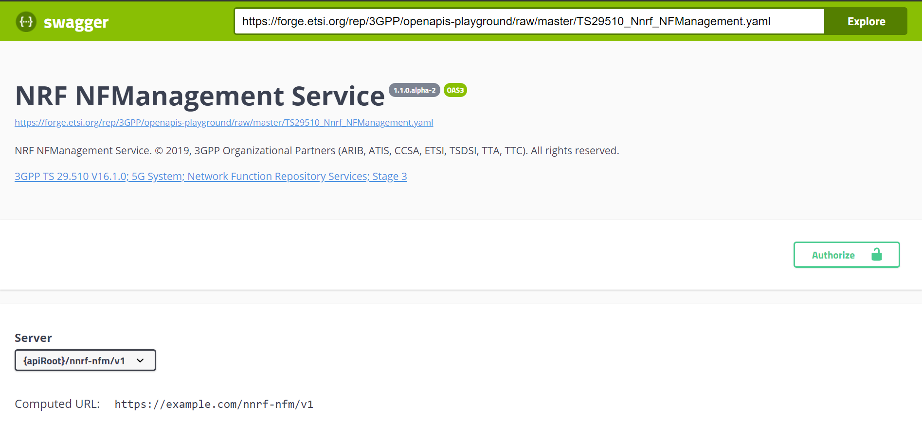
Third party tools integrated (see yourself)

Slide 37
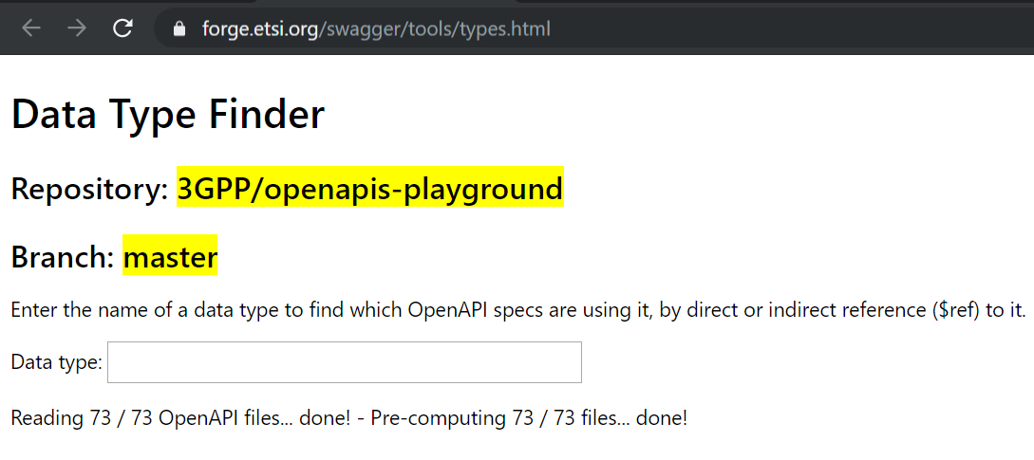
Third party tools integrated

Slide 38
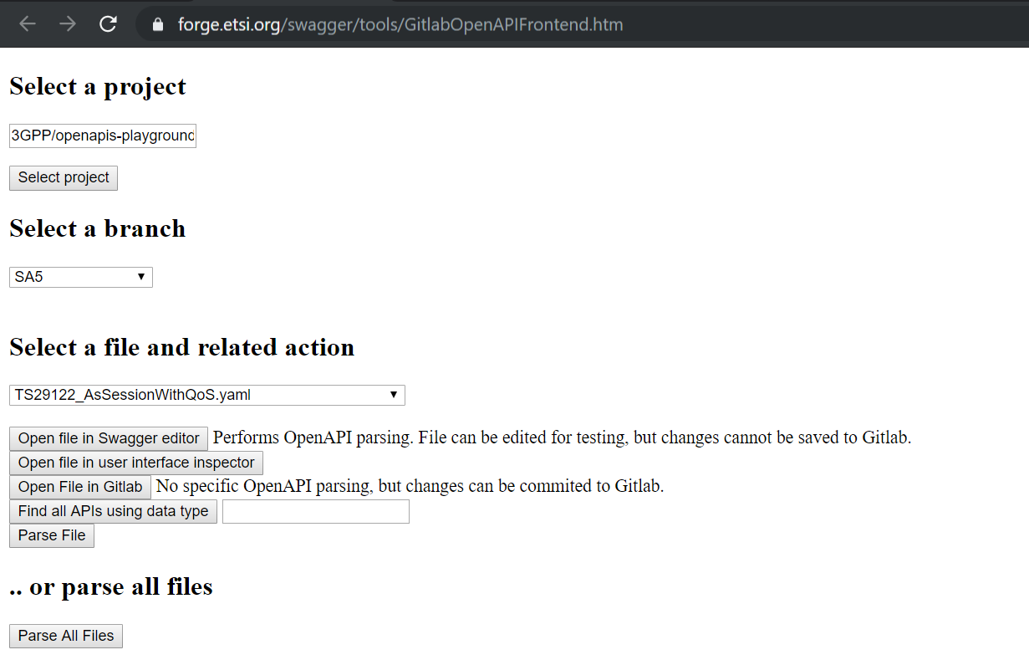
Third party tools integrated

