Slide 1
MeCAR offline discussion on device categories
22/08/2022

Slide 2
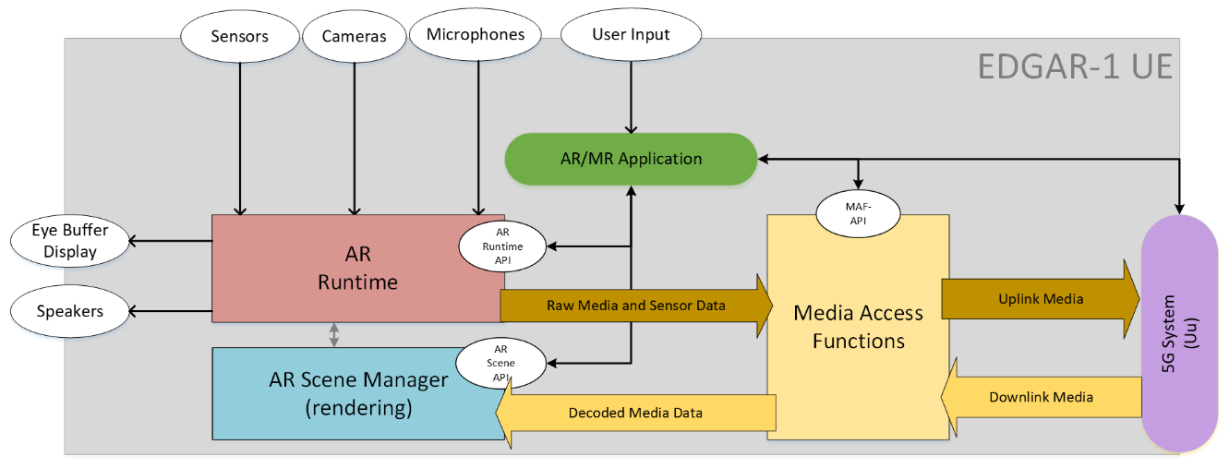
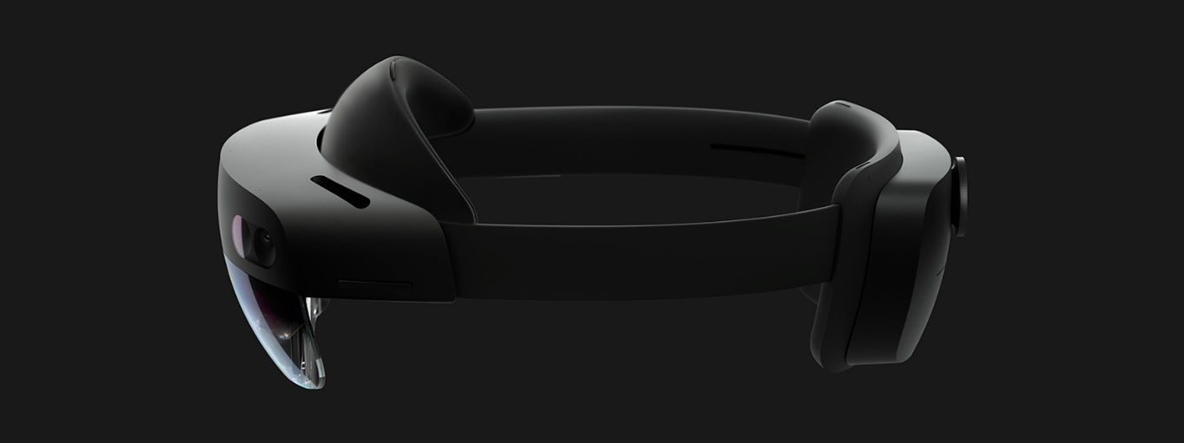
Categorization of EDGAR Devices
PD
Device category as interop point. Two approaches for creation:
  Media capabilities determines the device category (“media-first”)
    Why: Content creator can address multiple devices with same content
  Each physical device design corresponds to a new category (“device-first”)
    Why: MeCAR device categories directly mapping on real-world devices

Slide 3
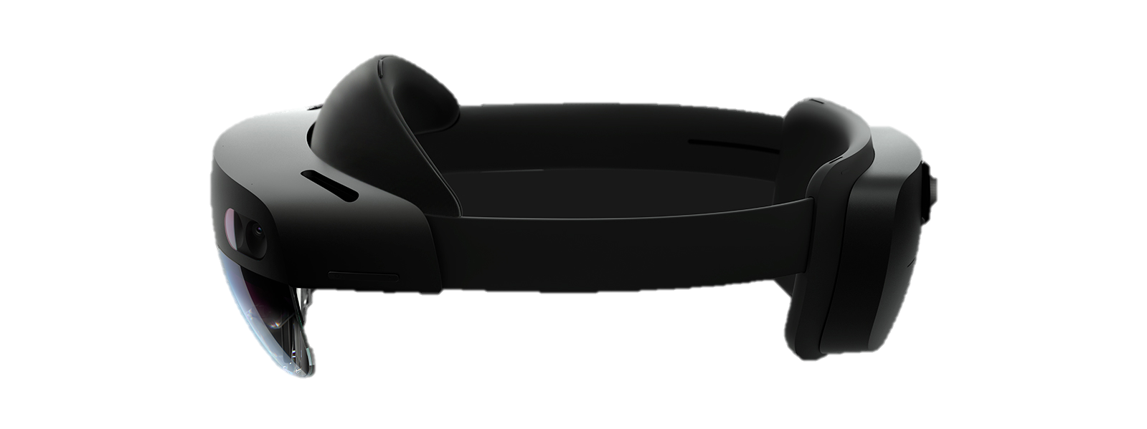
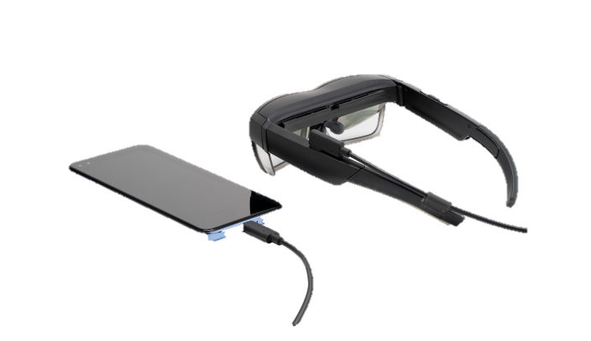
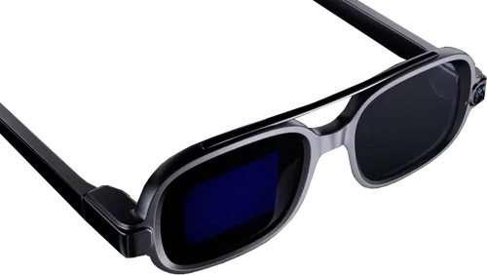
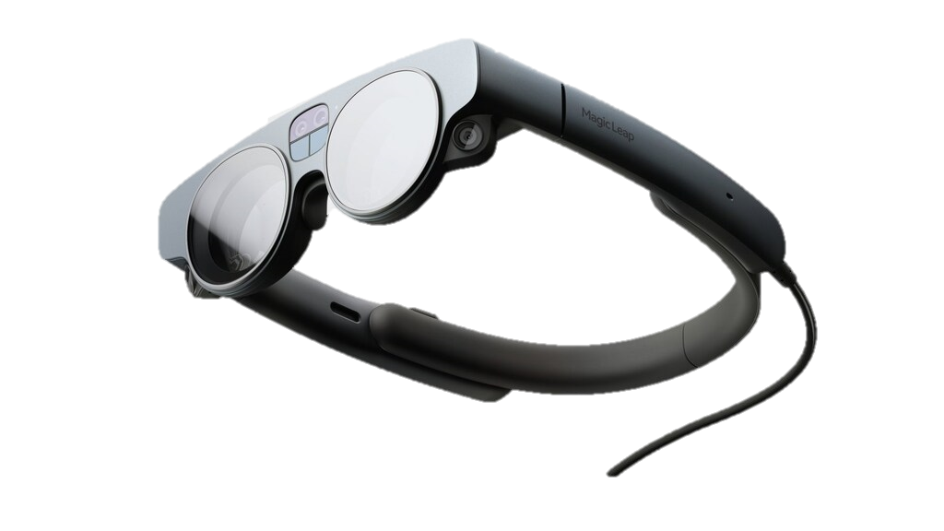
Categorization of EDGAR Devices
Criteria, for media-first:
  - Supported formats, resolutions, bitrates etc.
  Supported modalities
  Communication status (i.e., offline processing)
Example relationship:
MeCAR device cat. 1
(powerful media cap.)
MeCAR device cat. 2
(lightweight media cap.)
…
Note: Device in the same category may have different design (e.g. standalone vs, edge-based etc..)

Slide 4
Categorization of EDGAR Devices
Criteria, for device-first:
  Benchmarks (e.g., processing power, battery duration ...)
  Standalone / Tethered (and in between)
  Type/number of sensors
Example relationship:
MeCAR device cat. 1
(standalone)
MeCAR device cat. 2
(tethered)
…
Note: Media capabilities may be quite similar between categories

Slide 5
Discussion

Slide 6
Proposed EDGAR Types in ‘972
subtitle

Slide 7
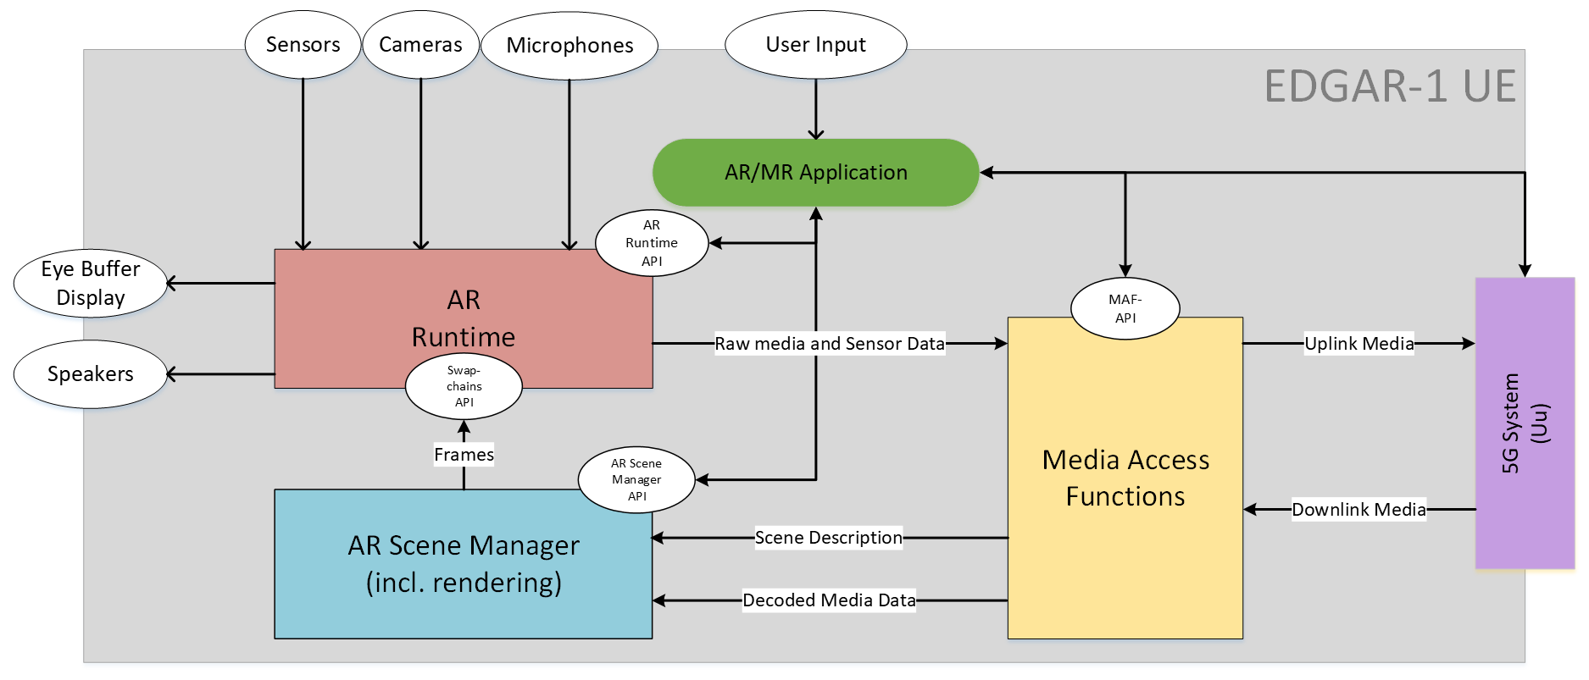
Proposed EDGAR Type 1 (from 1064)
Key Difference(s) w PD
  Using Swapchains API for frame exchange between the AR Scene Manager and the AR Runtime
Discussion
  blabla
  blabla
    sub balblallalalal

Slide 8
Proposed EDGAR Type 1 (from 0972)
Key Difference(s) w PD
  Illustrate Scene Description exchange between MAF and XRSceneManager
  Replace data type (i.e. decoded media) with data exchange mechanism (i.e. primitive buffers) at MAF-XRSceneManager
Discussion
  blabla
  blabla
    sub balblallalalal

Slide 9
Proposed EDGAR Type 2 (new - from 0972)
Discussion
  blabla
  blabla
    sub balblallalalal

Slide 10
Proposed EDGAR Type 3 (new - from 0972)
Discussion
  blabla
  blabla
    sub balblallalalal

Slide 11
Reserve
subtitle

Slide 12
Categorization of EDGAR Devices
From WID:
  - For each AR device category
  o Define a reference terminal architecture regarding media capability aspects for this AR device category
  o Define media types and formats produced and consumed by the AR device, including basic scene descriptions, audio, graphics and video as well as sensor information and metadata about user and environment.
  o Define the integration of the relevant existing 3GPP codecs into the reference terminal architecture
  o Define decoding capabilities, including support for multiple parallel decoders
  o Define encoding capabilities
  o Define security aspects related to the media capabilities
  o Define the required, recommended and optional media capabilities for this AR device category
Relevant Criteria, for media-first:
  - Supported formats, resolutions, bitrates etc.
  Supported modalities
  Communication status (i.e. offline processing)
Relevant Criteria, for device first:
  Benchmarks (e.g. processing power, battery duration ….)
  Standalone / Tethered (and in between)
  Type/number of sensors

