Slide 1
CTA Update
Brian Markwalter
13 October 2021

Slide 2
Topics and Projects
WAVE
ATSC 3.0 – NEXTGEN TV
Closed Captioning
CTA-861, HDMI and Plugfests
TV Power Consumption

Slide 3
WAVE Project Recent Standards Activities (1)
Publications:
WAVE main specifications/updates, to be published Q4 2021
  Update of CTA-5003-A, Device Playback Specification (adds a Media Capabilities Discovery annex)
  Update of CTA-5000-D, Web Media Snapshot 2021 (will be the 2nd update to the –B version cited in A/344)
  Update of CTA-5001-D, Content Specification; adds AV1 (working on test vectors for codecs subparameter variations)
Newly available:
  CTA-5005, DASH/HLS Interop Specification
    Conformance test will be via JCCP (Joint Content Conformance Project) with ATSC/DASH-IF/DVB/HbbTV
  CTA-5004, Common Media Client Data
    Info passed from client (e.g. bitrate, buffer & segment signaling, more) to allow CDNs to optimize traffic
Other Projects:
  CMAF Byte Stream Format: WAVE is offering a technical proposal to W3C
  Common Media Server Data – info passed from server to client, e.g., bandwidth & bitrate, redirection, caching…
  Common Token Format – to standardize mechanisms for structuring, naming, generating & revoking access tokens.

Slide 4
WAVE Project Recent Standards Activities (2)
Test Suites:
Continuing work preparing a full end-to-end test suite release.
JCCP (Joint Content Conformance Project)
  CTA WAVE, DASH-IF, DVB, HbbTV are rewriting the existing DASH-IF tool for streaming DASH/HLS conformity assessment
CMAF IF Activities:
White paper on actual deployment of CMAF, DASH/HLS, A/V codecs & captions, more, to be published Q4
Conducting a survey re Smart TV browser integration
  Asks questions related to streaming tech integration and deployment
WAVE specifications are available as zero-cost downloads from the CTA.tech store.
See https://cta-wave.github.io/Resources/ for details on all things WAVE and CMAFIF.org for CMAF Industry Forum.

Slide 5
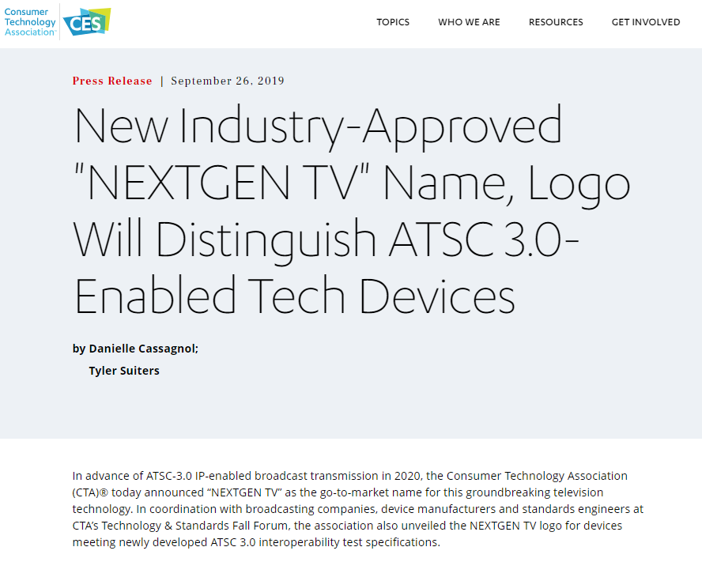
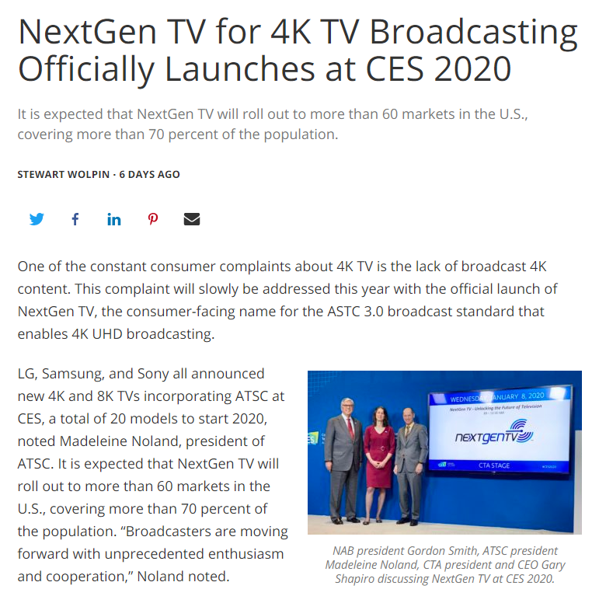
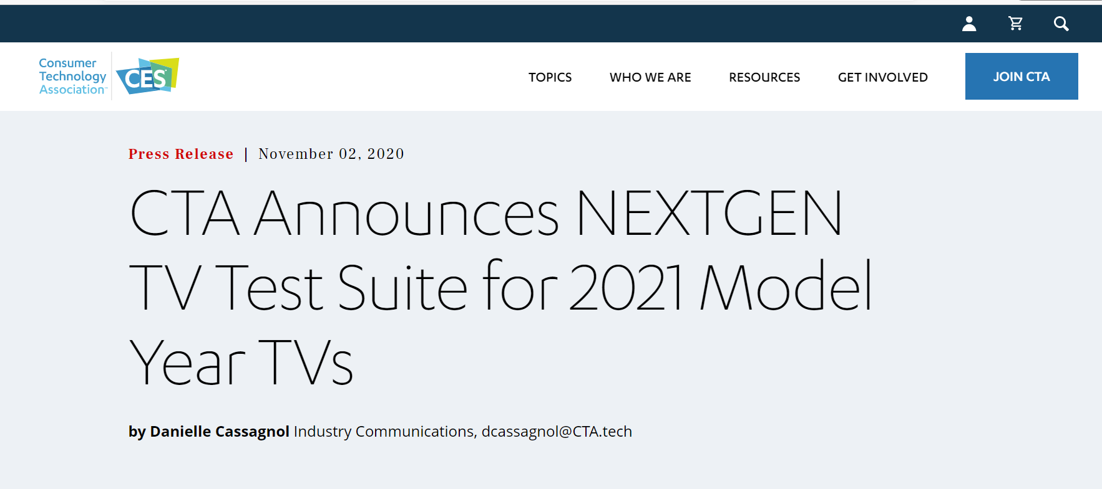
ATSC 3.0, NEXTGEN TV
September 2019
January 2020
November 2020

Slide 6

2021
Added “compatible” logo for antenna manufacturers
Released 2021 V1.0 Test Suite
Raised NEXTGEN TV sales forecast to 2.1 million units

Slide 7
Test Suite for NEXTGEN TV Logo - Status
2021-1.0 NEXTGEN Test Suite released June/end
  For 2022 model year TVs & licensees of CTA’s NEXTGEN TV Logo Program
  More than 280 tests covering over 375 testable requirements (assertions)
  200 tests required for NEXTGEN logo; 82 ‘Recommended’ tests for interoperability check
  Test coverage includes:
    PHY (code lengths & rates, modulation order, reserved bits, single & multiple PLPs)
    Route & MMT
    ”Watch TV” Audio, Video, Captions, Content Ratings
      (basic AC-4 up to 7.1.4 w/Dialog Enhancement; IMSC1 captions; 4K & HDR video)
    Service changes (frame rates, EOTFs, audio only channels)
    Broadcast Application support (many BA<>Receiver API tests aligned with ATSC 3.0 A/344)
    Signal Signing (signing structure compliance; not certificate/signature checking)
    AEA&I (advanced alerts)
    DRM support (recognition of basic signaling; not a decryption check)
    Audio Watermark
    Many, many others incl. off-air Broadcast station contributions (e.g., ESG test cases)
    Coverage continues to expand (both new test cases + depth of existing test cases)
    A Maintenance Release (minor tweaks) is on-schedule for September/end.

Slide 8
CEB32 Recommended Practices Status
Recommended Practice | Status
CEB32 Overview | Passed ballot, published December 2019
CEB32.1 System Integration | Passed ballot, published December 2019
CEB32.2-A Physical Layer | Revision Underway
CEB32.3-B Logical Layer | Revision Underway
CEB32.4-B Video | Revision Underway
CEB32.5-B Audio | Revision Underway; nearly completed.
CEB32.6 Advanced Emergency InformAtion | Passed ballot, published September 2019
CEB32.8-A Interactive Applications | Revision Underway
CEB32.9 Security & Protected Services | Passed ballot, published September 2019
CEB32.10 Watermarking | Passed re-ballot, published November 2020

Slide 9
Closed Captioning Project Scopes (R4WG3)
CTA 2064 (IMSC1 Tests)
  Analyze ATSC CS/343 “Captions and Subtitles” and consider developing standards, bulletins or technical reports. Oversee the development of test files conforming to ATSC CS/343, CS/331 and DASH-IF ATSC Profile including corresponding video and audio content as well as DASH MPD and MMT files. Document discrepancies with decoding and presentation on the DASH-IF reference decoder, DASH.js
CEB-35 Revision (NEW)
  Revise the document to provide a clear mapping of font names between 708 and IMSC1; add subsection numbers for easier external referencing (e.g., from ATSC A/344); other updates as needed; and liaise with ATSC

Slide 10
Progress
IMSC1
  CTA Staff received several sets of IMSC1 segment files from EDT; and we have requested a description of what the tests (besides the DTVCC IT1) are intended to do.
  Recommended to WG18 that they consider inclusion of the decoder-related material in ATSC T/300 in an appropriate existing part of CEB32
  Work on hold
CEB-35
  Drafting is complete.
  Approval ballot to be issued week of October 4th.

Slide 11
Plans
IMSC1
  Discuss the future of CTA 2064 when the converted DTVCC IMSC1 is made available
CEB-35
  Approval ballot to be issued week of October 4th

Slide 12
CTA-861, HDMI and Plugfests

Slide 13
CTA-861: R4 WG7 Activity
Continuing work on Amendment to CTA-861-H: CTA-861.6
Most recent publication:
  CTA-861-H, A DTV Profile for Uncompressed High Speed Digital Interfaces, December 2020
  Download link:
    https://shop.cta.tech/collections/standards/products/a-dtv-profile-for-uncompressed-high-speed-digital-interfaces-cta-861-h

Slide 14
CTA-861: R4 WG7 Work Status
15 of 74comments remain open (20 new since last R4 meeting):
  5 In Progress, 2 Substantial, 8 Editorial, 0 Questions
Ongoing discussion of details of new video timing proposal: Signaling requirements, data structure versioning. Details of colorimetry indication.
Work done:
  New data block for native timing indication
  Additional resolutions and frame rates:
    New signaling to expand VIC system (VFDB, VFD, RID)
    New timing formula (OVT)
  Addition of Auro-Cx and MPEG-D USAC audio formats
  Various editorial corrections (language, graphics formatting, doc template)
  EDID requirements
  Updates to referenced specifications:
    VESA DisplayID Errata, MPEG audio, IEC 61937-2 audio coding types, SMPTE 2094-10

Slide 15
CTA-861: R4 WG7 Liaison Activity
Submitted advanced draft document to VESA and HDMI Forum, for review and comments of ongoing work. Awaiting responses from both.

Slide 16
CTA-861: R4 WG7 Work Ahead
Publication of 861.6 expected this Summer Fall
  (Considering current meeting cadence and downstream demand)

Slide 17
HDMI and Plugfest
Continued dialog among various groups on interop issues
Coordination among CTA, DTG, German television group on plugfests

Slide 18
TV Power Consumption
U.S. activity at EPA and CTA
Work underway in IEC TC100

Slide 19
TV Energy Update – TV VA
CTA-2037-C approved by R4
  Waiting for IEC to make video test signals available on its website
TV manufacturers participating in TV voluntary agreement with energy advocates are collecting data on TV energy consumption using CTA-2037-C
  Data will be discussed with advocates, and energy efficiency limits will be negotiated

Slide 20
TV Energy Update – ENERGY STAR
ENERGY STAR continues work on a version 9 specification for TVs
  Limited topic proposal on high contrast ratio TVs, comments due 10/7/21
  New “high contrast ratio” definition = “A display where pixels emit no light when displaying a pure black color”
  Earlier ENERGY STAR analysis found no HCR display could meet On Mode criteria without some allowance, so ENERGY STAR proposed an adjustment factor for HCR displays
  New proposal is for that adjustment factor to be 12%, meaning an HCR display may consume 12% more power than a comparable non-HCR display when determining ENERGY STAR compliance

Slide 21
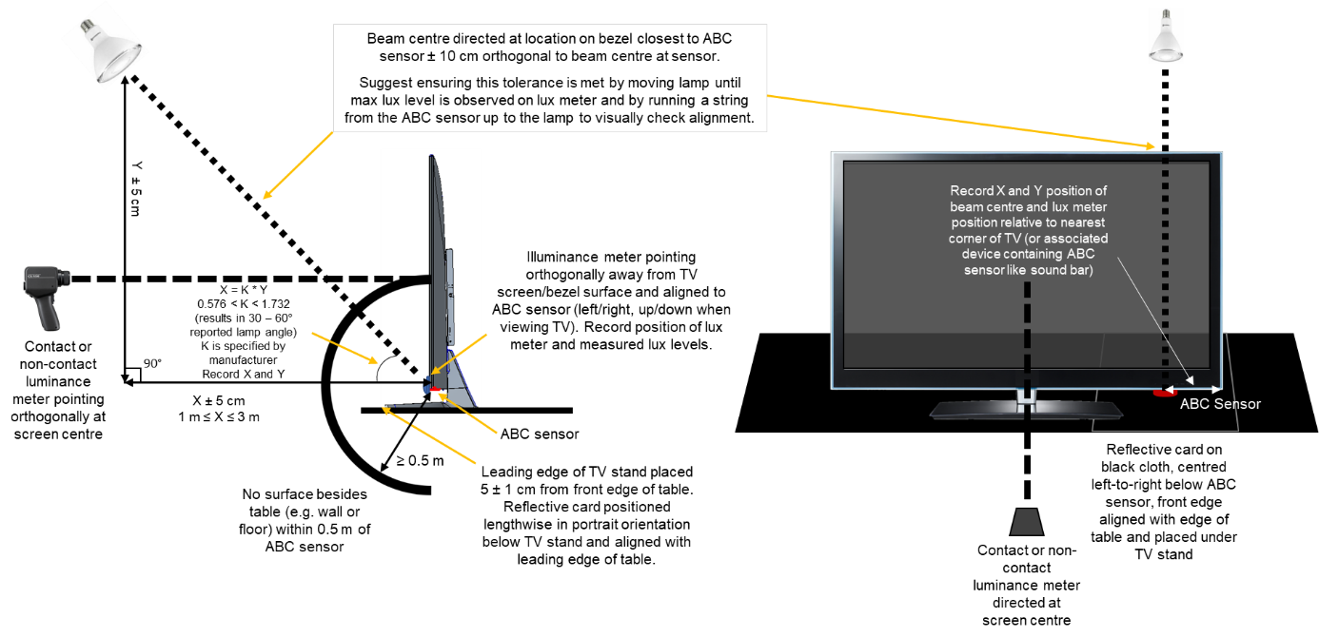
IEC 62087 TV Energy (refresher + update: new 62087-2 & -3 publication ~Apr 2022)
IEC 62087:2015 TV parts under revision to be “representative of actual use” (esp. halogen->LED)
  Advocates + European Commission requested new SDR clips; new HDR clips; new ABC method
  New draft = old SDR clips with new MDD constraint; new HDR clips; new ABC method incl. LED source
  2021: confirmed copyright; retested TV pwr (Interlace v Progressive); rev’d clips & draft; setup online clips
  TA19 Officers + IEC editors readying CD for Sep/end CD ballot with 50+ regional test clips online
HDR clips + ABC method add test burden - HDR format used (HDR10 or HLG) depends on region
  HDR tests are in addition to current SDR tests, but can be run immediately after current SDR tests finish
ABC Test Revised = Halogen → LED ABC source + new test configuration
Nearest
test room
surface
NEW LED bulb →
@ 30~ 60 deg angle to ABC sensor
UUT
ABC
sensor
Light
source
1,5 m
± 0,1 m
0° ± 5°
Old halogen bulb
Head-on to ABC sensor
Table (optional)
Illuminance measuring
instrument or ND filter
immediately in front of
ABC sensor assembly
> 0,5 m
Table not beyond
front of stand
IEC

Slide 22
Thanks.

