Slide 1
Status of HONTRA
SA3#107e
He Li

Slide 2
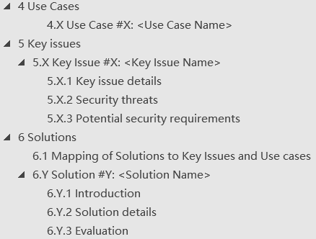
The skeleton
collect scenarios that could benefit from or require a home network triggered primary authentication.
business as usual, record the threat and the potential requirements for the solution
Showing the relationship with use causes and/or Key issues of a solution
business as usual, ideally solution address as many use cases as possible
Skeleton S3-220831-r1

Slide 3
Overview to use case
UC#1
Adding a usecase of interworking from EPS to 5G | Huawei, HiSilicon | pCR | Approval
New Use Case for Security of Interworking | Beijing Xiaomi Mobile Software | pCR | Approval
UC#2
A use case of HONTRA in SoR protection service suspension | LG Electronics France | pCR | Approval
A use case of HONTRA in UPU protection service suspension | LG Electronics France | pCR | Approval
New Use Case for Continuity of Steering of Roaming Service Delivery | Beijing Xiaomi Mobile Software | pCR | Approval
New Use Case for Continuity of UE Parameters Update Service Delivery | Beijing Xiaomi Mobile Software | pCR | Approval
Adding a usecase of SoR Counter Wrap around | Huawei, HiSilicon | pCR | Approval
UC#3
Adding a usecase of Kakma refresh | Huawei, HiSilicon | pCR | Approval

Slide 4

The proposals to KI#1
KI#1
S3-220708 | New KI on Home network triggered primary authentication | China Telecomunication Corp. | pCR | Approval
S3-220822 | A Key issue in UPU protection service suspension | LG Electronics France | pCR | Approval
S3-220820 | A Key issue in SoR protection service suspension | LG Electronics France | pCR | Approval
S3-220834 | KI on Scalability of the home triggered primary authentication | Huawei, HiSilicon | pCR | Approval
S3-220904 | Key issue on HN triggering primary reauthentication | Nokia, Nokia Shanghai Bell | pCR | Approval
S3-220905 | Reauthentication during the handover | Intel Corporation (UK) Ltd | pCR | Approval
S3-221041 | Key Issue on Refresh of Long Lived Key KAUSF | Beijing Xiaomi Mobile Software | pCR | Approval
S3-221042 | Key Issue on Security of Interworking | Beijing Xiaomi Mobile Software | pCR | Approval
S3-221125 | New Key issue on HN initiated Re-authentication | Samsung | pCR | Approval
Two alternatives:
The greens are agreed to merge using 834 as basis.（834-r1 will be shown in the next page）
Don’t know whether others are agree to merge. If no, they can be discussed separately as separate key issues.

Slide 5
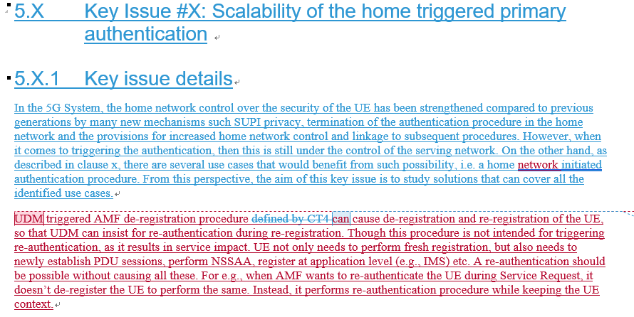
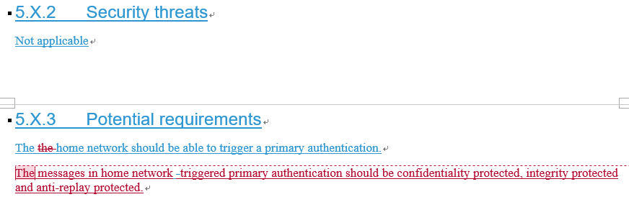
834-r1

Slide 6
Others
KI#2
S3-220836 | KI on Signalling overhead | Huawei, HiSilicon | pCR | Approval
S3-220903 | Key issue on KAF refresh without primary reauthentication | Nokia, Nokia Shanghai Bell | pCR | Approval
KI#3
S3-221093 | Adding a key issue of Multiple registrations | Huawei,HiSilicon | pCR | Approval
sol
S3-221083 | HN-auth-NAS based HN triggered authentication | Apple | pCR | Approval
S3-221126 | New Solution on UDM initiated re-authentication based on AUSF request | Samsung | pCR | Approval
S3-221127 | New solution on HN initiated re-authentication via AUSF | Samsung | pCR | Approval
S3-221128 | New solution on UDM triggered key update procedure based on AAnF request | Samsung | pCR | Approval
S3-221129 | New solution on UPU based re-authentication procedure | Samsung | pCR | Approval
Basis to merge 836
Under discussion
Under discussion

