Slide 1
RAN Reader Selection
China Mobile
Conclusion from RAN in Athens Meeting:
How to transfer RAN reader information from RAN to CN:
Taking OAM as baseline method.
NGAP method is in FFS and SA2 will sync up it with RAN WG;
Note: if don’t consider status of RAN reader in RAN , OAM method is an efficient way to transfer the AIoT RAN information to CN. NGAP method will encounter sync up issue between AMF and AIOTF in indirection connection
AIoT RAN information from the AIoT RAN to CN:
A-IoT RAN information (supported Area, served reader ID list)
Node“Global gNB ID + Reader index" is used to uniquely identify the Reader globally;
Note: It is FFS whether to define a new A-IoT Area, or use Tracking Area dedicated for A-IoT in RAN
Proposal 1: Using OAM method as baseline in April meeting. Don’t discuss NGAP method in April Meeting (Still Keeping NGAP related ENs)
Proposal 2: Considering both RAN reader ID and A-IoT Area in RAN Reader selection.

Slide 2
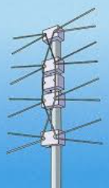
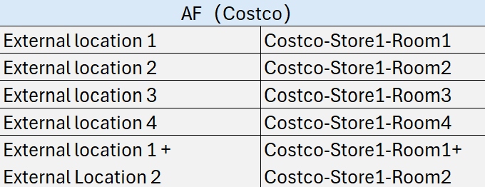
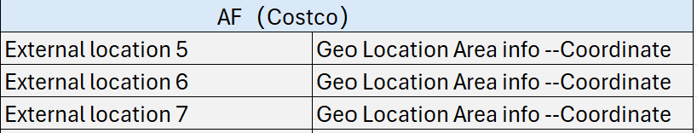


RAN Node 1
RAN Reader 3
RAN Reader 2
AIoT Area 1 | AIoT Area 2
AIoT Area 3 | AIoT Area 4
AIoT RAN Node 1
AIoT Area 1 | RAN reader1 + RAN Reader 2
AIoT Area 2 | RAN reader3
AIoT Area 3 | RAN reader4
AIoT Area 4 | RAN reader5
Taking External 5 as an example：
Conver it to AIoT Area 1 + AIoT Area 2，but how RAN node1 know it just need to paging the fractional area of AIoT Area 1 and AIoT Area 2 and how can RAN node1 do it like that?
RAN Reader 1
RAN Reader 4
RAN Reader 5
Sync up
AF (Costco)
External location 1 | External Location 2
External Location 3 | External location 4
External
area 7
External
area 5
External
area 6
Discussion 1: AF can choose Geo location area freely for indoor scenario? or there is a limitation
Discussion 2: Is it possible for RAN reader to page partial serving area of the RAN reader
Discussion 3: what is the external location information input from AF -- external location Identifier or external location area defined by Geo coordinates?
Considerations on matching between external location area/location and AIoT RAN information

Slide 3
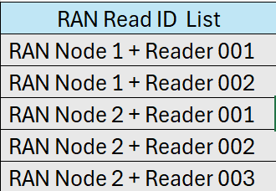
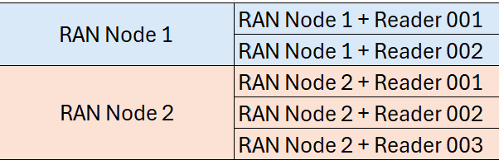
RAN Node and RAN reader selection in AIOTF – Option 1
Additional Internal area information definition (e.g. TAC list) in NEF and AIOTF
RAN Node1 choose reader 001 and 002
OAM
OAM
If it is the RAN service area ID, RAN Node1 chooses the reader based on the RAN service area ID
Service Request
(RAN Node1+Reader 001
RAN Node1+ Reader 002
RAN Node 1
AIOTF
NEF
AF
RAN Node 2
Service Request
(Internal Location/Area)
Service Request
(External Location area
or External location ID)
Service Request
(RAN Node2+Reader 001
RAN Node2+ Reader 002
RAN Node2+ Reader 003
RAN Node2 choose readers 001,002, and 003
Convert Internal location/Area to RAN reader ID or RAN service Area ID based on input from NEF and local OAM configuraitons
The AIOTF selects the AIoT RAN node(s) based on the internal area information (RAN reader ID list or * RAN service Area ID list)
If multiple AIoT RAN nodes are involved in the service request, AIOTF shall split the RAN Reader ID list based on the AIoT RAN node accordingly
If it is the RAN service area ID, RAN Node2 chooses the reader based on the RAN service area ID
Convert the external location area/location ID to
the internal location/area)—e.g. TAC list
Example
* RAN Service Area ID definition is FFS in RAN3 WG. SA2 can take the same logic as the RAN reader ID to handle the RAN service Area ID

Slide 4
RAN Node and RAN reader selection in AIOTF – Option 2
Leveraging RAN reader ID or * RAN Service Area ID to be an internal location area in NEF
OAM
RAN Node1 choose reader 001 and 002
The AIOTF selects the AIoT RAN node(s) based on the internal area information (RAN reader ID list or * RAN service Area ID list)
If multiple AIoT RAN nodes are involved in the service request, AIOTF shall split the RAN Reader ID list based on the AIoT RAN node accordingly
If it is the RAN service area ID, RAN Node1 chooses the reader based on the RAN service area ID
Service Request
(RAN Node1+Reader 001
RAN Node1+ Reader 002
RAN Node 1
AIOTF
NEF
AF
RAN Node 2
Service Request
(RAN Node2+Reader 001
RAN Node2+ Reader 002
RAN Node2+ Reader 003
Service Request
(RAN Reader ID list
or * RAN service Area ID list)
Service Request
(External Location area
or External location ID)
Convert the external location area/location ID to
the internal location/area (e.g. RAN reader ID or * RAN service Area ID)
RAN Node2 choose readers 001,002, and 003
If it is the RAN service area ID, RAN Node2 chooses the reader based on the RAN service area ID
Example
* RAN Service Area ID definition is FFS in RAN3 WG. SA2 can take the same logic as the RAN reader ID to handle the RAN service Area ID

Slide 5
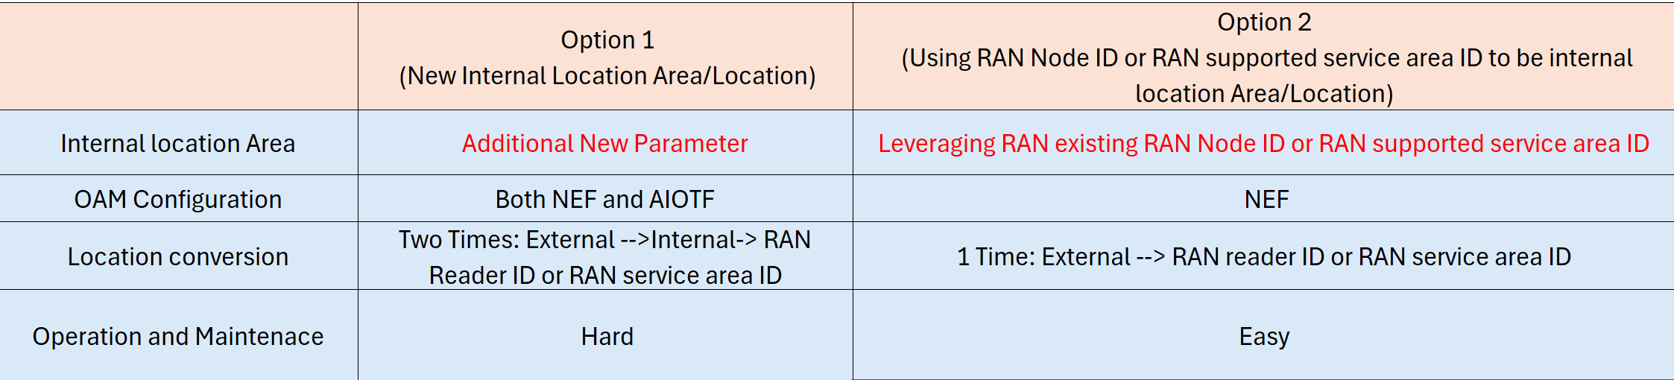
Option 1 VS Option 2
e.g.,TAC list
e.g.,TAC list

