Slide 1
GMEC
SA2#154AH-e

Slide 2
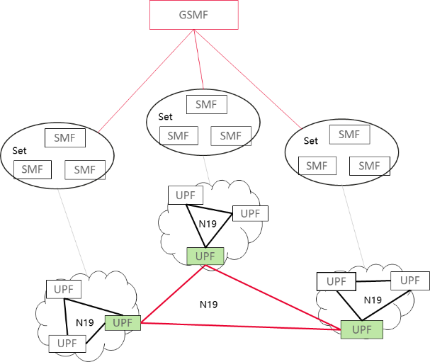
Key Issue #4 Conclusion
Border UPF?
N19?
Border UPF?
N16a extension
GSMF
Whether to support dynamic control of connectivity between any two UPFs served by different SMF Sets:
  Option 1 support using only N16a enhancements ? See S2-2301268
    YES: NO:
  Option 2: support using only new GSMF? See S2-2301190
    YES: NO:
  Option 3: support using either N16a enhancements or new GSMF? See S2-2301190
    YES: NO:
  Option 4: Not pursued in this release See S2-2301268
    YES: NO:

