Slide 1
Moderator's summary for 6G SI: deployment scenarios
AI 8.2.1.0
3GPP TSG RAN #110
Baltimore, USA, Dec. 8th – 11th, 2025
RP-253777
Axel Klatt
Deutsche Telekom AG / Co-Rapporteur RAN P SI

Slide 2
Summary of work progress
Summary:
TR 38.914v0.2.0 - agreed at RAN#109 - listing already the main scenarios and captured agreed outcome of the related discussions at RAN#109
RP-252915 provided a draft pCR to capture the contributions to RAN#109 which include those not yet agreed
RAN Chair guidance via email Reflector on 14.11.2025 provided that this document should be used as starting point for further discussions in RAN#110
30 contributions submitted to RAN#110 for this A.I. (2 late, 1 moved)
  Many contributions simply resubmitted the same input as for RAN#109 which was already captured by the moderator in the draft pCR in RP-252915: -> deltas were requested !
This summary provides the aspects to be decided online before pCR can be cleaned up

Slide 3
Why are we creating the deployment scenarios ?
RECAP:
There seems to be still different understanding of chapter 4 of TR 38.914
At RAN#109 it was decided to define scenarios to:
  analyse that the air interface design (aka “6GR”) to be developed during the 6G Radio Study fullfills the requirements of IMT-2030 (for the ITU process)
  analyse technical benefits of the “6GR” in realistic/practical deployment scenarios
  and allow comparsison to 5G-Advanced (with baseline to be agreed, e.g. NGMN RPAF, 3GPP internal, …)

Slide 4
Decision1: Do we add new deployment scenarios ?
Summary/conclusions:
The following new deployment scenarios were proposed in RAN#109 & RAN#110:
  Urban Grid (Subchapter existed -> details proposed) [RP-252001, RP-252218, RP-252127, RP-252177, RP-252470]
  Highway (Subchapter existed -> details proposed) [RP-252218, RP-252127, RP-252177, RP-252470]
  High Speed (train) (Subchapter existed -> details proposed) [RP-252121]
  Single cell with large coverage [RP-252118]
  Indoor Factory (InF) [RP-252118, RP-252127, RP-252021, RP-252581]
  UAV [RP-252126]
  Multi-layer heterogeneous network with assisting node [RP-252021]
  Nearshore water [RP-252021]
  [@RAN#110] High Rise Building Deployment in 6G deployment scenarios [RP-253157]
  [@RAN#110] 6G Intra-frequency Het-Net deployment scenarios [RP-253233]
  [@RAN#110] Single layer urban micro scenario [RP-253233]
Moderator Proposal:
After finalization of the scenarios already in the TR 38.914v0.2.0 only the new scenarios 1 – 5 should be introduced. Scenario 4 shall be combined with chapter 4.7.

Slide 5
Decision2: Diverse views on antenna configurations
Summary/conclusions:
For UE wide range of antenna assumptions per band have been proposed:
  For UE from 1T1R to up to 32 antenna elements; often depending on the band and device type
  Different notation was used in the different contrinutions
    1T/1R, 1T2R, 2T2R, 2T4R, 4T4R, 4T8R ….
    Up to 4T/8R
    Up to 8 Tx Rx elements
    Up to 8 Tx and Rx antenna elements
    Up to 8 Tx and 8 Rx antenna elements
    Up to [2/4/8/16/32] antenna elements
Moderator Proposal:
A consistent notation shall be decided in RAN P
For UE it can be dependent on the device type and frequency range or band specific specific.
  Device type A (e.g. Iot)
  Devive type B (e.g smartphone)
  Device type C (e.g. FWA)
Usage in TR 38.913 (for 5G):

Slide 6
Moderator Proposal:
A consistent notation for RX/TX antenna capability shall be decided in RAN P – same as what was used for 5G study
For the purpose of further study in RAN and RAN WGs for FR1, UE RX/TX antenna capability can be dependent on the service, device characteristics, frequency range / band, etc
  Type A: 4
  Type B: 8
  Type C: 16

Slide 7
For the purpose of further study in RAN and RAN WGs for frequency up to 7GHz, evaluate the following UE RX/TX antennas
  Up to 4
  Up to 8
  Up to 16 (for RX only and intended only for FWA)
Note: Above does not impact future discussions on UE capability

Slide 8
Decision3: For UE adopt the style in the deployment tables
…
 | eMBB | FWA | IoT
Antennas | Up to 8 Tx and Rx antenna elements | Up to 16 Tx and Rx antenna elements | Up to 4 Tx and Rx antenna elements
Velocity | 3 .. [120] km/h | 0 km/h | 3 .. [120] km/h
UE antenna elements
eMBB
FWA
IoT
User distribution and
UE speed
eMBB
FWA
IoT
These 3 categories could be used in the updated pCR (depending on previous decision)

Slide 9
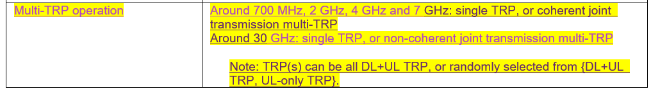
Decision4: Introduce multi-TRP operation ?
Question:
Should we introduce multi-TRP operation as a specific deployment option ?
Topic was proposed by only 1 company
Moderator Proposal:
Do not introduce a specific multi-TRP operation (at least not now at RAN#110)

Slide 10
Decision5: Keep macro / micro deployment
Summary/conclusions:
For some scenarios macro / micro deplyoments and the related frequencies are already defined in TR 38.914v0.2.0 after lengthy discussion in RAN#109
One contribution [RP-253038] proposes to remove the explicit notation of macro and micro from all scenarios
One other contribution [RP-253198] suggests adding additional frequencies of 4 + 4 GHz and 7 + 7 GHz for such scenarios
which was discussed at RAN#109 and ruled out in the offline discussions then
Moderator Proposal:
Keep what we have agreed in RAN#109 and documented in TR 38.914v0.2.0 already

Slide 11
Decision6: Sensing: Add Sensing block per scenario ?
…
Sensing Parameters
Parameter 1
Parameter 2
Parameter 3
…

Slide 12
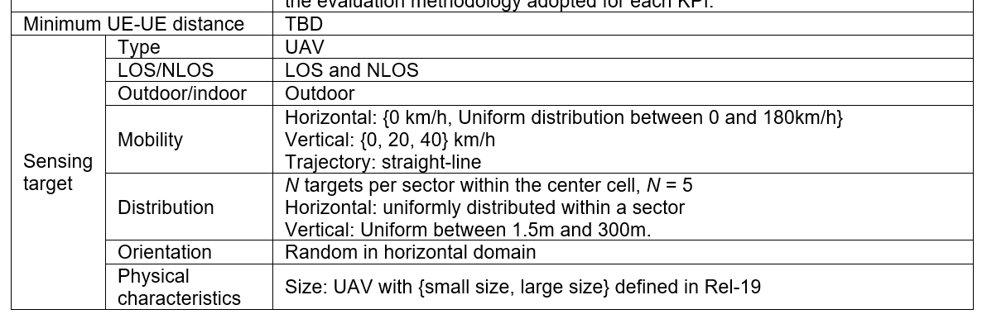
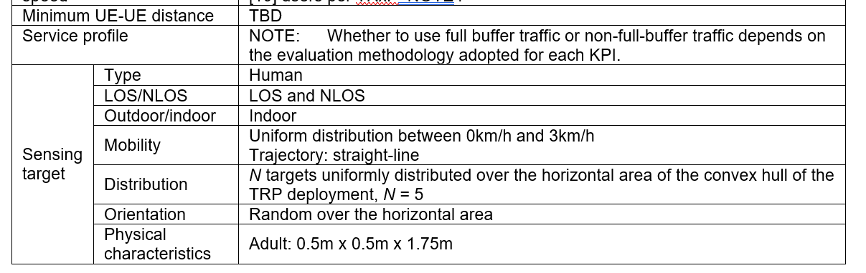
Suggested sensing parameters per deployment scenario [RP-252202->3247]
Urban Grid for ISAC
Indoor hotspot for ISAC
Moderator Proposal:
Interested companies to offline consolidate and come with a proposal for all relevant deployment scenarios

Slide 13
Work organization this week at RAN#110
Tdoc RP-25xxxx contains an updated draft pCR for TR38.914v0.2.0 as much as possible cleaned by by the moderator tanking into account submissions to RAN#109/110
We need 1 offline slot to try to develop a version for approval at this RAN#110
  We concentrate on the 5 main scenarios (indoor, dense urban, urban, rural, sub-urban) to finalise these chapters with highest priority
    Sensing related block will be added AFTER the initial offline based on a consolidated proposal provided by [name]
  We detail existing chapters and add one new scenarios (“InF”) -> use moderators updated pCR
    4.6 High speed
    4.7 Extreme long distance coverage in low density area
    4.8 Urban coverage for massive connection
    4.9 Air-to-Ground Scenario
    4.10 Non-Terrestrial Network
    4.11 Urban grid / Urban grid for connected vehicles
    4.12 Highway Scenario
    (new) Indoor Factory (InF)

Slide 14
Notes on the pCR
Moderator’s updated pCR is the basis for offline discussion
Based on the decisions 1 – 6 another update will be provided before offline session
No changes of the draft pCR by companies via the drafts folder, nor via email
No offline email discussions via the 3GPP RAN reflector please (I will not read those mails)
Blue maked: Decision needed (in offline), typically on values
Magenta marked: Consolidated sensing input required
Yellow marked: Multi-TRP related (keep/remove based on D4)

Slide 15
List of contributions considered
RP-253297 | Views on 6G NTN Scenarios | CSCN, CATT, CBN, China Broadnet, China Unicom
RP-253325 | Coverage definition from an operator view | Deutsche Telekom
RP-253301 | Discussion on deployment scenarios for Vehicular Use Cases | Volkswagen AG, BMW AG, Toyota ITC, Robert Bosch GmbH, AUMOVIO, Fraunhofer IIS
RP-253303 | Discussion on single layer urban micro scenario in 6GR deployment for 38.914 | CableLabs, Charter Communications, Rogers Communications, Comcast
RP-253329 | Views on Deployment Scenarios | QUALCOMM
RP-253038 | On deployment scenarios | Ericsson
RP-253040 | Discussion on 6G NTN deployment scenario | Xiaomi
RP-253043 | Discussion on 6G deployment scenarios | OPPO
RP-253069 | Requirements for support of FWA service in 6G deployment scenarios | T-Mobile USA Inc., Deutsche Telekom, Ericsson, Nokia, Jio Platforms, Verizon
RP-253166 | 6G Intra-frequency Het-Net deployment scenarios | Jio Platforms
RP-253157 | High Rise Building Deployment in 6G deployment scenarios | Jio Platforms
RP-253158 | Discussion on UE antenna configurations | Samsung
RP-253059 | 6G Deployment Scenarios | AT&T
RP-253140 | Deployment scenarios | MediaTek Inc.
RP-253169 | FWA Device Mix in 6G Deployment Scenarios | Jio Platforms
RP-253182 | Views on 6G deployment scenarios | NTT DOCOMO, INC.
RP-253198 | General views on 6G deployment scenarios | ZTE Corporation, Sanechips
RP-253085 | TP on remaining aspects of 6G deployment scenarios for TR 38.914 | Deutsche Telekom, Vodafone, Orange, Telecom Italia
RP-253086 | TP on NTN deployment scenarios | THALES, TNO, Iridium, BMW, Bosch, Airbus, Eutelsat, Novamint, Toyota, ESA CATT, CSCN, LG Electronics, Sharp, EchoStar
RP-253115 | Text proposal for TR 38.914 for deployment scenarios | CMCC
RP-253104 | TR 38.914 text proposal for Extreme Long Distance coverage | Telstra Limited
RP-253271 | Support indoor factory as one of 6G scenarios | CATT, CICTCI, China Telecom, China Unicom, ZTE, Huawei
RP-253280 | Consideration on 6G deployment scenarios | Huawei, HiSilicon
RP-253281 | Discussion on 6G ISAC deployment scenarios | Huawei, HiSilicon, CAICT, China Telcom, China Unicom, KT Corp., LG Uplus,SK Telecom, CATT, CICTCI
RP-253214 | Discussion on 6G deployment scenario with assisting node | Kyocera
RP-253221 | Discussion on 6G UE antenna configuration | Xiaomi
RP-253231 | Discussion on 6G Deployment Scenarios | Tejas Network Limited, CEWiT, IIT Madras, IIT Kanpur
RP-253233 | 6G Intra-frequency Het-Net deployment scenarios | Jio Platforms
RP-253247 | Deployment scenarios for ISAC | Xiaomi
RP-253251 | Discussion on 6G Deployment scenarios | vivo
RP-253269 | Views on 6G NTN scenarios | CATT, CSCN, CBN, China Broadnet
RP-253499 | Consideration of deployment scenarios for vehicular use cases | LG Electronics
RP-253515 | Views on 6G Deployment Scenarios | Apple Inc.
RP-253338 | Discussion on 6G deployment scenarios | Ofinno
Moved to AI 8.2.1.1
Not available at deadline
Not available at deadline
Not available
Not available at deadline

