Slide 1
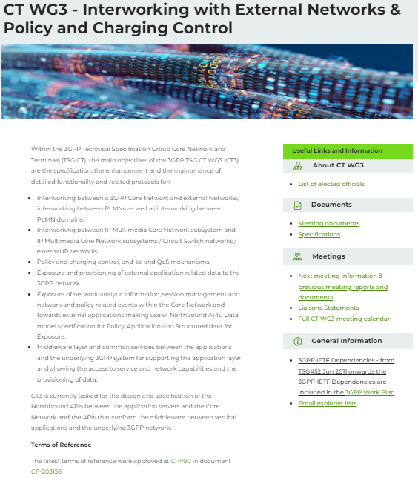
Meeting guidance for 3GPP CT3#144
Susana Fernández
3GPP CT3 Chair
Ericsson

Slide 2
Time plan for CT3#144
Tdoc allocation & submission deadline: Monday, 10th November 2025 13:00 UTC
DAD at submission deadline: Tuesday, 11th November 2025 9:00 UTC
Preliminary proposed Schedule: Wednesday, 12th November 2025 16:00 UTC
Official DAD & proposed Schedule at Start of Day 1: Friday, 14th November 2025 13:00 UTC
Start of the meeting: Monday, 17th November 2025 09:00 Local time
DAD at Start of Day X: End of every Business Day
End of the meeting: Friday, 21st November 2025 15:30 Local time (estimated time)

Slide 3
Before the CT3#144 meeting (1/2)
Tdoc reservation and submission will be handled as per the current procedures, i.e. via the 3GU Portal (https://portal.3gpp.org). The tdoc number shall be used as the zip file name for each submitted contribution.
  Refer to the draft agenda as C3-255000.
  Delegates will prepare and submit their contributions considering (see CP-252252):
    All (pre-)Release 19 contributions will be included in the Agenda.
    Release 19 contributions will have maximum priority.
    Any SID/WID, CR or pCR related to Rel-20 5G-A will NOT be handled.
    Any WID, CR or pCR related to Rel-20 6G will NOT be handled.
    DP(s) and SID(s) related to 6G will be treated.
    For topics that require to be discussed in more than one WG, the related documents should be submitted to the impacted WGs and the Chairs should be informed for organizing possible joint sessions.
  Maximum number of PCR(s)/CR(s) (considering mirrors) per company is set to 100.
  It is assumed delegates have read the submitted contributions and have the comments ready before the meeting.

Slide 4
Before the CT3#144 meeting (2/2)
The Chair will provide the DAD at submission deadline (as C3-255004) by Tuesday, 11th November 2025. The DAD will include the LS related actions proposed by the Chair.
The Chair will provide a preliminary proposed schedule by Wednesday, 12th November 2025. If needed, delegates should inform the Chair about any controversial topics that should be prioritized so that it is considered in the schedule.
The Chair will provide the official DAD at Start of Day 1 (as C3-255005) and the official proposed schedule (as C3-255003) by Friday 14th November 2025.
MCC will reserve conference bridges using Microsoft Teams and share the associated link(s) to remote participants registered for the CT3#144 meeting.

Slide 5
During the meeting (1/4)
CT3#144 meeting will officially start at 09:00 on Monday 17th November 2025, in Dallas, US.
CT3#144 will be a F2F meeting with two-way remote participation
  The documents being processed in the meeting room will be shared to both F2F and remote participants (via Teams).
  F2F participants should raise their hand to speak and use standing microphone in the meeting room to speak when their turn is given.
  Remote participants may access the meeting using Teams and raise their hands in Teams to ask for the floor.
  Comments from both f2f and remote participants provided in the meeting will be equally considered, with the exceptions:
    Remote participants will not be able to object to any decision made in the F2F meeting.
    Remote participants are not allowed to vote.
  Details for remote access to the ftp server will be provided by MCC.

Slide 6
During the meeting (2/4)
The time schedule as in C3-255003 will be followed during the meeting.
  Updated draft versions will be provided daily based on the progress of the meeting.
The author may be required to make a quick presentation of the contribution.
Delegates will provide all comments when the document is opened. Offline or late comments will NOT be considered.
The revised contributions will be discussed in the assigned slot for revisions. Only documents available in the Inbox will be opened/discussed/concluded.
  The author will limit the presentation to the changes.
  Additional comments may be provided in relation to the changes.

Slide 7
During the meeting (3/4)
The Chair will conduct the sessions in the Main room.
Breakout sessions conducted by one of the Vice-Chairs will be handled for the progress of the meeting. As part of the Breakout sessions, it is possible to:
  Agree CRs & pCRs and allocate tdoc numbers for the revisions.
  Pre-agree revisions.
  Discuss and review SIDs/WIDs.
  Discuss and review Outgoing LS drafts.
  Discuss and review Working Plans
Final agreement of SIDs/WIDs, Outgoing LSs and Working Agreements will always take place in the Main session.
The Chair will share the updated official DAD on the CT3 reflector at the end of each day, including the outcome of both Main and Breakout sessions.

Slide 8
During the meeting (4/4)
Delegates can use the Drafts folder on the local ftp server for offline discussions related to preliminary versions.
  Sub-folders will be created for the Work Items discussed in the meeting.
Email discussions can take place for the progress of the discussion, either using the CT3 reflector (3GPP_TSG_CT_WG3@LIST.ETSI.ORG) or addressing the relevant delegates directly.
  Participants have no obligation to stay updated with email threads.
  Comments provided by email are not considered part of the official meeting and thus will not be implemented in the DAD.
  Comments provided by email cannot prevent the agreement of a contribution.
  Files should not be shared as attachments when using the CT3 reflector.
Late documents should be avoided with the following exceptions:
  Incoming LS(s) received during the meeting and required reply/outgoing LS(s).
  Contributions identified and accepted by the WG as part of a discussion handled in the meeting.
  Outcome of an action addressed during a joint session.

Slide 9
Technical Voting
There will be a technical voting for CT3#144, according to article 26 of the Working Procedures.
  https://www.3gpp.org/ftp/information/working_procedures/3gpp_wp.htm
The vote will be secret.
Date of the voting: Thursday, November 20th, 12:30-13:45
3GPP secure voting tool will be used. Check the following link to learn how to use it:
  https://help.3gpp.org/index.php?title=3GPP_voting_tool
Two questions are being asked, already in the 3GPP portal:
  1st Question: https://portal.3gpp.org/VotingTool/Vote/DetailList/1196
  2nd Question: https://portal.3gpp.org/VotingTool/Vote/DetailList/1197
If CT3 receives the LS Reply related to C3-254615 before the voting date and the WG decides the response makes the voting unnecessary, the voting will be cancelled.
If the voting outcome does not surpass 71% in any of the questions, the WG is strongly encouraged to support the proposal that got more votes.

Slide 10
Tdoc reservation & submission
Tdoc number will be assigned by the Chair (with the help of MCC). Tdoc number request for new/revised tdoc can be done during the meeting or can be asked offline if needed.
The delegate will upload the contribution updated with the received comments in the Inbox before the assigned slot for the revision. MCC will provide credentials to allow access to remote participants.
The Tdoc numbers, if needed, for CRs/DP on OpenAPI version update, new TSs/TR not under change control, presentation sheets for WIs will be allocated by the MCC before the end of the meeting. Those documents will be handled during the email approval procedure.
Please do NOT upload the final Tdoc(s) in 3GU, the MCC will do that after the meeting.
  For a revised WID, only rm version will be included in the final zip file.
  For a new WID, only cl version will be included in the final zip file.
  For a CR, the “rev” field of the cover sheet should be upgraded whenever the Tdoc number is changed.

Slide 11
Email discussions
Naming convention for the subject field in emails will be followed during the email approval phase and Plenary preparation, as follows:
[WIC] [Agenda item] [Tdoc number] [version] [Title]
  CR example: [OpenAPI_Updates][6.5][C3-253725][r0][CR 0430 29.222 Rel-19 Update of info and externalDocs fields]
  Exception sheet example: [Metaverse_App][19.42][C3-253712][r0][Exception sheet for Metaverse_App]

Slide 12
End of the meeting
The CT3#144 meeting will officially end at 15:30 (estimated time) on Friday 21st November, 2025.

Slide 13
After the meeting
Rapporteurs will implement all the pCRs agreed in this meeting into the new TSs/TRs that are not under change control, if any.
Rapporteurs will implement the OpenAPI impacts of the CRs agreed in this meeting into the SBI-related TSs under change control.
MCC will implement all the CRs agreed in this meeting in the Non-SBI TSs under change control.
Rapporteurs will store the OpenAPI files in 3GPP Forge as per current procedures and will indicate the identified syntax errors and whether some revision of agreed CRs need to be sent to CT3#144 meeting.
For more details about the procedure after the CT3#144 meeting , please refer to C3-255002, which will be shared by the Chair to the CT3 reflector when the meeting is officially closed.

Slide 14
Annex

Slide 15
Preparation of contributions
For SBI-related TS, the OpenAPI impact in a CR shall be indicated in the “Other comments” section of the cover sheet, as:
  The CR introduces a new OpenAPI file of the Nxx_yyyy API.
  Or
  The CR introduces backward [compatible/incompatible][feature/correction] to the following APIs:
  TS<Spec_Number>_<API_name>.yaml
  TS<Spec_Number>_<API_name>.yaml
  …
  TS<Spec_Number>_<API_name>.yaml
For a revised WID, only rm version will be included in the zip file
For a new WID, only cl version will be included in the zip file.

Slide 16

Thank You!
Susana Fernández
3GPP CT WG3 Chair
susana.fernandez@ericsson.com

