Slide 1
Introducing 3GPP
<Name>
<Role>

Slide 2
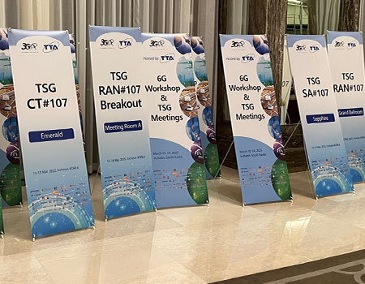
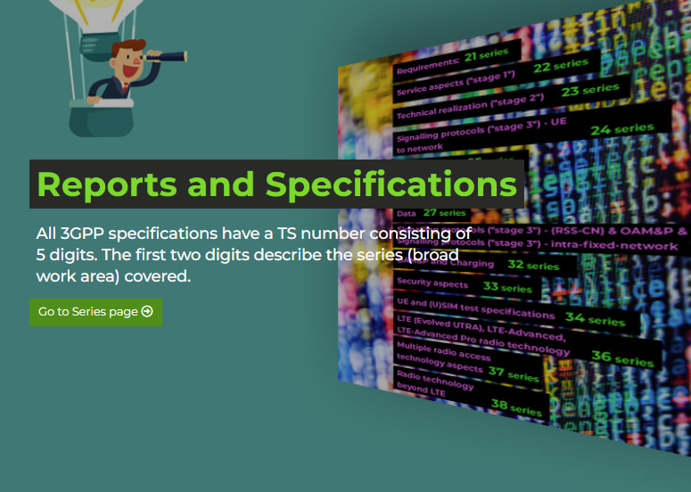
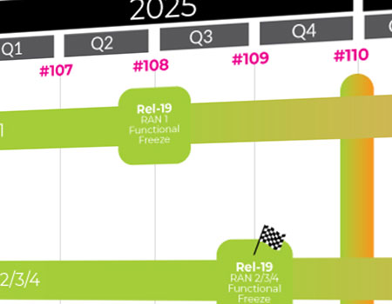
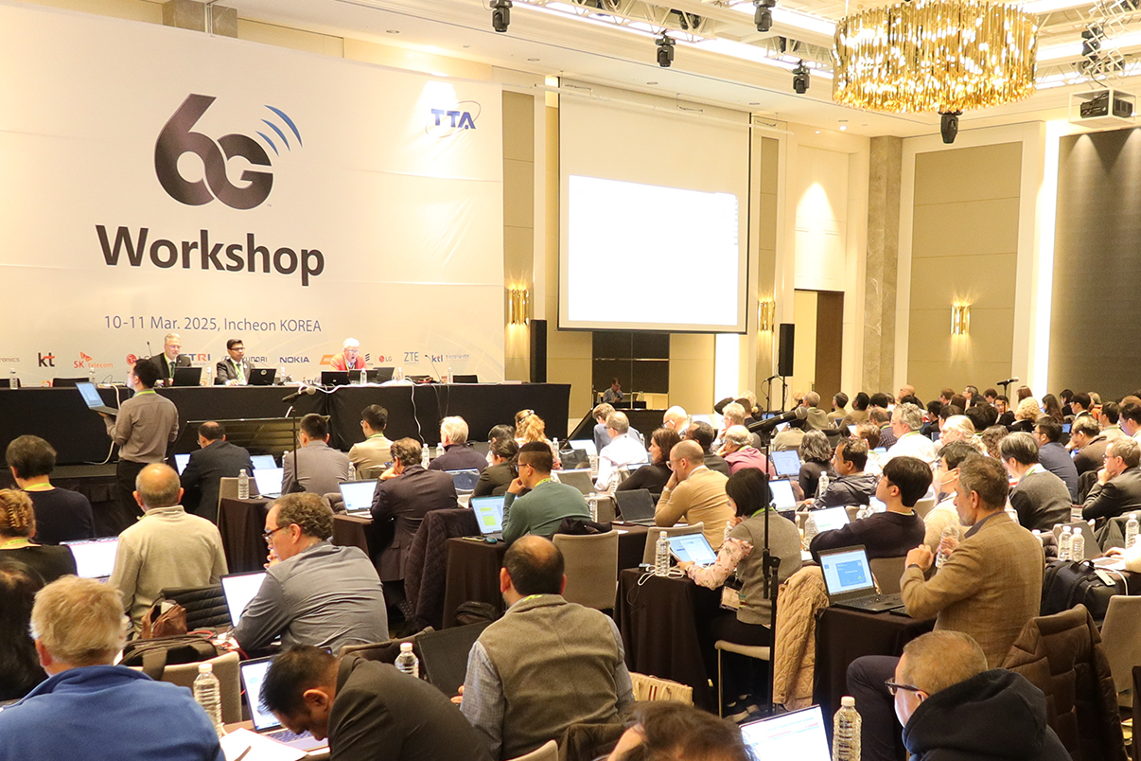
Content
The role of 3GPP
3GPP – How the project works
Partnership & the 3GPP eco-system
Technical Specification Groups
Bringing the work in
3GPP releases & Stages of a release
Quarterly meeting cycle
5G Releases
Rel-20 planning

Slide 3

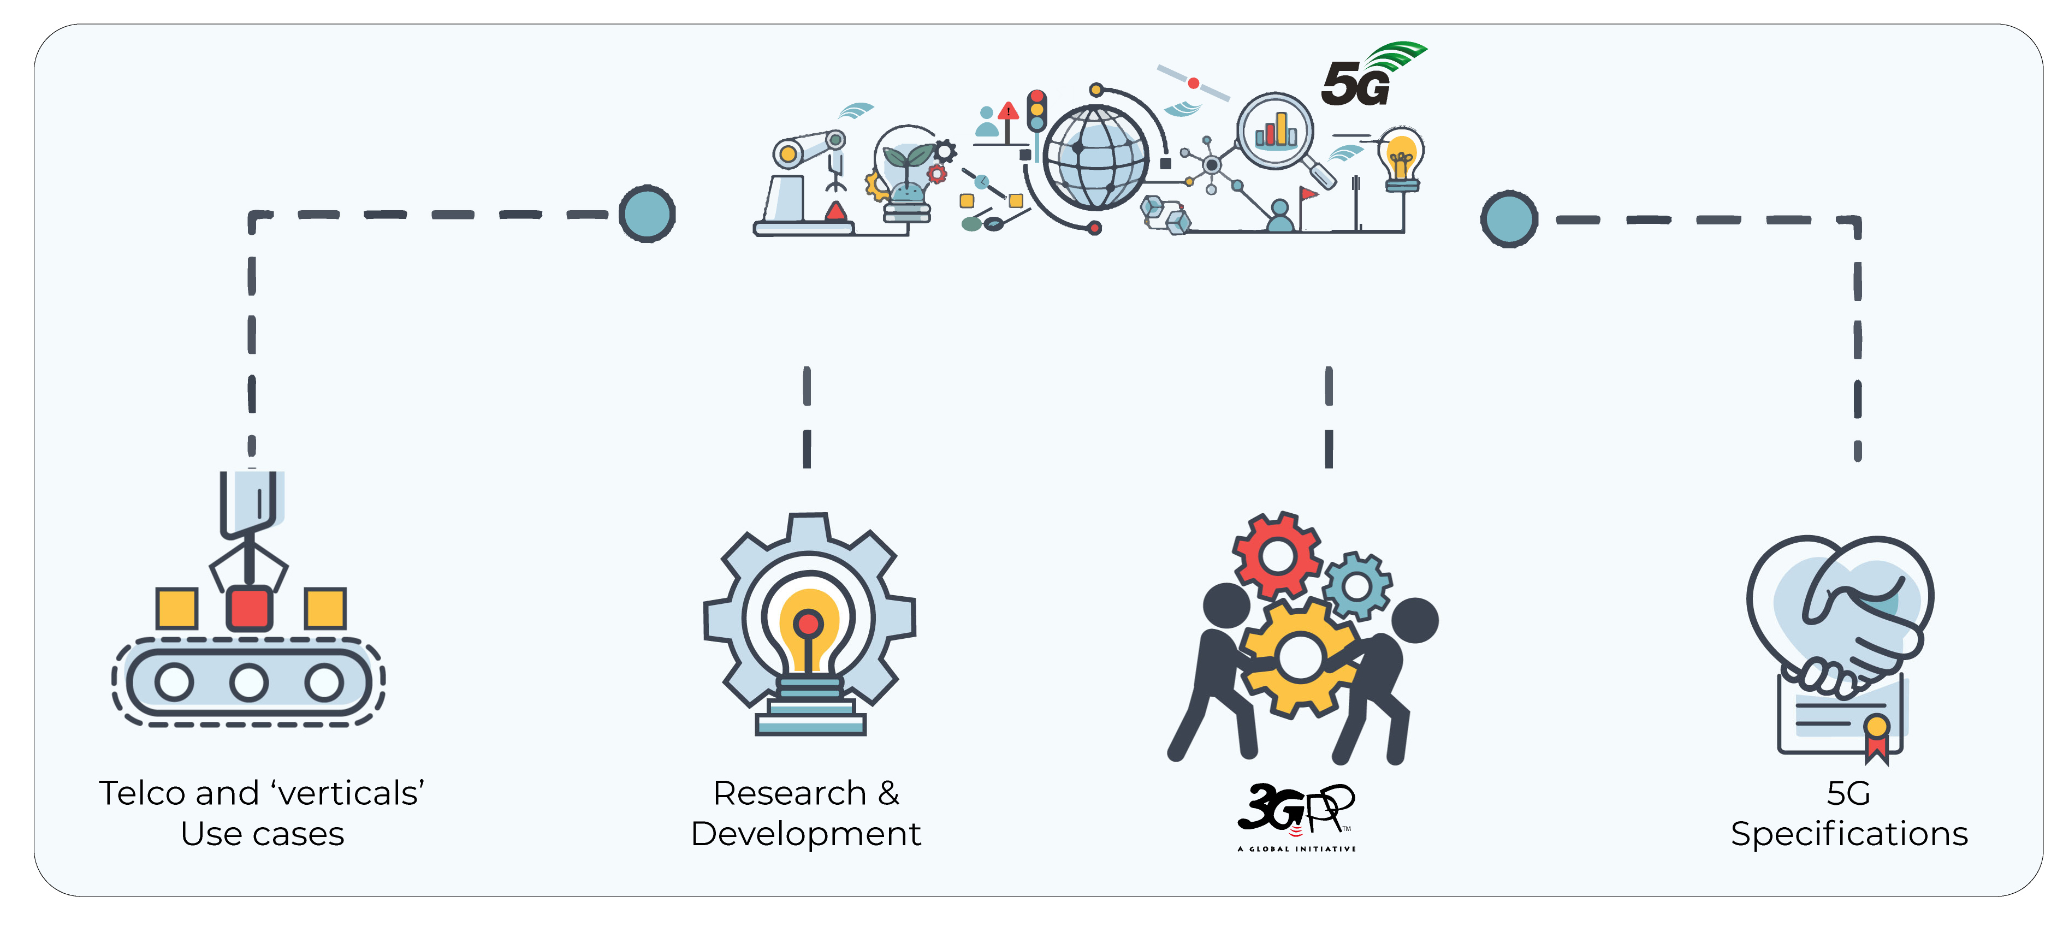

The role of 3GPP
Standardization of four generations of cellular.
Providing the system description for mobile telecommunications
This system description is characterized by a number of standardized interfaces. It is not a description of a standardized deployment
Enabling an interoperable, multi-vendor approach to deployment for mass market economies of scale, without stifling innovation

Slide 4

3GPP – How the project Works
3GPP works based on
  Participation in face-to-face meetings
  Pro-activity & Contributions. You need written proposals to get attention
  Consenus – nobody says “no”
Organization of…
  Study Items, Work Items
  Releases with fixed time-lines, which are partially overlapping
  The Work Plan (A spreadsheet view of WIDs and SIDs, by Release)
Over 3 Stages
  Stage 1: Service description & Requirements
  Stage 2: Architecture of functions & flows between them
  Stage 3: Concrete implementable Protocols
Companies not individuels participate
  From all over the world
  All major telecommunication companies – operators, vendors, service providers
  Ministries, Regulators and government agencies actively engaged
  More and more vertical industry representatives bring their work directly to 3GPP
Building on our Track Record
  3GPP started 1998, since then all 3GPP Releases have been deployed
  Seamless migration from “old” to “new” mobile generations
A new Release every 15 to 24 months
  Allows for resonably fast standardization & deployment of new technologies
  Strong commitment to time-lines guarantees reliable planning

Slide 5





3GPP standards eco-system
3GPP Organizational Partners (OPs)
The 3GPP Organizational Partners (OP) - 7 Standards Organizations - from China, Europe, India, Japan, Korea and the United States.
Participation in 3GPP by companies and organizations becoming Members of one of these 7 OPs.
Inputs on market requirements may come in to the Project via 3GPP Market Representation Partners (MRP).
There is a lot of additional external liaison activity…SDOs, Industry bodies, projects…
Liaisons in/out:
850+ companies
450 MHz Alliance, AISG, Bluetooth, Broadband Forum (BBF), CableLabs, International Special Committee on Radio Interference (CISPR), CTIA, Digital Video Broadcasting (DVB) Project, Ecma, International, Expert Group for Emergency Access (EGEA), Eurescom, COST 273, European Radiocommunications Committee (ERC), Fixed Mobile Convergence Alliance (FMCA), GCF, Global TD-LTE Initiative (GTD), GPS Industry Council, GSM Association, HomeRF Forum, IDB Forum, IEEE, Internet Engineering Task Force (IETF), IrDA, International Multimedia Telecomunications Consortium (IMTC), Internet Streaming Media Alliance, ISO-ITU expert group, ISO MPEG / JPEG, ITU-T SG2, JAIN tm (Javatm APIs for Integrated Networks), The Java Community Process (JCP), Liberty Alliance Project, Metro Ethernet Forum (MEF), NENA, NGMN (Next Generation Mobile Networks), oneM2M, OMA (Open Mobile Alliance ), Open Networking Foundation (ONF), Open IPTV Forum, Object Management Group (OMG), PCS Type Certification Review Board (PTCRB), Portable Computer and Communications Association (PCCA), Presence and Availability Management (PAM) Forum, RSA Laboratories, SDR Forum, Sun Micro Systems Inc., Steerco, SyncML Initiative, Trusted Computing Group (TCG), TeleManagement Forum (TMF), TCCA, TIA /TR45, TIA/TR47, ITU, TV-anytime Forum, Voice eXtensible Mark-up Language (VXML) Forum, Wi-Fi Alliance, Wireless Broadband Alliance (WBA), WLAN Smart Card Consortium, Wireless World Research Forum (WWRF), World Wide Web Consortium (W3C)
(Source: extract from https://www.3gpp.org/about-3gpp/15-bodies-with-which-3gpp-has)
3GPP Market Representation Partners (MRPs)
5G / 6G Projects
Certification Bodies

Slide 6
Technical Specification Groups
TSG RAN – Radio Access Network
TSG SA – Service and System Aspects
TSG CT – Core Network and Terminals
TSGs prepare, approve and maintain the 3GPP Technical Specifications and Technical Reports.
Responsible for the detailed time frame and management of the work’s progress;
  Management of work items;
  Technical Co-ordination;
  Proposal and approval of work items within the agreed scope and Terms of reference of the TSG
TSG Chair is responsible for the overall management of the technical work within the TSG and its Working Groups.
WG Chair is responsible for the overall management of the technical work within the WG and its sub-groups.
3GPP Project Coordination Group (PCG) and OP group are management groups (See ‘About/PCG’ section of the website)
RAN1 – Radio Layer 1 (Physical Layer)
SA WG1 - Services
CT WG1 - User Equipment - Core Network Protocols
RAN2 – Radio Layer 2 and Radio Layer 3 RRC
SA WG2 - System Architecture and Services
CT WG3 - Interworking with External Networks & Policy and Charging Control
RAN3 – UTRAN/E-UTRAN/NG-RAN Architecture and Related Network Interfaces
SA WG3 - Security and Privacy
CT WG4 - Core Network Protocols
RAN4 – Radio Performance and Protocol Aspects
SA WG4 - Multimedia Codecs, Systems and Services
CT WG6 - Smart Card Application Aspects
RAN5 – Mobile Terminal Conformance Testing
SA WG5 - Management, Orchestration and Charging
RAN AH1 – TSG RAN ITU-R Ad Hoc
SA WG6 - Application Enablement and Critical Communication Applications

Slide 7
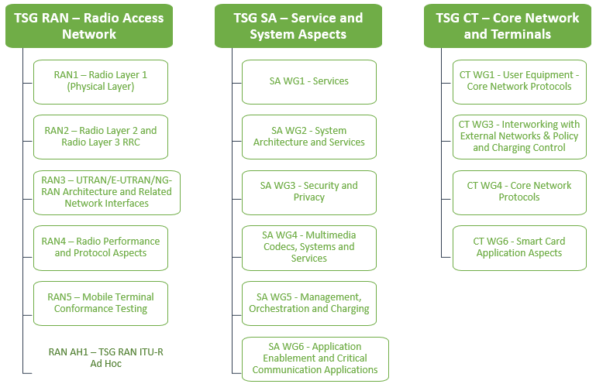
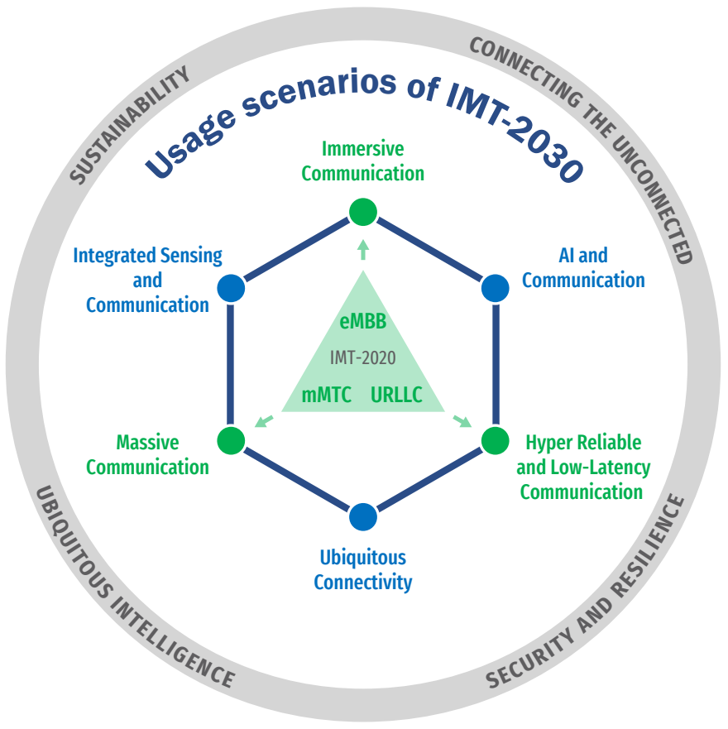

Bringing the work into the groups
Use Case diversity
High or Low data rates
Higher user mobility
Improved coverage
3GPP Specifications and Reports:
Requirements | 21 series
Service aspects ("stage 1") | 22 series
Technical realization ("stage 2") | 23 series
Signalling protocols ("stage 3") - user equipment to network | 24 series
Radio aspects | 25 series
CODECs | 26 series
Data | 27 series
Signalling protocols ("stage 3") -(RSS-CN) and OAM&P and Charging (overflow from 32.- range) | 28 series
Signalling protocols ("stage 3") - intra-fixed-network | 29 series
Programme management | 30 series
Subscriber Identity Module (SIM / USIM), IC Cards. Test specs. | 31 series
OAM&P and Charging | 32 series
Security aspects | 33 series
UE and (U)SIM test specifications | 34 series
Security algorithms | 35 series
LTE (Evolved UTRA), LTE-Advanced, LTE-Advanced Pro radio technology | 36 series
Multiple radio access technology aspects | 37 series
Radio technology beyond LTE | 38 series
3GPP Working Groups
Overall SystemGoals
Enable new business
Greater efficiency
More flexibility – not one-size-fits-all
Pre-Standards R&D
Test beds
3GPP MRP Papers and Vision
Regional initiatives
IMT process (ITU)

Slide 8
Three stage approach to Features, through Releases
time
Stage 1 Requirements: Overall service description from the user’s standpoint.
SA1
Requirements
RAN
Release content
definition
RAN
WGs
Stage 2
Architecture: Overall description of the organization of the network functions to map service requirements into network capabilities.
SA2
Architecture
SA3
Security
SA4
Media
SA5
OAM
SA6
Apps/MC
Stage 3
Protocols: The definition of switching and signalling capabilities needed to support services defined in Stage 1.
CT – Protocols & Coding

Slide 9
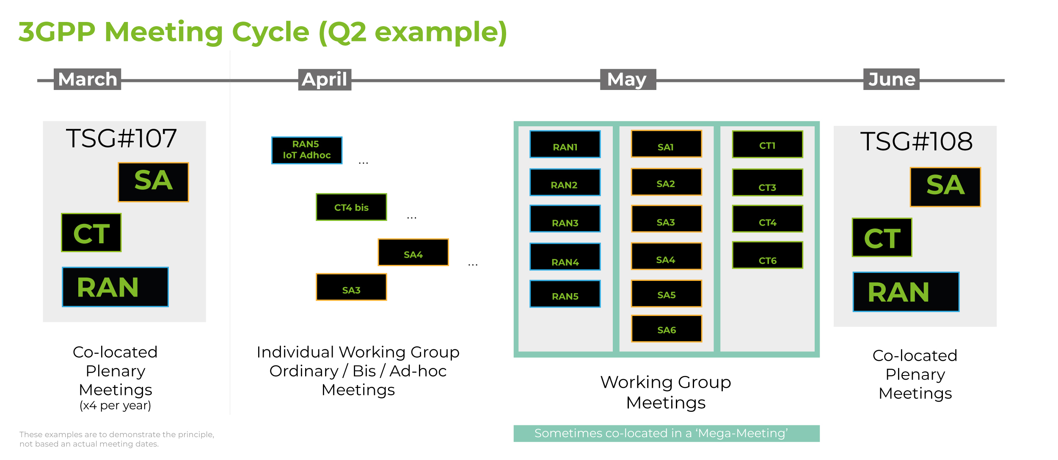
Work Schedule driven by technical meetings
New work is initiated by member companies as Study/Work Items, via Tdocs at meetings
Study/Work Items are prioritised and allocated time for discussion during meetings
3GPP member companies may contribute to any work item, on equal terms
3GPP seeks consensus on all technical matters (but has mechanisms if consensus cannot be reached)
The Release deadline is respected. Unfinished work is deferred to a later release

Slide 10
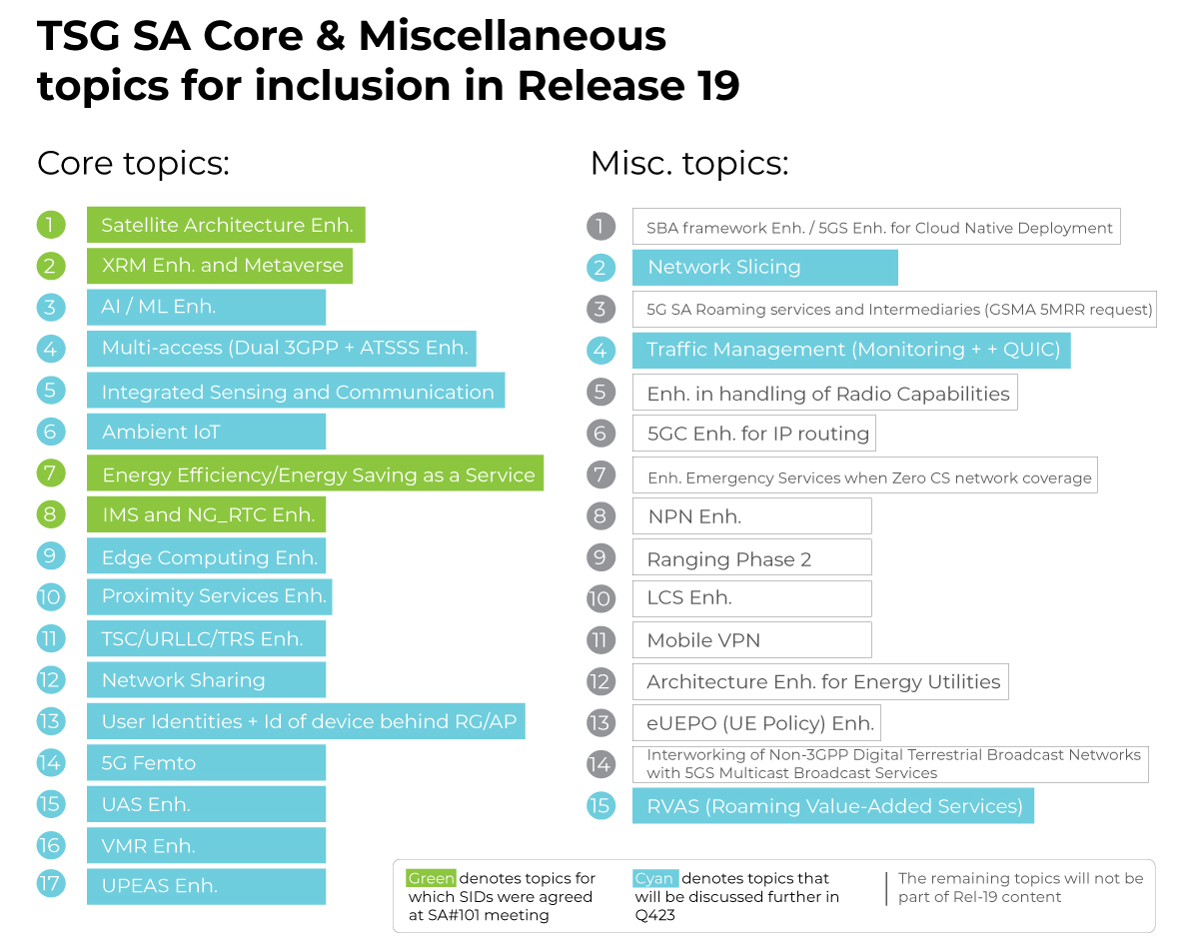
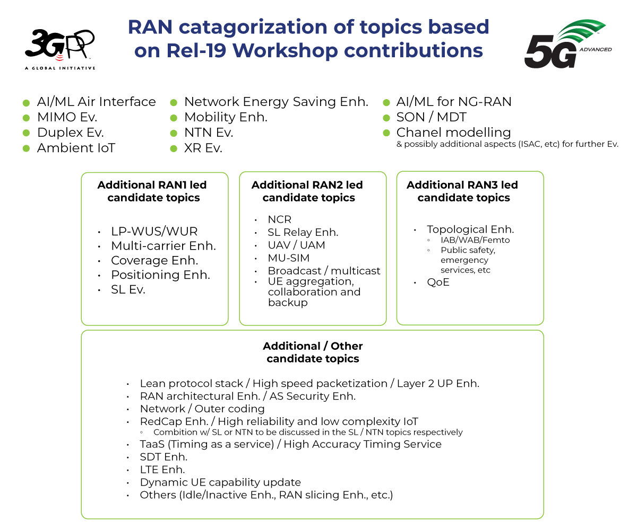
5G Releases
Release15: The work on new radio (nr) and the 5G system (5GS) jointly addressed the urgent subset of needs for early commercial deployments.
Release16: Met all identified 5G use cases, to allow a full 3GPP IMT-2020 submission to ITU-R.
Release 17: Enhances the earlier 5G work, meeting more 'vertical' industry needs, specifying NR operation in unlicensed bands, NR MIMO, V2-everything.
Release 18: Brought a balanced evolution in terms of:
  Mobile broadband evolution versus further vertical domain expansion;
  Immediate versus longer-term market needs;
  Device evolution versus network evolution.
  Introduced 5G-Advanced as a mid-generational marker (covers Rel-18, 19, 20)
Release 19: The current focus of the groups. Due for completion in 2025…
Release 20: Further 5G Advanced content. Stage-3 freeze envisaged Mar. 2027. First 6G studies.
Rel-19 topics:
Source: https://www.3gpp.org/specifications-technologies/releases/release-19
TSG SA (SP-230765, SP-230759)
TSG RAN (RWS-230488)
Notes:
10/31/16

Slide 11
Release 20: 6G Study Items
Source: Summary of 3GPP 6G workshop: 6GWS-250243
6G Study Item(s) – TSG SA
6G Study Items(s) - RAN Plenary
6G Study Item(s) – TSG CT
  SA SI Approval
    SA1 SI approval: TSG#105 (Sept 2024)
    SA2 SI approval: TSG#108 (Jun 2025)
    Other SA WG (SA3, SA4, SA5, SA6) SI approval: TBD at future TSG meeting
  SA SI completion (18/21 months)
    SA1 6G SI completion: Mar 2026
    SA2 6G SI completion: Dec 2026 or Mar 2027 (To be confirmed at future TSG meeting)
  RAN Plenary (RP) work is split into an ITU-focused SI and General RAN SI
    IMT-2030 discussion is expected in RAN from Sep 2024 to Dec 2024
    RP SI Rel-20 focusing on ITU– IMT-2030: approval Dec 2024 until June 2025
    RP SI Rel-20 focusing on 6G General: approval Mar 2025 (after 6G WS), until June 2026
  CT WGs: at least 9 months
    Discussion on 6G studies will start in Q4 2025 in CT
    CT WG 6G SI is expected to be approved in Mar 2026 (or Dec 2025).
6G Study Item(s) – RAN WGs
  RAN WGs: 21 months
    RAN WG SI package approval June 2025
    RAN1 SI starts in June 2025 until Mar 2027
    RAN2/3/4 SI start in Sep 2025 until June 2027

Slide 12
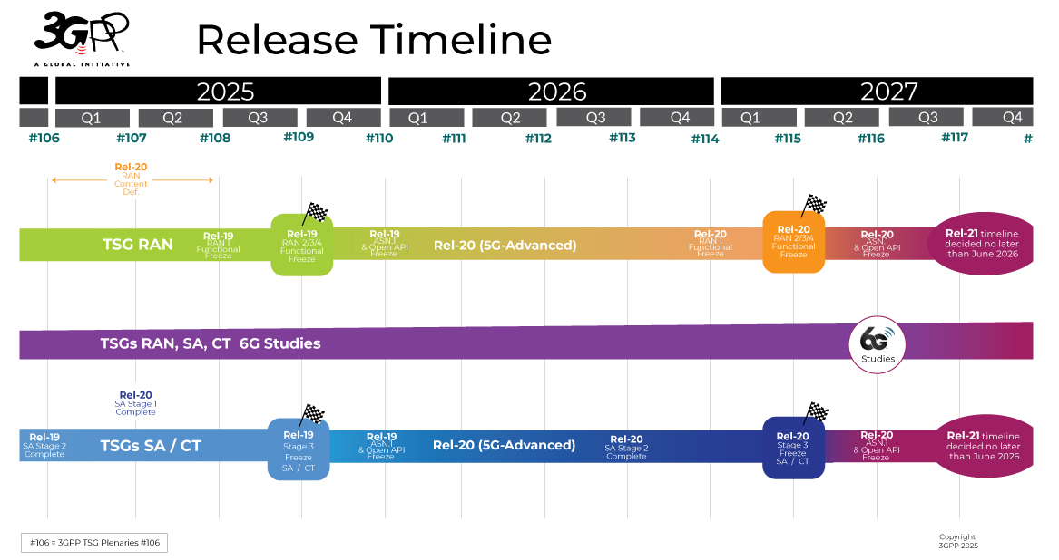
Beyond Release 19
Release 19: Complete e/o 2025
Release 20:
  TSG-Wide Rel-20 Workshops completed (5G-A Dec24, 6G Mar25)
  Focusing on Technical Specifications for 5G Advanced and early 6G studies
  RP‑243327: The 6G RAN Study (part I: ITU focused) is underway
Release 21:
  1st set of 3GPP 6G technical specifications and IMT-2030 submission, expected to be delivered with a single drop (i.e., a single code freeze).
  Rel-21 timeline is to be decided no later than June 2026
  With ASN.1/OpenAPI freeze date is no earlier than March 2029

Slide 13

Concluding thoughts
3GPP is industry driven - Standardization of interfaces enables an interoperable, multi-vendor approach to deployment.
The 3GPP processes are necessarily complex, but we will adapt to bring new sectors into the work.
Release 19 is the current focus of the groups. Due for completion by the end of 2025.
5G Advanced will lay the foundations for 6G features.
Release 20 content and priorities established.
6G timeline will be decided by June 2026. Studies will come in Rel-20 and Specifications no sooner than Rel-21.
3GPP uses a system of parallel "Releases" which provide developers with a stable platform for the implementation of features at a given point and then allow for the addition of new functionality in subsequent Releases.
You can learn more about 3GPP Releases by looking into the following resources:
TR 21.914 | Release 14 Description; Summary of Rel-14 Work Items
TR 21.915 | Release 15 Description; Summary of Rel-15 Work Items
TR 21.916 | Release 16 Description; Summary of Rel-16 Work Items
TR 21.917 | Release 17 Description; Summary of Rel-17 Work Items
TR 21.918 | Release 18 Description; Summary of Rel-18 Work Items

Slide 14


For more info on 3GPP…
Specifications, working documents, news, portal, technology articles:
  Online; www.3gpp.org
Consider attending a WG or TSG meeting (listing):
  https://portal.3gpp.org/
Subscribe to our regular newsletter:
  www.3gpp.org/highlights
Keep in touch:
  www.3gpp.org/contact
www.3gpp.org

