Slide 1
3GPP TSG RAN Current Status and Future Aspects
Wanshi Chen (Chairman of 3GPP RAN, Qualcomm)
Hiroki Takeda (KDDI)

Slide 2

Outline
Short Bio of Wanshi Chen
3GPP RAN Rel-17 Status
3GPP RAN meeting planning
3GPP RAN Rel-18 update

Slide 3

Wanshi Chen’s Short Bio
Wanshi Chen is currently 3GPP TSG RAN Plenary Chair appointed in April 2021
He was TSG RAN1 Chair from August 2017 to May 2021, and TSG RAN1 Vice Chair from August 2013 to August 17
Wanshi Chen has over 20 years of experience in telecommunications in leading telecom companies.
The highest degree that Wanshi Chen holds is a Ph.D. degree in Electrical Engineering from the University of Southern California, Los Angeles, CA, USA
An avid Marathon runner, with a personal best time of 2hrs 54mins
+1 858 366 3080
wanshic@qti.qualcomm.com
San Diego, CA, USA

Slide 4
3GPP RAN Rel-17 Status
Key Timelines for 3GPP RAN Rel-17
Rel-17 RAN1 freeze: December’2021
Rel-17 stage 3 freeze: March’2022
Rel-17 ASN.1 freeze: June’2022
Rel-17 RAN performance completion: September’2022
Careful planning and management are crucial in handling the challenges in completing Rel-17 in time
Challenges primarily due to cancellations of physical meetings in the entire 2021 for all RAN WGs
Important to carefully monitor Rel-17 progress and take actions when necessary
2021
2022
Q3
Q4
Q1
Q2
Q3
Rel
-
17
Rel
-
17 stage
RAN1
freeze
freeze
-
3
Rel
-
17 ASN.1
Rel
-
17 RAN4
freeze
performance
completion

Slide 5
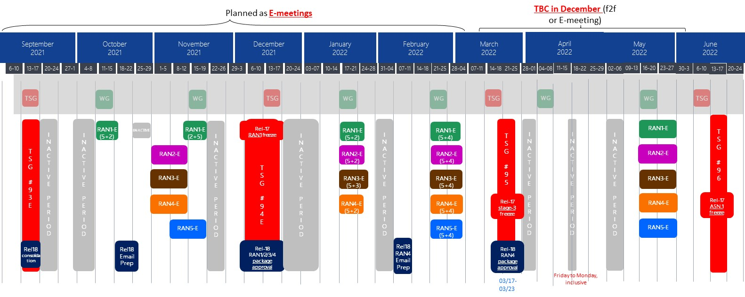
3GPP RAN Meeting Plan and Rel-18 Planning (as endorsed in RP-212587)

Slide 6
3GPP RAN Rel-18 Timeline
RAN Rel-18 release duration is decided to be 18 months
Rel-18 starts in 2Q’22 for RAN1 and in 3Q’22 for RAN2/3/4
This is, RAN1 functional freeze is September’2023, RAN2/3/4 functional freeze is December’2023, while ASN.1 freeze is March’2024.
2021
2022
2023
2024
Dec.’21, RAN1 R17
Func. Freeze
Mar.’22, RAN 2/3/4 R17
Func. Freeze
June’22, RAN R17
ASN.1 Freeze
Sept. 2023
RAN1
Func. Freeze
Dec. 2023
RAN2/3/4
Func. Freeze
Mar. 2024
ASN.1
Freeze
3Q’22
RAN2/3/4
Starts
RAN Rel-18 Timeline
2Q’22
RAN1
Starts

Slide 7

3GPP RAN Rel-18 Workshop
Dates: June 28th – July 2nd
A first discussion in 3GPP RAN on 5G-Advanced
Starting from Rel-18. Official logo is shown on the right
500+ submissions from ~80 different companies/organizations
1200+ checked-in participants
A generally balanced evolution is observed from the submissions to RAN Rel-18 workshop, and is intended to be reflected in the proposed set of topics for subsequent email discussion and in the final Rel-18 package, in terms of:
Balanced mobile broadband evolution vs. further vertical domain expansion,
Balanced immediate vs. longer term commercial needs, and,
Balanced device evolution vs. network evolution.
Note: the categorization of the topics (eMBB/non-eMBB/crossFunc) is a first-order approximation, and not be pursued further after the workshop

Slide 8
3GPP RAN Rel-18 Potential Projects (RP-212608)
Potential RAN1-led
MIMO Evolution for Downlink and Uplink
UL Enhancements (e.g. coverage enhancements; excluding MIMO)
Additional topological improvements – smart repeater
Sidelink enhancements (excluding positioning and relaying)
RedCap Evolution
Expanded and improved Positioning
Evolution of Duplex Operation
AI (Artificial Intelligence)/ML (Machine Learning) for Air interface
Network energy savings
Potential RAN2-led
Mobility Enhancements
Enhancements for XR
Sidelink Relay Enhancements
NTN (Non-Terrestrial Networks) evolution
Evolution for broadcast and multicast services
UAV (Uncrewed Aerial Vehicle)
Multiple SIM (MUSIM) Enhancements
In-Device Co-existence (IDC) Enhancements
Additional Projects for Considerations
Low power wake-up receiver / wake-up signal (WUR/WUS) (as part of RedCap)
RAN4-led discussion: bandwidths lower than 5 MHz in dedicated spectrum and DSS
Inter-gNB coordination
UE aggregation
High-speed Packetization
SDT (small data transmission)
CA (Carrier Aggregation)/DC (Dual-Connectivity) enhancements (excluding mobility aspects)
Potential RAN3-led
Additional topological improvements – IAB/VMR
AI/ML for NG-RAN
SON/MDT Enhancements
QoE Enhancements

Slide 9
Outline
Short Bio of Hiroki Takeda
Rel-17 Redcap (Reduced capability)
Rel-17 RAN slicing
Rel-18 Evolution of duplex
Rel-18 AI/ML
Conclusions

Slide 10
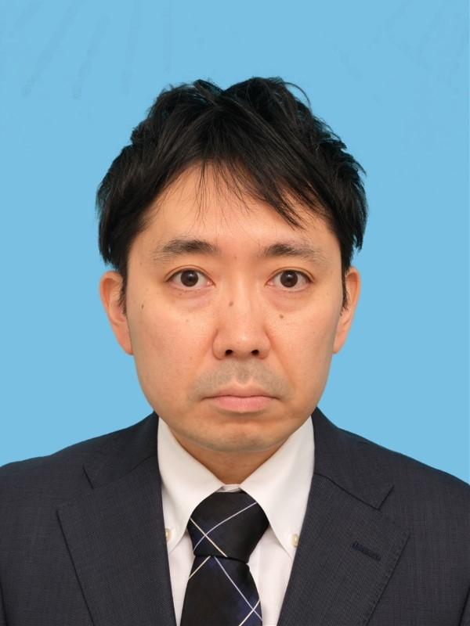
Hiroki Takeda’s Short Bio
3GPP RAN KDDI delegate
RAN Plenary
RAN WG2/WG3
Over 20 years of experience in telecom industry
1999 - 2013 : UE software development
2013 - ongoing : 3GPP RAN standardization
Not a Marathon runner, just looking other people running☺
ho-takeda@kddi.com

Slide 11
Rel-17 Redcap (Reduced capability)
Motivation (Use cases)
Wearables
Industrial wireless sensors
Video surveillance
Target data rate 2~150Mbps to accommodate above use cases
Reduced device capabilities
Bandwidth reduction
Reducing the max number of MIMO layers
Relaxation of the max downlink modulation order
Half-duplex (HD) operations in FDD(only FR1)
Total cost reduction
FR1 FDD ~67%, TDD ~61%@2Rx, ~72%@1Rx
FR2 ~53%
BW
5G NR
100MHz~
Redcap
20~MHz
eMTC, NB-IoT
KHz ~MHz
30kbps~1Mbps
2~150Mbps
Serval to dozen Gbps~
Technology | Category | BW | DL peak | UL peak
NB-IoT | Cat-NB1 | 200KHz | 62.5kbps | 25.3kbps
LTE-M | Cat-M1 | 1.4MHz | 0.8Mbps | 1Mbps
NR | NSA | >100MHz | 4-10Gbps | 4-10Gbps
Redcap | - | 20MHz | 2-150Mbps | 2-50Mbps

Slide 12

Rel-17 RAN slicing
Motivation
Fast access to intended Slices
Slice service continuity for UE mobility
Cell reselection
Fast UE access to the cell supporting the intended slice
Slice related information for cell selection is provided by both broadcast and dedicated signaling
RACH partitioning
Access resource isolation, providing guaranteed RA resources for their sensitive slices
Support service continuity
Solutions for the scenarios caused by slice resource shortage/overload
Candidate solutions are Configuration Based Solution, Slice resource re-partitioning, Multi-carrier radio resource sharing
NSSAI=1
NSSAI=1
NSSAI=2
RACH for NSSAI1
: PRACH
→ Time
→Frequency
0 | 1 | 2 | 3 | 4 | 5 | 6 | 7 | 8 | 9
RACH for NSSAI2

Slide 13

Rel-18 Evolution of duplex
Motivation
Increase UL resources for TDD to reduce latency
Full duplex enhances system capacity
UL/DL Subband
Subband Non-overlapping
Subband overlapping
Full overlapping
Duplex mode
TDD (and FDD?)
Enhancement at gNB and/or UE
Interference Management
inter-gNB and inter-UE CLI* (RAN1)
self-interference and the inter-operator CLI (RAN4)
co-existence with the legacy operation (RAN1/4)
Freq
Freq
UE2
DL
gNB
UE1
UL
DL
gNB
UE1
UE2
UL
UL
DL
DL
UE3
time
time
Subband non-overlapping
Subband overlapping
UL
DL
(Adjacent carrier)
Operator 1
Operator 2
UL
DL
Carrier 1
Carrier 2
Interference issue at operator1 gNB side
UL
DL
(Adjacent carrier)
UE (Op. 1)
UE (Op. 2)
inter-operator CLI
Carrier 1
Carrier 2
Interference issue at operator2 UE side
* CLI : Cross Link Interference

Slide 14
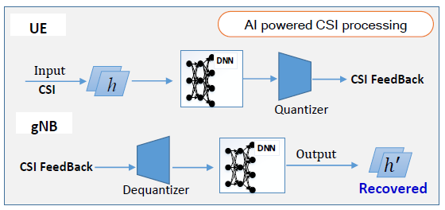
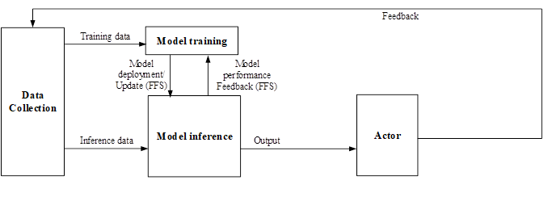
Rel-18 AI/ML
Motivation
Optimizations and system improvements
Not fully implementation-specific, need some coordination among NW nodes, between UE and NW
Physical Layer
CSI*1 feedback compression (lower overhead)
Beam management (beam selection, beam recovery...)
RS*2 overhead reduction (channel estimation)
Higher Layer(Continuation from Rel-17 Study item)
Use case : Energy saving, Load balancing, Mobility optimization
Procedure for training, learning, inference
Configuration, Data management
Example in CSI feedback (excerpt from RWS-210185 Samsung)
AI/ML frame work
(excerpt from 37.817 Study on enhancement for Data Collection for NR and EN-DC
*1 CSI : Channel State Information
*2 RS : Reference Signal

Slide 15
Conclusions
Release 17 and 18 is the next step expansion from the current 5G
Balanced features addressing the needs from mobile industries and verticals
Adaptation of 3GPP techniques to other verticals, industrial, V2X, NTN
Covering various enhancements relevant to mobility, capacity, latency, network deployment, power saving, device costs
Release 17 and 18 is the prologue for 6G
3GPP discussion on new study areas has started in advance
Examples are evolution on duplex operation, AI/ML, RAN slicing
Further enhancements contribute to integrate cyberspace and physical space

