Slide 1
Workshop on
3GPP Drafting rules
Frédéric Firmin
Specifications manager, MCC

Slide 2
Content
Introduction
Specifications
Change requests – specific aspects
Styles
Configuration of Microsoft Word
Q&A

Slide 3
Introduction

Slide 4
The 3GPP Drafting rules
The 3GPP drafting rules are derived from ISO, CEN/CENELEC and ETSI’s drafting rules;
They define:
  a common structure and presentation style for all specifications; and
  how requirements must be written.
They apply to 3GPP specifications and documents that are used in their drafting process (e.g. CRs);
They can be found in TR 21.801 (https://www.3gpp.org/DynaReport/21801.htm)

Slide 5
Specifications

Slide 6
General aspects
TSs and TRs
3GPP specifications are written in (British) English.
3GPP specifications are edited using Microsoft Word.
Consistency in term of structure and style is important.
Templates for TS and TRs can be found at https://www.3gpp.org/ftp/Information/All_Templates
Follow guidance in the template itself.

Slide 7
Drafting a new specification
Use the TS/TR template as a basis and follow the guidance.
Do not delete the foreword or clauses 1 to 3.
Do things right from a drafting rules standpoint from the start,
Additional details can be found at https://www.3gpp.org/specifications-groups/delegates-corner/writing-a-new-spec

Slide 8
Requirements
Each requirement shall be:
  Necessary: It should specify only what is required to meet its objectives, and not impose a particular approach to implementation.
  Unambiguous: It should be impossible to interpret the normative parts of the standard in more than one way.
  Complete: The requirement should contain all the information necessary to understand that requirement, either directly or by reference to other documents. The reader of a standard should not need to make assumptions about the implementation of any particular requirement.

Slide 9
Requirements (continued)
Each requirement shall also be:
  Precise: The requirement should be worded clearly and exactly, without unnecessary detail that might confuse the reader.
  Well-structured: The individual elements of the requirement should all be included in an appropriate and easy-to-read manner.
  Consistent: There should be no contradiction between different requirements within the standard, nor with other related standards.
  Testable: There should be clear and obvious means of demonstrating that an implementation complies with the requirement.

Slide 10
Requirements (continued)
Keep it simple.
Follow a consistent approach in the way requirements are written throughout the specification.
Use the active rather than the passive: e.g. “The UE shall perform xxx” rather than “xxx shall be performed by the UE”.
Make sure the actor is always clearly identified. Good practive to make sure always name the actor in the main clause rather than use “it”, e.g. “If the UE xxxx, then the UE shall yyyy” rather than “If the UE xxxx, then it shall yyyy”.
Don’t worry too much if your text ends up repeating the same term over and over again, as in the example above. Don’t seek to paraphrase technical terms which have a well understood (and maybe formally defined) meaning.

Slide 11
Requirements (continued)
A specification shall not contain requirements on entities which are outside of its scope.
There shall be no requirements in TRs or informative content, i.e.:
  no ‘shall’ in notes in the body of the specification, but also
  no terms that imply requirements: no ‘required to’, ‘have to’, etc.
  Note: Notes in the body of the specification are of informative nature, but notes to tables may contain requirements and hence be normative.

Slide 12
Modal verbs
Use these modal verbs:
  Requirements: shall / shall not
  Recommendations: should / should not
  Permissions: may / need not
  Possibility, capability: can / cannot
  Inevitability: will / will not
  Facts: is / is not
→ See annex E of 21.801 for more details

Slide 13
Inclusive language
3GPP TSs and TRs should not contain non-inclusive terminology.
Annex K of 21.801 lists terms that are deemed non-inclusive and provides with suggested alternatives:
When a change in terminology would introduce backwards incompatibilities or interoperability issues, a deliverable may contain such terminology.
Non-inclusive term | Examples of alternative terms
master (when used in "master / slave" context) | primary, controller, main
slave | secondary, standby
white list (NOTE) | allow list, accept list
black list (NOTE) | block list, drop list, forbidden list
grey list (a term which has been used in conjunction with white list and black list) should be replaced with e.g. track list, inspect list (NOTE).
NOTE: including single word and hyphenated versions.

Slide 14
References
Referenced documents shall be listed in clause 2. Do not list documents that are not referred to from the text.
References should be given to Standards and Recommendations issued by recognized standardization bodies.
Other referenced documents shall be publicly available in the English language during the approval phases and for the expected lifetime of the 3GPP TS or 3GPP TR.
  ‘publicly available’ means that access to the document is available to anyone (with payment of a fee, possibly), i.e. not restricted to members of the publishing organization.
  If availability cannot be guaranteed, MCC will endeavour to secure the rights from the copyright holder.

Slide 15
References (continued)
References to other documents may be either:
  Specific: i.e. identified by version, date of publication, etc.
  Example: ETSI TS 1xx yyy v1.2.3 (September 2021)
  → In the body of the specification, the document is referred to using the short form, e.g. ETSI TS 1xx yyy (do not include identifiers)
  Or
  Non-Specific: i.e. not identified by version, date of publication, etc.
  Example: 3GPP TR 21.9xx
  → Non-specific references to another 3GPP specification refer to the latest version of that specification in the same release.

Slide 16
References (continued)
References may also be made to other elements such as clauses, figures or tables.
For non-specific references, it is not permissible to cite particular clauses, figures or tables, since it cannot be guaranteed that the numbering will be unchanged in later versions of the referenced document.
For specific references, it is permissible to refer to a specific clause, figure or table of the referenced document.
It is not permissible to refer to specific pages.

Slide 17
References (continued)
The term “subclause” appears in many specifications. Its usage has been deprecated. Use “clause”.
References to annexes:
  If the reference is to the entire annex, refer to e.g. “annex A”,.
  If the reference is to a clause under an annex, the reference should be to e.g. “clause A.1”, not “annex A.1”.

Slide 18
Definitions of terms, symbols and abbreviations
Definitions of terms need to be listed in clause 3,1.
When considering adding a new definition, check if it already appears in TR 21.905 (‘Vocabulary for 3GPP Specifications’) or in another spec. -> Avoid duplication.
Check if a term or definition already exists for the concept you want to define. -> Avoid introduction of synonyms.
Symbols and abbreviations need to be listed in clauses 3.2 and 3.3.

Slide 19
Annexes
Each annex shall start on a new page.
In TSs, it needs to be specified if an annex is informative or normative.
EXAMPLE: Annex A (normative):
Title of annex A
Informative annexes in TSs or annexes in TRs shall not contain requirements.
Change history shall not be deleted. Also, it shall:
  be the last annex of the document. It is permissible to renumber it, if new annexes have been added.
  be updated at each new version.

Slide 20
Numbering
Renumbering of elements such as clauses, figures or tables is allowed for specifications that are not under change control yet.
For specifications under change control, renumbering is strongly discouraged. As an alternative:
  Deletion of element: mark as ‘void’ and keep numbering, e.g. ‘8.1 (Void)’.
  Addition of element: add a suffix to the element number, e.g. ‘Figure 6.3A’ inserted between figures 6.3 and 6.4.
→ See clause 5.2 of 21.801 for more information

Slide 21
Capitalisation
Do not unnecessarily use capital letters.
Restrict use to:
  Beginning of new sentences.
  Titles (and in standards it is first letter of first word only).
  Proper names, e.g. names of people or names of cities. “Mobile equipment” is not a proper name.
  Abbreviations. Make sure also that abbreviations are used consistently throughout the document. They should only appear in expanded form on first usage.

Slide 22
Trade names
Avoid using trade names whenever possible, use generic term instead.
When not possible:
  indicate that there is a trademark by putting the appropriate symbol (e.g. cdma2000®), and
  add a note as described in clause 6.6.3 of 21.801
  NOTE: exact wording of that note may vary.
It is recommended to contact MCC on that matter before submitting change requests.

Slide 23
Change requests
– specific aspects

Slide 24

How to request numbers for CR?
Go to https://portal.3gpp.org/ and login
In the ‘Meetings’ tab, find the meeting to which you want to contribute
Click on the button on the right hand side of the window
Note: depending on the resolution of your screen, that button may not be visible. Click on the button to expand the menu.

Slide 25
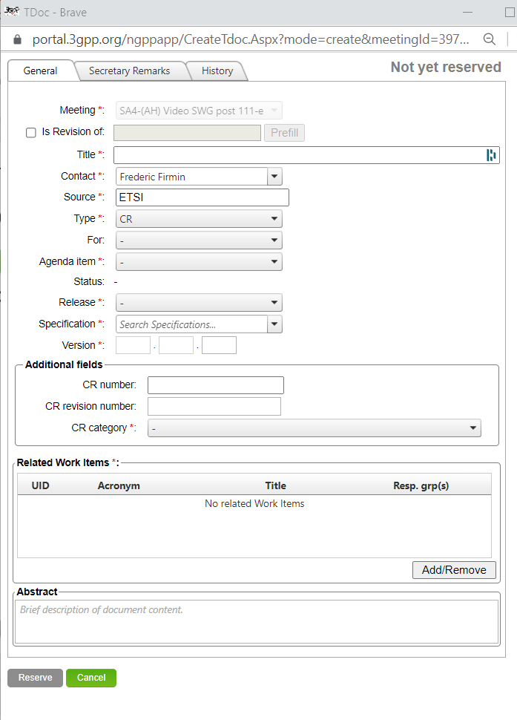
How to request numbers for CR? (ct’d)
Select CR in the Type menu, additional fields will appear
Fill in all mandatory fields (marked with *):
Title, Contact (auto-filled with your EOL account by default), Source, Agenda item, Release and Specification (Version is auto-filled)
Click on Add/Remove to select one or more work items
Click on Reserve
→ don’t forget to reserve numbers for mirror CRs

Slide 26

Filling in a CR cover sheet
The CR cover sheet can be either:
  Downloaded from the 3GPP portal (click on the button upon reservation of tdoc/CR numbers) →RECOMMENDED
  or
  Filled in manually
Guidance can be found at https://www.3gpp.org/specifications/change-requests/85-change-requests-step-by-step and TR 21.900

Slide 27
Filling in a CR cover sheet (continued)
Spec number: do not include “TS” or “TR”.
CR number: 4-digits, prefix with a 0 if needed. (number provided by 3GU)
Revision: use ‘-’ for the first version (number provided by 3GU)
Title:
  Use a descriptive title, which gives a good overview of its topic.
  Do not include redundant wording such as "Change Request to 3GPP TS 21.456 Release 4 version 4.19.0 on XXX“.
  Use the same title on all mirror CRs, even if the text being changed is not quite identical in all cases.

Slide 28
Filling in a CR cover sheet (continued)
Proposed change affects: tick all entities that are affected by the CR.
Source to WG: if CR is submitted to a WG meeting, list individual members that co-signed this CR. If CR is submitted to a TSG meeting directly, leave empty
Source to TSG: if CR is submitted to a WG meeting, put WG’s short code (e.g. R1 for RAN1). If CR is submitted to a TSG meeting, list individual members that co-signed this CR.
Category and Release: pick one from the list.
Date: use format yyyy-mm-dd

Slide 29
Filling in a CR cover sheet (continued)
Reason for change: explain why the change is needed.
Summary of change: summarize the change. No need to enter into much detail.
Consequences if not approved: explain what will happen if the CR is not approved.
Clauses affected: list all clauses that are modified in the CR.
Other comments: any comment that may be useful
This CR's revision history: if the CR is a revision, describe the changes compared to the previous version

Slide 30
Drafting a CR
  Open the specification you wish to modify. Make sure you have the current reference version of the specification for the release you wish to create the CR for.
  Remove the subclauses you DO NOT wish to modify. This leaves the subclauses you do wish to modify. Do not include subclauses that are not modified.
  Paste the CR cover sheet page at the top of the open document.
  Complete the details on the cover sheet.
  Insert some appropriate marker between modified subclauses, e.g. <*** Next change ***>
  Make your modifications with revision marks turned on.
  Save as some appropriate file name for the change request.
DO NOT paste the clauses to be modified into the CR cover sheet. You will lose the style sheet this way.
DO NOT take a CR from one meeting to another just by changing the header and tdoc number. The reference version will have changed as well.
Do NOT assume that the text in a subclause is the same in two different releases. Rebuild mirror CRs for each release from the beginning.

Slide 31


Revision marks
Make sure that revision marks are enabled before doing any changes
When revising a CR:
  using a different user name will make identification of new changes easier
  do not make ‘changes on changes’:
Don’t:
Do:

Slide 32
Additional guidance
You can fix some editorial problems in clauses you modify in your CR, but do not make a full clean-up as part of a technical CR: better split into several CRs.
Make sure that all added text and elements follow the drafting rules
Write the requirements properly (see Requirements slides in the Specifications aspects section)

Slide 33
Styles

Slide 34
Styles: general
Always use the appropriate style for the appropriate construct
Never modify a style
Only use the styles to apply format to the document
Use ‘Normal’ style for main document text

Slide 35
Headings
Use the Heading style appropriate to its level (see next slide).
Separate the number of the heading and the text of the heading with a tab: e.g. 7.4→General
Do not use automatic heading numbering; you may, however, use it as an initial aid when outlining the structure of your document, as long as it is eliminated before handover to the MCC.

Slide 36
Headings (continued)
Avoid hanging paragraphs (see 21.801 clause 5.2.4):
DON’T
5.2.1 XXXXX
Blabla ← hanging paragraph
5.2.1.1 YYYYY
Blablabla
5.2.1.2 ZZZZZZ
Blablablabla
DO
5.2.1 XXXXX
5.2.1.1 General
Blabla
5.2.1.2 YYYYY
Blablabla
5.2.1.3 ZZZZZZ
Blablablabla

Slide 37
Headings styles
Heading 1: Used for Main clauses (1, 2, 3, etc.). Also used for Annex clauses (A.1, A.2, etc.).
Heading 2: Used for Main clauses (4.1, 4.2, 5.1, 5.2, etc.). Also used for Annex clauses (A.1.1, A.1.2, etc.).
Heading 3: Used for 2nd level clauses (4.1.1, 4.1.2, 5.1.1, 5.1.2, etc.). Also used for Annex clauses (A.2.1.1, A.2.1.2, etc.).
Heading 4 & 5: Used for 3rd and 4th level clauses and Annex clauses.
Heading 6 & 7: Not used, instead use style "H6" so that the title appears in the document, but does not appear in the Table of Contents.
Heading 8: Used for Main Annex titles in Specifications (3GPP TS) (e.g. Annex A (normative): ).
Heading 9: Used for Main Annex titles in Reports (3GPP TR) (e.g. Annex A: ).

Slide 38
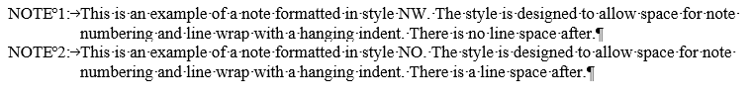
Notes
NO: Used for notes in the text (Allows Tab and Indent). See example below.
NW: Same as NO, but without line space after. Used when there are many notes in sequence.
TAN: Used for notes in tables
(reminder: Notes to tables may contain requirements)

Slide 39
Figures
Figures shall not exceed 17cm in width or 22cm in height.
Figures shall be editable by other users (provide source code to MCC if needed).
Figures shall have a title using format <Figure X: zzz> or <Figure X>.
Numbering of figures may be either global (i.e. numbered sequentially throughout the document), or taking into account the clause numbering.
Use style TH for the figure itself and TF for its title.
→ See clause H.5 for details on tools and formats.

Slide 40
Tables
Max width= 17cm in portrait orientation, 22cm in landscape.
A table within a table is not permitted.
Make sure that rows do not span over several pages.
Heading → use TAH
Left justified → use TAL |  | Centered → use TAC |  | Right justified → use TAR
NOTE: blabla blabla ← use style TAN
Table X.Y: title ← use style TH

Slide 41
References
References in clause 2 shall use style EX.
Specify version or publication date for specific references
Example: ISO/IEC Directives - Part 3 (1997): "Rules for the structure and drafting of International Standards“

Slide 42
General advice
Do not alter any styles or the document format (e.g. tabulation position, paper format, etc.)
Use Word’s “show all formatting marks” to reveal special characters.
Use real tabulations when needed (e.g. between a clause number and its title), do not use multiple spaces.
Use non-breaking spaces (°, achieved by CTRL+shift+space) or hyphens (—, CTRL+underscore) in order to avoid unexpected wrap around between two words and/or numbers.
Examples: 50°cm, clause°6, table°1, figure°1, TR°21°801—1, etc.

Slide 43
General advice (continued)
Use straight quotes ("), not curly or smart ones (“).
Do not use the underline attribute, as this causes confusion when revision marks are used.
Do not put more than one space after a full stop.
Do not precede comma (,), semicolon (;), colon (:), full stop (.), question mark (?) or exclamation mark (!) by spaces.

Slide 44
Configuration of
Microsoft Word

Slide 45
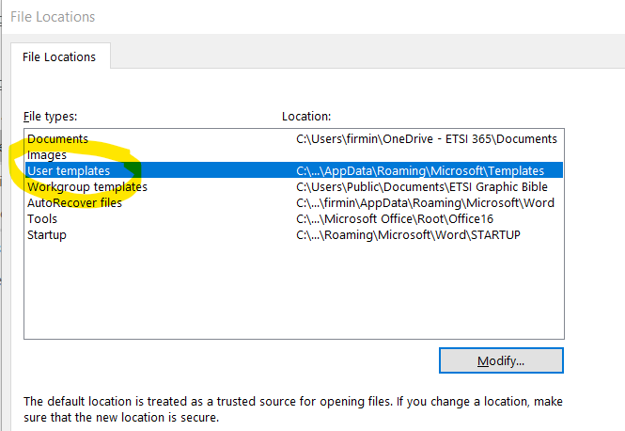
Word templates
Download 3gpp_70.dot from https://www.3gpp.org/ftp/Information/All_Templates
Locate the ‘User templates’ folder under File -> Options -> Advanced -> File Locations
Place 3gpp_70.dot into the ‘User templates’ folder identified above

Slide 46
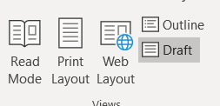
Views
3GPP documents are best viewed in ‘Draft View’
Go to the View menu and click on Draft

Slide 47
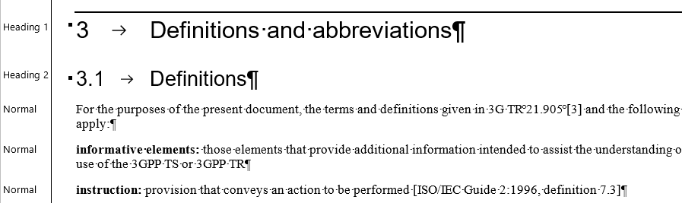
Style area pane (1/2)
When this feature is used, Word reveals styles on the left of the document
NOTE: this feature is available in draft and outline views only

Slide 48
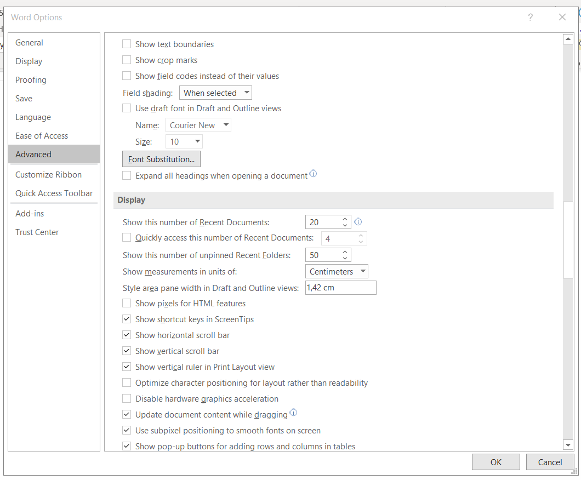
Style area pane (2/2)
To activate the feature:
  go to File -> Options -> Advanced
  set a non-null value to ‘Style area pane width in Draft and Outline views’

Slide 49
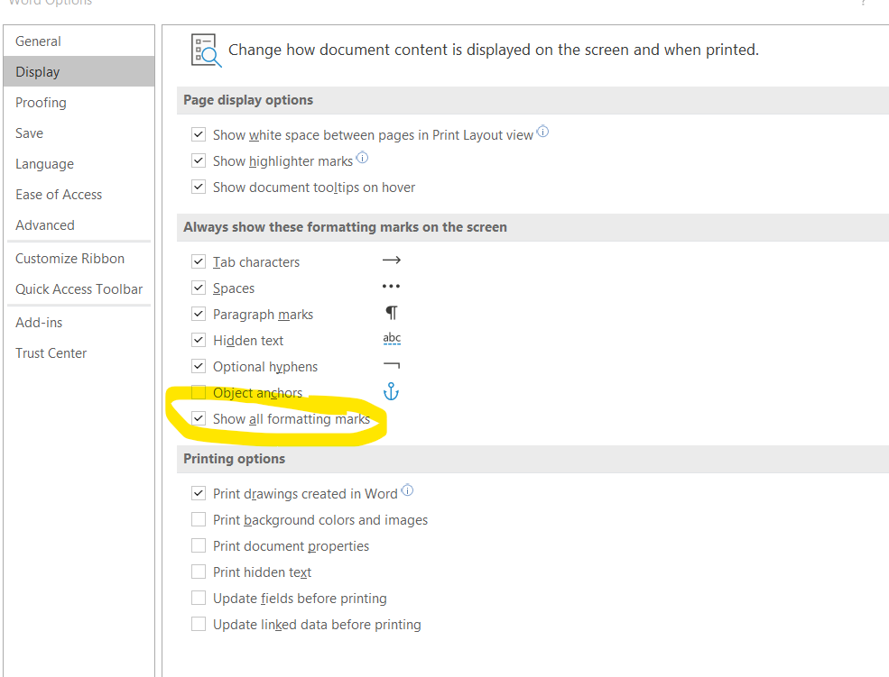
Formatting marks
Go to File → Options → Display and tick ‘Show all formatting marks’

Slide 50
Need help?
The MCC is here to help for any questions or problems you may have during the drafting of a specification or a change request.
Rapporteurs have the possibility to submit their specification to ETSI EditHelp (edithelp@etsi.org). It is recommended to do so before the specification is presented for approval.

Slide 51
Questions?
For more information
contact frederic.firmin@etsi.org

Slide 52
Resources
Drafting rules: TR 21.801 available at https://www.3gpp.org/DynaReport/21801.htm
Working methods: TR 21.900 available at https://www.3gpp.org/DynaReport/21900.htm
All templates available at https://www.3gpp.org/ftp/Information/All_Templates
Credits: parts of this document are based on material by John Meredith (ETSI Seminar) and ETSI’s Guide to Writing World Class Standards.

