Slide 1
Rel-20 SA5 Work Planning SA5#161, Fukuoka, Japan, 19 - 23 May 2025
Zou Lan, 3GPP SA5 Chair, HUAWEI
Thomas Tovinger, 3GPP SA5 Vice-Chair, ERICSSON
Anatoly Andrianov, 3GPP SA5 Vice-Chair, NOKIA

Slide 2
Content
Release 20
3GPP SA background information
3GPP SA5 general information
SA5 time plan
5GA
6G
TU planning

Slide 3
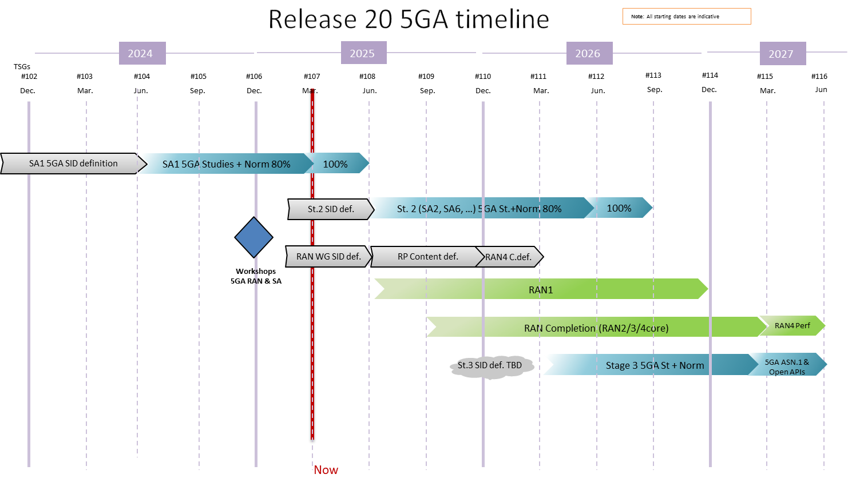
SA#107 information: Rel-20 5GA timeline (ref:SP-250420)

Slide 4
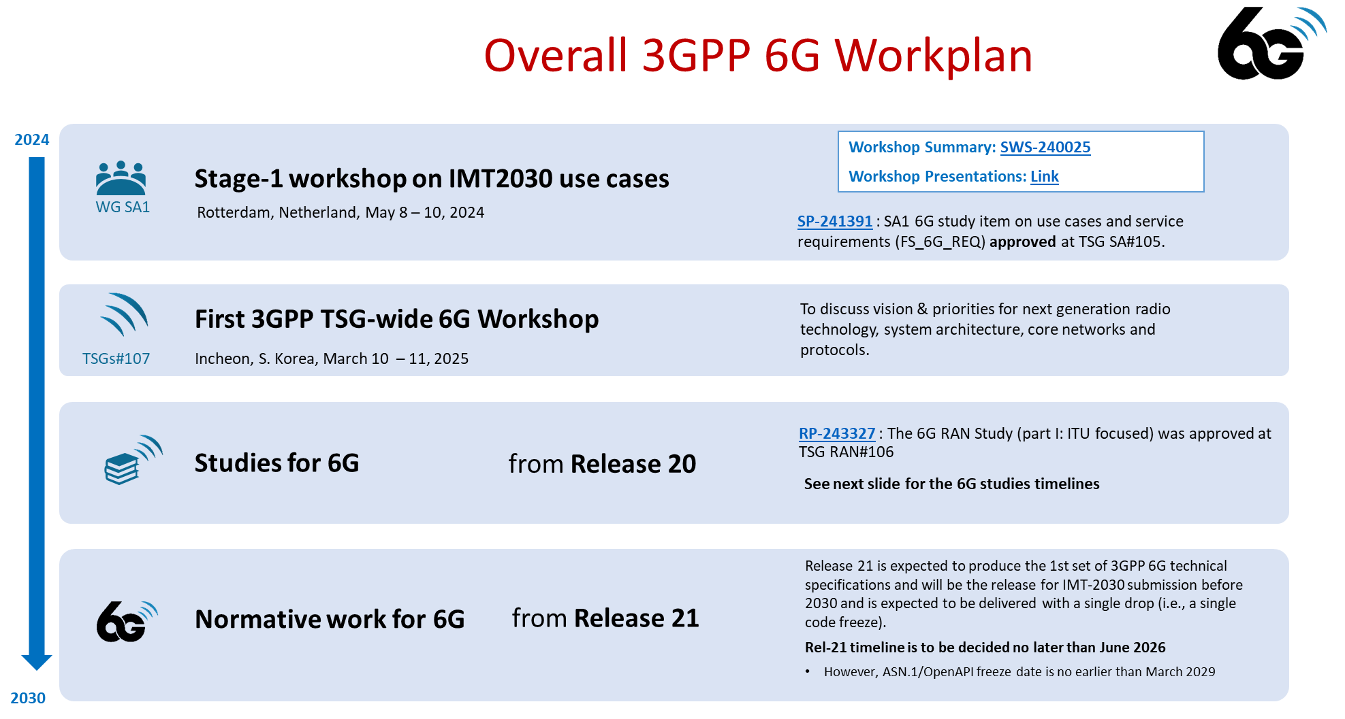
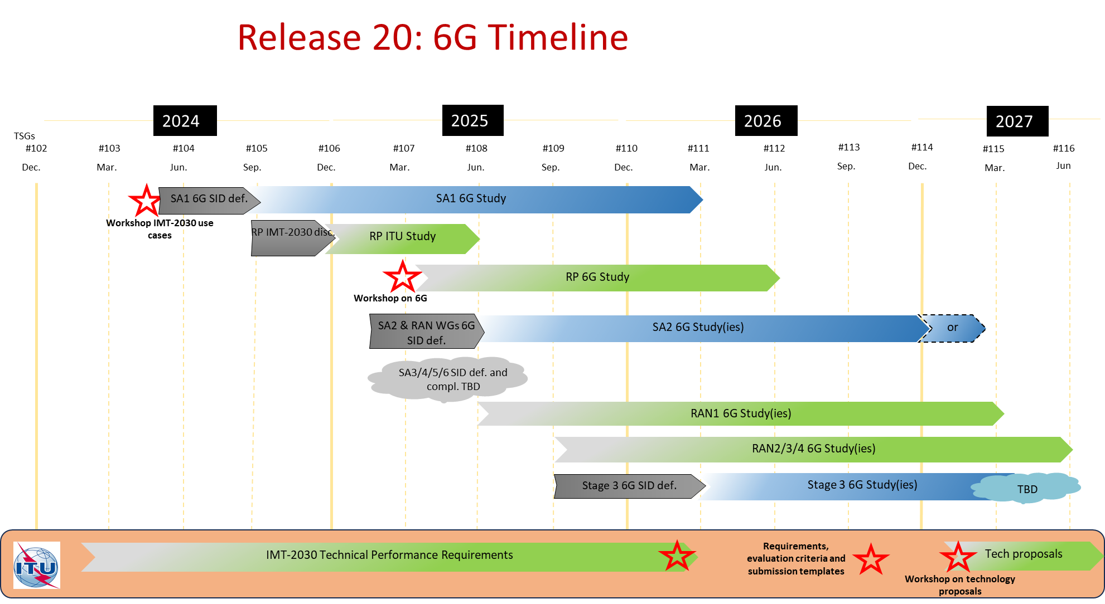
SA#107 information: Overall 6G Workplan

Slide 5
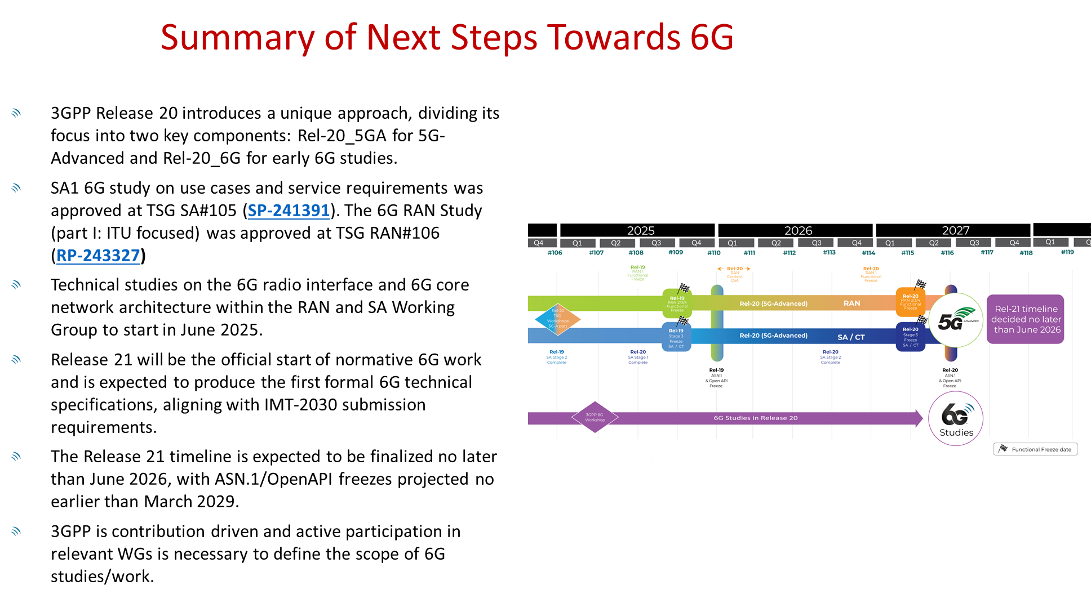
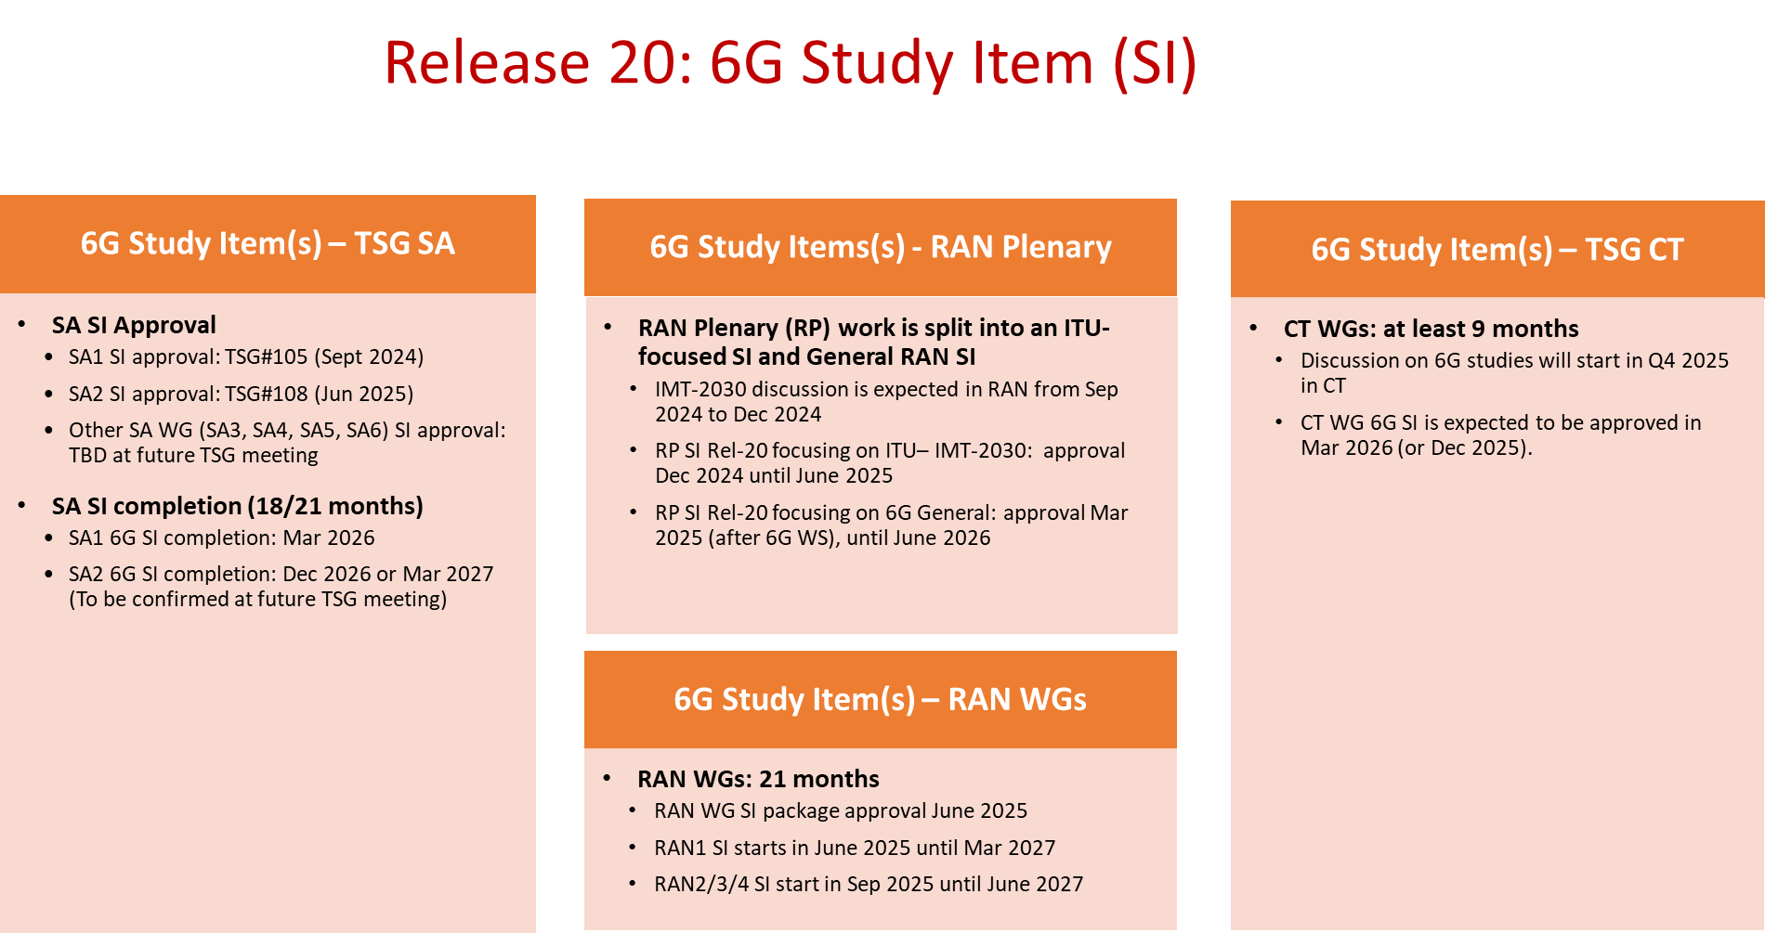
SA#107 information: Overall 6G Workplan

Slide 6
Content
Release 20
3GPP SA background information
3GPP SA5 general information
SA5 time plan
5GA
6G
TU planning

Slide 7
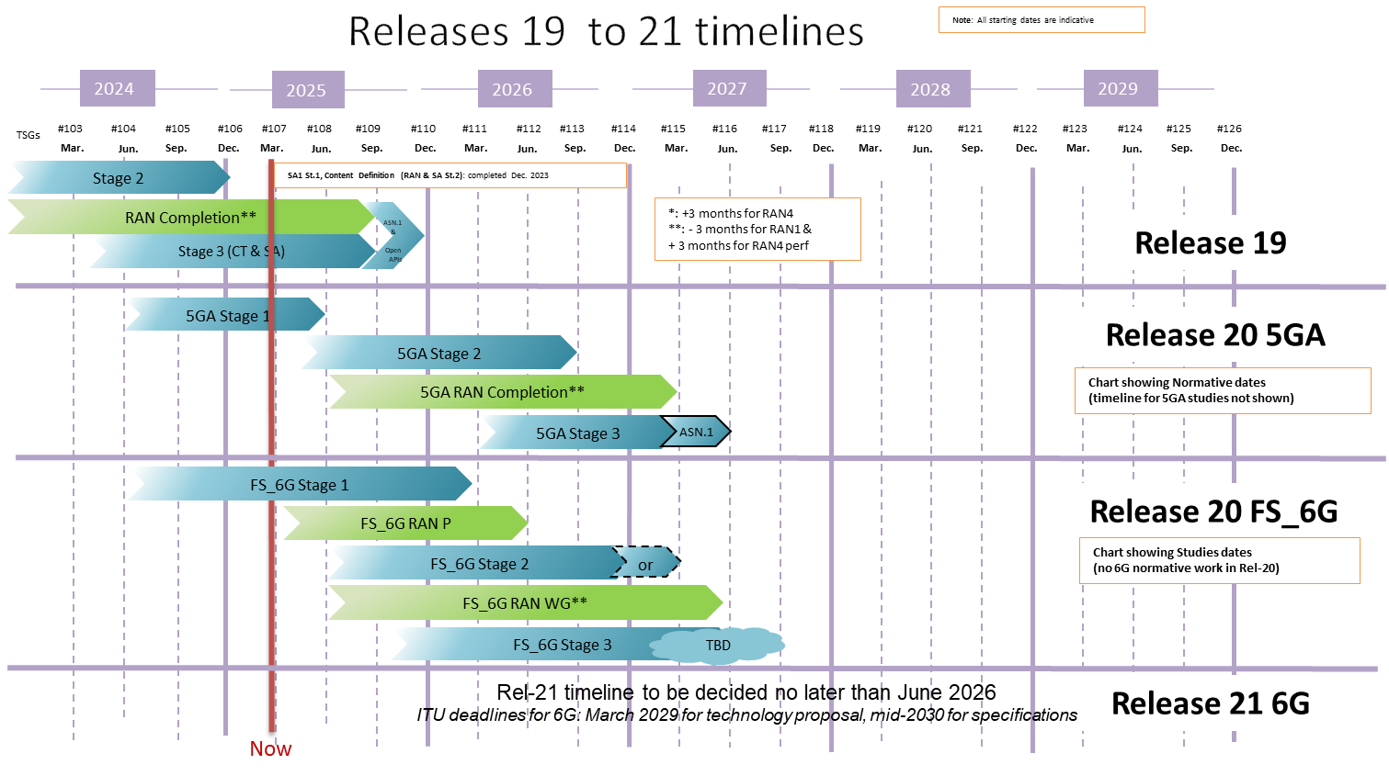
Rel-19~21 timelines with SA5
SA5 Rel-19 5GA study/norm
SA5 Rel-20 5GA study/norm
SA5 6G study(ies)
(updated SA5 based on SP-250420)

Slide 8
Detailed Rel-20 time plan with 5GA/6G
Overall Plan:
Start of Rel-20: Jun.2025 (SA#108/SA5#161)
End of Rel-20: Mar.2027 (SA#115/SA5#171)
5GA Rel-20:
OAM/CH prime feature:
Some WIDs and All Prime SIDs to be agreed no later than May.2025(SA5#161) and target for approval in Jun.2025 (SA#108).
It’s recommended to take max 6~9 months for study phase if normative work is planned for Rel-20.
Start of Rel-20 prime study: right after Jun.2025 (SA#108/SA5#161)
End of Rel-20 prime normative: Dec.2026 (SA#114/SA5#170)
OAM/CH supporting to network feature(SA5 is ready to support network features pending the availability of inputs from other WGs)
All supporting studies/normative WIDs to be agreed no later than May.2026 (SA5#167) and target for approval in Jun.2026 (SA#112).
Start of Rel-20 supporting study (if needed): right after Jun.2026 (SA#112/SA5#167)
End of Rel-20 supporting normative: Mar.2027 (SA#115/SA5#171)
6G SI Rel-20:
Start of Rel-20 study: Sep.2025 (SA#109/SA5#163)
End of Rel-20 study: Mar.2027 (SA#115/SA5#171) (end time may be adjusted according to overall 3GPP time plan)

Slide 9



SA5 Rel-20 Capacity Summary
SA5 capacity :
Max TUs : 124 (OAM) / 80 (Charging)
Additional buffer TUs: 61(OAM)/40(CH)
Max number of SIs/WIs: 10~15 (OAM) / 6~10 (Charging)
Note: one feature made up of SI+WI is counted as one item
Max TUs per Feature: 12~8 TU
Adopt 1:1 on TU allocation portion of 5GA part/6G part in Rel-20
Assumptions
Start: Jun 2025, End: Mar 2027 (21 months)
One track for OAM and One track for Charging
Number of meetings: 10
Expected total TUs per meeting (for all releases)(with Q5 included): 18.5 (OAM) / 12 (Charging)
Total TUs (for all releases): 185 (OAM) / 120 (Charging)
TUs for maintenance of past releases: 35 (OAM) / 20 (Charging)
Note: detailed TU calculation see slides 22~27

Slide 10
Expectation of SA5 rapporteur role
Expectation of SA5 rapporteur role:
Actively contribute and facilitate the progress of the WI/SI, coordinate the discussion within SA5 and with external groups if necessary
Prepare tdoc sequence list and tdoc grouping suggestion before the meeting
Provide inputs to TU planning/TU consumption for each meeting.
Provide timely progress report in NWM before closing plenary with clear highlights for external readers with references to the WID/SID objectives.
Implement any necessary draftCR/draft TR/draft TS and facilitate the email approval of draftCR/draft TR/draft TS
Moderate the breakout sessions/offline calls and provide summary report
Refer to TR 21.900 clause 6.3.2 for Role of the work item rapporteur and 4.1.2 Role of the specification rapporteur
Be familiar with 3GPP drafting rules as specified in TR 21.801.
If you agree with the expectation above, please provide the nomination for the new WIDs/SIDs (one company one email please send the nominee’s name for Rel-20 SID/WID directly to SA5 chair and SA Chair, rather than sharing it on the SA reflector):
Please consider the guidance (bullet 2/3/4/5) provided in Rel-19 Rapporteurship document SP-230746 from SA.
Indicate if the nomination is for the role of Primary Rapporteur.
Indicate if the nomination is for the role of Secondary Rapporteur.
The work responsibility of Primary/Secondary Rapporteurs shall be clearly described if there are proposals for co-rapporteurs.
Note： While operating in Rapporteurs roles, delegates are expected to carry out their assigned duties with impartiality and in the interests of 3GPP, and regular participation to SA5 f2f meeting is a must for commitment to the rapporteur role

Slide 11
Content
Release 20
3GPP SA background information
3GPP SA5 general information
SA5 time plan
5GA
6G
TU planning

Slide 12

Release 20 5GA timeline with SA5
Release 20 5GA timeline
Note: All starting dates are indicative
2024
2025
2026
2027
①
OAM/CH prime feature:
Some WIDs and All prime SIDs to be agreed no later than May.2025(SA5#161) and target for approval in Jun.2025 (SA#108).
It’s recommended to take max 6~9 months for study phase if normative work is planned for Rel-20.
Start of Rel-20 prime study: right after Jun.2025 (SA#108/SA5#161)
End of Rel-20 prime normative:
Dec.2026 (SA#114/SA5#170)
OAM/CH supporting to network feature(SA5 is ready to support network features pending the availability of inputs from other WGs)
All supporting studies/normative WIDs to be agreed no later than May.2026 (SA5#167) and target for approval in Jun.2026 (SA#112).
Start of Rel-20 supporting study (if needed): right after Jun.2026 (SA#112/SA5#167)
End of Rel-20 supporting normative: Mar.2027 (SA#115/SA5#171)
TSGs
#113
#114
#102
#103
#104
#105
#106
#107
#108
#109
#110
#111
#112
#115
#116
Dec.
Mar.
Jun.
Sep.
Dec.
Mar.
Jun.
Sep.
Dec.
Mar.
Jun.
Sep.
Dec.
Mar.
Jun
SA1 5GA SID definition
SA1 5GA Studies + Norm 80%
100%
St.2 SID def.
St. 2 (SA2, SA6, …) 5GA St.+Norm 80%
100%
RAN WG SID def.
RP Content def.
RAN4 C.def.
②
Workshops
5GA RAN & SA
RAN1
RAN Completion (RAN2/3/4core)
RAN4 Perf
St.3 SID def. TBD
Stage 3 5GA St + Norm
5GA ASN.1 & Open APIs
OAM/CH Prime
SID def.
SA5 (5GA OAM/CH Prime) management St.+Norm Stage1/2/3
3GPP SA5
Timeline
Workshops 5GA SA5
①
OAM/CH Supporting
SID def.(if needed)
SA5 (OAM/CH Stage 2/Stage3 supporting) SA&RAN (SA5)
②
Now
(updated SA5 based on SP-250420)

Slide 13
SA5 Rel-20 5GA Content Definition steps
Following SA content definition steps guidance in SP-241738 :
Discussion and Guidance for Rel-20 5GA Scope: The content proposals for SA5 Rel-20 5GA being discussed during the SA5 Rel-20 5GA Workshop in January and February.
The potential topics include a list of prime and supporting topics for SA5 Rel-20 5GA.
Maximum total number of SID/WID for OAM/CH Rel-20 is 15/10 and 1:1 TU allocation portion of 5GA part/6G part in Rel-20 estimates will be taken into account.
Number of 5GA topics for OAM
Maximum 62 TUs available (e.g. max 8 with TU allocation per topic 8 TUs)
46 TUs for OAM Prime, 16 TUs for network supporting based on Rel-19 TU usage experience (consumed TU ratio of prime and supporting are around 3:1)
Number of 5GA topics for CH
Maximum 40 TUs available (e.g. max 5 with TU allocation per topic 8 TUs)
All the topics shall be technically ready before Tuesday 20 May, 2025 (SA5#161) to be in the list for prioritization.
Prioritization is targeted to be done in SA5#161 if needed.
Note1: One feature made up of SI+WI is counted as one item
Note2: Small network support features (mini WIDs) are not counted in the maximum number. One Mini WID will allocate maximum 2 TUs.
Moderated Email Discussions: Moderated Email Discussions to develop SID/WID details corresponding to the Rel-20 5GA topics identified in the prime/supporting feature list. The focus will be on defining technical objectives, work tasks, and estimated budgets for each task. These discussions are planned to start after SA5#159. Further prioritization, if necessary, will be handled in SA5#160/SA5#161 (for the first package) and SA5#166/ SA5#167(for the second package) .
Approval of Selected Rel-20 5GA SID/WID (first package): Companies may submit the SID/WID to SA5#160/#161 for WG agreement. SA5 targets to submit WID/SIs to SA#108 for approval. Ideally, the Rel-20 5GA SID/WID for approval at this step should have no dependencies on Rel-20 work in RAN and SA. SID/WID for approval should follow the guidance on Rapporteurship (see SP-230746). Part of WG capacity will be allocated during the first step approval process.
WG commences Rel-20 5GA SI/WI Work: After the approval of the SID/WID at SA#108, SA5 will start working on the approved SID/WID during Q3 meetings.
Final Approval of Rel-20 5GA SID/WID (second package): This represents the second and final step in the approval process for the Rel-20 5GA content definition. Companies may submit additional SID/WID to SA5#166/#167 for WG agreement. SA5 targets to submit the second package of WID/SIs to SA#112 for approval. The Rel-20 5GA SID/WID for approval at this step should be mainly the network support features to Rel-20 work in RAN and SA. SID/WID for approval should follow the guidance on Rapporteurship (see SP-230746).

Slide 14
SA5 Rel-20 5G-A candidate topics
S.No. | Rel-20 OAM Prime Topics | Rel-20 OAM Support Topics | Rel-20 CH Prime Topics | Rel-20 CH Support Topics
1 | AIML management enhancement | ISAC management->postpone to be discussed in 5GA Rel-20 second package | Charging reliability enhancement (failure handling) | AIML charging
2 | Energy efficiency enhancement | NTN management enhancement | Inter CHF communication continuation | AIoT charging
3 | Intent driven management enhancement | AIoT management | Charging profile enhancement | 5GSAT_Ph4 charging
4 | NDT enhancement | Management and SON for 5G Femto | CCS architecture evolution | 5G Femto + WAB Charging
5 | CCL enhancement | PM/KPI |  | CAPCH
6 | SBMA enhancement | AdNRM |  | EE charging - continuation
7 | Cloud-native management and orchestration | NWDAFM |  | NG_RTC charging –continuation ISAC charging
8 | MDA enhancement | Management of Network Sharing Phase 4
9 | Semantic Network Management -> Potential 6G topic | XR management
10 | Mexpo enhancement | Vehicle Mounted Relays management
11 | MADCOL/Data Management | Management of WAB
12 | Trace/MDT/QoE/SON enhancement
13 | Security Monitoring
The above blue and red highlighted topics have been discussed in SA5#160.
Rel-20 topic NWM reference: https://forge.3gpp.org/rep/sa5/MnS/-/wikis/SA5/Rel-20-Moderated-Topics
See S5-250168 for the consolidated list.
NOTE: A Topic may result in one or more SIDs.

Slide 15
SA5 Rel-20 5G-A candidate topics (NWM Links)
Rel-20 5GA OAM Support topics
Rel-20 5GA OAM Prime topics
No | Topic | Topic Moderator | NWM Link
14 | ISAC management | Bangqiu Ruan (ZTE) | 9054
15 | NWDAFM | Zhen Li (China Telecommunications) | 9049
16 | AdNRM | Sean(Nokia) | 9053
17 | XR management | Xiepengxiang (ZTE) | 9138
18 | PM/KPI | Chenxiumin (China Telecom) | 9139
No | Topic | Topic moderator | NWM Link
1 | AIML management enhancement | Hassan Al-kanani (NEC) yizhi(Intel) | 9047
2 | Energy efficiency enhancement | Srilakshmi (Nokia) | 9027
3 | Intent driven management enhancement | Xu Ruiyue (Huawei), Mark Scott (Ericsson) | 9063
4 | NDT enhancement | Yushuang Hu (CMCC) | 9052
5 | CCL enhancement | Deepanshu Gautam (Samsung) /Stephen(Nokia) | 9040
6 | SBMA enhancement | Kai Zhang (Huawei) | 9037
7 | Cloud-native management and orchestration | Guangjing Cao (CMCC) | 9051
8 | MDA enhancement | Brendan Hassett (Huawei) | 9036
9 | Knowledge-assisted management / Semantics – Based Network Management | Zhaoning Wang (China Unicom) /Deepanshu(Samsung) | 9034
10 | Mexpo enhancement | Winnie Nakimuli (Nokia) | 9044
11 | MADCOL/Data Management | Sreekumar Pothera Kalloor (Nokia) | 9046
12 | Trace/MDT/QoE/SON enhancement | Robert Petersen (Ericsson) | 9029
13 | Security Monitoring | Balazs Lengyel (Ericsson) | 9059
Rel-20 5GA CH Prime topics
No | Topic | Topic Moderator | NWM Link
19 | Charging reliability enhancement (failure handling) | Yimeng Deng (Huawei) | 9057
Rel-20 5GA CH Support topics
No | Topic | Topic Moderator | NWM Link
20 | CAPCH | João Rodrigues (Nokia) | 9062

Slide 16
Content
Release 20
3GPP SA background information
3GPP SA5 general information
SA5 time plan
5GA
6G
TU planning

Slide 17

Release 20 6G timeline with SA5
Release 20 (FS) 6G timeline
Note: All starting dates are indicative
2024
2025
2026
2027
TSGs
#113
#114
#102
#103
#104
#105
#106
#107
#108
#109
#110
#111
#112
#115
#116
Dec.
Mar.
Jun.
Sep.
Dec.
Mar.
Jun.
Sep.
Dec.
Mar.
Jun.
Sep.
Dec.
Mar.
Jun
SA5 6G SI Rel-20:
Start of Rel-20 study: Sep.2025 (SA#109/SA5#163)
End of Rel-20 study: Mar.2027 (SA#115/SA5#171) (end time may be adjusted according to overall 3GPP time plan)
SA1 6G SID def.
SA1 6G Study(ies)
Workshop SA1 on IMT-2030 use cases
RP IMT-2030 disc.
RP ITU Study
RP 6G Study(ies)
Workshop 6G TSGs
SA2 & RAN WGs 6G SID def.
SA2 6G Study(ies)
or
RAN1 6G Study(ies)
RAN2/3/4 6G Study(ies)
SA3/4/5/6 6G SID def. TBD
SA3/4/5/6 6G Study(ies)TBD
Stage 3 6G Study(ies)
CT & St. 3 6G SID def.
TBD
SA5 6G SID def.
SA5 6G Study(ies)
3GPP SA5
Timeline
Workshops 6G SA5
Now
(updated SA5 based on SP-250420)

Slide 18
SA5 Rel-20 6G Content Definition steps
Following SA content definition steps guidance in SP-241738 :
Discussion and Guidance for Rel-20 6G Scope: The content proposals for SA5 Rel-20 6G being discussed during the SA5 Rel-20 6G Workshop in June.
The potential topics should be categorized by prime and supporting topics.
Maximum 62 TUs available for OAM, Maximum 40 TUs available for CH
The study of 6G should start with 1 study item for OAM and 1 study item for CH.
Note: Please contact leadership if your company is interested to moderate the 6G discussion, target to decide the moderators in SA5#161 so that moderator could coordinate 6G discussion after SA5#161.
Moderated Email Discussions: Moderated Email Discussions to develop SID details corresponding to the Rel-20 6G topics identified in the prime/supporting feature list. The focus will be on defining technical objectives, work tasks, and estimated budgets for each task. These discussions are planned to start after SA5#161.
Approval of Selected Rel-20 6G SID: Companies may submit the SID to SA5#162 for WG agreement. SA5 targets to submit SIs to SA#109 for approval. Ideally, the Rel-20 6G SID for approval at this step should have no dependencies on Rel-20 work in RAN and SA. SID for approval should follow the guidance on Rapporteurship (see SP-230746).
WG commences Rel-20 6G SI Work: After the approval of the SID at SA#109, SA5 will start working on the approved SID during Q4 meetings.

Slide 19
Rel-20 6G management features workshop
Scope: 6G related new management features including OAM/CH prime features and management support to new network features.
Workshop#1: Online presentation on potential topics and directions (4 TUs)
Jun 25, 2025 13:00-15:00 UTC
Jun 26, 2025 13:00-15:00 UTC
Agenda
Opening of the workshop
Contributions from 3GPP member companies
Contributions on potential Rel-20 management use cases and requirements, etc.
Up to one contribution per company
Chairman's summary and open discussion
Closing of the workshop
Please feel free to contact Chair if you plan to provide presentation, and it will be helpful to make better planning for this activity.

Slide 20
Summary of SA5 6G work planning
DateTime | Meeting | Work plan
before SA5#161 | NA | Company nomination of 6G study moderators (1 study for OAM, 1 study for Charging)
19~23 May 2025 | SA5#161 f2f meeting | Selection of 6G study moderators (1 study for OAM, 1 study for Charging)
25~26 June 2025 | SA5 6G online workshop | SA5 6G workshop presentation
June~August 2025 | NA | SA5 6G NWM discussion
25~29 August 2025 | SA5#162 f2f meeting | SA5 approval of 6G SIDs
15~19 September 2025 | SA#109 f2f meeting | SA approval of 6G SIDs
October 2025 | SA5#163 f2f meeting | Start of SA5 6G study
Reminders:
Company nomination of 6G study moderators: one company one email please send the nominee’s name for Rel-20 SID directly to SA5 chair and SA Chair, rather than sharing it on the reflector.

Slide 21
Content
Release 20
3GPP SA background information
3GPP SA5 general information
SA5 time plan
5GA
6G
TU planning

Slide 22
SA5 calendar with OAM TU (one track)
Assumption:
Every day = 5 sessions (TUs), total TU in 1 ordinary meeting (exclude closing plenary TUs) = 18.5 TUs
Time | Monday | Tuesday | Wednesday | Thursday | Friday (Closing plenary)
Q0 (8:00~8:55) (If needed) | NA | Breakout (opt.) | Breakout (opt.) | Breakout (opt.) | Closing plenary Start at 8:30am (may change depends on the host restriction)
Q1 (9:00 - 10:30) | Plenary Session#1 (1TU) [Single Stream] | Stream#1 (1TU) | Stream#1 (1TU) | Stream#1 (1TU) | Closing plenary
10:30 - 11:00 | Morning Coffee Break | Morning Coffee Break | Morning Coffee Break | Morning Coffee Break | Morning Coffee Break
Q2 (11:00 - 12:30) | Stream#1 (1TU) | Stream#1 (1TU) | Stream#1 (1TU) | Stream#1 (1TU) | Closing plenary
12:30 - 14:00 | Lunch | Lunch | Lunch | Lunch | Lunch
Q3 (14:00 - 15:30) | Stream#1 (1TU) | Stream#1 (1TU) | Stream#1 (1TU) | Stream#1 (1TU) | Closing plenary
15:30 - 16:00 | Afternoon Coffee Break | Afternoon Coffee Break | Afternoon Coffee Break | Afternoon Coffee Break | Afternoon Coffee Break
Q4 (16:00 - 17:30) | Stream#1 (1TU) | Stream#1 (1TU) | Stream#1 (1TU) | Revision session | Closing plenary
17:30 - 17:40 | Break | Break | Break | Break | Break
Q5 (17:40 – 19:10) | Stream#1 (1TU) | Stream#1 (0.5 TU) Stop around 18:45 Social evening | Stream#1 (1TU) | Revision session

Slide 23
TU Budget for SA5 OAM
Assumptions for SA5 OAM :
6 ordinary meeting per year.
Rel-20 spans 21 months for SA5 (with early start of studies) = 10 meetings
1 Session = 1.5 hour time window
Max 5 sessions per meeting day
1 Stream = 1 TU (Time Unit)
1 TU is time (i.e., 1.5 hours) spent to discuss/handle technical contributions.
Revisions/Drafting/offline conference call are not counted for the TU estimates.
OAM revision sessions normally planned to be in Thursday Q4 and Q5 (initial assump.)
Statistics:
1 parallel (OAM) stream per session => 18.5 TUs per meeting (incl. 2 TUs as buffer) = 185
Assume Maintenance + Buffer = 33% => ~ 61 TU
Resulting total TUs avail. f. SI/WI: 10 meetings x 18.5 sessions = 185 TU minus 61 => 124 TU
With 15 SI/WI => Average 8 TU per SI/WI (0.8/meeting).

Slide 24
SA5 Rel-20 OAM TU planning (Jan.2025~Mar.2027)
Assumptions:
Every meeting day = 5 quarters (= 5 TUs)
Total TUs per meeting = 18.5 TUs
Buffer = 2 TUs
OAM = 16.5 TUs
Maintenance CRs + remaining Rel-19 work (TU allocation will decrease over time )
Rel-21 preparation work (TU allocation will be zero at the beginning and will increase over time )
All remaining time is available for Rel-20 SIDs / WIDs
Total TUs allocated to Rel-20 SIDs / WIDs = 124 TUs
 | Maintenance+R18/R19 | R19 | R20 | R21 preparation | Buffer (revision session)
Jan.2025~Jun.2025: SA5#159~#161 (3 meetings) (5GA OAM/CH Prime SID def.) | 1.5 TU*3 meetings= 4.5 TU (CRs) | 13 TU*3 meetings= 39 TU | 2 TU*3 meetings = 6 TU | NA | 2 TU*3=6 TU
Jun.2025~Sep.2025: SA5#162 (1 meeting) (Rel-19 stage-3 freeze, first meeting for Rel-20 6G OAM/CH SID def.) | 1.5 TU (CRs) | 13 TU | 2 TU | NA | 2 TU
Oct.2025~Dec.2026: SA5#163~#169 (7 meetings) (OAM/CH Prime stage-3 freeze) SA5#165~#167 (3 meetings) (5GA OAM/CH Supporting SID def.) | 2.5 TU*7 meetings= 17.5 TU (CRs) | NA | 14 TU*7 meetings = 98 TU | NA | 2 TU*7=14 TU
Jan. 2027~Mar.2027: SA5#170~#171 (2 meetings) (5GA OAM/CH Supporting stage-3 freeze) (6G study completion) | 1.5 TU*2 meetings = 3 TU (CRs) | NA | 12 TU*2 meetings = 24 TU | 3 TU*2 meetings = 6 TU | 2 TU*2=4 TU
Total=185 TU | 22 TU | 13 TU | 124 TU | 6TU | 20 TU

Slide 25
SA5 calendar with CH TU (one track)
Assumption:
Every day = 5 sessions (TUs), total TU in 1 ordinary meeting (exclude closing plenary and offline TUs) = 12 TUs
Time | Monday | Tuesday | Wednesday | Thursday | Friday (Closing plenary)
Q0 (8:00~8:55) (If needed) |  | Breakout (opt.) | Breakout (opt.) |  | Closing plenary Start at 8:30am (may change depends on the host restriction)
Q1 (9:00 - 10:30) | Plenary Session#1 (1TU) [Single Stream] | Stream#1 (1TU) | Stream#1 (1TU) | Revision session | Closing plenary
10:30 - 11:00 | Morning Coffee Break | Morning Coffee Break | Morning Coffee Break | Morning Coffee Break | Morning Coffee Break
Q2 (11:00 - 12:30) | Stream#1 (1TU) | Stream#1 (1TU) | Stream#1 (1TU) | Revision session | Closing plenary
12:30 - 14:00 | Lunch | Lunch | Lunch | Lunch | Lunch
Q3 (14:00 - 15:30) | Stream#1 (1TU) | Stream#1 (1TU) | Offline session | CH Closing | Closing plenary
15:30 - 16:00 | Afternoon Coffee Break | Afternoon Coffee Break | Afternoon Coffee Break | Afternoon Coffee Break | Afternoon Coffee Break
Q4 (16:00 - 17:30) | Stream#1 (1TU) | Stream#1 (1TU) | Offline session | CH Closing | Closing plenary
17:30 - 17:40 | Break | Break | Break | Break | Break
Q5 (17:40 – 19:10) | Stream#1 (1TU) | Social evening | Offline session (Opt.) | CH Closing(Opt.)

Slide 26
TU Budget for SA5 CH
Assumptions for SA5 CH :
6 ordinary meeting per year.
Rel-20 spans 21 months for SA5 (with early start of studies) = 10 meetings
1 Session = 1.5 hour time window
Max 5 sessions per meeting day
1 Stream = 1 TU (Time Unit)
1 TU is time (i.e., 1.5 hours) spent to discuss/handle technical contributions.
Revisions/Drafting/offline conference call are not counted for the TU estimates.
CH revision sessions normally planned to be in Thursday Q1 and Q2 (initial assump.),CH closing plenary planned to be in Thursday Q3 and Q4.
Detail statistics:
1 (CH) stream per session => 12 TUs per meeting (incl. 2 TUs as buffer) = 120
Assume Maintenance + Buffer = 33% as in SA2 => ~ 40 TU
Resulting total TUs avail. f. SI/WI: 10 meetings x 10 sessions = 120 TU minus 40 => 80 TU
With 10 SI/WI => Average 8 TU per SI/WI (0.8/meeting).
Note: TU capacity for CH could be extended if more topics are proposed.

Slide 27
SA5 Rel-20 CH TU planning (Jan.2025~Mar.2027)
Assumptions:
Every meeting day = 5 quarters (= 5 TUs)
Total TUs per meeting = 12 TUs
Buffer = 2 TUs
CH = 10 TUs
Maintenance CRs + remaining Rel-19 work (TU allocation will decrease over time )
Rel-21 preparation work (TU allocation will be zero at the beginning and will increase over time )
All remaining time is available for Rel-20 SIDs / WIDs
Total TUs allocated to Rel-20 SIDs / WIDs = 80 TUs
 | Maintenance+R18/R19 | R19 | R20 | R21 preparation | Buffer (revision session)
Jan.2025~Jun.2025: SA5#159~#161 (3 meetings) (5GA OAM/CH Prime SID def.) | 1.5 TU*3 meetings= 4.5 TU (CRs) | 7.5 TU*3 meetings= 22.5 TU | 1 TU*3 meetings = 3 TU | NA | 2 TU*3=6 TU
Jun.2025~Sep.2025: SA5#162 (1 meeting) (Rel-19 stage-3 freeze, first meeting for Rel-20 6G OAM/CH SID def.) | 1.5 TU (CRs) | 6.5 TU | 2 TU | NA | 2 TU
Oct.2025~Dec.2026: SA5#163~#169 (7 meetings) (OAM/CH Prime stage-3 freeze) SA5#165~#167 (3 meetings) (5GA OAM/CH Supporting SID def.) | 1.5 TU*2 meetings+ 1 TU*5 meetings = 8 TU (CRs) | NA | 8.5 TU*2 meetings + 9 TU *5 meetings = 62 TU | NA | 2 TU*2=4 TU
Jan. 2027~Mar.2027: SA5#170~#171 (2 meetings) (5GA OAM/CH Supporting stage-3 freeze) (6G study completion) | 1 TU*2 meetings = 2 TU (CRs) | NA | 8 TU*2 meetings = 16 TU | 1 TU*2 meetings = 2 TU | 2 TU*2=4 TU
Total=120 TU | 11.5 TU | 6.5 TU | 80 TU | 2 TU | 20 TU

Slide 28
Thank you!

Slide 29
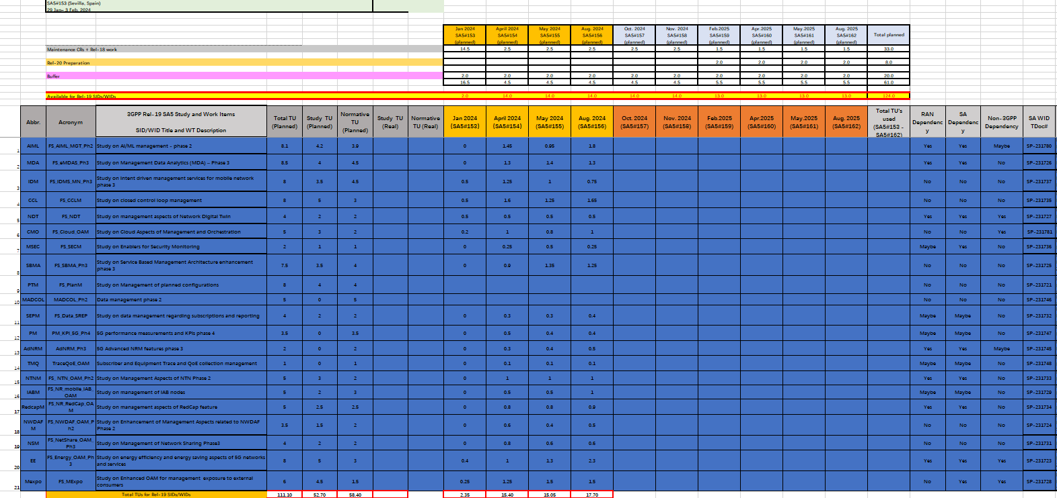
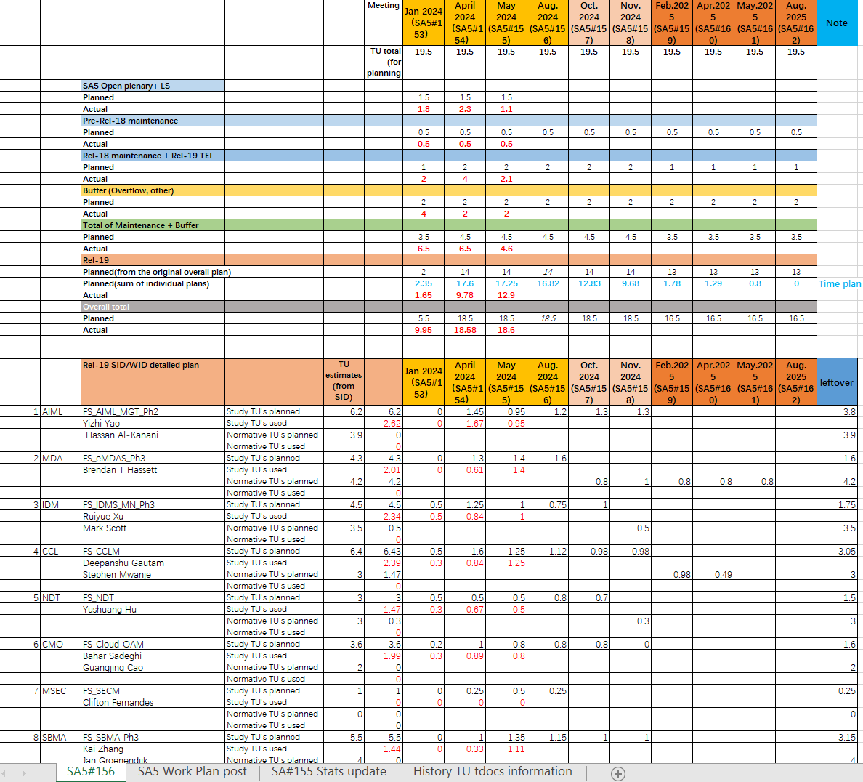
Sample of OAM TU planning and statistics
TU planning: to be proposed by rapporteurs and agreed by the group
TU statistics: to be filled by chair based on the time consumed after each meeting
This is an example to illustrate TU planning and statistics

