Slide 1
User Guide - Using Forge in SA5 (updated for SA5 #154)
Nokia, Nokia Shanghai Bell
(Revision of S5-235736)

Slide 2

Background/Problem
High level steps for CR Authors
A simple guide of Forge usage with screenshot for newcomers:
Basic Forge environment
Forge environment: tools provided
Basic operations
Pinpoint the cause of validation failure
Create branches
Create merge request
Web IDE for editing, reviewing changes, commit change set
Generating word CR (code change part) automatically with a Draft merge request
Advanced user tips
Rebase with command line
Merge with conflictions
Common Q&A

Slide 3
High level steps for CR author
Create the CR branch from release branch or meeting integration branch, whichever includes the latest stage 3 (Refer to: create a branch)
Create draft MR towards integration branch (Refer to: create a Merge Request)
Add stage 3 changes to CR branch, check validation status (Refer to: web IDE Editor)
Resolve the validation issue(s) if there is any (Refer to: Pinpoint the cause of validation failure)
Download the "Word CR text: artifact" and (Refer to: high level step 5)
Copy MR link and commit code to CR cover page
Copy-paste change-marked stage 3 clause into the Word CR
If CR updates (e.g., new revisions) are needed, repeat steps 3-5
Set MR to final (Mark as Ready) when CR is agreed in SA5 meeting (Refer to: create a Merge Request)

Slide 4
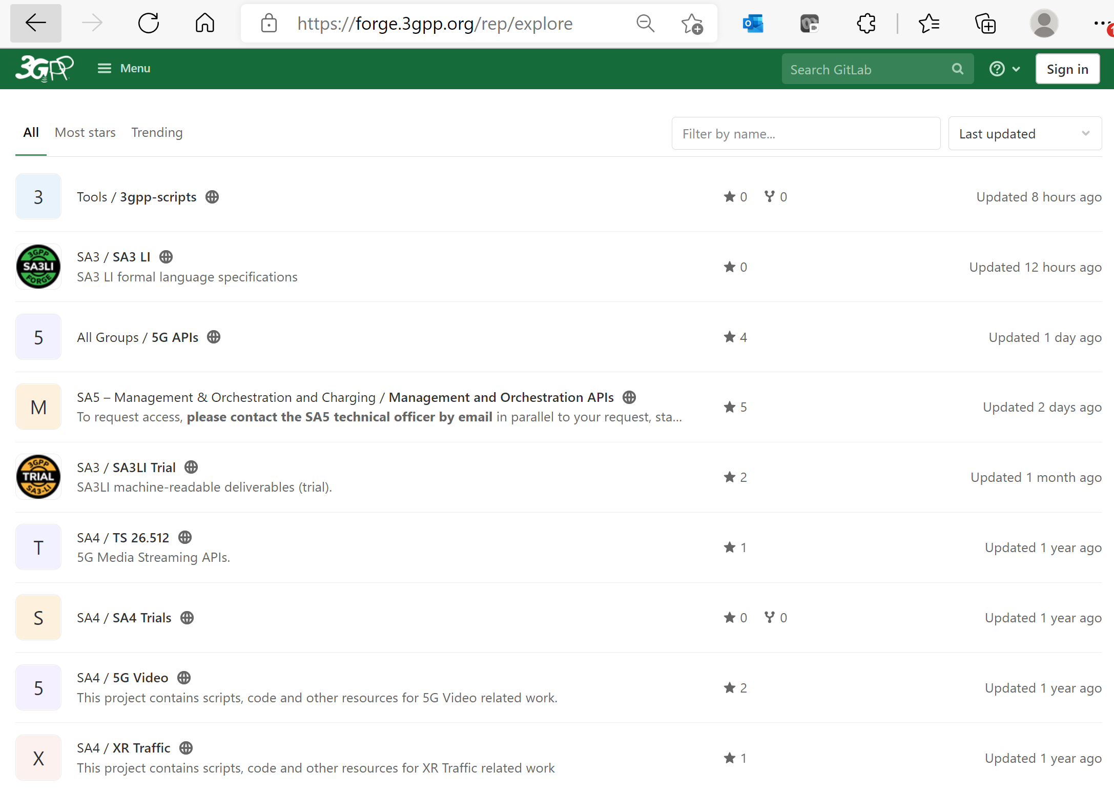
Basic Forge environment: to find SA5 Repo
Common validation scripts used in SA5
Forge is built with GitLab Enterprise Edition.
Using forge requires understanding of basic knowledge of git. More material could be found here:
Git (git-scm.com) or
Index · User · Help · GitLab (3gpp.org)
CT repository: also including SA5 OpenAPI
SA5 Repository

Slide 5
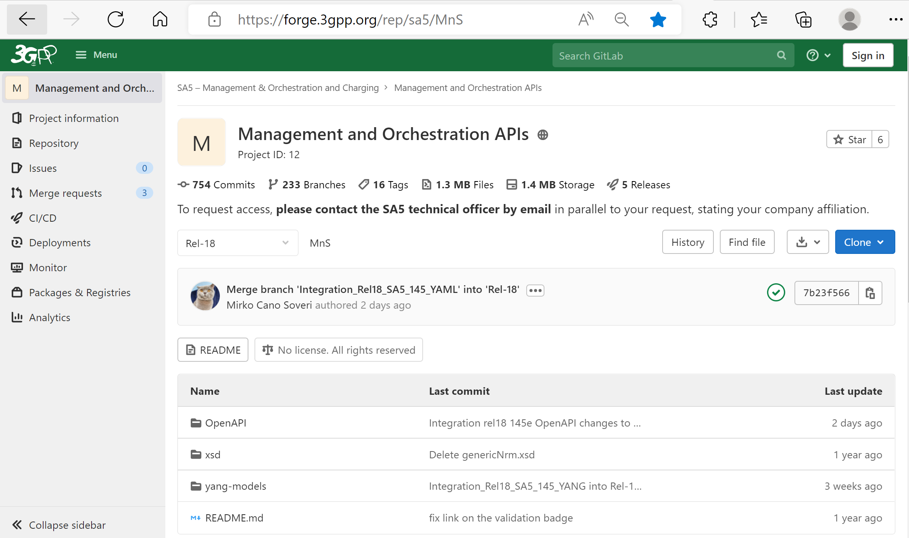
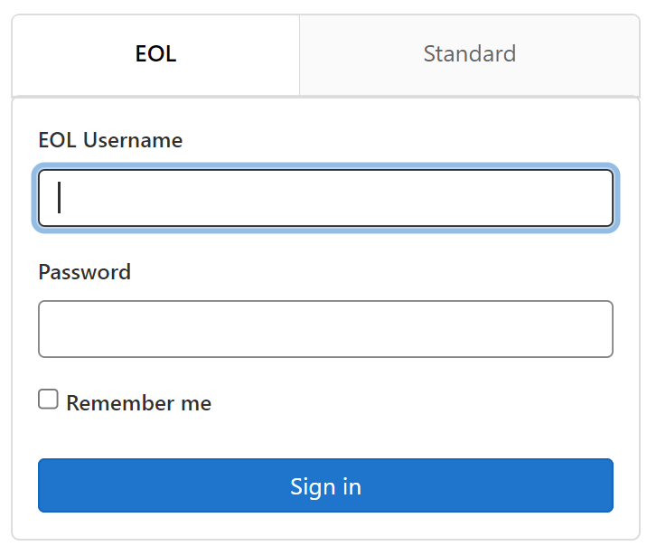
Forge: main entry and login
updated for 154
Direct Link to SA5 repository start page: https://forge.3gpp.org/rep/sa5/MnS
After login, first to select your branch or create a CR branch, then code change can be done by opening the stage 3 code file directly or using the Web IDE tool.
Note: if you do not have the write access (e.g., can not see the new branch button), send email to MCC to apply the access. (Credential is the same as that for 3GPP portal.)
Without login, you will have read only permission.

Slide 6
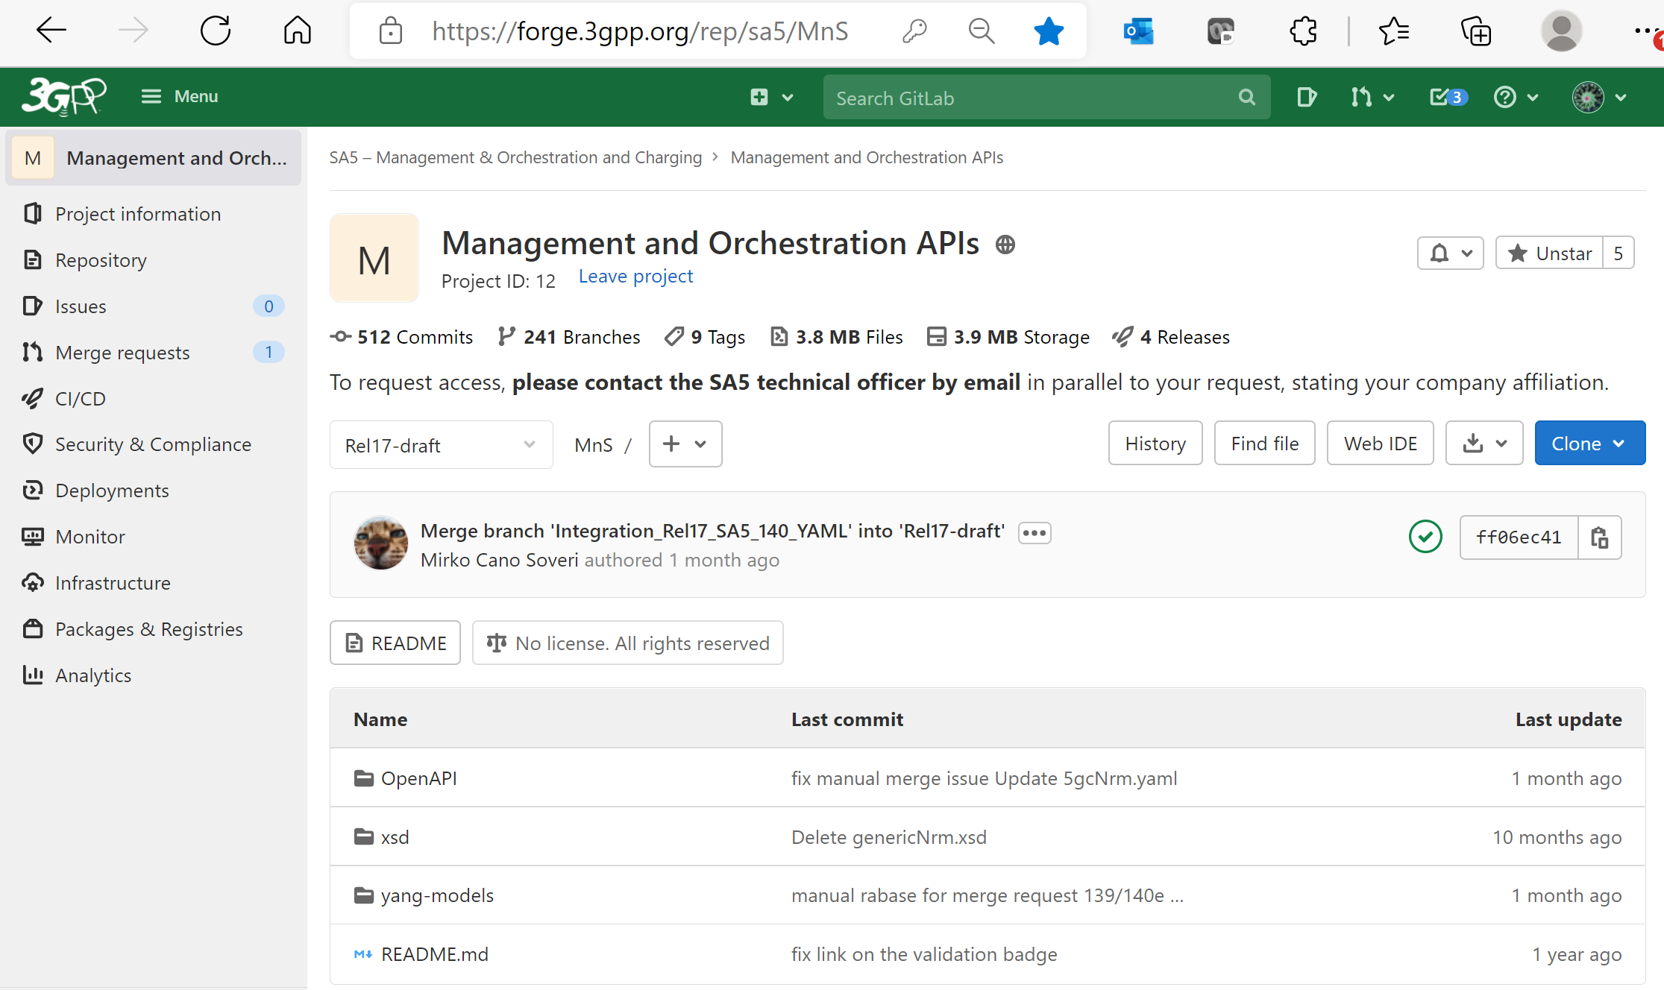
Basic Forge environment for SA5
“Repository” is to find branches/commits
The “Web IDE” is very powerful tool for code changes/review, commit
“+” is to add new file/create branches
“History” is to find commit history
Indicates which branch is, you could select branch/tag to switch between branches/tag
Green V indicating validation is successful.
OpenAPI Solution set
YANG Solution set

Slide 7
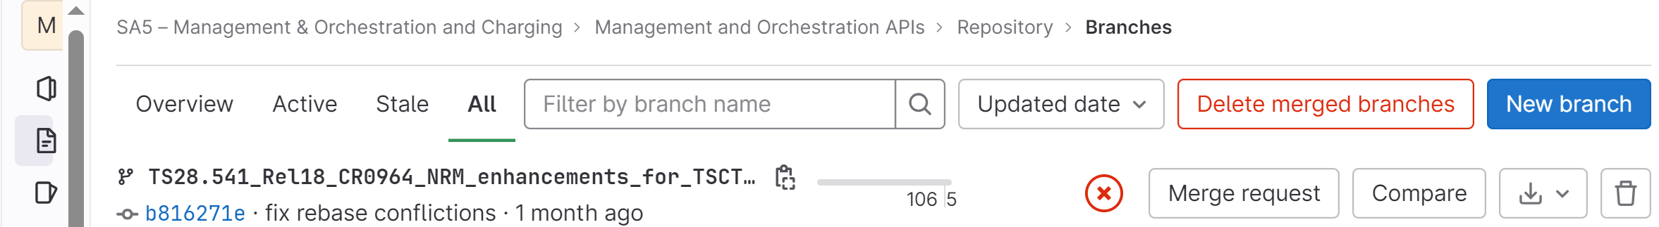
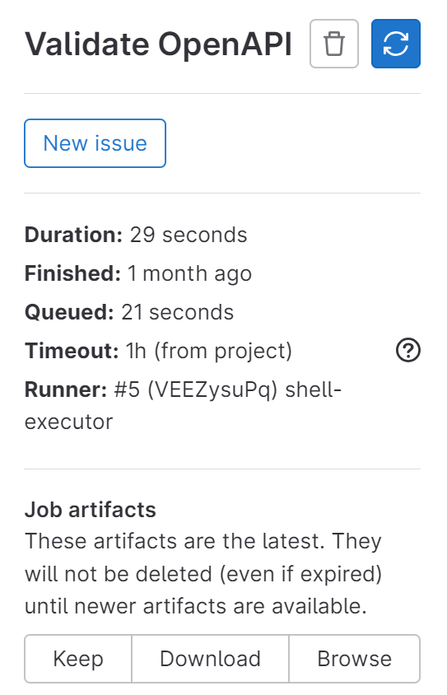
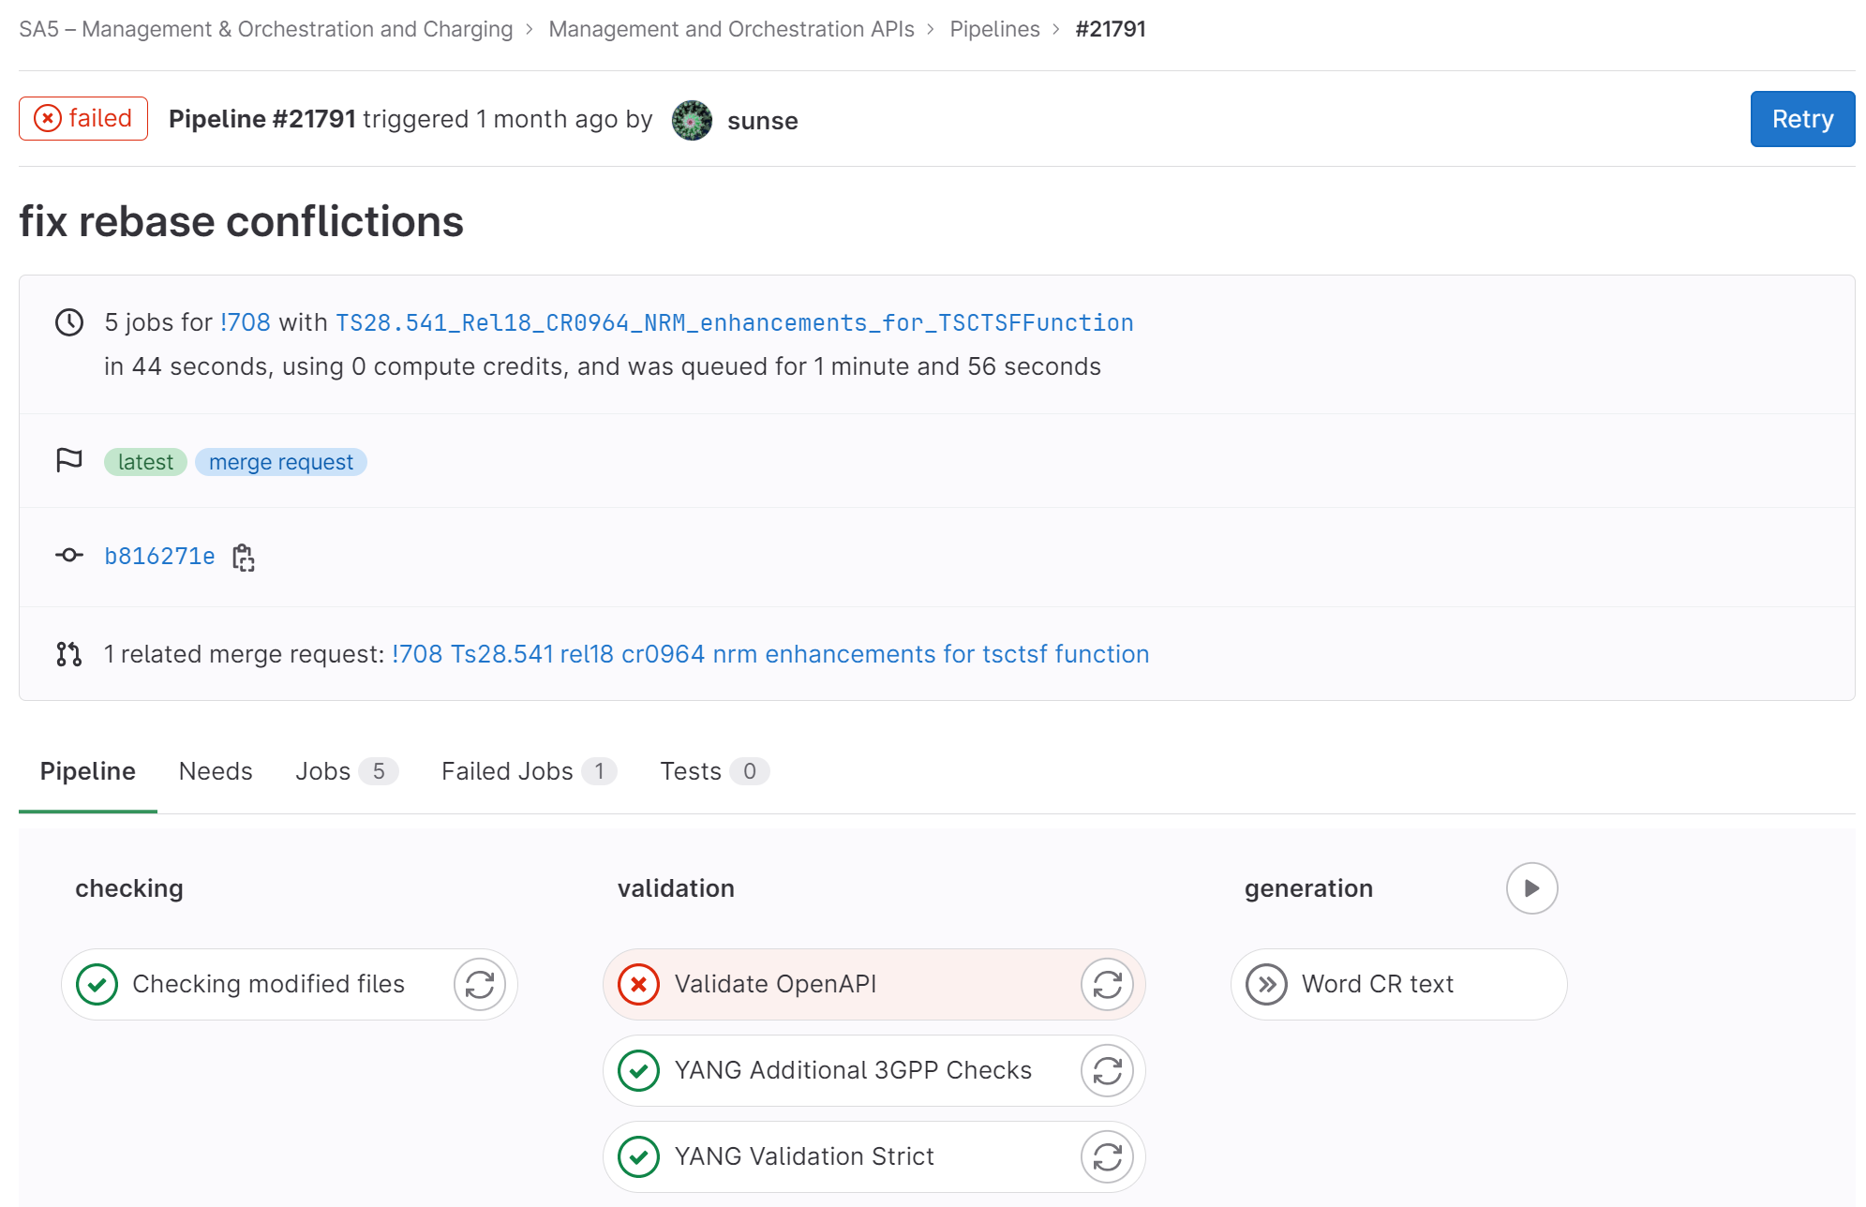
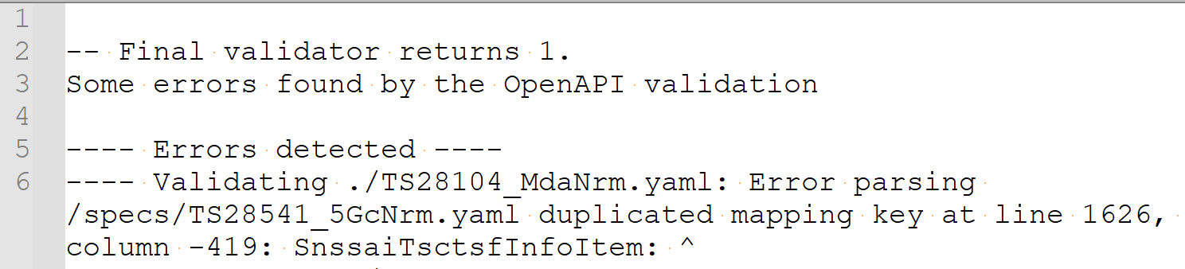
Basic Forge environment for SA5: pinpoint the cause of a validation failure
Step 1: open the failed pipeline
Step 2: locate the validation failure of related solution set
Step 3: download the failure log
Step 4: pinpoint the cause(s) of error(s) and fix it accordingly

Slide 8
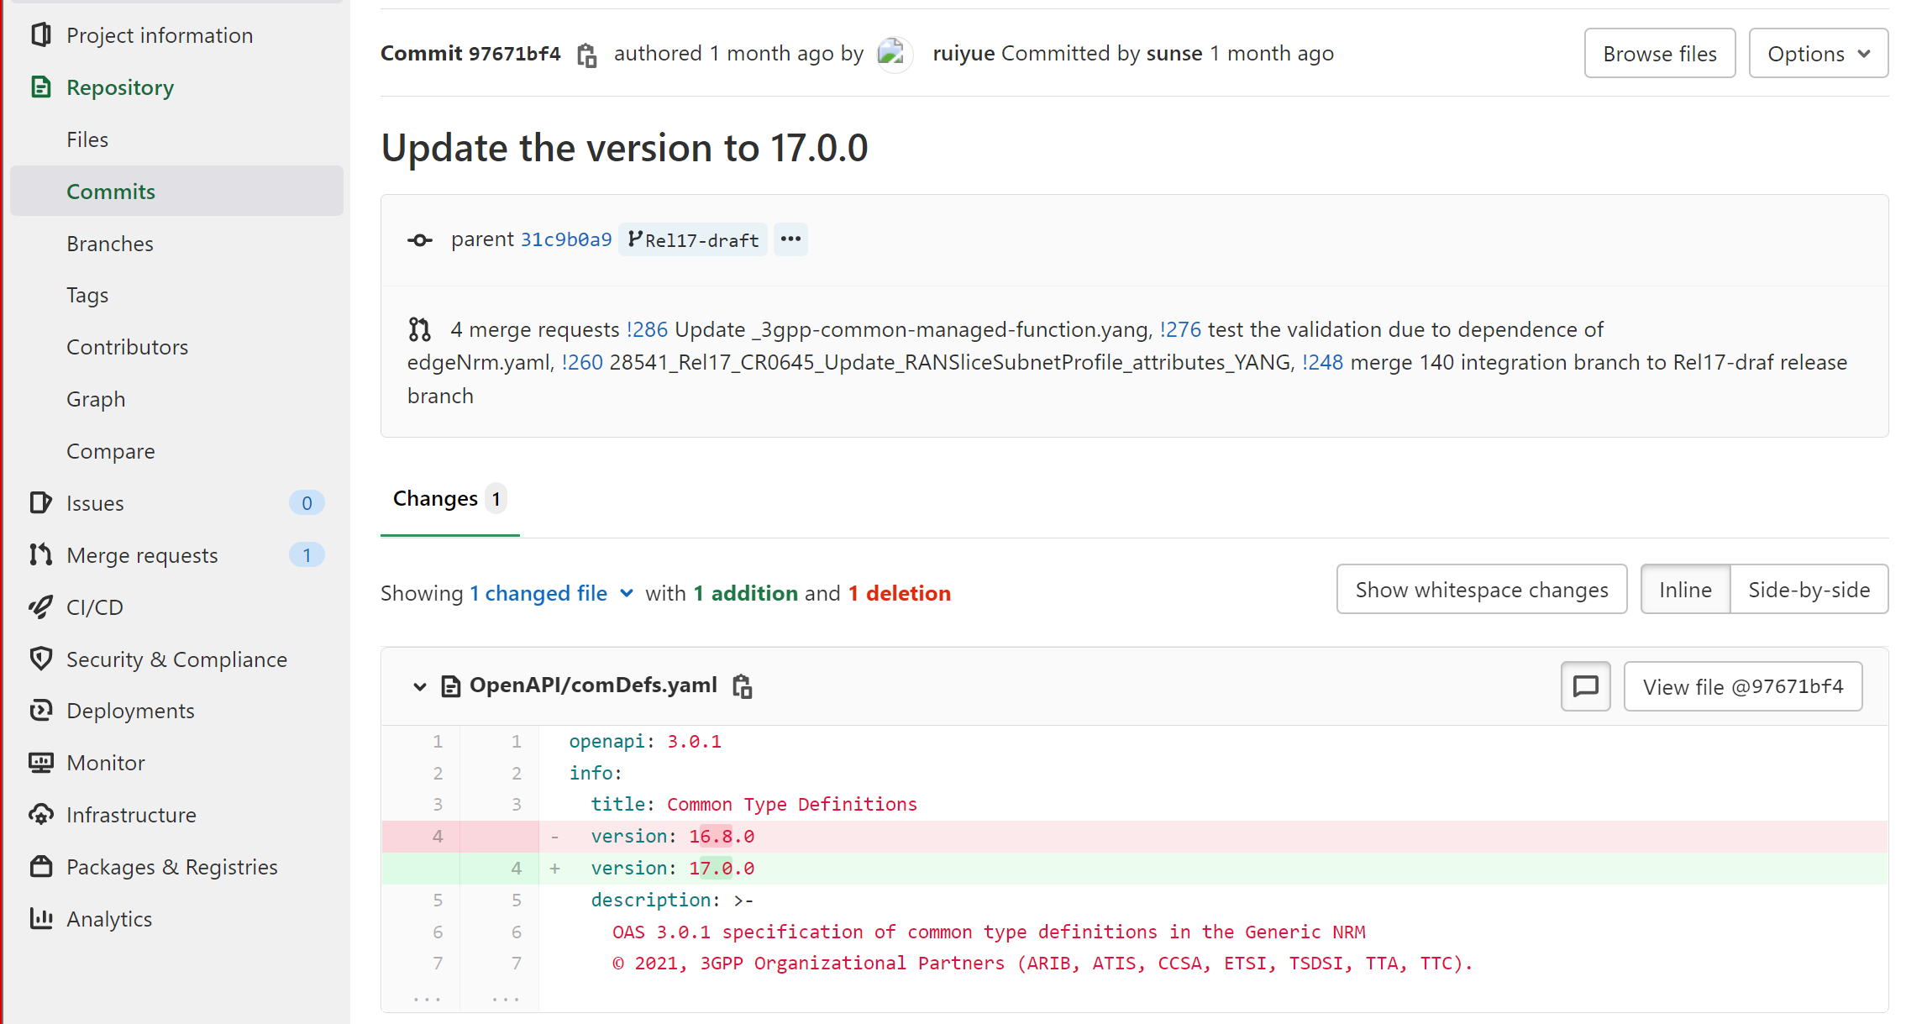
Basic Forge environment for commit
What service provided by Forge: check details of commit
target branch
Change details: line by line
Summary of total changes in this commit

Slide 9
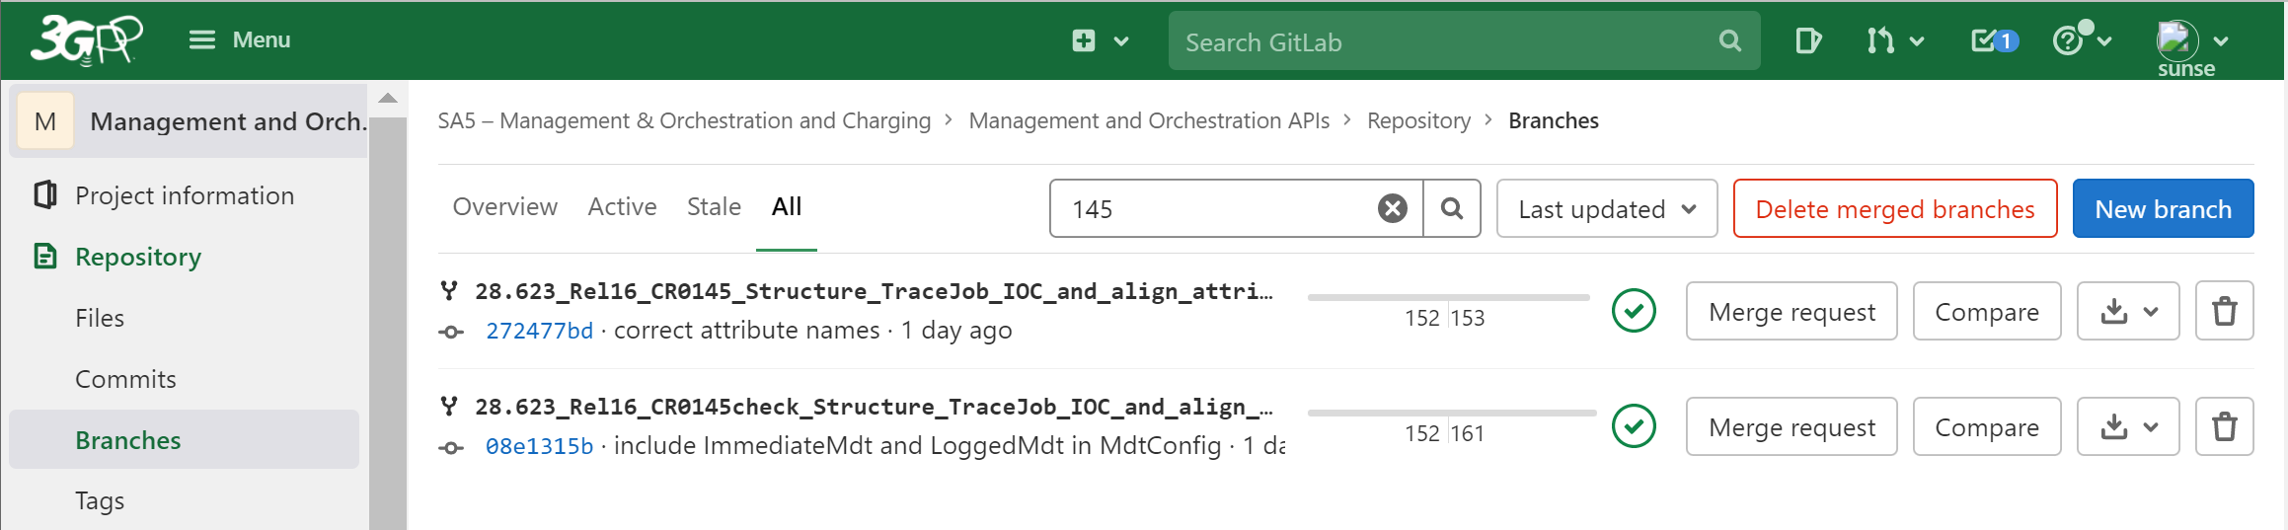
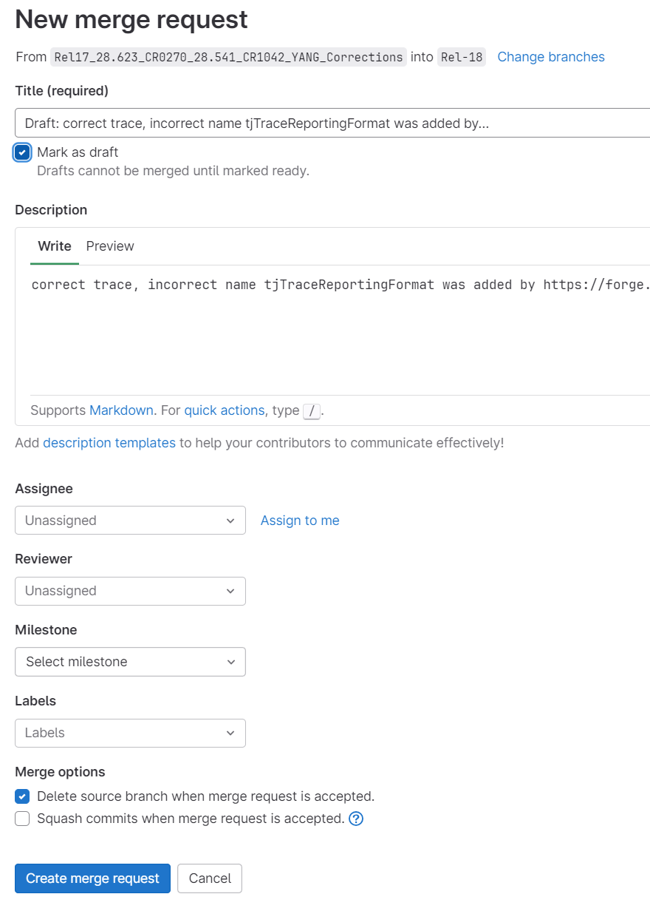
Forge: creating Merge request
Step 1: Find you Branch and Click Merge Request button
Step 2: Update target Branch (if not correct): normally target branch should be an integration branch: e.g. Integration_Rel18_SA5_150_YAML
Step 3: MR title shall include:
TS number,
Release number,
CR number,
CR summary (CR key words, CR title, etc.)
By default, it will use the last commit comments.
Step 4: should mark the MR as “Draft”
Step 5: click "create merge request", then you are done

Slide 10
Forge workflow with meeting timeline
updated for 154
Branch handling: what action needed and at when (for details to check working procedure)
Meeting Timeline
SA5 base branch, Normally release branch (i.e., Rel-18)
Base release branch with e.g., SA5#150 meeting approved contents
CR author is recommended to reserve the tDoc before creating MR
CR author to create CR development branch from latest release branch (Or meeting specific Integration branch) anytime.
150 CR1 branch
150 CR2 branch
150 CRn branch
CR author should create a draft merge request (Note: with CR number in MR title*)
SA5 meeting done
CR author to mark Merge request as ready (from draft): once agreed at SA5 level
Code Moderator handle merger request: validation passed,
Update the merge request from draft to ready.
150 integration branch
Integration_Rel18_SA5_150_YAML
SA Plenary meeting done
Code moderator to initiate the Merge request (after SA meeting)
Code Master (MCC) address merge request to release branch
Code moderator or Code Master creates tag after SA meeting
SA5 release branch (i.e., Rel-18)
* If the tDoc reservation is done post creating MR, the MR title shall be updated to include the CR number.

Slide 11
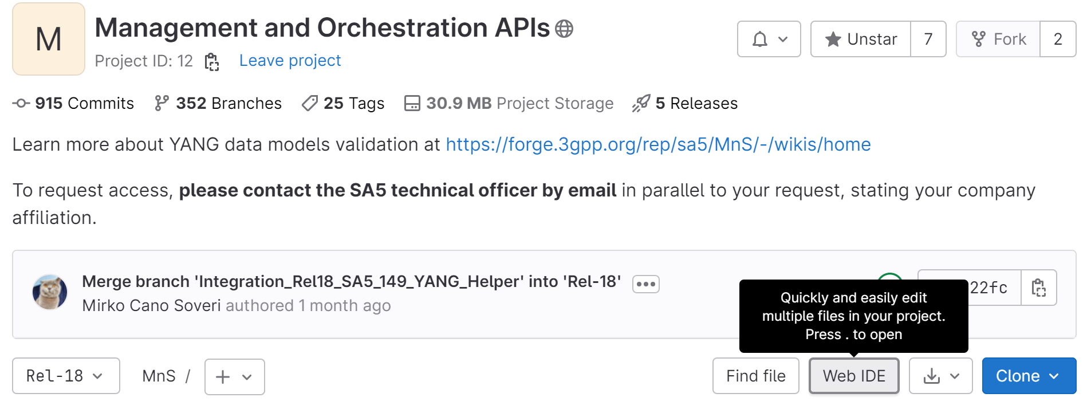
Forge: Web IDE editor overview
You can use the Web Editor to make changes to a single file directly from the GitLab UI. To make changes to multiple files, see Web IDE.
In the Web Editor, you can:
Create a file
Edit a file
Upload a file
Create a directory
Create a branch
Create a tag
Switch Branch
Commit changes
Create Merge request
And more: Web IDE | GitLab
Click “web IDE” button to active Web IDE

Slide 12
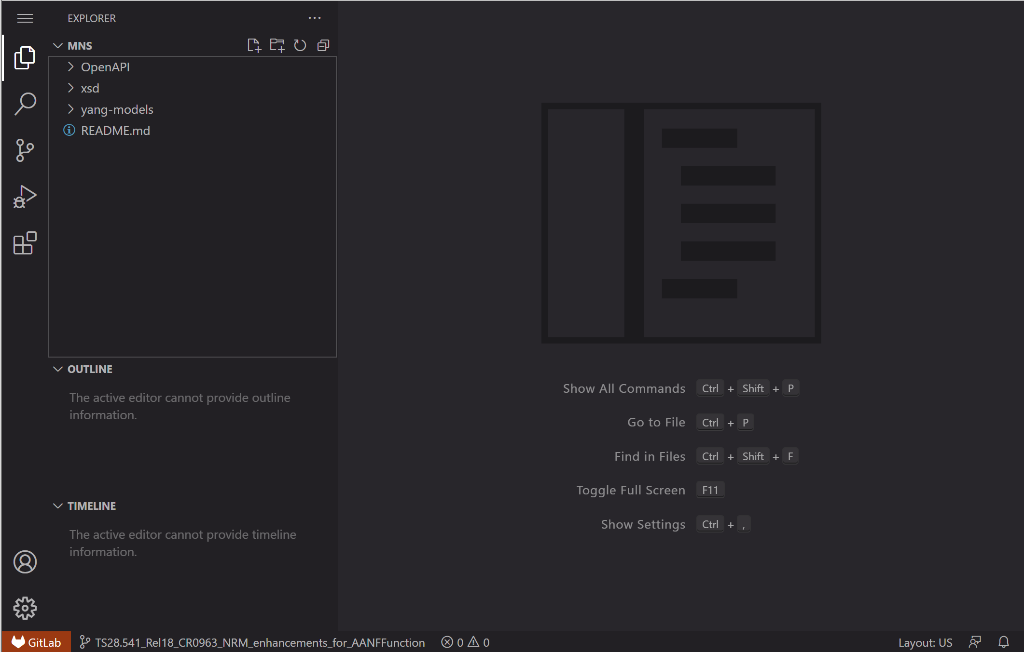
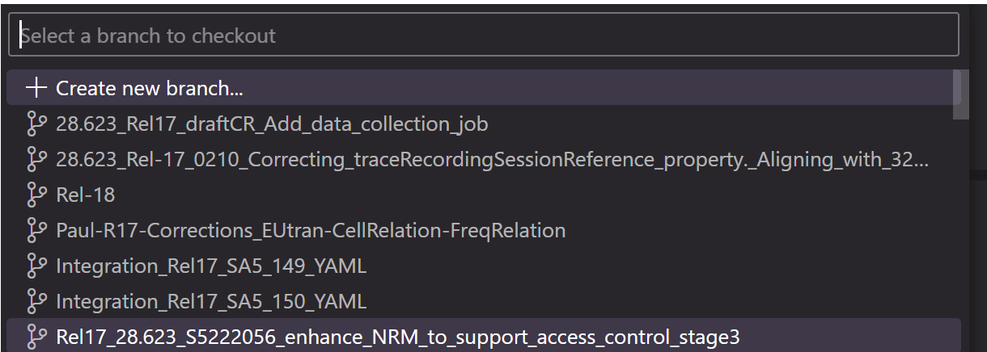
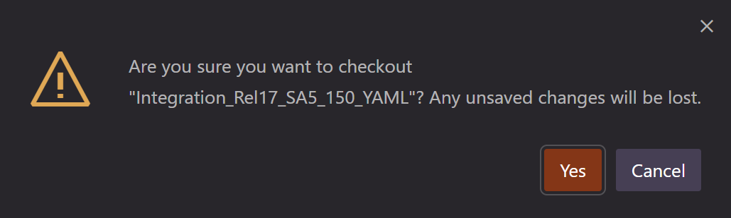
Forge: Web IDE editor: switching branches
updated for 154
switch from current working branch to another branch (existing or a new branch)
There two buttons are used to add new file(s) or folders.
New folder is only for new SS. New file is for new SS file (e.g., a new OpenAPI Yaml file)
Step2: In new pop-up window, to:
> Select “+ Create new branch” to create a new branch, or
> Input the target branch name (part of the name or full branch name) you would like to switch to
Step3: Click “yes” to checkout the target branch (to make it editable). Just to make sure you have saved (committed) the changes in the current branch.
Step1: Click current branch name to switch to another branch or create a new branch

Slide 13
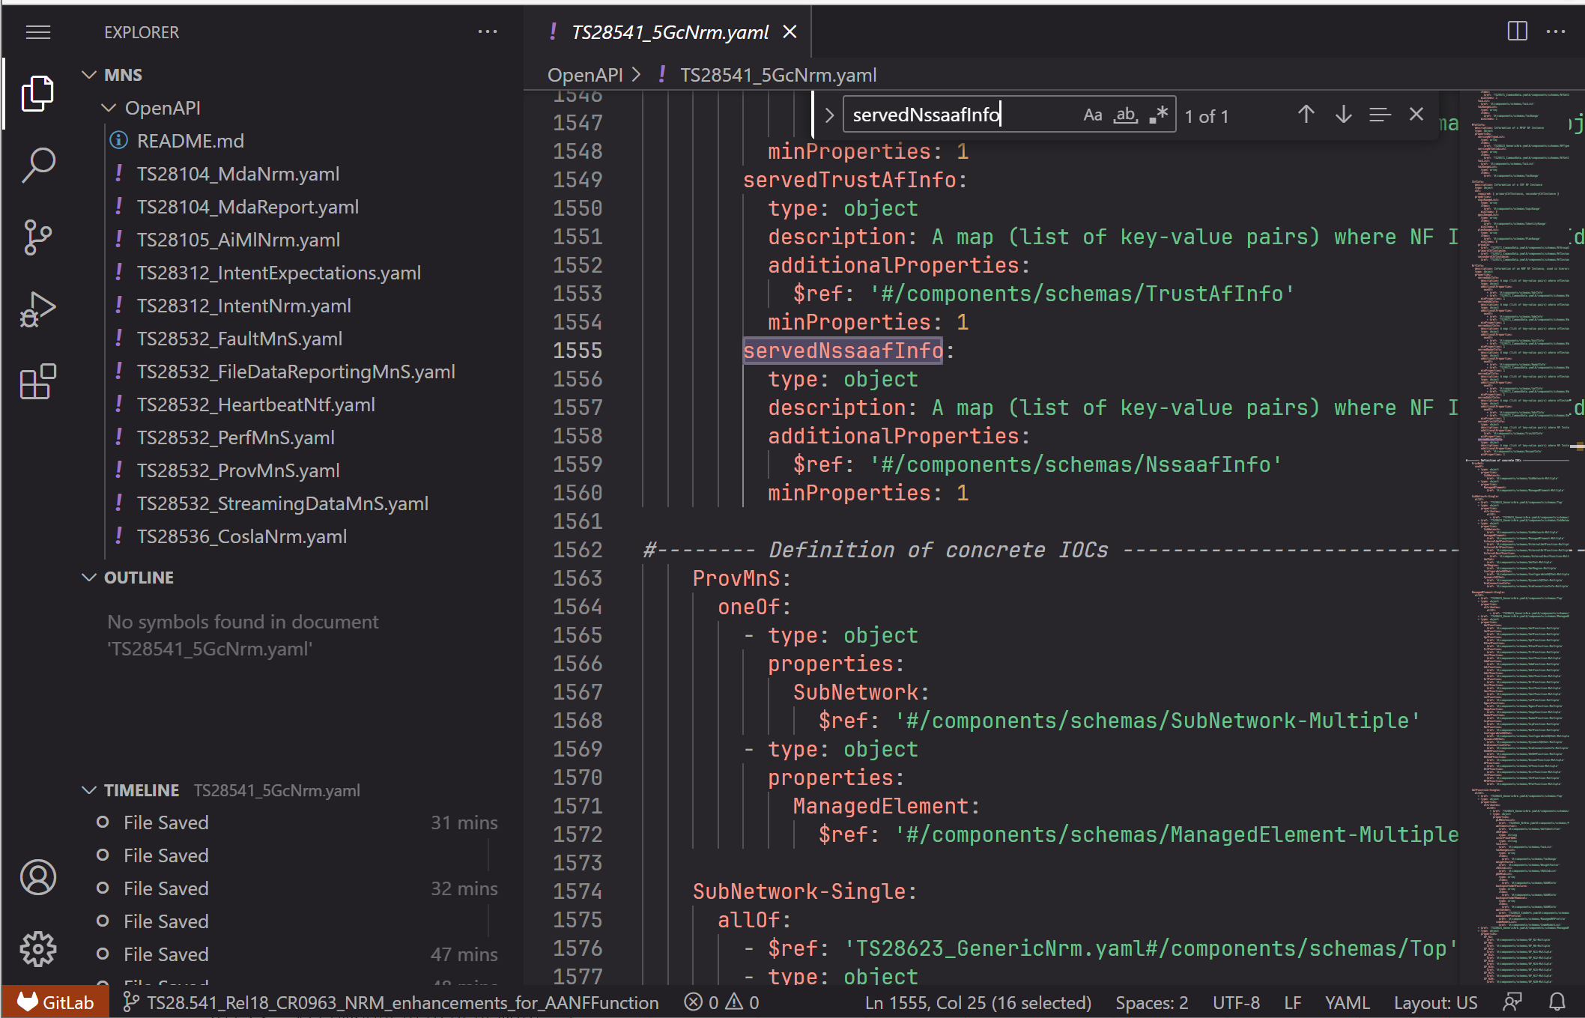
Forge: Web IDE editor: searching and editing
Step1: Input the key words (not case sensitive) you would like to locate in the file
Step2: You will see the “n of m” summary, m indicates the total number of matched key words, n indicates the n-th match
This area is so-called miniMap of the Stage 3 file. It’s kind of full screenshot of the whole stage 3 file
You could use the grey bar to quickly move around your editing area (in case the file is huge). To be noted, the grey bar will be invisible if your mouse leaving the file for some time, it will be visible once mouse moving back.

Slide 14
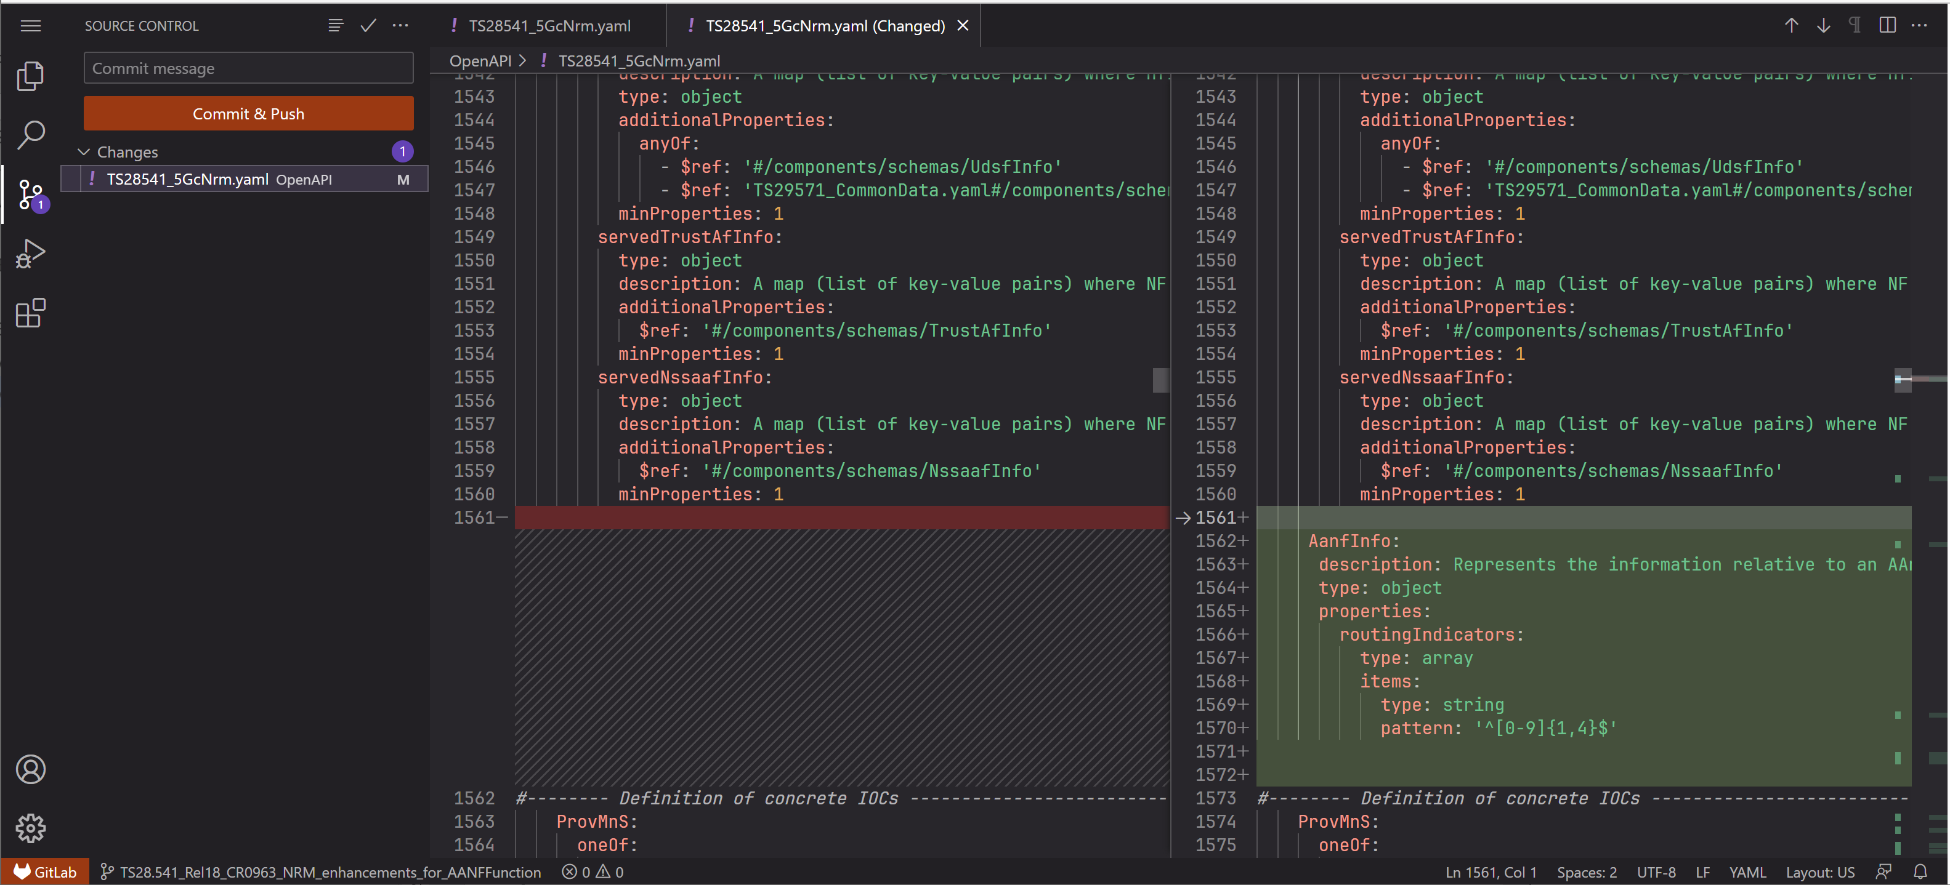
Forge: Web IDE editor: diff
Step 1: Select this button to check the total changes (per file).
Step2: each highlight indicates a change (relative location of a file). You could see the character-by-character difference (against original file, which is in the left part)

Slide 15
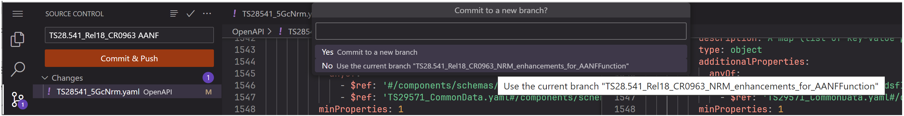
Forge: Web IDE editor: commit changes
updated for 154
Step1: Input commit comments (TS number, release number, CR number and change summary/key words are needed)
Note: this comment will be used as MR title by default.
Step3: To confirm the commit to which branch. Normally to the 2nd option, the current branch.
For advanced user, the change can be done to a new branch, the naming of new branch shall follow the naming convention (in working procedure)
Step2: click “Commit & Push” button. This is to commit the change and push to a Forge branch.

Slide 16
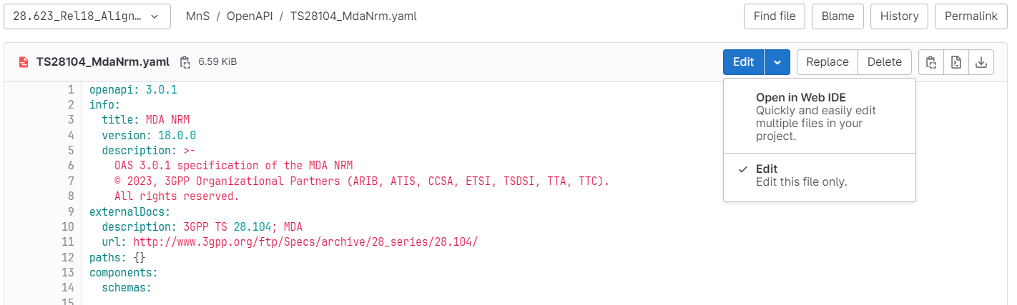
Edit one file
updated for 154
When one stage 3 file opened, there are two optional to edit it.
Open with Web IDE: Refer to Slide Editing with Web IDE
Edit: Edit the current file only, simple to use, good for single file.

Slide 17
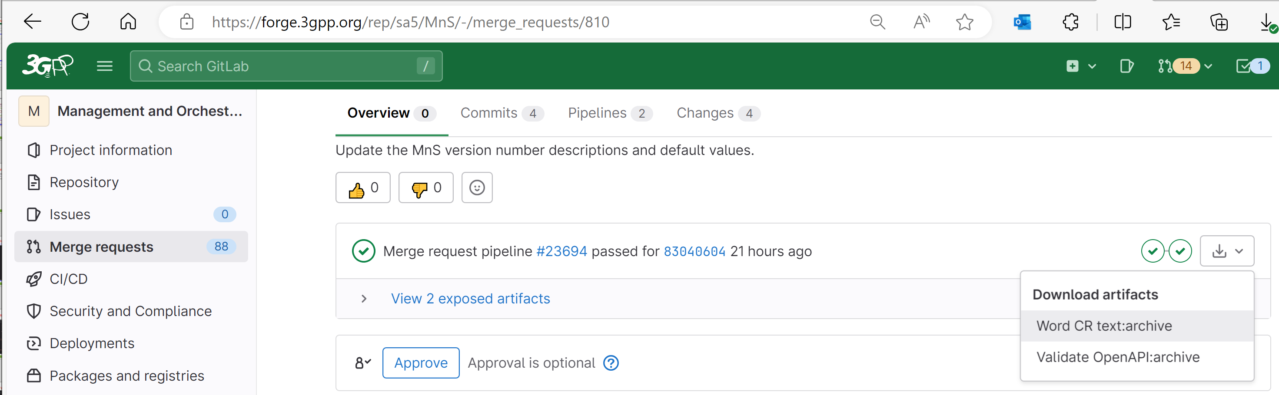
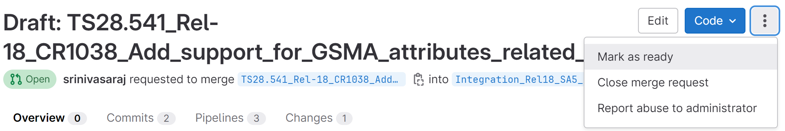
Forge: Generating word CR (code change part) with a Draft merge request
This function was newly introduced function from Forge in late 2022.
Note 1: Contribution author creates a merge request towards the Integration branch before meeting start. At this stage the MR shall be marked as a draft MR. If a CR includes both YANG and YAML changes, two separate MRs are needed. The MR Forge link(s) shall be added to the MS Word CR's cover page 'Other Comments' section."
Step1: open the merge request
Step 2: Click first option (Download “Word CR text:archive” artifact)
Note 4:
The automatically generated word artifact is a Word file with line-by-line stage 3 change track per Yaml file (for YANG, it’s a YANG file).
At the top of the word artifact, you could find the MR link and commit code. They can be copied directly to Word CR cover page.
The stage 3 content may be used directly in Word CR
Note 2: before CR is agreed in SA5 closing plenary meeting, the merge request shall be in status “Draft”. When in draft status, the title of merge request starts with “Draft:”, see example below.
Select “Mark as ready” or Click “Mark as ready” button to make it ready for merge (e.g., when CR is agreed in SA5 closing plenary meeting).
Note 3: MR in Draft status cannot be merged.

Slide 18
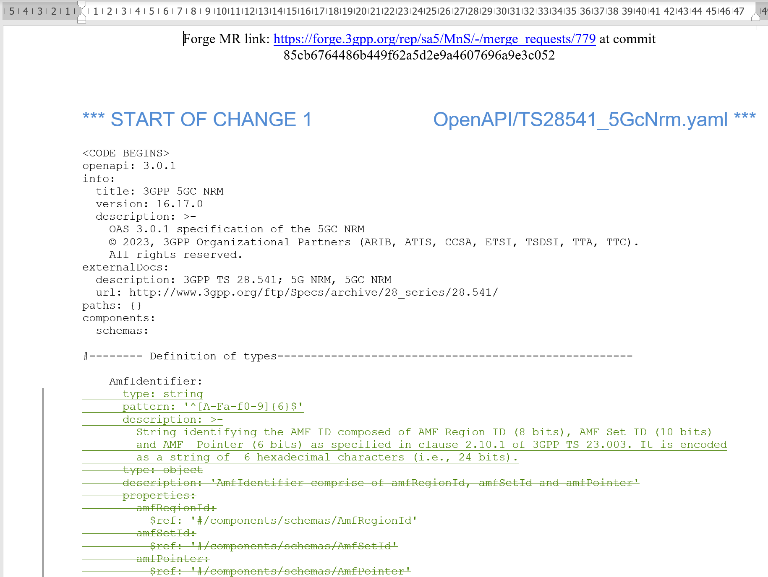
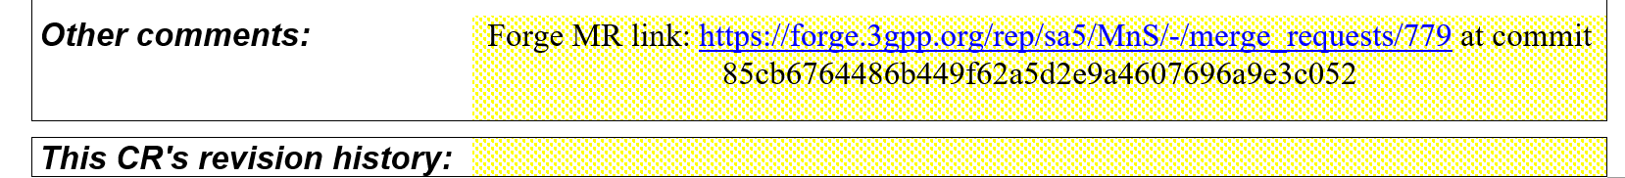
High level step: Step 5 (Forge Link)
Step1: open the merge request
Step 2: Download artifacts: “Word CR text:archive”
Step 0: Find the merge request here
Step 3: At the top of the word artifact, you could find the MR link and commit code. They can be copied directly to Word CR cover page (to “Other comments”).
Step 4: The 2nd part of word artifact is the stage 3 with change track per stage 3 file.
This stage 3 content may be used directly in Word CR.
(No more manual editing to stage 3 code in word! You may add the clause number before stage 3 code)

Slide 19
Forge: advanced tips
Rebase and command line rebase
Merge confliction handling
Note:
> Only for advanced user or code moderators.
> Assumed the user has good experience with git and has a local git environment as well as some common tools for code editing, comparison, etc.

Slide 20
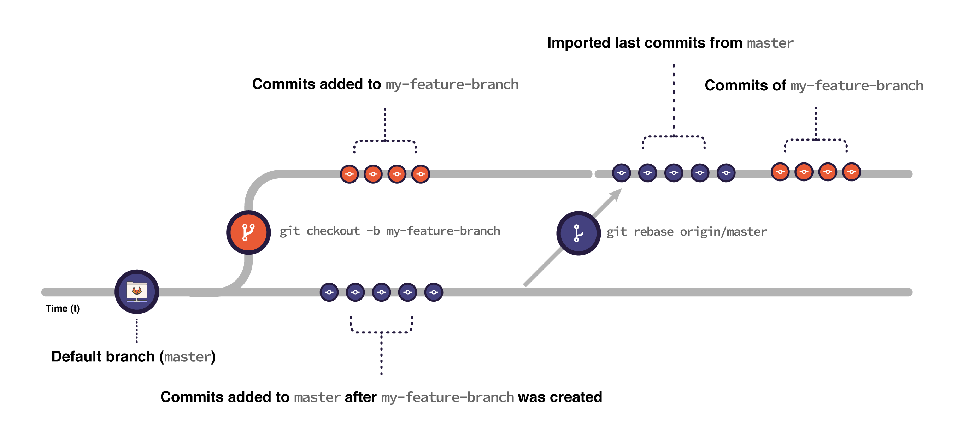
Git: Rebase
When you rebase:
Git imports all the commits submitted to main after the moment you created your feature branch until the present moment.
Git puts the commits you have in your feature branch on top of all the commits imported from main:
Figure is from: Introduction to Git rebase and force-push | GitLab
Command line example for rebased
git fetch origin
git fetch origin Rel17-draft
git checkout "Integration_Rel17_SA5_140_YAML"
git pull
## --- backup 140_yaml branch & switch back --
>> git checkout -b "Integration_Rel17_SA5_140_YAML_rebaseBK26Jan2022"
>> git checkout "Integration_Rel17_SA5_140_YAML"
git rebase "origin/Rel17-draft"
git pull
git push origin "Integration_Rel17_SA5_140_YAML"
Command to create a backup branch, which has all contents before rebase, could be used for recovery anytime
This command is to push commit (rebase) in local branch to remote repo
Notes:
It’s safer to back up your branch before rebasing to make sure you don’t lose any changes. For example, consider a feature branch called my-feature-branch:
Open your feature branch in the terminal:
>> git checkout my-feature-branch
Checkout a new branch from it:
>> git checkout -b my-feature-branch-backup
Go back to your original branch:
>> git checkout my-feature-branch
Now you can safely rebase it. If anything goes wrong, you can recover your changes by resetting my-feature-branch against my-feature-branch-backup:
Make sure you’re in the correct branch (my-feature-branch):
>> git checkout my-feature-branch
Reset it against my-feature-branch-backup:
>> git reset --hard my-feature-branch-backup
Note that if you added changes to my-feature-branch after creating the backup branch, you lose them when resetting.

Slide 21
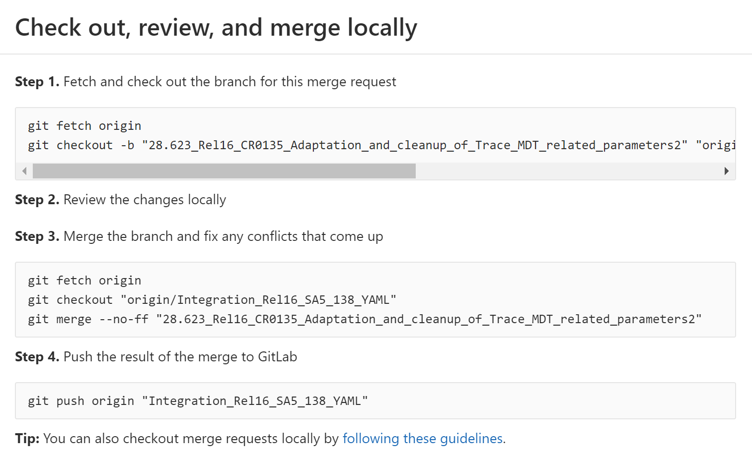
Fetch origin copies all branches from remote refs/heads name space and store them to local refs/remotes/origin name space
Git: Merge Request handling
Create a local branch from remote branch and switch to local branch 28.623_xx
(Note: Same branch name is used)
Alternatively, 2nd command can be:
git checkout -b "Integration_Rel16_SA5_138_YAML" "origin/Integration_Rel16_SA5_138_YAML“
Use some tools (e.g., vim, VSC, WinMerge, etc.) to resolve confliction, then “git add x, git commit x”
## ---- Example for CR0584
git fetch origin
git checkout -b "TS28.541_CR0584_Enhance_NRM_to_support_local_NEF_selection" "origin/TS28.541_CR0584_Enhance_NRM_to_support_local_NEF_selection"
git checkout "Integration_Rel17_SA5_139_YAML"
git merge --no-ff "TS28.541_CR0584_Enhance_NRM_to_support_local_NEF_selection"
git push origin "Integration_Rel17_SA5_139_YAML"
Notes:
git fetch origin
git checkout -b "28.541_Rel17_CR0630_Stage3_update_for_UPF_and_PCF" "origin/28.541_Rel17_CR0630_Stage3_update_for_UPF_and_PCF"
git fetch origin
git checkout -b “Integration_Rel16_SA5_138_YAML” “origin/Integration_Rel16_SA5_138_YAML“ or integration已经有了
git checkout "Integration_Rel17_SA5_140_YAML"
git merge --no-ff "28.541_Rel17_CR0630_Stage3_update_for_UPF_and_PCF“
git push origin "Integration_Rel17_SA5_140_YAML"
## ---- Example for CR0584
git fetch origin
git checkout -b "TS28.541_CR0584_Enhance_NRM_to_support_local_NEF_selection" "origin/TS28.541_CR0584_Enhance_NRM_to_support_local_NEF_selection"
git checkout "Integration_Rel17_SA5_139_YAML"
git merge --no-ff "TS28.541_CR0584_Enhance_NRM_to_support_local_NEF_selection"
git push origin "Integration_Rel17_SA5_139_YAML"

Slide 22


Common Q&A
Q1. I can not create branch, (or I do not see the New branch/Merge Request button)?
A1: You are not logged in to Forge, refer to login to Forge. Or you do not have the edit permission, send request to MCC for the same.
Q2. After creating the MR and commits, if there further revision of stage 3, anything to do with MR?
A2: MR link remains the same, but there will be new commit code. Each commit has one commit code and there will be new validation record. You only need to update the final commit code to CR cover page (no change to MR link). You can also get the update word artifact with the same MR link and update commit code.
Q3. I can create CR branch from a release/integration branch or a tag, what’s the difference?
A3: A branch is an active line of development whereas a tag is an immutable reference to a specific commit on a branch. Tag is a fixed version number, point to a specific version of code e.g., code approved in SA#100 meeting. A branch of Rel-18 is changing from time to time when never there is a new batch of contents approved for Rel-18. Hence, creating a CR branch from a Rel-18 branch, the CR branch created at different meeting will have different contents (i.e., the latest Rel-18 contents of the recent SA meeting). Creating a CR branch from a Rel-18 tag, the CR branch will always have the same contents as that in the Tag.

Slide 23
updated for 154
Reference
Wiki for CI/CD pipeline, validation and Word CR text: https://forge.3gpp.org/rep/sa5/MnS/-/wikis/home
Git resource: Git (git-scm.com) or Index · User · Help · GitLab (3gpp.org)
Forge Repository list: https://forge.3gpp.org/rep/explore
Direct Link to SA5 repository start page: https://forge.3gpp.org/rep/sa5/MnS

Slide 24
Change History
Since SA5#152
SA5#152: high level workflow, WebIDE updated
SA5#154: wording update, outdated information updated, Reference, Editing one file.

Slide 25
Thanks

