Slide 1
3GPP SA5 Rel-19 working progress and Rel-20 3GPP SA5 Work Planning
Zou Lan, 3GPP SA5 Chair, HUAWEI

Slide 2
Content
3GPP SA5 introduction
Release 19 working progress
Release 20 work planning

Slide 3
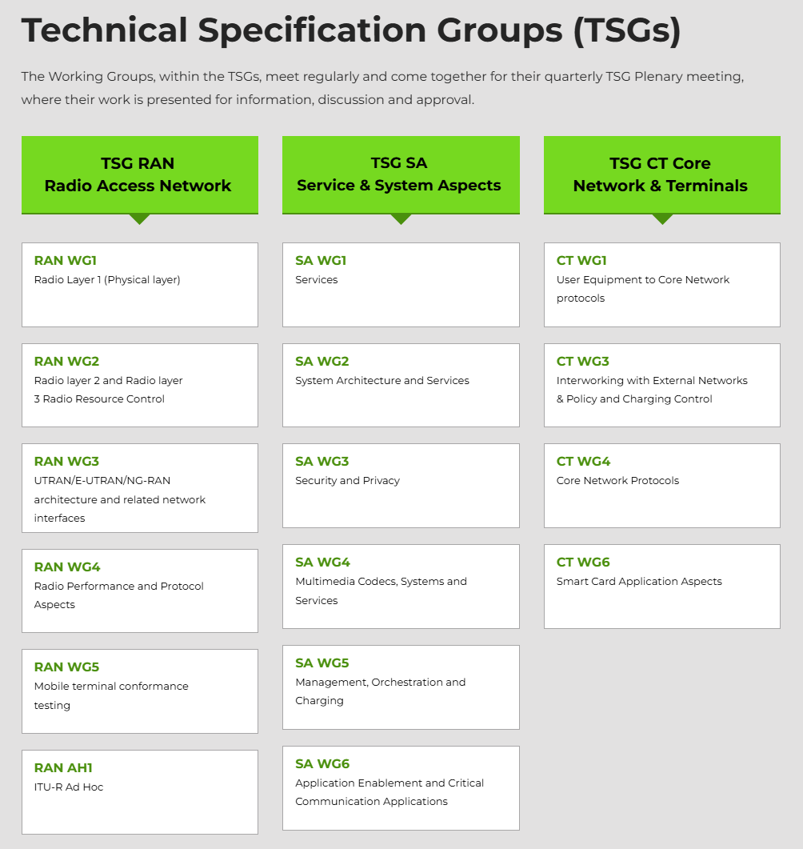
3GPP SA5 Introduction
Introducing 3GPP
The 3rd Generation Partnership Project (3GPP) unites seven telecommunications standard development organizations (ARIB, ATIS, CCSA, ETSI, TSDSI, TTA, TTC), known as “Organizational Partners” providing their members with a stable environment to produce the Reports and Specifications that define 3GPP technologies.
3GPP specifications cover cellular telecommunications technologies, including radio access, core network and service capabilities, which provide a complete system description for mobile telecommunications. The 3GPP specifications also provide hooks for non-radio access to the core network, and for interworking with non-3GPP networks.
https://www.3gpp.org/about-us/introducing-3gpp
Introducing 3GPP SA5
TSG SA WG5 is currently responsible for:
Management and Orchestration which covers aspects such as operation, assurance, fulfillment and automation, including management interaction with entities external to the network operator (e.g. service providers and verticals).
Charging which covers aspects such as Quota Management and Charging Data Records (CDRs) generation, related to end-user and service-provider.
https://www.3gpp.org/3gpp-groups/service-system-aspects-sa/sa-wg5

Slide 4
3GPP Working Methodology
3GPP Working methodology
4.1 Overview
Where appropriate, the three-stage methodology defined in ITU‑T Recommendation I.130 should be employed:
Stage 1 is an overall service description from the user's standpoint.
Stage 2 is an overall description of the organization of the network functions to map service requirements into network capabilities.
Stage 3 is the definition of switching and signalling capabilities needed to support services defined in stage 1.
In addition, it is often appropriate to perform a feasibility study prior to formal specification work. This is sometimes referred to as "stage 0".
Furthermore, it will often be appropriate to follow stage 3 with the production of test specifications – a stage 4.
https://www.3gpp.org/ftp/Specs/archive/21_series/21.900/21900-i20.zip
3GPP SA5 follows 3GPP working procedures and cover related work in multiple stages.
SA5 stage 0 - Management features studies
(technical reports)
SA5 stage 1 - Management requirements
(technical specifications)
SA5 stage 2 - Management stage 2 protocol agnostic
(technical specifications)
SA5 stage 3 - Management stage 3
Protocol specific
(technical specifications and source code in 3GPP forge)

Slide 5
Content
3GPP SA5 introduction
Release 19 working progress
Release 20 work planning

Slide 6
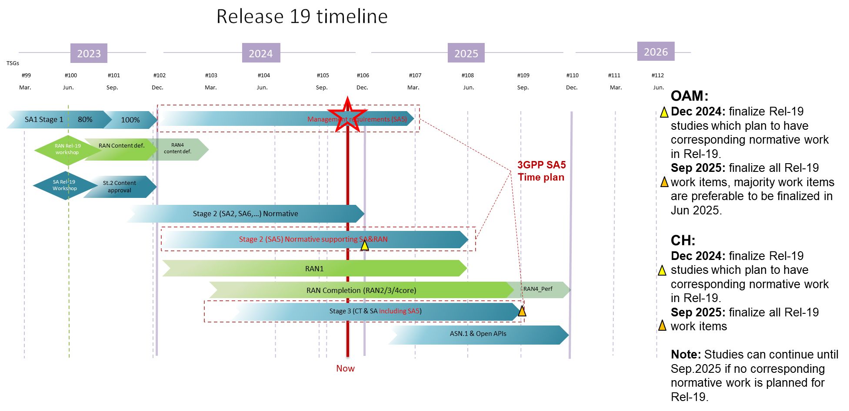
SA5 Rel-19 Time Plan

Slide 7
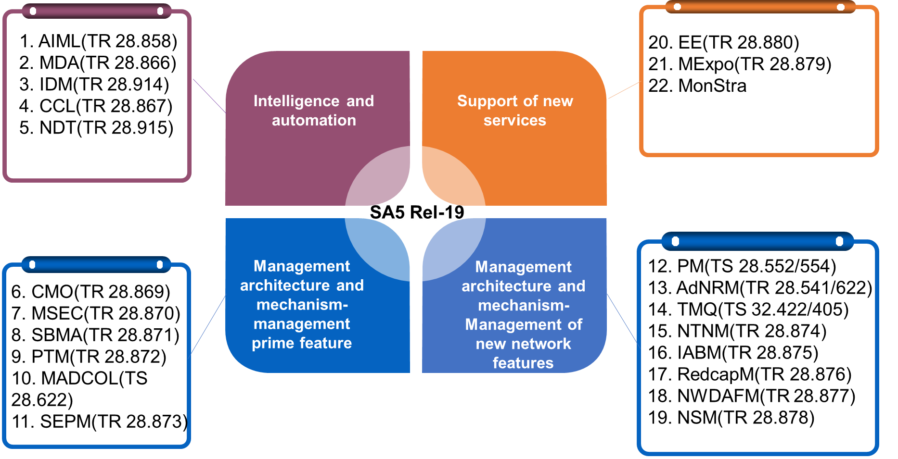
Summary of Rel-19 topics
Intelligence and automation
AI/ML management (AIML) studies the mechanisms of how to enable and facilitate the efficient deployment, operation of the relevant AI/ML features located in 5GC, RAN or management functions. It is targeted to provide manageable capability to perceive how AIML model works with lifecycle management, giving the operator the confidence of taking advantage of AIML technology under their own supervision.
Management data analytics (MDA) investigates the potential management analytics solutions for Energy efficiency analytics, End-to-End performance analytics including Edge computing domain, Data correlation analytics, ATSSS performance analytics, UE throughput analytics, Fault management related analytics and alarm prediction, Software Upgrade Validation.
Intent driven management (IDM) Enhanced management functionalities like Intent negotiation mechanisms, network intent to support new business opportunities, adopting natural language to express intent will be discussed. With the new enhancement features, operators could interact with the intent handler more efficiently and extend the intent capability to support new services.
Closed control loop (CCL) investigates the dynamic closed control loop creation for communication service assurance, Conflict Detection and Resolution across multiple CCLs. The CCL could be disintegrated into multiple parts each coming from different vendors.
Network Digital Twin (NDT) NDT helps operators to efficiently verify changes in network operation’s potential impact on the real network before it takes effect. Network digital twin could construct a full view of network topology and traffic, which can help the operator with efficient end-to-end or single-domain fault localization, traffic path optimization, prediction and avoidance of signaling storms.
Support of new services
Management capability exposure (MExpo) focuses on defining a generic approach for discovery and exposure of SA5 management service capabilities to external consumers including verticals. The study will also investigate exposing network slice capability in network sharing scenarios for communicating with external consumers.
Energy efficiency management (EE) new or enhanced Energy Consumption (EC) and Energy Efficiency (EE) KPIs and measurements while considering various granularities, and also provide the estimation of Carbon emissions efficiency and information on renewable energy consumption to operators. This study also addresses how to measure or estimate the energy consumption of containerized network functions.
Charging Management
SATCH
CAPCH
RTCCH
CHSEG
RAGCH
NSCH
UASCH
EESCH

Slide 8

R19 AIML Management (AIML) Study
ML model lifecycle
New Capabilities
New Scenarios
Following AIML management capabilities have been investigated in TR 28.858 and recommended for R19 normative work:
Management capabilities for ML model training，including ML-Knowledge-based Transfer Learning, ML pre-training and fine-tuning, Management of Reinforcement Learning, Sustainable AI/ML for ML training, Management of Federated Learning, ML explainability, etc.
Management capabilities for AI/ML inference emulation, including ML inference emulation, ML inference emulation environment selection.
Management capabilities for ML model deployment, including Enhancements to ML model loading, ML model transfer/delivery.
Management capabilities for AI/ML inference, including Coordination between the ML capabilities,ML remedial action management, etc.
NG-RAN AIML-based Coverage and Capacity Optimization, and NG-RAN AIML-based Network Slicing defined by RAN3,
Model delivery/transfer as defined by RAN1/2,
ML model training and AI/ML inference functions for 5GC as defined by SA2
MDA (Management Data Analytics) as defined by SA5.
TR 28.914

Slide 9
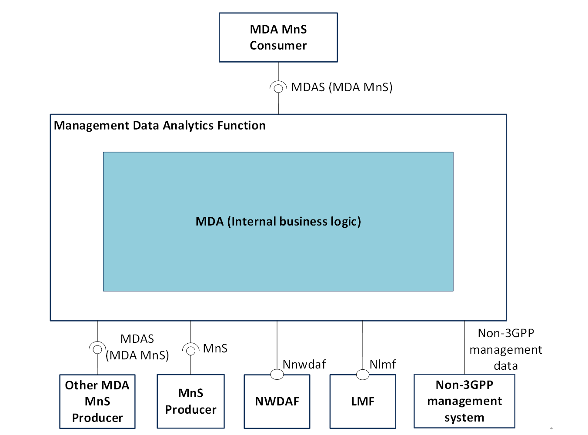
R19 Management data analytics (MDA) Study
MDA functional overview and service framework
New Capabilities
Following management data analysis management capabilities have been investigated in TR 28.858 and recommended for R19 normative work:
Energy efficiency analytics
End-to-end performance analytics including edge computing domain
Data correlation analytics
ATSSS performance analytics
UE throughput analytics
Fault management related analytics
Software upgrade validation
Control plane congestion analytics
TR 28.914

Slide 10
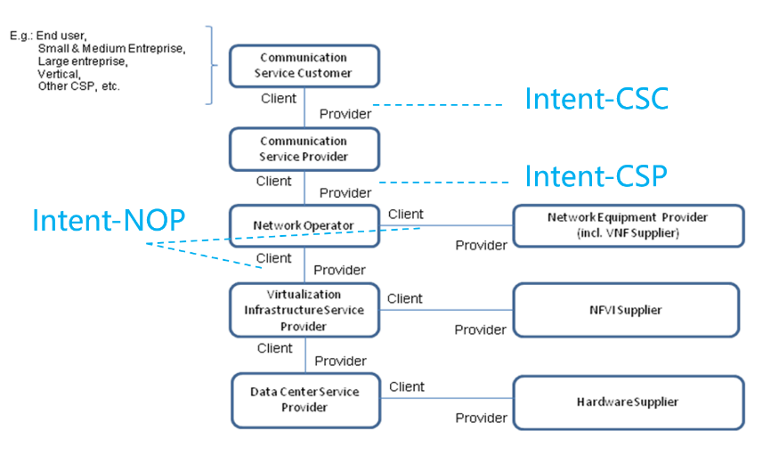
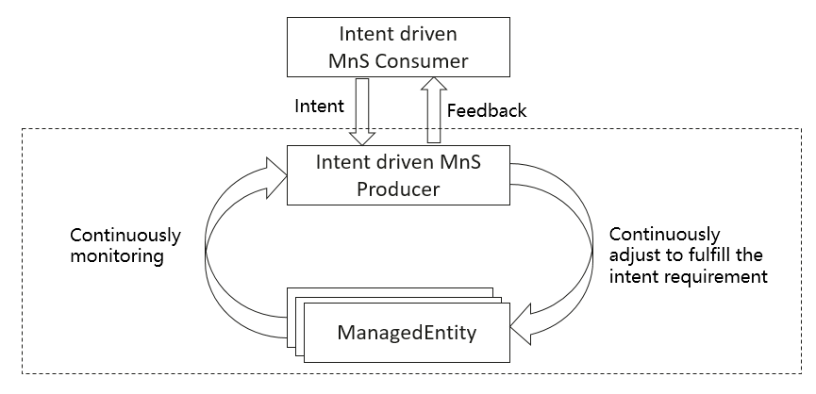
R19 Intent-driven Management (IDM) Study
High-level model of different kind of intents expressed by different roles
New Capabilities
Intent negotiation functionalities
Implicit intent report subscription with customized requirements.
Intent handling state management.
Intent handling capability enhancement.
Intent degradation based on expectation preference.
New Scenarios
Enhance the RadioServiceExpectation to support the scenario of delivering a radio service in a scheduled time scenario.
Enhance the RadioNetworkExpectation to support following scenarios: RAN energy saving scenario, Radio network traffic assurance for scheduled events scenario, Radio network support for UAV pre-flight preparation and Radio Network support MOCN undifferentiated radio service.
Introduce communication service expectation for communication service delivering and assurance.
Introduce intent expectation for network maintenance.
Intent driven closed-loop
TR 28.914

Slide 11
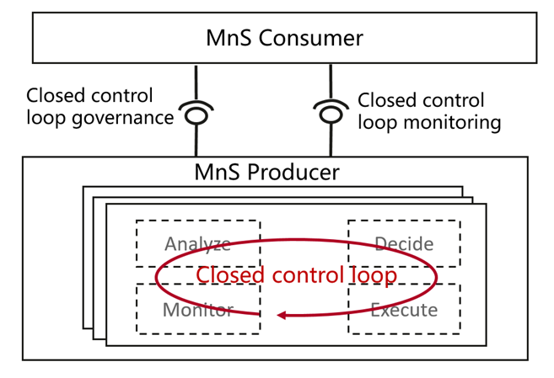
R19 Closed Control Loop (CCL) Study
Closed control loop governance and monitoring
Following CCL Use cases investigated in TR 28.867
Use case 1: Dynamic CCL Creation
Use case 2: Triggered CCL
Use case 3: CCL creation based on Historical CCL data
Use case 4: closed control loop for problem recovery
Use case 5: CCL for fault management
Use case 6: CCL conflicts management
Use case 7: CCL scope management
Use case 8: CCL-impact assessment and resolution
Use case 9: Consumers feedback on CCL actions
Use case 10: CCL decision escalation
Use case 11: Performance Evaluation of a Closed Control Loop
Use case 12: Coordinating CCLs with other management functions
TR 28.914

Slide 12
R19 Network Digital Twin (NDT) Study
Relations between digital twins and network automation functions
NDT Scenarios
NDT support for network automation including signalling storm analysis, emergency preparedness, network failure and risk prediction and network issue inducement.
NDT support for verification including RAN energy saving policy verification, configuration verification.
NDT support for generation including generating data for ML model training and measuring customer satisfaction with the network services
Advanced NDT capabilities including nested NDTs.
TR 28.914

Slide 13
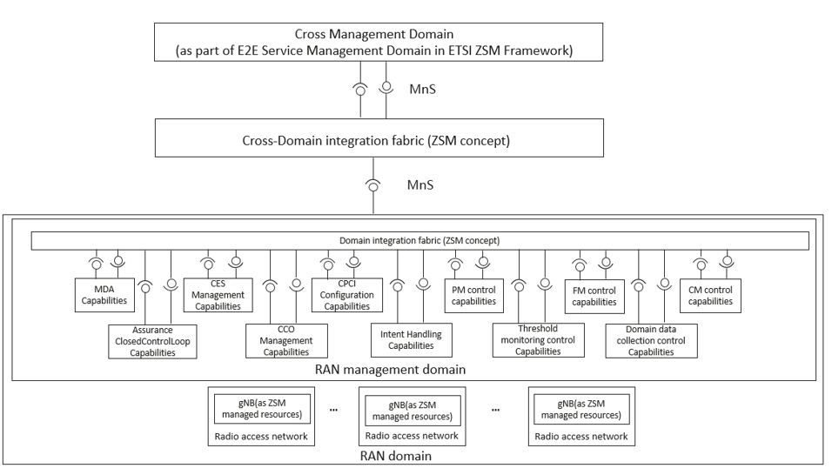
Rel-19 Service Based Management Architecture (SBMA) study
An example of deployment scenario for RAN management functions
R19 eSBMA topics
NRM investigation
Connection between 3GPP TS 28.537 and 3GPP TS 28.622 for generic control NRM capabilities
Discovery of management capabilities of MnS supported by a MnS Producer
<<Support IOCs>> instances in SBMA
Discovery of management capabilities of MnS instances based on area of interest
PM investigation
Common Notification Header
Schema retrieval enhancements
Schema reference enhancements
List and handle Alarming-Conditions
Overview of management capabilities and corresponding Solution Sets
MnS Version Number Handling
Reliable notification transfer
Usage of MnS Registry NRM fragment for MnS Registry and Discovery for different deployment scenarios
Decouple the management and resource models
TS 28.533

Slide 14
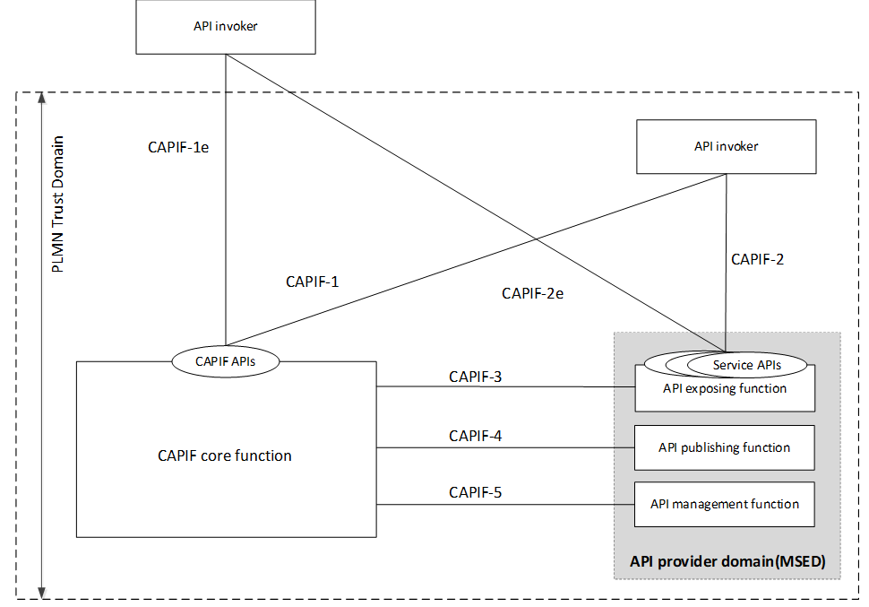
Rel-19 Management Service Exposure (MExpo) Study
MSED providing the API provider domain functions as defined by the CAPIF framework
New Scenarios
The following use cases of exposure of management services to external consumers have been investigated in TR 28.879
Use case #1: MnS producer registration into CAPIF
Use case #2: Publishing of management services to the CCF
Use case #3: Configuring discovery information of an external MnS consumer
Use case #4: Authorization of the external MnS consumer to access the management service API
Use case #5: Logging the management service API invocations to the CCF

Slide 15
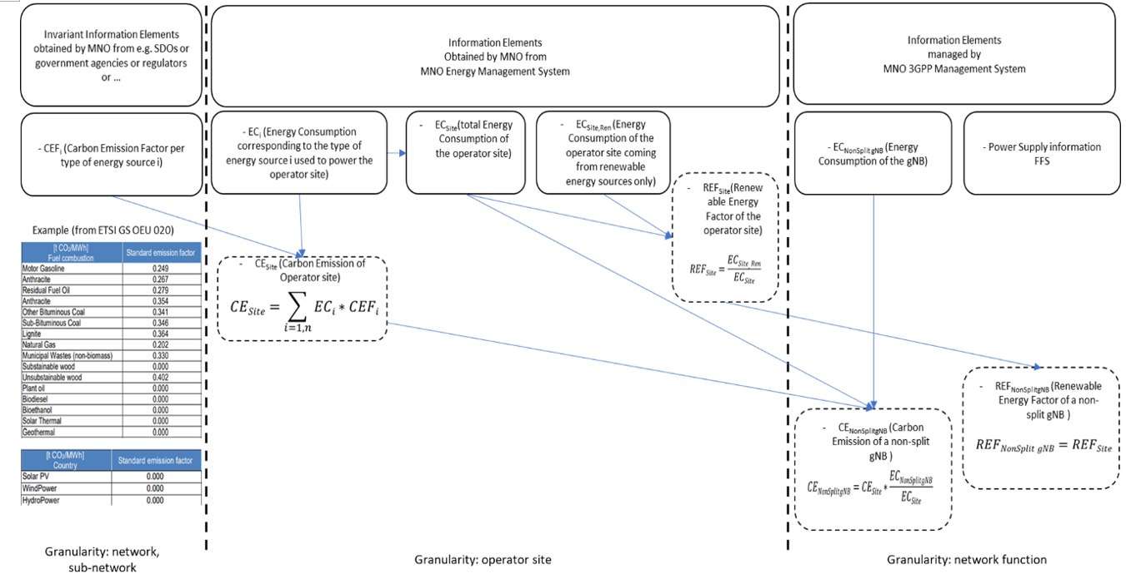
Rel-19 Energy Efficiency (EE) Study
Types of energy related information
New Scenarios
The following use cases of energy efficiency and energy saving aspects of 5G networks and services have been investigated in TR 28.880:
    Use case #1: Estimation of containerized VNF/VNFC energy consumption
    Use case #2: Alternative option to obtain energy consumption of VNF/VNFC
    Use case #3: Enabling renewable energy consumption and carbon emission information reporting
    Use case #4: Exposure of carbon and renewable energy related information
    Use case #5: Estimating averaged gNB energy consumption per UE
    Use case #6: Multi-dimensional network energy efficiency metrics
    Use case #7: Renewable energy based LBO
    Use case #8: Energy saving by converting QoS of a service
    Use case #9: Renewable energy enabling 5GC NF re-selection
    Use case #10: Deployment of Network Slices depending on the energy source of the operator site
    Use case #11: Handling of power shortages
    Use case #12: Cell proximity-based energy saving
    Use case #13: Per-network slice gNB and 5GC NF Energy Consumption

Slide 16
Rel-19 SA5 Summary Information in forge
SA5 Rel-19 ongoing topics
  Details of SA5 Rel-19 approved WIDs/SIDs :
  https://forge.3gpp.org/rep/sa5/MnS/-/wikis/SA5/Rel-19-Moderated-Topics
Stage 3 forge links: https://forge.3gpp.org/rep/sa5/MnS
  Management and Orchestration APIs:
    OpenAPI solution is captured in https://forge.3gpp.org/rep/all/5G_APIs (3GPP unified stage3 repository) and https://forge.3gpp.org/rep/sa5/MnS/-/tree/Rel-19/OpenAPI (SA5 stage3 repository)
    YANG solution is captured in https://forge.3gpp.org/rep/sa5/MnS/-/tree/Rel-19/yang-models (SA5 stage3 repository)
  Charging APIs:
    OpenAPI solution to be captured in https://forge.3gpp.org/rep/all/5G_APIs (3GPP unified stage3 repository) and https://forge.3gpp.org/rep/sa5/CH/-/tree/Rel-19/OpenAPI (SA5 stage3 repository)
    ASN.1 solution to be captured in https://forge.3gpp.org/rep/sa5/CH/-/tree/Rel-19/ (SA5 stage3 repository)

Slide 17
Content
3GPP SA5 introduction
Release 19 working progress
Release 20 work planning

Slide 18


For Information:
SA 5G-A/6G Rel-20 Workshop Plan (Ref:SP-240952)
  5G-Advanced in Rel-20 for TSG-SA (SA#106):
  5G-Advanced timelines :
    Stage-1 freeze: Jun 2025
    Stage-2 freeze: Jun 2026 (>=80%); Sep 2026 (100%)
    Stage-3 freeze: Mar 2027
    ASN.1/OpenAPI freeze: June 2027
Dedicated agenda and discussion for 5G-Advanced in Rel-20 will be arranged in December 2024 as part of SA#106
  Targeting a 1-day “workshop” for 5G-Advanced within SA#106. [Details TBD]
  SA#106: Start 0900 Tuesday, Finish 1600 Friday.
  Rel-20 prioritization to take place after Dec 2024
  1-step Prioritization (June, 25), or 2-step Prioritization (Mar, 25 + June, 25)? [TBD no later than Dec]
6G Workshop Plan:
Dates: March 10th – 11th (Monday – Tuesday), collocated with TSG#107 meetings.
Workshop timings
  Parallel RAN/SA sessions starting from Monday afternoon to Tuesday early afternoon
    Monday: 1400 – 1800
    Tuesday: 0900 – 1530
  Joint RAN/SA/CT session
    Monday morning: 0900 - 1230
    Tuesday 1600 – 1800: summary of the workshop
6G Workshop: SA Agenda (SA#107):
Draft preliminary Agenda for SA
  Opening of the workshop (Monday 0900 local time)
  Contributions from 3GPP members
    Contributions on 6G technologies with a focus on System/CN aspects, 6G Stage-2 study organization, etc. [Details TBD]
    Up to one contribution per company
      6G usecases related papers may be submitted for information but will not get handled.
  Chairman's summary and open discussion
    No individual contributions, please. TSG Chairs will prepare the summary
  Closing of the workshop (Tuesday 1800 local time)
Contributions
  Individual contributions are invited for the parallel sessions
    Contributions are welcome from 3GPP members and MRPs / verticals only
    A subset of the contributions will be selected for presentation, with details TBD
  TSG chairs will prepare a summary for the joint session
    No individual contributions, please

Slide 19
Release 20 timeline– figure with SA5 (recommended by SA5 leaders)
Release 20 timeline
Note: All starting dates are indicative
2024
2025
2026
2027
TSGs
#113
#114
#102
#103
#104
#105
#106
#107
#108
#109
#110
#111
#112
#115
#116
Dec.
Mar.
Jun.
Sep.
Dec.
Mar.
Jun.
Sep.
Dec.
Mar.
Jun.
Sep.
Dec.
Mar.
Jun
SA1 5GA SID definition
SA1 5GA Studies + Norm 80%
100%
Rel-20 - 5GA part
OAM/CH prime feature:
Start of Rel-20 study: Jan.2025 (SA#107/SA5#159)
End of Rel-20 work: Mar.2027 (SA#115/SA5#172)
OAM/CH support to network feature (SA5 is ready to support network features pending the availability of inputs from other WGs. )
Start of Rel-20 study: Jun.2025 (SA#108/SA5#161)
End of Rel-20 study: Mar.2027 (SA#115/SA5#172)
St.2 SID def. TBD
St. 2 (SA2, SA6, …) 5GA St.+Norm 80%
100%
RP Content def.
RAN4 C.def.
Workshop 5GA SA
RAN1
RAN Completion (RAN2/3/4core)
RAN4 Perf
Workshop 5GA RAN
OAM/CH prime Stage1
Management Stage 2/Stage3 St.+Norm supporting SA&RAN (SA5)
This time plan is in working progress, maybe updated later
St.3 SID def. TBD
Stage 3 5GA St + Norm
5GA ASN.1 & Open APIs
SA1 6G SID def.
SA1 6G Study(ies)
Workshop IMT-2030 use cases
RP IMT-2030 disc.
Rel-20 – FS_6G part
RP ITU Study
RP 6G Study(ies)
Workshop 6G TSGs
3GPP SA5
Time plan
SA2 & RAN WGs 6G SID def.
SA2 6G Study(ies)
or
SA3/4/6 SID def. and compl. TBD
RAN1 6G Study(ies)
RAN2/3/4 6G Study(ies)
SA5 6G SID def.
SA5 6G Study(ies)
Stage 3 6G SID def.
Stage 3 6G Study(ies)
TBD
Now
Reference：SP-241424

Slide 20
Detailed Rel-20 time plan with 5GA/6G
Overall Plan:
OAM/CH prime feature:
  Start of Rel-20 study: Jan.2025 (SA#107/SA5#159)
  End of Rel-20 work: Mar.2027 (SA#115/SA5#172)
OAM/CH support to network feature (SA5 is ready to support network features pending the availability of inputs from other WGs. )
  Start of Rel-20 study: Jun.2025 (SA#108/SA5#161)
  End of Rel-20 study: Mar.2027 (SA#115/SA5#172)
This time plan is in working progress, maybe updated later
5GA:
OAM/CH Prime:
  OAM/CH prime Stage-1 freeze: Jun 2025 – (same as SA1 stage-1 freeze)
  Stage-2 freeze : Jun 2026 (>=80%); Sep 2026 (100%) – (same as SA2 stage-2 freeze)
  Stage-3 freeze : Mar 2027 – (same as CT stage-3 freeze)
OAM/CH support network features:
  OAM/CH support Stage-1 freeze : Dec 2025 – (6 months later than SA1 stage-1 freeze)
  Stage-2 freeze: Sep 2026 (>=80%); Dec 2026 (100%) – (3 months later than SA2 stage-2 freeze)
  Stage-3 freeze : Mar 2027 – (3 months earlier than CT OpenAPI/ASN.1 freeze)
6G SI Approval:
OAM/CH Prime:
  SA5 SI approval: TSG#108 (Jun 2025) – (same as SA2 SI approval)
OAM/CH support:
  SA5 SI approval: TSG#110 (Dec 2025) – (6 months later than SA2 SI approval)
6G SI completion:
OAM/CH Prime:
  SA5 6G SI completion: Dec 2026 or Mar 2027 (To be confirmed at future TSG meeting)
OAM/CH support:
  SA5 6G SI completion: Dec 2026 or Mar 2027 (To be confirmed at future TSG meeting) ·

Slide 21
SA5 Rel-20 capacity summary
SA5 capacity:
  Max TUs: 124 (OAM) / 80 (Charging)
    Additional buffer TUs: 61(OAM)/40(CH)
  Max number of SIs/WIs: 10~15 (OAM) / 6~10 (Charging)
    Note: one feature made up of SI+WI is counted as one item
  Max TUs per Feature: 12~8 TU
Assumptions
  Start: Jun 2025, End: Mar 2027 (21 months)
  One track for OAM and One track for Charging
  Number of meetings: 10
  Expected total TUs per meeting (for all releases): 18.5 (OAM) / 12 (Charging)
  Total TUs (for all releases): 185 (OAM) / 120 (Charging)
  TUs for maintenance of past releases: 35 (OAM) / 18 (Charging)
This time plan is in working progress, maybe updated later

Slide 22
Potential Rel-20 management features workshop
Plan for management Feature Workshop (details to be updated according to the availability of inputs):
  January 2025: Online presentation on potential topics and directions (4 TUs)
  February 2025 (SA5#159): Contributions more focused on concrete topics, especially on management prime features (2 TUs)
Draft Agenda
  Opening of the workshop
  Contributions from 3GPP member companies
    Contributions on potential Rel-20 management use cases and requirements, etc.
    Up to one contribution per company
  Chairman's summary and open discussion
  Closing of the workshop
  Please feel free to contact Chair if you plan to provide presentation, and it will be helpful to make better planning for this activity.

Slide 23
3GPP SA & SA5 meeting calendar (2025)
Meeting info | DateTime | Location | Release dates | Other WGs (potential colocation)
SA5#159 | 17 Feb 2025- 21 Feb 2025 | Sophia Antipolis, FR
SA#107 | 10 Mar 2025- 14 Mar 2025 | Incheon, South Korea | 6G workshop
SA5#160 | 07 Apr 2025- 11 Apr 2025 | Goteborg, SE |  | SA2/3/4/5/6
SA5#161 | 19 May 2025- 23 May 2025 | Fukuoka, Japan |  | SA WGs
SA#108 | 09 Jun 2025- 13 Jun 2025 | Europe
SA5#162 | 25 Aug 2025- 29 Aug 2025 | Goteborg, SE |  | SA WGs/CT WGs
SA#109 | 15 Sep 2025- 19 Sep 2025 | China | Rel-19 freeze
SA5#163 | 13 Oct 2025- 17 Oct 2025 | China |  | SA2/3/4/5/6 and CT1/3/4 WGs
SA5#164 | 17 Nov 2025- 21 Nov 2025 | US |  | CT WGs, SA WGs, RAN WGs
SA#110 | 08 Dec 2025- 12 Dec 2025 | US
6 f2f SA5 meeting planned in 2025, 3 meetings in Europe, 1 in Japan, 1 in China, 1 in US.
Please book your hotel/flight when you received official meeting invitation

Slide 24
Thank you!

Slide 25
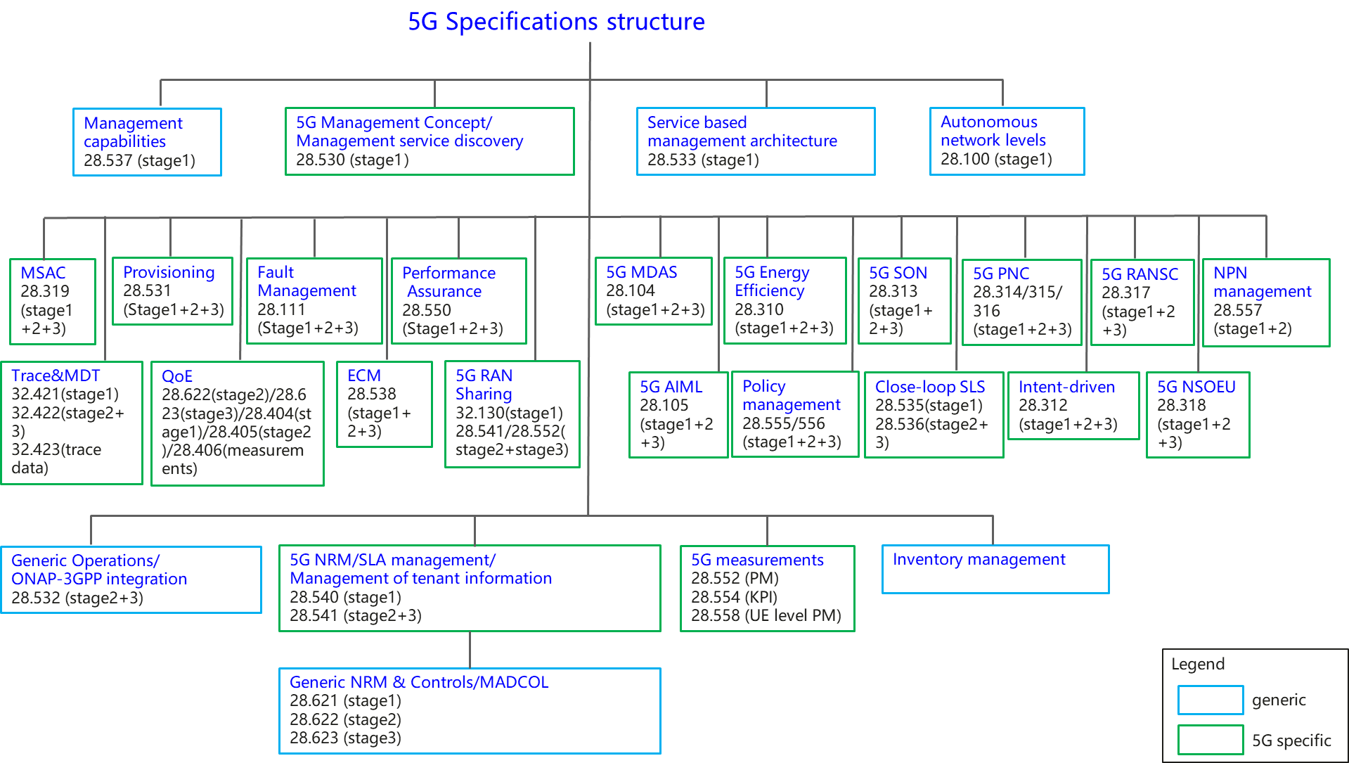
Overview of 5G management specifications
Ref: 3GPP TS 28.533

