Slide 1
Rel-19 SA5 work planning
SA5#156, 19 – 23 August, 2024
Zou Lan, 3GPP SA5 Chair, HUAWEI
Thomas Tovinger, 3GPP SA5 Vice-Chair, ERICSSON
Anatoly Andrianov, 3GPP SA5 Vice-Chair, NOKIA

Slide 2
Content
Release 19
  Release 19 timeline– figure with SA5
  WIs/SIs in other 3GPP WGs potentially related to SA5
Release 20 and 6G workshop plan

Slide 3
Release 19 timeline– figure with SA5 (Not yet integrated to SA timeline)
Release 19 timeline
2023
2024
2025
2026
TSGs
#99
#100
#101
#102
#103
#104
#105
#106
#107
#108
#109
#110
#111
#112
Mar.
Jun.
Sep.
Dec.
Mar.
Jun.
Sep.
Dec.
Mar.
Jun.
Sep.
Dec.
Mar.
Jun.
SA1 Stage 1 80%
100%
Management requirements (SA5)
OAM:
Dec 2024: finalize Rel-19 studies which plan to have corresponding normative work in Rel-19.
Sep 2025: finalize all Rel-19 work items, majority work items are preferable to be finalized in Jun 2025.
CH:
Dec 2024: finalize Rel-19 studies which plan to have corresponding normative work in Rel-19.
Sep 2025: finalize all Rel-19 work items
RAN Rel-19 workshop
RAN Content def.
RAN4
content def.
3GPP SA5
Time plan
SA Rel-19
Workshop
St.2 Content approval
Stage 2 (SA2, SA6,…) Normative
Stage 2 (SA5) Normative supporting SA&RAN
RAN1
RAN Completion (RAN2/3/4core)
RAN4_Perf
Stage 3 (CT & SA including SA5)
ASN.1 & Open APIs
Now
Group members are welcome to contact SA5 Chair offline for any opinions on the time plan

Slide 4
Content
Release 19
  Release 19 timeline– figure with SA5
  WIs/SIs in other 3GPP WGs potentially related to SA5
Release 20 and 6G workshop plan

Slide 5
Rel-19 OAM Study / Work Items
21 topics including: 13 OAM prime features and 8 OAM support to network features (in red background).
 |  | Abbr. | Acronym | Title | UID | rapp | Tdoc | TS/TR | Type
Intelligence and Automation | 1 | AIML | FS_AIML_MGT_Ph2 | Study on AI and ML management phase 2 | 1020007 | Intel, NEC | SP-231780 | TR 28.908 | SID
 | 2 | MDA | FS_eMDAS_Ph3 | Study on Management Data Analytics (MDA) – Phase 3 | 1020019 | Huawei | SP-231726 | TR 28.866 | SID
 | 3 | IDM | FS_IDMS_MN_Ph3 | Study on intent driven management services for mobile networks phase 3 | 1020008 | Huawei, Ericsson | SP-231737 | TR 28.914 | SID
 | 4 | CCL | FS_CCLM | Study on Closed Control loop management | 1020009 | Samsung, Nokia | SP-231735 | TR 28.867 | SID
 | 5 | NDT | FS_NDT | Study on Management aspect of Network Digital Twin | 1020018 | CMCC | SP-231727 | TR 28.915 | SID
Management Architecture and Mechanisms | 6 | CMO | FS_Cloud_OAM | Study on cloud aspects of management and orchestration | 1020010 | Microsoft,CMCC | SP-231781 | TR 28.869 | SID
 | 7 | MSEC | FS_SECM | Study on Enablers for Security Monitoring | 1020016 | Nokia | SP-231736 | TR 28.870 | SID
 | 8 | SBMA | FS_SBMA_Ph3 | Study on SBMA enhancement phase 3 | 1020011 | Huawei, Ericsson | SP-231725 | TR 28.871 | SID
 | 9 | PTM | FS_PlanM | Study on Plan management | 1020033 | Nokia, Ericsson | SP-231721 | TR 28.872 | SID
 | 10 | MADCOL | MADCOL_Ph2 | Data Management phase 2 | 1020025 | Nokia | SP-231746 | TS 28.622 | WID
 | 11 | SEPM | FS_Data_SREP | Study on data management, regarding subscriptions and reporting | 1020012 | Ericsson | SP-231732 | TR 28.873 | SID
 | 12 | PM | PM_KPI_5G_Ph4 | 5G performance measurements and KPIs phase 4 | 1020026 | China Telecom, ZTE | SP-231747 | TS 28.552/554 | WID
 | 13 | AdNRM | AdNRM_Ph3 | 5G Advanced NRM features phase 3 | 1020027 | Nokia, Huawei | SP-231745 | TS 28.541/622 | WID
 | 14 | TMQ | TraceQoE_OAM | Subscriber and Equipment Trace and QoE collection management | 1020028 | Ericsson | SP-231748 | TS 32.422/405 | WID
 | 15 | NTNM | FS_ NTN_OAM_Ph2 | Study on Management Aspects of NTN Phase 2 | 1020013 | China Unicom, CATT | SP-231733 | TR 28.874 | SID
 | 16 | IABM | FS_NR_mobile_IAB_OAM | Study on Management of IAB Nodes | 1020014 | Ericsson | SP-231729 | TR 28.875 | SID
 | 17 | RedcapM | FS_NR_RedCap_OAM | Study on management aspects of RedCap feature | 1020017 | China Unicom, Asiainfo | SP-231734 | TR 28.876 | SID
 | 18 | NWDAFM | FS_NWDAF_OAM_Ph2 | Study on Enhancement of Management Aspects related to NWDAF Phase 2 | 1020020 | China Telecom | SP-231724 | TR 28.877 | SID
 | 19 | NSM | FS_NetShare_OAM_Ph3 | Study on Management of Network Sharing Phase 3 | 1020015 | China Unicom | SP-231731 | TR 28.878 | SID
Support of New Services | 20 | EE | FS_Energy_OAM_Ph3 | Study on energy efficiency and energy saving aspects of 5G networks and services | 1020021 | Huawei, Samsung | SP-231723 | TR 28.880 | SID
 | 21 | Mexpo | FS_MExpo | Study on Enhanced OAM for management exposure to external consumers | 1020022 | Nokia | SP-231728 | TR 28.879 | SID

Slide 6
Rel-19 CH Study / Work Items
8 CH topics.
 | Abbr. | Acronym | Title | UID | rapp | Tdoc | TS/TR | Type
1 | SATCH | FS_5GSAT_Ph3_CH | Study on charging aspects of satellite access Phase 3 |  | CATT | SP-240980
2 | CAPCH | FS_CAPIF_CH | Study on Charging Aspects of CAPIF |  | Nokia | SP-240981
3 | RTCCH | FS_NG_RTC_Ph2_CH | Study on Charging aspects of next generation real time communication services phase 2 |  | CMCC | SP-240982
4 | UASCH | FS_UAS_CH | Study on Charging aspects of Uncrewed Aerial Vehicle |  | CMCC | SP-240983
5 | CHSEG | CHFSeg | New WID on CHF Segmentation |  | Verizon | SP-241001
6 | RAGCH | Ranging_SL_CH | New WID on Charging Aspects of Ranging and Sidelink Positioning |  | China Telecom | SP-241002
7 | EESCH | EnergySys_CH | New WID on Charging Aspects for Energy Efficiency of 5G |  | Huawei | SP-241003
8 | NSCH | NetShare_CH | new WID on Charging enhancement for indirect network sharing |  | Ericsson | SP-241004

Slide 7
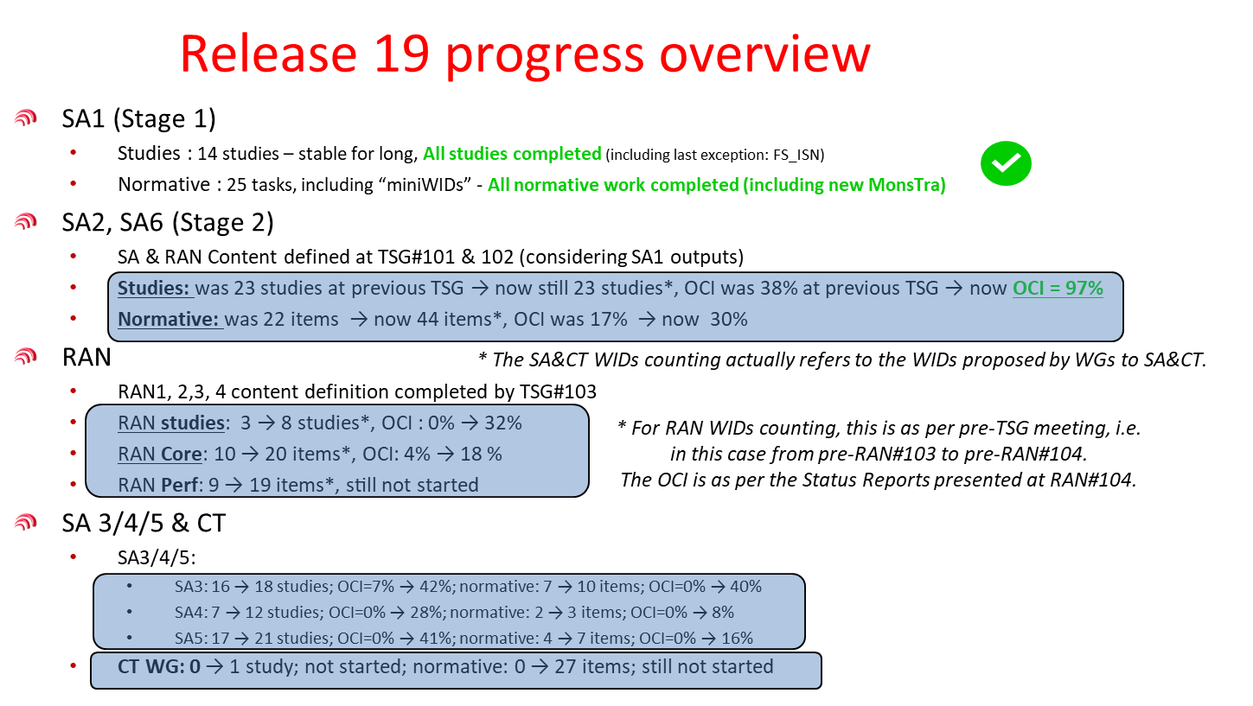
Rel-19 Progress overview in SA#104
Reference：SP-241020

Slide 8
SA5 Rel-19 OAM TU planning (Jan.2024~Sep.2025)
Assumptions:
Every meeting day = 5 quarters (= 5 TUs)
Total TUs per meeting = 18.5 TUs
  Buffer = 2 TUs
  OAM = 16.5 TUs
    Maintenance CRs + remaining Rel-18 work (TU allocation will decrease over time )
    Rel-20 preparation work (TU allocation will be zero at the beginning and will increase over time )
    All remaining time is available for Rel-19 SIDs / WIDs
Total TUs allocated to Rel-19 SIDs / WIDs = 124 TUs
 | Maintenance+R18 | R19 | R20 preparation | Buffer (revision session)
Jan.2024~Mar.2024 SA5#153 (1 meeting) (Last meeting for Rel-18) | 1.5 TU (CR)+13 TU (Rel-18)=14.5 TU | 2 TU | NA | 2 TU
Apr. 2024~Dec.2024: SA5#154~#158 (5 meetings) | 2.5 TU*5 meetings = 12.5 TU (CRs) | 14 TU*5 meetings= 70 TU | NA | 2 TU*5=10 TU
Jan.2025~Sep.2025: SA5#159~#162 (4 meetings) | 1.5 TU*4 meetings= 6 TU (CRs) | 13 TU*4 meetings= 52 TU | 2 TU*4 meetings = 8 TU | 2 TU*4=8 TU
Total=185 TU | 33 TU | 124 TU | 8 TU | 20 TU

Slide 9
SA5 Rel-19 CH TU planning (May.2024~Sep.2025)
Assumptions:
Every meeting day = 5 quarters (= 5 TUs)
Total TUs per meeting = 15.5 TUs
  Buffer = 2 TUs
  CH = 13.5 TUs
    Maintenance CRs + remaining Rel-18 work (TU allocation will decrease over time )
    Rel-20 preparation work (TU allocation will be zero at the beginning and will increase over time )
    All remaining time is available for Rel-19 SIDs / WIDs
Total TUs allocated to Rel-19 SIDs / WIDs = 83 TUs
 | Maintenance+R18 | R19 | R20 preparation | Buffer (revision session)
May. 2024: SA5#155 (1 meeting) | 2.5 TU*1eetings = 2.5 TU (CRs) | 6 TU*1 meetings= 6 TU 5 TU: Rel-19 topic discussion | NA | 2 TU*4=8 TU
July. 2024~Dec.2024: SA5#156~#158 (3 meetings) | 2.5 TU*3 meetings = 7.5 TU (CRs) | 11 TU*3 meetings= 33 TU | NA | 2 TU*4=8 TU
Jan.2025~Sep.2025: SA5#159~#162 (4 meetings) | 1.5 TU*4 meetings= 6 TU (CRs) | 11 TU*4 meetings= 44 TU | 1 TU*4 meetings = 4 TU | 2 TU*4=8 TU
Total= 124 TU | 16 TU | 83 TU | 4 TU | 16 TU

Slide 10
Question raised regarding SA5 feature releases in SA#104
SP-240712 (SID NEW) New SID on Charging Aspects of Uncrewed Aerial Vehicle (Source: SA WG5)
Plenary Discussion:
The Rapporteur and TR number should be added. The MCC Work Plan Manager commented that it is unclear which Phase of charging is intended as the Acronym and title do not indicate this. The SA WG5 Chair replied that this is Phase 2 and the Acronym and title should be updated. The Release of this should be considered as the charging is for the Rel-18 Feature. Ericsson commented that we should not add this to a frozen Release and suggested that the Rel-19 charging should cover both Rel-18 and Rel-19 UAS Charging. Vodafone asked TSG SA to ensure that charging is always included in the Release of the Features in future as this causes problems for all Operators. The SA WG5 Chair commented that in the report to TSG SA there was a slide asking for WGs to list the Features which have Charging impacts. The Work Plan Manager was asked to prepare some proposals in coordination with the SA WG5 Chair for the next TSG SA meeting. This was revised to SP-240983.
Proposal: SA5 management solutions should be provided in the same release as the related new network features as much as possible.
Actions needed:
Rapporteurs and interested companies are requested to regularly check list of features from SA2 and RAN groups update status of management support to the new features in the following tables.

Slide 11
Summary of SA5 Rel-19 management support to SA2 features
Acronym | OAM | Not covered by SA5 OAM yet | CH | Not covered by SA5 CH yet
5GSAT_Ph3_ARCH | FS_ NTN_OAM_Ph2 |  | FS_5GSAT_Ph3_CH
NG_RTC_Ph2 | NA | NA | FS_NG_RTC_Ph2_CH
XRMPh2 | PM_KPI_5G_Ph4 (to be checked) | OAM (NRM)?? |  | CH?? (CH indicated in SA2 WID)
MPS4msg | NA | NA |  | CH?? (CH indicated in SA2 WID)
VMR_Ph2 | OAM (NRM) (to be provided) (Samsung) | (PM??) |  | CH?? (CH indicated in SA2 WID)
5G_ProSe_Ph3 |  | OAM (NRM+PM)?? | 5G_ProSe_Ph3_CH
UIA_ARC | NA | NA |  | CH?? (CH indicated in SA2 WID)
eEDGE_5GC_Ph3 |  | OAM (NRM+PM)?? |  | CH?? (CH indicated in SA2 WID)
UAS_Ph3 | NA | NA | FS_UAS_CH (to be checked) | FS_UAS_CH only targets UAS_Ph2
UPEAS_Ph2 |  | OAM (NRM+PM)?? |  | CH?? (CH indicated in SA2 WID)
5G_Femto | NA | NA | NA | NA
MASSS | PM_KPI_5G_Ph4 (to be checked) | OAM (NRM)?? | NA | NA
AIML_CN | FS_AIML_MGT_Ph2 FS_NWDAF_OAM_Ph2 |  |  | CH?? (CH indicated in SA2 WID)
TEI19_NetShare | FS_NetShare_OAM_Ph3 |  | NetShare_CH
FS_AmbientIoT |  | OAM (TBD) |  | CH indicated in SA2 SID
FS_EnergySys | FS_Energy_OAM_Ph3 FS_MExpo |  | EnergySys_CH | CH indicated in SA2 SID
OAM Summary
SA2:
The following features, there are no extra management standardization support identified so far:
  NG_RTC_Ph2
  MPS4msg
  UIA_ARC
  UAS_Ph3
The following features, management support are to be provided in corresponding SA5 Rel-19 work
  eEDGE_5GC_Ph3
    Configurations to manage features to manage Edge. (adNRM)
  AIML_CN
    Coordination of AIML in CN and management AIML features (AIML)
  TEI19_NetShare
    Configurations to manage features to manage NetShare. (adNRM)
  FS_EnergySys
    Coordination of EE in CN and management EE features (AIML)
    Coordination of EE in CN and management EE expo features (Mexpo)
The following features, need to check whether OAM support are needed in Rel-19.
  XRMPh2
  VMR_Ph2
  5G_ProSe_Ph3
  UPEAS_Ph2
  5G_Femto
  MASSS
  FS_AmbientIoT
Rapporteurs are requested to check and provide inputs to this slides.
CH Summary
SA2:
The following features, charging support may be provided in corresponding SA5 Rel-19 work
  5G_ProSe_Ph3
The following features, need to check whether Charging support are needed in Rel-19.
  AIML_CN
  FS_AmbientIoT

Slide 12
Summary of SA5 Rel-19 management support to RAN1/2/3 features
RAN1
RAN2
Acronym | OAM | Not covered by SA5 yet
NR_MIMO_Ph5-Core | NA | NA
FS_NR_7_24GHz_CHmod | NA | NA
NR_MIMO_Ph5 | NA | NA
Netw_Energy_NR_enh-Core | NA | NA
FS_Sensing_NR |  | OAM (TBD)
NR_AIML_air-Core | NA | NA
NR_duplex_evo | NA | NA
NR_LPWUS-Core |  | OAM (NRM+PM)？？
FS_Ambient_IoT_solutions |  | OAM (TBD)
FS_NR_AIML_Mob | NA | NA
NR_Mob_Ph4 | PM_KPI_5G_Ph4 AdNRM_Ph3 (to be checked)
NR_NTN_Ph3-Core | FS_ NTN_OAM_Ph2
IoT_NTN_Ph3-Core | FS_ NTN_OAM_Ph2
NR_XR_Ph3-Core | NA | NA
LTE_TN_NR_NTN_mob | FS_ NTN_OAM_Ph2
NR_ENDC_SON_MDT_Ph4 | PM_KPI_5G_Ph4 AdNRM_Ph3 TraceQoE_OAM
FS_NR_WAB_5GFemto | NA | NA
FS_NR_AIML_NGRAN_enh | FS_AIML_MGT_Ph2 FS_Energy_OAM_Ph3
RAN3
Summary:
RAN1:
1. The following features, there are no extra management standardization support identified so far:
NR_MIMO_ph5-Core
FS_NR_7_24GHz_CHmod
NR_MIMO_Ph5
Netw_Energy_NR_enh-Core
NR_AIML_air-Core
NR_duplex_evo
2. The following features, need to check whether OAM support are needed in Reld-19.
FS_Sensing_NR
NR_LPWUS-Core
FS_Ambient_IoT_solutions
RAN2:
1. The following features, management support are to be provided in corresponding SA5 Rel-19 work:
NR_Mob_Ph4
NR_NTN_Ph3-Core
IoT_NTN_Ph3-Core
LTE_TN_NR_NTN_mob
The following features, there are no extra management standardization support identified so far:
FS_NR_AIML_Mob
NR_XR_Ph3-Core
RAN3:
1. The following features, management support are to be provided in corresponding SA5 Rel-19 work:
NR_ENDC_SON_MDT_Ph4
FS_NR_AIML_NGRAN_enh
2. The following features, need to check whether OAM support are needed in Reld-19.
FS_NR_WAB_5GFemto
Rapporteurs are requested to check and provide inputs to this slides.
Color code： to be evaluated /in scope of SA5 Rel-19

Slide 13
SA5 Rel-19 topics relation to other WGs (OAM)
Abbreviation | Acronym | SA1 | SA2 | SA3 | SA4 | SA6 | RAN1 | RAN2 | RAN3 | CT4 | Other related groups
AIML | FS_AIML_MGT_Ph2 | TS 22.261 (AIML) | AIML_CN | X |  | X |  |  | FS_NR_AIML_NGRAN_enh |  | 3GPP SA
MDA | FS_eMDAS_Ph3 |  |  |  |  |  |  |  | X (EE cost index)
IDM | FS_IDMS_MN_Ph3 | TS 22.125 (UAV pre-flight) |  |  |  |  |  |  |  |  | GSMA/CAMARA/ETSI ZSM/TMF
CCL | FS_CCLM | TS 22.104?? |  |  |  |  |  |  |  |  | ETSI ZSM
NDT | FS_NDT |  | X |  |  |  |  |  |  |  | ETSI ZSM
CMO | FS_Cloud_OAM |  |  |  |  |  |  |  |  |  | ETSI NFV
MSEC | FS_SECM |  |  | X
SBMA | FS_SBMA_Ph3
PTM | FS_PlanM
MADCOL | MADCOL_Ph2
SREP | FS_Data_SREP
PM | PM_KPI_5G_Ph4 | TS 22.137 (Sensing KPI) ?? |  |  |  |  | FS_Sensing_NR?? | NR_Mob_Ph4 | XNR_ENDC_SON_MDT_Ph4
AdNRM | AdNRM_Ph3 | TS 22.261-6.51 (MonStra) ?? |  |  |  | eEDGE_5GC_Ph3 | FS_Sensing_NR?? | NR_Mob_Ph4 | NR_ENDC_SON_MDT_Ph4 | SBIProtoc19 | GSMA (GST)
TMQ | TraceQoE_OAM | TS 22.261-6.51 (MonStra) | X |  | X |  |  | X | X | X
NTNM | FS_ NTN_OAM_Ph2 |  | 5GSAT_Ph3_ARCH |  |  |  |  | NR_NTN_Ph3-Core IoT_NTN_Ph3-Core | LTE_TN_NR_NTN_mob
IABM | FS_NR_mobile_IAB_OAM |  | X |  |  |  |  |  | X
RedcapM | FS_NR_RedCap_OAM |  | NR_REDCAP_Ph2 (R18) |  |  |  | X
NWDAFM | FS_NWDAF_OAM_Ph2 |  | X
NSM | FS_NetShare_OAM_Ph3 | TS 22.261 | TEI19_NetShare |  |  |  |  |  |  | X
EE | FS_Energy_OAM_Ph3 | TS 22.261 (EE as a service) | FS_EnergySys |  |  |  |  |  | FS_NR_AIML_NGRAN_enh |  | NGMN/ETSI NFV/ETSI EE/ITU-T SG5
Mexpo | FS_MExpo | TS 22.261 (EE as a service) |  |  |  | TS 29.222(CAPIF framework)?? |  |  |  |  | GSMA OPG/CAMARA/TMF
Rapporteurs are requested to check and provide inputs to this slides.

Slide 14
SA5 Rel-19 topics relation to other WGs (CH)
Abbreviation | Acronym | SA1 | SA2 | SA6 | CT3 | CT4 | Other related groups
SATCH | FS_5GSAT_Ph3_CH | 5GSAT_Ph3 (TS 22.261) | 5GSAT_Ph3_ARCH (TS 23.501; TS 23.502; TS 23.503; TS 23.682; TS 23.228; TS 23.401 ) | 5GSAT_Ph3_App (TS 23.558; TS 23.434; TS 23.289 )
CAPCH | FS_CAPIF_CH |  |  | FS_CAPIF_Ph3 (TR 23.700-22)
RTCCH | FS_NG_RTC_Ph2_CH |  | TS 23.228; TS 23.502 FS_NG_RTC_Ph2 (TR 23.700-77)
UASCH | FS_UAS_CH | ID_UAS (Rel-17) | ID_UAS (Rel-17) UAS_Ph2 (Rel-18) UAS_Ph3 (Rel-19) ?? (TS 23.256; TS 23.288; TS 23.503; TS 23.502; TS 23.401 ) | UASAPP_Ph3 (TS 23.255; TS 23.434) (to be checked) | UASAPP_Ph3 (to be checked) |  | Mapping to the UAS in the Release 18( TS 23.256)
CHSEG | CHFSeg
RAGCH | Ranging_SL_CH | Ranging (TS 22.261) | Ranging_SL (23.304; 23.287; 23.273; 23.502; 23.503 ; 23.586) |  | Ranging_SL (24.501.24.554.24.555.24.571.24.587.24.588.29.122.29.522.29.525.29.519.29.503.29.504.29.505.29.510.29.515.29.571.29.572) | Ranging_SL (24.501.24.554.24.555.24.571.24.587.24.588.29.122.29.522.29.525.29.519.29.503.29.504.29.505.29.510.29.515.29.571.29.572; 29.586) | Mapping to the Ranging in the Release 18 of other related WG groups
EESCH | EnergySys_CH | EnergyServ (TS 22.261) | FS_EnergySys (TR 23.700-66; TR 28.880)
NSCH | NetShare_CH | NetShare (TS 22.261) | TEI19_NetShare (TS 23.501; TS 23.502 )
Rapporteurs are requested to check and provide inputs to this slides.

Slide 15
Rel-19 work progress in other SA groups
SA1 (38 topics with 8 topics potentially related to SA5)
960019 | Study on Energy Efficiency as service criteria | FS_EnergyServ | SP-230235 | Xiaonan Shi, CMCC
1000033 | Stage 1 of Energy Efficiency as Service Criteria | EnergyServ | SP-230520 | Xiaonan Shi, CMCC
950008 | Study on AI/ML Model Transfer Phase2 | FS_AIML_MT_Ph2 | SP-220439 | Yang Xu, OPPO
1000030 | AI/ML Model Transfer Phase 2 | AIML_MT_Ph2 | SP-230514 | Yang Xu, OPPO
950004 | Study on Ambient power-enabled Internet of Things | FS_AmbientIoT | SP-220085 | Rapporteur:Xu, weijie, OPPO
1020030 | Stage 1 of Ambient power-enabled Internet of Things | AmbientIoT | SP-231403 | Xu, Weijie, OPPO
960016 | Study on satellite access - Phase 3 | FS_5GSAT_Ph3 | SP-220679 | Rapporteur: Thierry Bérisot, Novamint
1000024 | Stage 1 of Satellite access Phase 3 | 5GSAT_Ph3 | SP-230516 | Rapporteur: Thierry Bérisot, Novamint
950005 | Study on Localized Mobile Metaverse Services | FS_Metaverse | SP-220353 | Guttman, Erik, Samsung
1000028 | Stage 1 of Localized Mobile Metaverse Services | Metaverse | SP-230509 | Guttman, Erik, Samsung
990052 | Supporting UE Mobility for XR Services | XRMobility | SP-230233 | Xiaonan Shi, ChinaMobile
950006 | Study on Network Sharing Aspects | FS_NetShare | SP-220087 | Wei, Qun, China Unicom
1000029 | (Stage 1 of) Indirect Network Sharing | NetShare | SP-230511 | Wei, Qun, China Unicom
960015 | Study on roaming value added services | FS_RVAS | SP-220442 | Peter Bleckert, Ericsson
990051 | Roaming Value-Added Services | RVAS | SP-230231 | Peter Bleckert, Ericsson
1000027 | Non-Public Network (NPN) security considerations | SecNPN | SP-230523 | Yinglin Chen, China Telecom
950003 | Study on Integrated Sensing and Communication | FS_Sensing | SP-220717 | Aleksiev, Vasil, Deutsche Telekom
1000026 | Stage 1 of Integrated Sensing and Communication | Sensing | SP-230750 | Aleksiev, Vasil, Deutsche Telekom AG
960017 | Study on (Stage 1 of) UAV Phase 3 | FS_UAV_Ph3 | SP-220954 | Pengtai Qin , China Mobile
1000032 | Stage 1 of Uncrewed Aerial System Phase 3 | UAS_Ph3 | SP-230518 | Pengtai Qin , China Mobile
960018 | Study on Upper layer traffic steering, switching and split over dual 3GPP access | FS_DualSteer | SP-220445 | Francesco Pica; Qualcomm
1020031 | Upper layer traffic steering and switching over dual 3GPP access | DualSteer | SP-231412 | Pica Francesco, Qualcomm
1010022 | Edge Computing Considering the Operational Needs of Service Hosting Environment | EdgeOpNeeds | SP-231037 | Yuying Zhang, China Telecom
950007 | Study on FRMCS Phase 5 | FS_FRMCS_Ph5 | SP-220437 | Patrick WIMART, UIC
1000031 | FRMCS Phase 5 | FRMCS_Ph5 | SP-230512 | Nikolopoulou, Vassiliki, UIC
850044 | Study on Supporting of Railway Smart Station Services | FS_RAILSS | SP-190838 | Han, Andrew Min-gyu, Hansung University
960020 | Study on Network of Service Robots with Ambient Intelligence | FS_SOBOT | SP-220447 | LEE, Ki-Dong, LG Electronics
990053 | Study on Interconnect of SNPN | FS_ISN | SP-230236 | Thierry Bérisot, Novamint
1030041 | Interconnect of SNPN | ISN | SP-240194 | Thierry Bérisot, Novamint,
990050 | Edge Computing for Industrial Scenarios | EDGINDUS | SP-230229 | Bruno Tossou, Orange
990049 | PS Data Off for IMS Data Channel Service | IMSDCDataOff | SP-230227 | Yue Hu, China Mobile
970044 | Multi-path relay | MultiRelay | SP-220943 | Yuying Zhang, China Telecom
1000025 | UE-to-UE multi-hop relay | UEMHopRelay | SP-230521 | Lipford, Mark, FirstNet Authority,
970043 | Interworking of Non-3GPP Digital Terrestrial Broadcast Networks with 5GS Multicast Broadcast Services | DTT4MBS | SP-220941 | Saha, Anindya, Saankhya Labs
970042 | MPS for Messaging services | MPS4msg | SP-220939 | Singh, Ray, Peraton Labs
970041 | Minimization of Service Interruption During Core Network Failure Phase 2 | MINT_Ph2 | SP-220992 | Yinglin Chen, China Telecom
980108 | Measurement Data Collection | MeasureData | SP-221263 | Yingjun Zhou, ZTE Corporation
1010025 | Local traffic routing for multi-access UE | LTR_MA | SP-231035 | Yinglin Chen, China Telecom
Rapporteurs are requested to identify concrete related aspects in corresponding SA5 topics
Ref: List of Approved Rel-19 topics （https://www.3gpp.org/ftp/Information/WORK_PLAN）
Color code: Blue (OAM related)/ Yellow(CH related)/Green( OAM&CH)

Slide 16
Rel-19 work progress in other SA groups
SA2 (29 topics with 8 topics potentially related to SA5 OAM and CH, and 4 topics related to CH, 2 topics related to OAM )
1010029 | Study on Energy Efficiency and Energy Saving | FS_EnergySys | 55% | SP-231391 | Jungshin Park (Samsung)
1020068 | Study on Core Network Enhanced Support for Artificial Intelligence (AI)/Machine Learning (ML) | FS_AIML_CN | 25% | SP-231800 | Xiaobo Wu, vivo
1020071 | Study on Architecture support of Ambient power-enabled Internet of Things | FS_AmbientIoT | 25% | SP-231803 | Runze Zhou (Huawei)
1010033 | Study on Integration of satellite components in the 5G architecture Phase 3 | FS_5GSAT_Ph3_ARCH | 55% | SP-231199 | Jean-Yves Fine (Thales)
1010032 | Study on Extended Reality and Media service (XRM) Phase 2 | FS_XRM_Ph2 | 45% | SP-231671 | Primary Rapporteur: Devaki Chandramouli (Nokia)
1030011 | (Stage 2 of) Indirect Network Sharing | TEI19_NetShare | 0% | SP-240117 | Xing, Tianqi, China Unicom,
1030013 | Architecture support of roaming value-added services | TEI19_RVAS | 0% | SP-240119 | Qian Chen, Ericsson,
1030016 | ProSe support in NPN | TEI19_ProSe_NPN | 0% | SP-240122 | Walter Dees, Philips International B.V.,
1030010 | 5GS enhancement on On-demand broadcast of GNSS assistance data | TEI19_OBGAD | 0% | SP-240116 | Aihua Li, China Mobile
1030012 | Minimize the Number of Policy Associations | TEI19_MINPA | 0% | SP-240118 | Ericsson, Belen Pancorbo
1030014 | Spending Limits for UE Policies in Roaming scenario | TEI19_SLUPiR | 0% | SP-240120 | Baniel, Uriuri dot baniel at oracle dot com
1030015 | Enhancing Parameter Provisioning with static UE IP address and UP security policy | TEI19_IP_SP_EXP | 0% | SP-240121 | Stefan Rommer, Ericsson
1030017 | Multiple Location Procedure for Emergency LCS Routing | TEI19_MLR4RTR | 0% | SP-240123 | Simon Cai (Nokia Shanghai-Bell)Simon<dot>Ca<at> nokia<dash>sbell<dot>com
1030018 | Roaming traffic offloading via session breakout in HPLMN | TEI19_HSBO | 0% | SP-240124 | Hyesung Kim, Samsung,
1030019 | Deferred 5GC-MT-LR Procedure for Periodic Location Events based NRPPa Periodic Measurement Reports | TEI19_DLPMR | 0% | SP-240125 | Richard, Batorfi, Ericsson,
1030020 | 5GS enhancement on QoS monitoring enhancement | TEI19_QME | 0% | SP-240126 | Aihua Li, China Mobile
1030021 | Subscription control for reference time distribution in EPS | TEI19_TIME_SUB_EPS | 0% | SP-240127 | Sebastian Speicher, Qualcomm
1030022 | Providing per-subscriber VLAN instructions from UDM and DN-AAA | TEI19_VLANSUB | 0% | SP-240128 | Stefan Rommer, Ericsson
1030023 | NF discovery and selection by target PLMN | TEI19_TPlmnNfSel | 0% | SP-240129 | Thomas Belling, Nokia,
1020069 | Study on (Stage 2 of) Phase 3 for UAS, UAV and UAM | FS_UAS_Ph3 | 50% | SP-231801 | LaeYoung Kim (LG Electronics)
1020070 | Study on Multi-Access (DualSteer and ATSSS_Ph4) | FS_MASSS | 30% | SP-231802 | Krisztian Kiss (Apple)
1020004 | Study on Enhancement of support for Edge Computing in 5G Core network - Phase 3 | FS_eEDGE_5GC_Ph3 | 50% | SP-231796 | Changhong Shan (Intel)
1020002 | Study on System aspects of 5G NR Femto | FS_5G_Femto | 40% | SP-231797 | Malla Reddy Sama (NTT DOCOMO)
1020066 | Study on Proximity-based Services in 5GS Phase 3 | FS_5G_ProSe_Ph3 | 45% | SP-231798 | Hugh Shieh (AT&T)
1020067 | Study on Vehicle Mounted Relays Phase 2 | FS_VMR_Ph2 | 40% | SP-231799 | Primary Rapporteur: Hong Cheng (Qualcomm)
1020063 | Study on User Identities and Authentication Architecture | FS_UIA_ARC | 35% | SP-231804 | Michael Starsinic, Interdigital
1020003 | Study on UPF enhancement for Exposure And SBA Phase 2 | FS_UPEAS_Ph2 | 45% | SP-231795 | Zhu Jinguo, ZTE
1010030 | Study on system architecture for next generation real time communication services phase 2 | FS_NG_RTC_Ph2 | 45% | SP-231196 | Yi Jiang (China Mobile)
1010031 | Study on MPS for IMS Messaging and SMS services | FS_MPS4msg | 70% | SP-231197 | Robert Streijl (Peraton Labs)
Rapporteurs are requested to identify concrete related aspects in corresponding SA5 topics
Ref: List of Approved Rel-19 topics （https://www.3gpp.org/ftp/Information/WORK_PLAN）
Color code: Blue (OAM related)/ Yellow(CH related)/Green( OAM&CH)

Slide 17
Rel-19 work progress in other SA groups
SA3 (26 topics with 1 topics potentially related to SA5 OAM)
1030038 | Study on security aspects of energy saving in 5G | FS_EE_5G_SEC | 0% | SP-240244
1030035 | Study on security aspects of Core Network Enhanced Support for AIML | FS_AIML_SEC | 0% | SP-240241
1030031 | Study on Security Aspect of Ambient IoT Services in 5G | FS_AIOT_Sec | 0% | SP-240237
1020044 | Study on Security Aspects of 5G Satellite Access Phase 3 | FS_5GSAT_Ph3_SEC | 10% | SP-231790 | Zhou Wei
1030039 | Study on security aspects of 5G Mobile Metaverse services | FS_Metaverse_Sec | 0% | SP-240245
1020039 | Study on security for PLMN hosting a NPN | PLMNNPN_SEC | 25% | SP-231786 | Jun Shen
1030033 | UAS security enhancements | FS_UAS3_Sec | 0% | SP-240239
1030037 | Study on security aspects for Multi-Access (DualSteer + ATSSS Ph-4) | FS_MASSS_Sec | 0% | SP-240243
1030036 | Study on Security Aspects of Enhancement of Support for Edge Computing in 5GC phase 3 | FS_EDGE_Ph3 | 0% | SP-240242
1030028 | Study on security aspects of 5G NR Femto Document for: Approval | FS_5G_Femto_Sec | 0% | SP-240234 | TBD
1030034 | Study on Security Aspects of Enhancement for Proximity Based Services in 5GS Phase 3 | FS_5G_ProSe_Ph3_SEC | 0% | SP-240240
1030032 | Study on security aspects of User Identities and Authentication | FS_UIA_Sec | 0% | SP-240238
1030030 | Security aspects for MSGin5G Service Phase 3 | 5GMARCH_SEC_Ph3 | 0% | SP-240236 | 7Work item leadership
1030029 | Security Assurance Specification for maintenance of 5G features | SCAS_5G_Maint | 0% | SP-240235
1010010 | 5G Security Assurance Specification (SCAS) for the Unified Data Repository (UDR) | SCAS_5G_UDR | 10% | SP-230864 | Andreas, Joerg, BSI Germany
1010011 | 5G Security Assurance Specification (SCAS) for the Short Message Service Function (SMSF) | SCAS_5G_SMSF | 40% | SP-231158 | Manjesh K. Hanawal, IIT Bombay
1010012 | Addition of 256-bit security Algorithms | 256_Algo | 100% | SP-231159 | Orkopoulos, Stawros
1020036 | Addition of Milenage-256 algorithm | Milenage_256 | 5% | SP-231792 | Mireille Pauliac
1020041 | Study on enabling a cryptographic algorithm transition to 256-bits | FS_CAT256 | 10% | SP-231788 | Yuto Nakano
1020034 | Study on enablers for Zero Trust Security | FS_eZTS | 20% | SP-231784 | Sheeba Backia Mary Baskaran
1020035 | Mission critical security enhancements for release 19 | MCXSec4 | 10% | SP-231783 | Woodward, Tim, Motorola Solutions, Inc.
1020038 | Study on the security support for the Next Generation Real Time Communication services phase 2 | FS_NG_RTC_SEC_Ph2 | 17% | SP-231785 | Vlasios Tsiatsis
1020040 | Study of ACME for Automated Certificate Management in SBA | FS_ACME_SBA | 15% | SP-231787 | Charles Eckel
1020042 | 3GPP profiles for cryptographic algorithms and security protocols | CryptoSP | 20% | SP-231793 | Mohsin Khan A
1020043 | Study on mitigations against bidding down attacks | FS_MiBiDA | 20% | SP-231789 | Noamen Ben Henda
1020045 | Security for mobility over non-3GPP access to avoid full primary authentication | FS_Non3GPPMob_Sec | 25% | SP-231791 | Saurabh Khare, Nokia
Rapporteurs are requested to identify concrete related aspects in corresponding SA5 topics
Ref: List of Approved Rel-19 topics （https://www.3gpp.org/ftp/Information/WORK_PLAN）
Color code: Blue (OAM related)/ Yellow(CH related)/Green( OAM&CH)

Slide 18
Rel-19 work progress in other SA groups
SA6 (16 topics with 9 topics potentially related to SA5 OAM)
1010005 | Study on application layer support for AI/ML services | FS_AIMLAPP | SP-231182 | Pateromichelakis, Emmanouil (Manos)
1020053 | Study on application enablement for Satellite access enabled 5G Services | FS_5GSAT_Ph3_App | SP-231738 | Basavaraj (Basu) Pattan, Samsung
1020052 | Study on application enablement for Localized Mobile Metaverse Services | FS_Metaverse_App | SP-231806 | Shah, Sapan, Samsung
1020051 | Study on Application enabler for XR Services | FS_XRApp | SP-2315739 | Zheng, Shaowen, CMCC
1020054 | Study on Sensing application enabler for vertical applications | FS_SensingAPP | SP-231579 | Yanmei Yang, Huawei
1010008 | Application Architecture for UAS applications Phase 3 | UASAPP_Ph3 | SP-230991 | Monrad, Atle, InterDigital
1000034 | Study on Service aspects for supporting the eMMTel service | FS_eMMTelAPP | SP-230779 | Liu, Yue, China Mobile
1000035 | Study on enhanced application layer support for location services | FS_eLSAPP | SP-230778 | Liping Wu, CATT
1000036 | Sharing of administrative configuration between interconnected MC service systems | MCShAC | SP-230692 | andreas.flander@bdbos.bund.de
1000037 | 5GMSG Service phase 3 | 5GMARCH_Ph3 | SP-230781 | Liu, Yue, China Mobile,
1000038 | Railways specific Enhancements to Mission Critical Services | enh4FRMCS | SP-230780 | Oettl, Martin, Nokia,
1000039 | Enhanced Mission Critical Architecture | enhMC | SP-230988 | Negalaguli, Harish, Motorola Solutions,
1010006 | SEAL DD (Data Delivery) Phase 2 | SEALDD_Ph2 | SP-230989 | Cuili Ge, Huawei
1010007 | Architecture for enabling Edge Applications Phase 3 | EDGEAPP_Ph3 | SP-231160 | Hyesung Kim, Samsung
1010009 | Guidelines for CAPIF Usage | CAPIF_EXT | SP-231161 | Junpei Uoshima, NTT DOCOMO
1020062 | Study on CAPIF Phase 3 | FS_CAPIF_Ph3 | SP-231741 | Preciado Rojas, Diego, Nokia
Rapporteurs are requested to identify concrete related aspects in corresponding SA5 topics
Ref: List of Approved Rel-19 topics （https://www.3gpp.org/ftp/Information/WORK_PLAN）
Color code: Blue (OAM related)/ Yellow(CH related)/Green( OAM&CH)

Slide 19
Rel-19 work progress in RAN1/2/3 groups
RAN1 (8 topics with 1 topic potentially related to SA5 OAM)
1021095 | Core part: Enhancements of Network energy savings for NR | Netw_Energy_NR_enh-Core | RP-234065 | Ericsson
1021094 | Core part: Low-power wake-up signal and receiver for NR (LP-WUS/WUR) | NR_LPWUS-Core | RP-234056 | vivo
1021093 | Core part: Artificial Intelligence (AI)/Machine Learning (ML) for NR air interface | NR_AIML_air-Core | RP-234039 | Qualcomm
1020085 | Study on solutions for Ambient IoT (Internet of Things) in NR | FS_Ambient_IoT_solutions | RP-234058 | CMCC
1020086 | Study on channel modelling for Integrated Sensing And Communication (ISAC) for NR | FS_Sensing_NR | RP-234069 | Xiaomi
1020081 | Study on channel modelling enhancements for 7-24GHz for NR | FS_NR_7_24GHz_CHmod | RP-234018 | Intel
1020089 | NR MIMO Phase 5 | NR_MIMO_Ph5 | RP-234007 | Samsung
1021089 | Core part: NR MIMO Phase 5 | NR_MIMO_Ph5-Core | RP-234007 | Samsung
1020090 | Evolution of NR duplex operation: Sub-band full duplex (SBFD) | NR_duplex_evo | RP-234035 | Huawei
1021090 | Core part: Evolution of NR duplex operation: Sub-band full duplex (SBFD) | NR_duplex_evo-Core | RP-234035 | Huawei
RAN2 (5 topics with 1 topic potentially related to SA5 OAM)
1020084 | Study on Artificial Intelligence (AI)/Machine Learning (ML) for mobility in NR | FS_NR_AIML_Mob | RP-234055 | Oppo
1021097 | Core part: Non-Terrestrial Networks (NTN) for NR Phase 3 | NR_NTN_Ph3-Core | RP-234078 | Thales
1021096 | Core part: Non-Terrestrial Networks (NTN) for Internet of Things (IoT) Phase 3 | IoT_NTN_Ph3-Core | RP-234077 | Mediatek
1021098 | Core part: XR (eXtended Reality) for NR Phase 3 | NR_XR_Ph3-Core | RP-234080 | Nokia
1020091 | NR mobility enhancements Phase 4 | NR_Mob_Ph4 | RP-234036 | Apple
1021091 | Core part: NR mobility enhancements Phase 4 | NR_Mob_Ph4-Core | RP-234036 | Apple
RAN3 (3 topics with 2 topic potentially related to SA5 OAM)
1020083 | Study on enhancements for Artificial Intelligence (AI)/Machine Learning (ML) for NG-RAN | FS_NR_AIML_NGRAN_enh | RP-234054 | ZTE
1020082 | Study on additional topological enhancements for NR | FS_NR_WAB_5GFemto | RP-234041 | NTT DOCOMO
1020092 | Data collection for SON (Self-Organising Networks)/MDT (Minimization of Drive Tests) in NR standalone and MR-DC (Multi-Radio Dual Connectivity) Phase 4 | NR_ENDC_SON_MDT_Ph4 | RP-234038 | China Unicom
1021092 | Core part: Data collection for SON (Self-Organising Networks)/MDT (Minimization of Drive Tests) in NR standalone and MR-DC (Multi-Radio Dual Connectivity) Phase 4 | NR_ENDC_SON_MDT_Ph4-Core | RP-234038 | China Unicom
Rapporteurs are requested to identify concrete related aspects in corresponding SA5 topics
Ref: List of Approved Rel-19 topics （https://www.3gpp.org/ftp/Information/WORK_PLAN）
Color code: Blue (OAM related)/ Yellow(CH related)/Green( OAM&CH)

Slide 20

Rel-19 SA5 Management and Orchestration cooperation with other groups
(for SA5 internal use)
3GPP Internal Cooperation:
  1. SA1: Management related requirements
  2. SA2: EE, AIML, NWDAF, CN NF management
  3. SA3: OAM Security
  4. SA4: QoE data collection
  5. SA6: MEC, Exposure
  6. CT: Trace, OpenAPI stage3 coordination
  7. RAN1: AIML,EE
  8. RAN2: Measurements, MDT, QoE
  8. RAN3: SON, EE, data collection, AIML, RAN NF management, Trace,MDT, QoE
time
SA1
Requirements
SA5 OAM
Stage 1
Stage 1
GSMA/
CAMARA/ETSI ZSM/
ETSI EE/
ETSI NFV/
ITU-T SG2/SG5/SG13/
TMF/
ONAP/
O-RAN
RAN
Radio Access
Stage 2
SA2
Architecture
SA3
Security
SA4
Media
SA5 OAM
Stage 2
SA6
Apps/MC
3GPP External Cooperation:
  1. GSMA: OPG requirements, slicing
  2. CAMARA: support of service API
  3. ETSI ZSM: management architecture, intent, closed loop control
  4. ETSI EE/ITU-T SG5: EE
  5. ITU-T SG2/SG13: intent, AIML, slicing
  6. ETSI NFV: virtualization, cloud native
  7. TMF: Autonomous networks level and evaluation, intent
  8. ONAP/O-RAN: reuse SA5 specifications where appropriate
Stage 3
CT – Protocols & Coding
SA5 OAM
Stage 3
Note: the topics for cooperation are not exhaustive.

Slide 21
Leaders’ recommendation for SA5 work improvement
Provide opportunities for more involvement from 3GPP companies (esp. from operators) to SA5 work in general
  Potential enhancement solutions:
    SA5 to consider always collocating SA5 with other SA WGs as much as possible in 2026 onwards. This could allow the maximum possibilities for companies who like to share the standard delegation resources across multiple SA WGs.
    Dedicated timeslot in SA5 plenary could be planned for operators’ presentation to share their opinions/expectations upon request.
Improve the SA5 technical visibility and work planning on TSG level, involving SA5 in early discussion of every release. Plan the management work considering close relationship with the new network features developed by other WGs more efficiently.
  Potential enhancement opportunities:
    Early involvement and planning of SA5 work in each release, closely monitor the progress of SA2 and RAN groups to provide the necessary management features as early as possible.
    SA5 to regularly report the progress of management support to network features (information as stated in slides 11~14) in SA meetings, with the goal of getting wider inputs about important management features.
    As SA5 also provides management support to RAN features, the management support to RAN network features (information as stated in slides 12 and 13) should also be shared to RAN WGs and get inputs from RAN in regular basis.

Slide 22
Content
Release 19
  Release 19 timeline– figure with SA5
  WIs/SIs in other 3GPP WGs potentially related to SA5
Release 20 and 6G workshop plan

Slide 23
Release 20 timeline– figure with SA5 (to be updated)
Release 20 timeline
Note: All starting dates are indicative
2024
2025
2026
2027
TSGs
#113
#114
#102
#103
#104
#105
#106
#107
#108
#109
#110
#111
#112
#115
#116
Dec.
Mar.
Jun.
Sep.
Dec.
Mar.
Jun.
Sep.
Dec.
Mar.
Jun.
Sep.
Dec.
Mar.
Jun
SA1 5GA SID definition
SA1 5GA Studies + Norm 80%
100%
St.2 SID def. TBD
St. 2 (SA2, SA6, …) 5GA St.+Norm 80%
100%
RP Content def.
RAN4 C.def.
Rel-20 - 5GA part
RAN1
RAN Completion (RAN2/3/4core)
RAN4 Perf
St.3 SID def. TBD
Stage 3 5GA St + Norm
5GA ASN.1 & Open APIs
SA1 6G SID def.
SA1 6G Study
Workshop IMT-2030 use cases
RP IMT-2030 disc.
RP ITU Study
Rel-20 - 6G part
RP 6G Study(ies)
Workshop 6G TSGs
SA2 & RAN WGs 6G SID def.
SA2 6G Study(ies)
or
RAN1 6G Study(ies)
SA3/4/5/6 SID def. and compl. TBD
RAN2/3/4 6G Study(ies)
Stage 3 6G SID def.
Stage 3 6G Study(ies)
Now
TBD
Reference：SP-241020

Slide 24


SA 5G-A/6G Workshop Plan information
  5G-Advanced in Rel-20 for TSG-SA (SA#106):
  5G-Advanced timelines :
    Stage-1 freeze: Jun 2025
    Stage-2 freeze: Jun 2026 (>=80%); Sep 2026 (100%)
    Stage-3 freeze: Mar 2027
    ASN.1/OpenAPI freeze: June 2027
Dedicated agenda and discussion for 5G-Advanced in Rel-20 will be arranged in December 2024 as part of SA#106
  Targeting a 1-day “workshop” for 5G-Advanced within SA#106. [Details TBD]
  SA#106: Start 0900 Tuesday, Finish 1600 Friday.
  Rel-20 prioritization to take place after Dec 2024
  1-step Prioritization (June, 25), or 2-step Prioritization (Mar, 25 + June, 25)? [TBD no later than Dec]
6G Workshop Plan:
Dates: March 10th – 11th (Monday – Tuesday), collocated with TSG#107 meetings.
Workshop timings
  Parallel RAN/SA sessions starting from Monday afternoon to Tuesday early afternoon
    Monday: 1400 – 1800
    Tuesday: 0900 – 1530
  Joint RAN/SA/CT session
    Monday morning: 0900 - 1230
    Tuesday 1600 – 1800: summary of the workshop
6G Workshop: SA Agenda (SA#107):
Draft preliminary Agenda for SA
  Opening of the workshop (Monday 0900 local time)
  Contributions from 3GPP members
    Contributions on 6G technologies with a focus on System/CN aspects, 6G Stage-2 study organization, etc. [Details TBD]
    Up to one contribution per company
      6G usecases related papers may be submitted for information but will not get handled.
  Chairman's summary and open discussion
    No individual contributions, please. TSG Chairs will prepare the summary
  Closing of the workshop (Tuesday 1800 local time)
Contributions
  Individual contributions are invited for the parallel sessions
    Contributions are welcome from 3GPP members and MRPs / verticals only
    A subset of the contributions will be selected for presentation, with details TBD
  TSG chairs will prepare a summary for the joint session
    No individual contributions, please
Reference：SP-240952

Slide 25
Potential source of management requirements for 5GA/6G (for discussion)
SA1
Requirements
GSMA OPG
NGMN
5G-ACIA
AECC
5G-A/6G
SA5
Stage 1
Any other groups which may provide management requirements to SA5?

Slide 26
Thank you!

Slide 27
Annex
Release 19
  Expectation of SA5 rapporteur role
  SA5 TU planning & statistics

Slide 28
Chair’s recommendation on Rel-19 study
Encourage companies and delegates to keep positive and collaborative attitude, be creative, open-minded to capture multiple potential solutions in the study.
Focus the efforts on the comparison and evaluation between multiple solutions and provide concrete conclusion at the end of the study.
3GPP standardization focuses on the interoperability in multi-vendor environment.
SA5’s work is an important component in a large eco-system. Rapporteurs and interested companies are encouraged to keep close track of the technical progress of related discussion within 3GPP and SDOs outside of 3GPP. Progress presentations on dedicated technical topics are welcome to keep SA5 updated.
Chair would be happy to help on:
  Coordinate joint meetings if needed based on the working progress
  Coordinate SA5 highlights inputs and tech articles in ETSI website
  Represent SA5 and promote SA5 achievement in external fora

Slide 29
Expectation of SA5 rapporteur role
Expectation of SA5 rapporteur role:
  Actively contribute and facilitate the progress of the WI/SI, coordinate the discussion within SA5 and with external groups if necessary
  Prepare tdoc sequence list and tdoc grouping suggestion before the meeting
  Provide inputs to Rel-19 TU planning/TU consumption for each meeting.
  Provide timely progress report in NWM before closing plenary with clear highlights for external readers with references to the WID/SID objectives.
  Implement any necessary draftCR/draft TR/draft TS and facilitate the email approval of draftCR/draft TR/draft TS
  Moderate the breakout sessions/offline calls and provide summary report
  Refer to TR 21.900 clause 6.3.2 for Role of the work item rapporteur and 4.1.2 Role of the specification rapporteur
  Be familiar with 3GPP drafting rules as specified in TR 21.801.
If you agree with the expectation above, please provide the nomination (one company one reply email please):
  Please consider the guidance (bullet 2/3/4/5) provided in Rel-19 Rapporteurship document SP-230746 from SA.
  Indicate if the nomination is for the role of Primary Rapporteur.
  Indicate if the nomination is for the role of Secondary Rapporteur.
  The work responsibility of Primary/Secondary Rapporteurs shall be clearly described if there are proposals for co-rapporteurs.

Slide 30
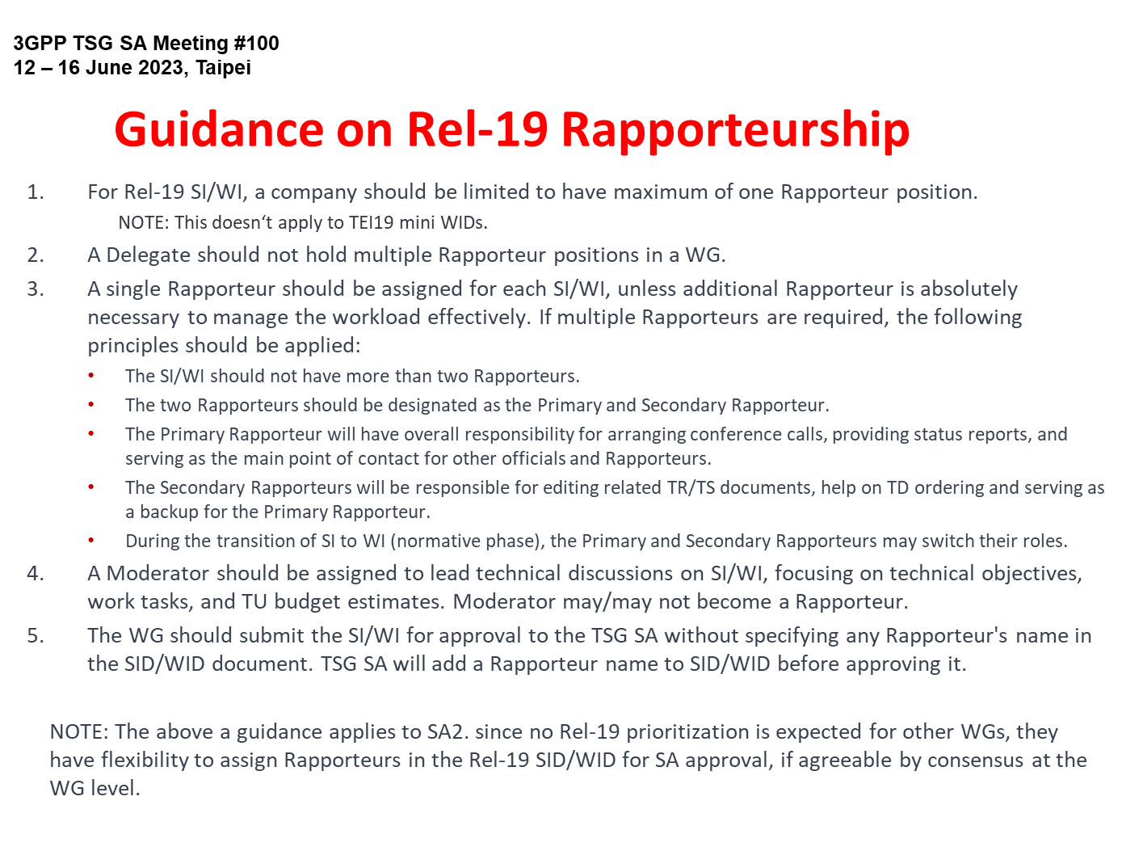
Reference: SP-230746
Note: The first bullet does not applicable to SA5.

Slide 31
Reference From TR 21.900 on rapporteur roles
4.1.2 Role of the specification rapporteur
The role of the rapporteur is to:
- Serve as Editor (following the guidance of the WG) until the specification is placed under change control.
- Deliver a clean specification to the MCC for editorial clean-up before submission for TSG approval to come under change control.
and, in co-operation with MCC, to:
- Review all CRs to the specification prior to agreement in the Working Group. This includes identifying and resolving clashes.
- Oversee the technical quality of the specification.
- Explain the specification to any other group (WG, TSG, inside or outside 3GPP), where appropriate.
- Serve as focal point for technical questions.
6.3.2 Role of the work item rapporteur
Every Work Item shall have a rapporteur. The rapporteur should be selected from regular attendees of the primary responsible Group and shall be selected from supporting companies. The role of the rapporteur is to:
- Monitor the progress of the work in all WGs for the WI.
- Report to the responsible WG and produce a report to the WG plenary on progress.
- Provide feedback to allow the work plan to be updated.
- Keep the WI sheet up-to-date.
- Identify the completion of the WI.
NOTE: Updates of WI sheets require approval by the responsible WG/TSG.

Slide 32
Annex
Release 19
  Expectation of SA5 rapporteur role
  SA5 TU planning & statistics

Slide 33
SA5 TU planning & statistics
OAM uses TU to facilitate the Rel-19 discussion.
Based on the collection of opinions in CH SWG from SA5#153, so far there is no need to use TU for CH in Rel-19 because of no expected need for prioritization process. This will be re-evaluated once Rel-19 Charging topics are identified.

Slide 34
Template for TU estimation
Moderators are requested to provide the following TU estimation based on the proposed objectives
Work Task ID | TU Estimate (Study) | TU Estimate (Normative) | RAN Dependency (Yes/No/Maybe) | SA Dependency (Yes/No/Maybe) | Non-3GPP Dependency
WT-1 | 1 | 1 | No | Maybe | No
WT-2
WT-3
TU estimates and dependencies
Total TU estimates for the study phase: ?
Total TU estimates for the normative phase: ?
Total TU estimates: 6

Slide 35
SA5 calendar with OAM TU (one track)
Assumption: Every day = 5 sessions (TUs), total TU in 1 ordinary meeting (exclude closing plenary TUs) = 18.5 TUs
Time | Monday | Tuesday | Wednesday | Thursday | Friday (Closing plenary)
Q0 (8:00~8:55) (If needed) | NA | Breakout (opt.) | Breakout (opt.) | Breakout (opt.) | Closing plenary Start at 8:30am (may change depends on the host restriction)
Q1 (9:00 - 10:30) | Plenary Session#1 (1TU) [Single Stream] | Stream#1 (1TU) | Stream#1 (1TU) | Stream#1 (1TU) | Closing plenary
10:30 - 11:00 | Morning Coffee Break | Morning Coffee Break | Morning Coffee Break | Morning Coffee Break | Morning Coffee Break
Q2 (11:00 - 12:30) | Stream#1 (1TU) | Stream#1 (1TU) | Stream#1 (1TU) | Stream#1 (1TU) | Closing plenary
12:30 - 14:00 | Lunch | Lunch | Lunch | Lunch | Lunch
Q3 (14:00 - 15:30) | Stream#1 (1TU) | Stream#1 (1TU) | Stream#1 (1TU) | Stream#1 (1TU) | Closing plenary
15:30 - 16:00 | Afternoon Coffee Break | Afternoon Coffee Break | Afternoon Coffee Break | Afternoon Coffee Break | Afternoon Coffee Break
Q4 (16:00 - 17:30) | Stream#1 (1TU) | Stream#1 (1TU) | Stream#1 (1TU) | Revision session | Closing plenary
17:30 - 17:40 | Break | Break | Break | Break | Break
Q5 (17:40 – 19:10) | Stream#1 (1TU) | Stream#1 (0.5 TU) Stop around 18:45 Social evening | Stream#1 (1TU) | Revision session

Slide 36
TU Budget for SA5 OAM
Assumptions for SA5 OAM :
  6 ordinary meeting per year.
  Rel-19 spans 21 months for SA5 (with early start of studies) = 10 meetings
  1 Session = 1.5 hour time window
  Max 5 sessions per meeting day
  1 Stream = 1 TU (Time Unit)
  1 TU is time (i.e., 1.5 hours) spent to discuss/handle technical contributions.
  Revisions/Drafting/offline conference call are not counted for the TU estimates.
  OAM revision sessions normally planned to be in Thursday Q4 and Q5 (initial assump.)
  1 parallel (OAM) stream per session => 18.5 TUs per meeting (incl. 2 TUs as buffer) = 185
  Assume Maintenance + Buffer = 33% as in SA2 => ~ 61 TU
  Resulting total TUs avail. f. SI/WI: 10 meetings x 18.5 sessions = 185 TU minus 61 => 124 TU
  With 21 SI/WI => Average 6 TU per SI/WI (0.6/meeting).

Slide 37
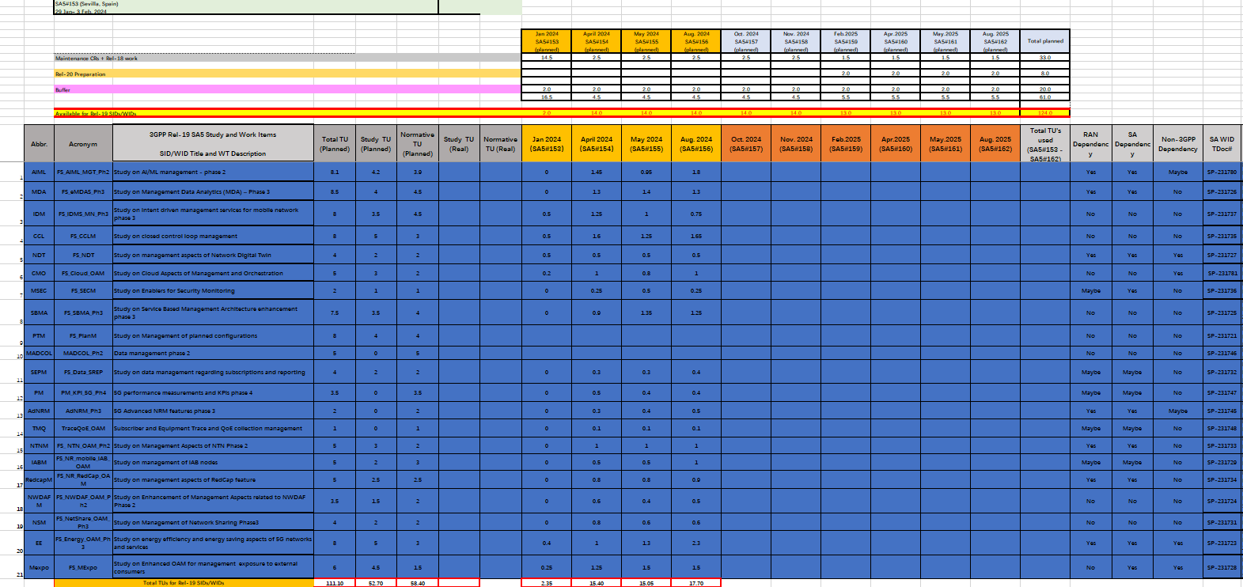
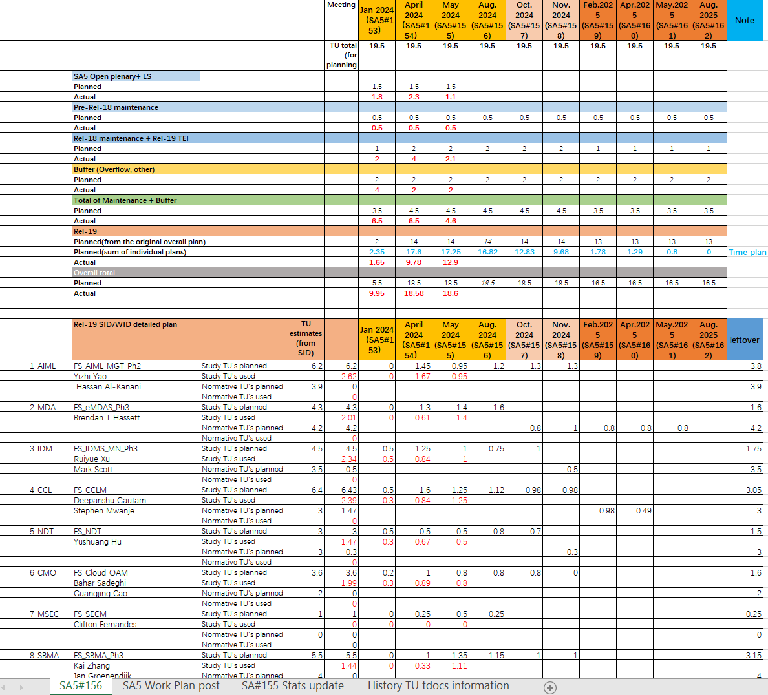
Sample of OAM TU planning and statistics
TU planning: to be proposed by rapporteurs and agreed by the group
TU statistics: to be filled by chair based on the time consumed after each meeting
This is an example to illustrate TU planning and statistics

Slide 38
SA5 calendar with CH TU (one track)
Assumption: Every day = 5 sessions (TUs), total TU in 1 ordinary meeting (exclude closing plenary TUs) = 15.5 TUs
Time | Monday | Tuesday | Wednesday | Thursday | Friday (Closing plenary)
Q0 (8:00~8:55) (If needed) |  | Breakout (opt.) | Breakout (opt.) |  | Closing plenary Start at 8:30am (may change depends on the host restriction)
Q1 (9:00 - 10:30) | Plenary Session#1 (1TU) [Single Stream] | Stream#1 (1TU) | Stream#1 (1TU) | Revision session | Closing plenary
10:30 - 11:00 | Morning Coffee Break | Morning Coffee Break | Morning Coffee Break | Morning Coffee Break | Morning Coffee Break
Q2 (11:00 - 12:30) | Stream#1 (1TU) | Stream#1 (1TU) | Stream#1 (1TU) | Revision session | Closing plenary
12:30 - 14:00 | Lunch | Lunch | Lunch | Lunch | Lunch
Q3 (14:00 - 15:30) | Stream#1 (1TU) | Stream#1 (1TU) | Stream#1 (1TU) | CH Closing | Closing plenary
15:30 - 16:00 | Afternoon Coffee Break | Afternoon Coffee Break | Afternoon Coffee Break | Afternoon Coffee Break | Afternoon Coffee Break
Q4 (16:00 - 17:30) | Stream#1 (1TU) | Stream#1 (1TU) | Stream#1 (1TU) | CH Closing | Closing plenary
17:30 - 17:40 | Break | Break | Break | Break | Break
Q5 (17:40 – 19:10) | Stream#1 (1TU) | Stream#1 (0.5 TU) Stop around 18:45 Social evening | Stream#1 (1TU) | CH Closing(Opt.)

Slide 39
TU Budget for SA5 CH
Assumptions for SA5 CH :
  6 ordinary meeting per year.
  Rel-19 spans 18 months for SA5 (with early start of studies) = 8 meetings
  1 Session = 1.5 hour time window
  Max 5 sessions per meeting day
  1 Stream = 1 TU (Time Unit)
  1 TU is time (i.e., 1.5 hours) spent to discuss/handle technical contributions.
  Revisions/Drafting/offline conference call are not counted for the TU estimates.
  CH revision sessions normally planned to be in Thursday Q1 and Q2 (initial assump.),CH closing plenary planned to be in Thursday Q3 and Q4.
  1 (CH) stream per session => 15.5 TUs per meeting (incl. 2 TUs as buffer) = 124
  Assume Maintenance + Buffer = 33% as in SA2 => ~ 41 TU
  Resulting total TUs avail. f. SI/WI: 9 meetings x 15.5 sessions = 124 TU minus 41 => 83 TU
  => Recommended MAX no. of SI/WI = 14
  With 14 SI/WI => Average 6 TU per SI/WI (0.75/meeting).

Slide 40
Summary of SA5 Rel-19 management support to SA2 features
Acronym | OAM | Not covered by SA5 OAM yet
5GSAT_Ph3_ARCH | FS_ NTN_OAM_Ph2
NG_RTC_Ph2 | NA
XRMPh2 |  | OAM (NRM+PM)??
MPS4msg | NA
VMR_Ph2 |  | OAM (NRM+PM)??
5G_ProSe_Ph3 |  | OAM (NRM+PM)??
UIA_ARC | NA
eEDGE_5GC_Ph3 | AdNRM_Ph3
UAS_Ph3 | NA
UPEAS_Ph2 |  | OAM (NRM+PM)??
5G_Femto |  | OAM (NRM+PM)??
MASSS |  | OAM (NRM+PM)??
AIML_CN | FS_AIML_MGT_Ph2 FS_NWDAF_OAM_Ph2
TEI19_NetShare | FS_NetShare_OAM_Ph3
FS_AmbientIoT |  | OAM (TBD)
FS_EnergySys | FS_Energy_OAM_Ph3 FS_MExpo
Summary:
SA2:
1. The following features, there are no extra management standardization support identified so far:
NG_RTC_Ph2
MPS4msg
UIA_ARC
UAS_Ph3
2. The following features, management support are to be provided in corresponding SA5 Rel-19 work
eEDGE_5GC_Ph3
  Configurations to manage features to manage Edge. (adNRM)
AIML_CN
  Coordination of AIML in CN and management AIML features (AIML)
TEI19_NetShare
  Configurations to manage features to manage NetShare. (adNRM)
FS_EnergySys
  Coordination of EE in CN and management EE features (AIML)
  Coordination of EE in CN and management EE expo features (Mexpo)
3. The following features, need to check whether OAM support are needed in Reld-19.
XRMPh2
VMR_Ph2
5G_ProSe_Ph3
UPEAS_Ph2
5G_Femto
MASSS
FS_AmbientIoT
Rapporteurs are requested to check and provide inputs to this slides.

