Slide 1
3GPP-ZSM joint discussion on Intent Driven Management
3th August,2023

Slide 2
Proposed agenda:
Welcome and (quick) introductions (~5 mins)
Introduction to SA5 workplan and progress on intent (~35 mins)
Introduction to ZSM workplan and progress on intent (~35 mins)
Discussion on further collaboration and way forward (~45 mins)

Slide 3
SA5 workplan

Slide 4
Outcome from 3GPP work on intent driven management
3GPP SA5 start the intent driven management work since June 2018.
Release 17
TR 28.812 Telecommunication management; Study on scenarios for Intent driven management services for mobile networks.
Published in Sep 2020.
TS 28.312 (R17) Management and orchestration; Intent driven management services for mobile networks.
Published in June 2022.
Release 18
TR 28.912 Study on enhanced intent driven management services for mobile networks.
Published in June 2023.
TR 28.836 Study on intent-driven management for network slicing.
Target date: Sep 2023.
TS 28.312 (R18) Management and orchestration; Intent driven management services for mobile networks.
  Target date: Dec 2023.

Slide 5
Key outcomes from R17 Intent Driven Management WI

Slide 6
3GPP R17 Intent definition and concept
Intent Definition:
Intent: expectations including requirements, goals and constraints given to a 3GPP system, without specifying how to achieve them.
General Concept of Intent:
An intent is typically understandable by humans, and also needs to be interpreted by a machine without any ambiguity.
An intent focuses more on describing the "What" needs to be achieved and less on "How" the outcomes should be achieved…
The expectations expressed by an intent are agnostic to the underlying system implementation, technology and infrastructure…
An intent needs to be quantifiable from network data so that the fulfilment result can be measured and evaluated.
Source: TS 28.312 v17.4.1

Slide 7
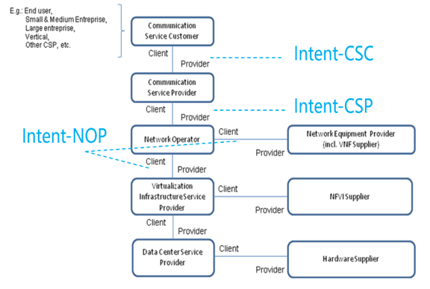
3GPP R17 Intent categories
Intent categories based on user types:
Based on roles related to 5G networks and network slicing management, different kinds of intents are applicable for different kinds of standardized reference interfaces.
- Intent from Communication Service Customer (Intent-CSC): Intent from Communication Service Customer enables Communication Service Customer (CSC) to express which properties of a communication service the CSC may request from CSP without knowing how to do the detailed management for communication service. For example, Intent-CSC can be 'Enable a V2X communication service for a group of vehicles in certain time'.
- Intent from Communication Service Provider (Intent-CSP): Intent from Communication Service Provider enables Communication Service Provider (CSP) to express an intent about what CSP would like to do for network without knowing how to do the detailed management for network. For example, Intent-CSP can be 'Provide a network service supporting V2X communications for Highway-417 to support 500 vehicles simultaneously'.
- Intent from Network Operator (Intent-NOP): Intent from Network Operator enables Network Operator (NOP) to provide what NOP would like to do for group of network elements (i.e. subnetwork) management and control without knowing how to do the detailed management for the network elements. For example, Intent-NOP can be 'Provide a radio network service to satisfy the specified coverage requirements and UE throughput requirement in certain area'.
Source: TS 28.312 v17.4.1

Slide 8
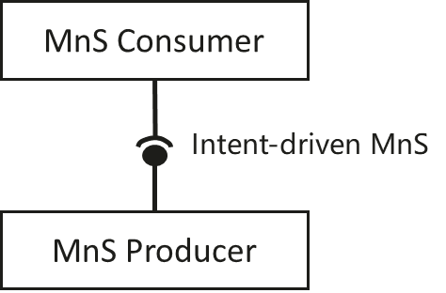
3GPP R17 intent driven MnS concept
Concept of Intent driven MnS
Intent support in 3GPP is provided via an Intent Driven Management Service (MnS). As with other 3GPP defined MnSs in Service Based Management Architecture (SBMA), an intent driven MnS Producer (provided by an intent driven system) allows
Its MnS consumer to express intents for managing the network and services and to obtain feedback of intent evaluation results.
Its MnS producer to provide the following intent handling capabilities:
Validate the intent
Translate the received intent to executable actions by:
- Performing service or network management tasks.
- Identifying, formulating and activating service or network management policies.
Evaluate the result/information about the intent fulfilment (e.g. the intent is initially satisfied or not) and intent assurance (e.g. the intent is continuously satisfied).
When the intent is created on the MnS producer, the MnS producer may consume other management services (including non-intent driven MnS and intent driven MnS) to fulfil or satisfy the intent, e.g. creating new assurance closed control loop instance(s) or using assurance closed control loop instance (s) to satisfy the intent. The internal implementation of the intent fulfilment will not be standardized
Source: TS 28.312 v17.4.1

Slide 9
3GPP R17 intent driven MnS concept
Management capability of Intent driven MnS
An Intent driven MnS includes the following management capabilities to support intent lifecycle management:
- Create an intent, a MnS Consumer request to create a new intent on the MnS producer.
- Delete an intent, MnS Consumer request to remove an intent on the MnS producer.
- Modify an intent, MnS Consumer request to modify the content of the intent (e.g. optimization goal) on the MnS producer.
- Query an intent, MnS Consumer request to return the content and state (e.g. active, inactive) of the intent on the MnS producer.
Mentioned, but not defined as of Rel-17:
Activate an intent, MnS Consumer request to activate an intent on the MnS producer when the intent is suspended.
De-activate an intent, MnS consumer request to de-activate an intent on the MnS producer for a temporary suspension.
Source: TS 28.312 v17.4.1

Slide 10
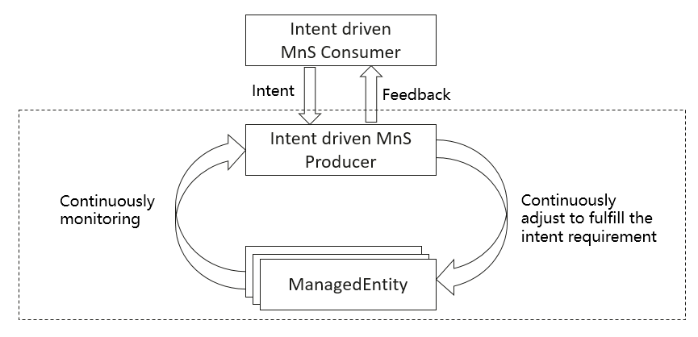
3GPP R17 Intent driven closed loop concept
Intent driven closed-loop
Intent can be used for management and control of closed-loop automation (e.g. intent can be used to specify the goals for the closed-loop), which means the intent can be translated to policies and management tasks that the MnS producer needs to execute for the closed-loop automation. In the intent driven management approach, the mechanisms that the MnS producer using closed-loop automation mechanisms to satisfy the intent is the implementation of the MnS producer and shall not be standardized.
Source: TS 28.312 v17.4.1

Slide 11
3GPP R17 Intent driven Use cases
Intent driven approach for delivering radio network
Intent driven approach for delivering a radio service
Intent driven approach for delivering a service
Intent driven approach for coverage performance to be assured
Intent driven approach for RAN UE throughput performance to be assured
Source: TS 28.312 v17.4.1

Slide 12
3GPP R17 Intent Driven MnS Stage2 and Stage3 definition
Management operations for intent (MnS component type A)
The operations (e.g. createMOI operations) and notifications (e.g. notifyMOIcreation) of generic provisioning MnS defined in 3GPP TS 28.532 [3] can be used for intent lifecycle management.
intent lifecycle management | IS operation | HTTP Method | Resource URI
Create an intent | createMOI operation | PUT | {MnSRoot}/ProvMnS/{MnSVersion}/{URI-LDN-first-part}/{intent}={id}
Delete an intent | deleteMOI operation | DELETE | {MnSRoot}/ProvMnS/{MnSVersion}/{URI-LDN-first-part}/{intent}={id}
Modify an intent | modifyMOIAttributes operation | PUT PATCH | {MnSRoot}/ProvMnS/{MnSVersion}/{URI-LDN-first-part}/{intent}={id}
Query an intent | getMOIAttributes operation | GET | {MnSRoot}/ProvMnS/{MnSVersion}/{URI-LDN-first-part}/{intent}={id}
OpenAPI: https://forge.3gpp.org/rep/sa5/MnS/-/blob/Rel-17/OpenAPI/TS28532_ProvMnS.yaml
Source: TS 28.532 and TS 28.312 v 18.0.0

Slide 13
3GPP R17 Intent Driven MnS Stage2 and Stage3 definition
Intent Information Model(MnS component type B)
Generic Intent model
Attribute Name | Support Qualifier | isReadable | isWritable | isInvariant | isNotifyable
intentExpectations | M | T | T | F | F
userLabel | M | T | T | F | F
intentContexts | O | T | T | F | F
intentFulfilmentinfo | M | T | F | F | T
Attribute Name | Support Qualifier | isReadable | isWritable | isInvariant | isNotifyable
expectationId | M | T | T | T | T
expectationVerb | O | T | T | T | F
expectationObject | M | T | T | F | F
expectationTargets | M | T | T | F | F
expectationContexts | O | T | T | F | F
expectationfulfilmentInfo | O | T | F | F | T
NOTE: The scenario/requirements-specific IntentExpectations are defined utilizing the constructs of this generic IntentExpectation model.
Attribute Name | Support Qualifier | isReadable | isWritable | isInvariant | isNotifyable
targetName | M | T | T | F | T
targetCondition | M | T | T | F | F
targetValueRange | M | T | T | F | F
targetContexts | O | T | T | F | F
targetfulfilmentInfo | O | T | F | F | T
Attribute Name | Support Qualifier | isReadable | isWritable | isInvariant | isNotifyable
objectType | CM | T | T | F | F
objectInstance | CM | T | T | F | F
objectContexts | O | T | T | F | F
OpenAPI: https://forge.3gpp.org/rep/sa5/MnS/-/blob/Integration_Rel17_SA5_149_YAML/OpenAPI/TS28312_IntentNrm.yaml
Source: TS 28.312 v 17.4.1

Slide 14
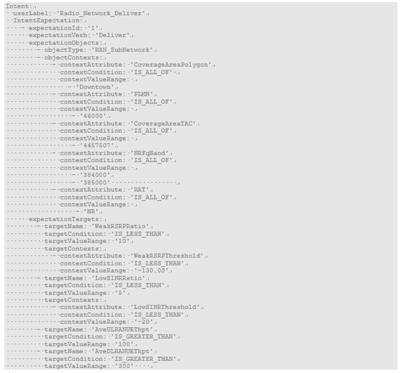
3GPP R17 Radio Network Expectation
Scenario specific intent expectation: Radio Network Expectation and ServiceSupport Expectation, following use the Radio Network Expectation as example
Radio Network Expectation
YAML document example for intent containing an expectation for delivering radio network
Radio Network Expectation is used to express expectations for RAN SubNetwork delivery and performance assurance.
It is defined using generic IntentExpectation <<dataType>> with a set of allowed values and supporting dataTypes as follows:
Attribute Name | Allowed Values
ObjectType | RAN SubNetwork
ObjectInstance | DN of the RAN SubNetwork
Attribute Name | Allowed Values
ObjectContexts | CoverageAreaPolygonContext CoverageTACContext PLMNContext NRFqBandContext RATContext
expectationTargets | WeakRSRPRatioTarget LowSINRRatioTarget AveULRANUEThptTarget AveDLRANUEthptTarget LowULRANUEThptRatioTarget LowDLRANUEThptRatioTarget
openAPI: https://forge.3gpp.org/rep/sa5/MnS/-/blob/Integration_Rel17_SA5_149_YAML/OpenAPI/TS28312_IntentExpectations.yaml
Source: TS 28.312 v18.0.0

Slide 15
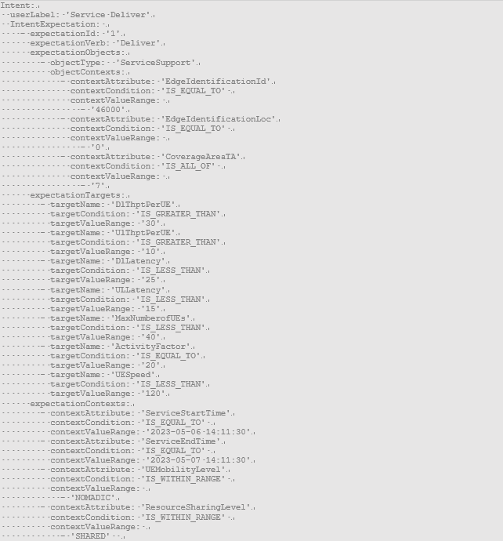
3GPP R17 Service Support Expectation
Service Support Expectation
YAML document example for Intent containing an expectation for delivering a service
Service Support Expectation is used to express expectations for service deployment.
It is defined using generic IntentExpectation <<dataType>> with a set of allowed values and supporting dataTypes as follows:
Attribute Name | Allowed Values
ObjectType | ServiceSupport
ObjectInstance | DN of the ServiceSupport
Attribute Name | Allowed Values
ObjectContexts | EdgeIdenfiticationIdContext EdgeIdenfiticationLocContext CoverageAreaTAContext
expectationTargets | DlThptPerUETarget UlThptPerUETarget DLLatencyTarget ULLatencyTarget MaxNumberofUEsTarget ActivityFactorTarget UESpeedTarget
expectationContexts | ServiceStartTimeContext ServiceEndTimeTargetContext UEMobilityLevelContext ResourceSharingLevelContext
openAPI: https://forge.3gpp.org/rep/sa5/MnS/-/blob/Integration_Rel17_SA5_149_YAML/OpenAPI/TS28312_IntentExpectations.yaml
Source: TS 28.312 v18.0.0

Slide 16
Workflow example of creating Intent containing an expectation for delivering radio network
Implemented by createMOI operation +Radio Network Intent
Implemented by notifyMOIAttributeValueChanges operation+ Radio Network Intent feedback information
Figure Source: TS 28.312 v 17.4.1

Slide 17
Key outcomes from R18 FS_enhanced Intent Driven Management Service SI

Slide 18
3GPP R18 New scenarios and new capabilities
New Scenarios
New capabilities
Intent driven approach for RAN energy saving
Intent driven approach for radio network capacity optimization
5GC related intent expectation, including 5GC network delivering and assurance
Intent report
Intent handling capability obtaining
Intent fulfilment feasibility check
Monitoring intent fulfilment information
Intent conflicts
Intent-driven Closed Loop control
Enablers for Intent Fulfilment
  Testing Intent-driven MnS Capabilities
  Mapping of Intents to MLEntities capabilities
  Intent-driven SON orchestration
  Intent-driven MDA
Missing solutions for the requirements documented in TS 28.312
Solution for radio service intent expectation
Enhancement for service support expectation
Figure Source: TR 28.912 v18.0.0

Slide 19
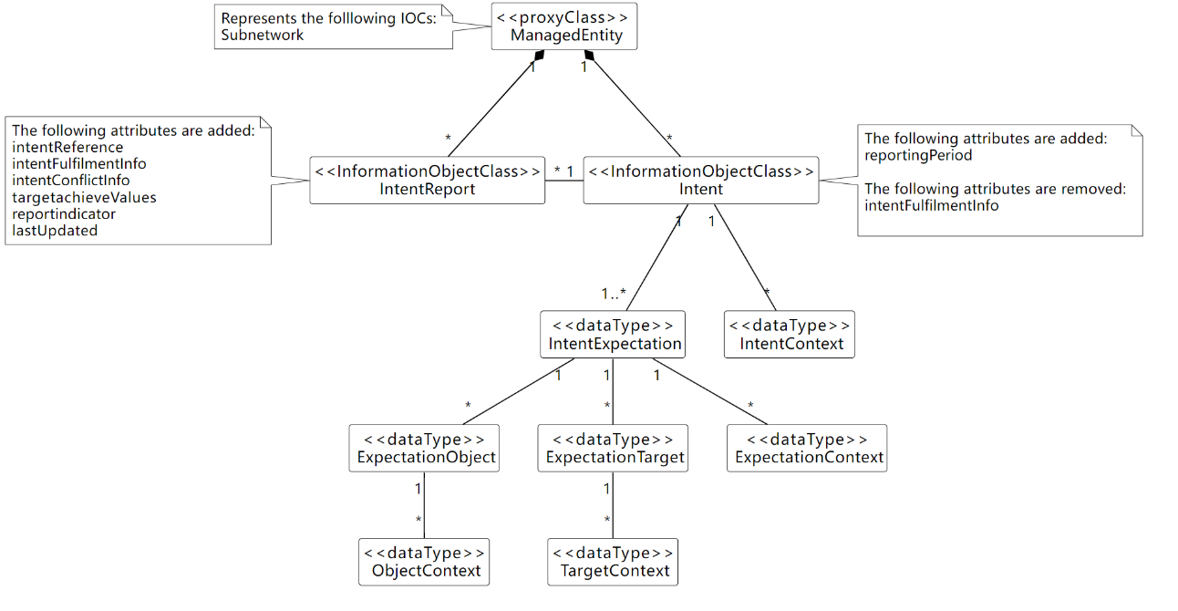
3GPP R18 Potential solutions for intent report
Intent Report
The IntentReport <<IOC>> includes the following attributes:
- "intentFulfimentInfo", to represent the fulfilment information for intent, intent expectation and expectation targets.
"intentConflictInfo", to represent the intent conflict information that should be informed to the MnS consumer.
"intentFeasibilityCheckInfo", to represent the intent fulfilment feasibility check information that should be informed to the MnS consumer.
- "targetAchieveValues", to represent the current performance value for the ExpectationTargets.

Slide 20
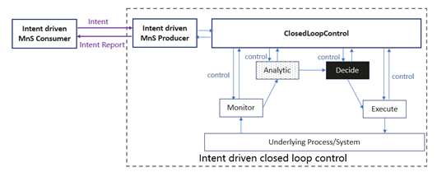
3GPP R18 Potential solutions for intent driven closed loop control
Using Intents towards Closed-Loop Control to automate closed loops management and control
Solution Description:
  Introduce an expectation with targets which capture the objectives for an entity that undertakes optimization; This enables the MnS Producer to take steps, e.g., configure closed loops or the goals thereof intended to deliver on those targets.
  The network optimization expectation may include relative prioritizations of the different targets which indicate the relative interests of the intent MnS consumer on the different optimization targets.
  Introduce the list of Closed loop Identifiers (e.g., DN of AssuranceClosedControlLoop) in IntentReport IOC to represent the closed loop instance(s) used to satisfy the intent.
Figure Source: TR 28.912 v18.0.0

Slide 21
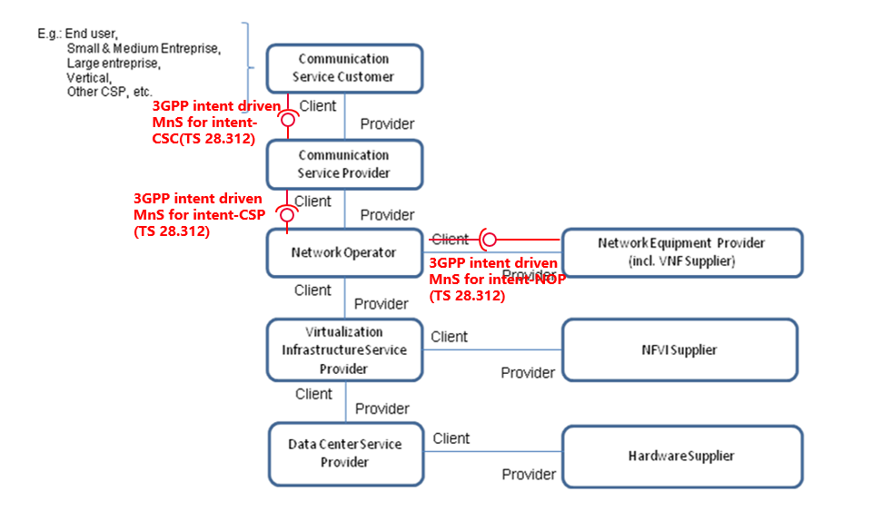
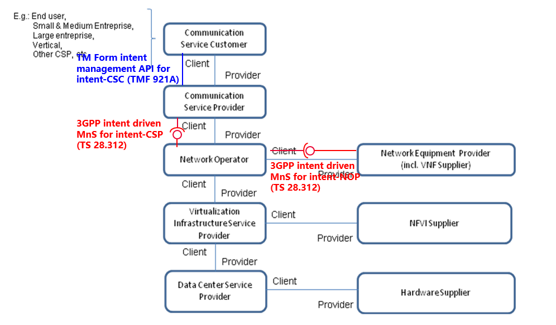
3GPP R18 Potential solutions for collaboration with other SDOs
Potential deployment scenarios for intent interface
Potential deployment scenario#1
Potential deployment scenario#2
In this deployment scenario, 3GPP intent driven MnS (defined in TS 28.312[2]) can be applicable for following kinds of standardized reference interfaces for the management of 3GPP network and services:
- Management interactions for Intent-NOP between NOP and NEP;
- Management interactions for Intent-CSP between CSP and NOP;
- Management interactions for Intent-CSC between CSC and CSP;
In this deployment scenario, 3GPP intent driven MnS can be applicable for following kinds of standardized reference interfaces for the management of 3GPP network and services:
- Management interactions for Intent-NOP between NOP and NEP;
- Management interactions for Intent-CSP between CSP and NOP;
TM Form intent management API can be applicable for following kinds of standardized reference interfaces for the management of 3GPP network and services:
- Management interactions for Intent-CSC between CSC and CSP;
Figure Source: TR 28.912 v18.0.0

Slide 22
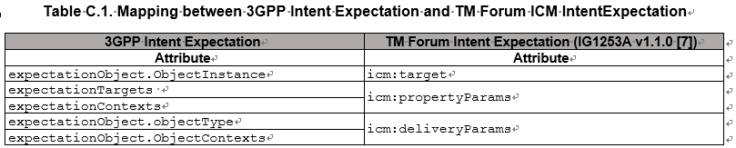
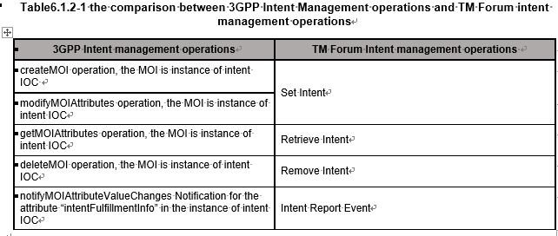
3GPP R18 Potential solutions for collaboration with other SDOs
Guidelines for transformation functionality between TM Forum intent management API for intent-CSC
Mapping the 3GPP and the TM Forum intentExpectation Models.
Comparison of 3GPP intent management operations and TM Forum intent management operations
Figure Source: TR 28.912 v18.0.0

Slide 23
Progress and Plan for R18 Intent Driven MnS for Mobile Network WI

Slide 24
3GPP R18 IDMS_MN_ph2 WI
UID | Name | Acronym | Target | Old % | WID | New % | Change or comment
990030 | Intent driven Management Service for Mobile Network phase 2 | IDMS_MN_ph2 | SA#102 (Dec 2023) | 0% | SP-230180 | 40%
Objectives:
Improve and correct the existing solutions for generic intent model in TS 28.312.
Specify requirements and solutions for new scenarios for intent driven management for 3gpp network and services, including:
Intent driven approach for RAN energy saving
Intent driven approach for radio capacity assurance
Intent driven approach for 5GC management, specifically 5GC network delivering
Specify new capabilities and solutions for intent driven management, including:
Intent report, including report intent fulfilment information and achieved value for expectation targets.
Intent conflict management, specifically priority information for intent, and notify/report intent conflict information.
Enablers for Intent Fulfilment, specifically mapping of Intents to MLEntities capabilities.
Intent fulfilment feasibility checks
Intent handling capability obtaining (i.e. allow MnS consumer know what expectation targets and expectation objects can be supported by MnS producer)
Improve the existing solutions and specify new solutions for the requirements documented in TS 28.312:
Radio service intent expectations
Enhancement of radio network intent expectations
Describe collaboration with other SDOs in the Annex of TS 28.312, including deployment scenarios for intent interface, and comparison of management operations and processes for intent management.
Stage 1 (use case and requirements) finished

Slide 25
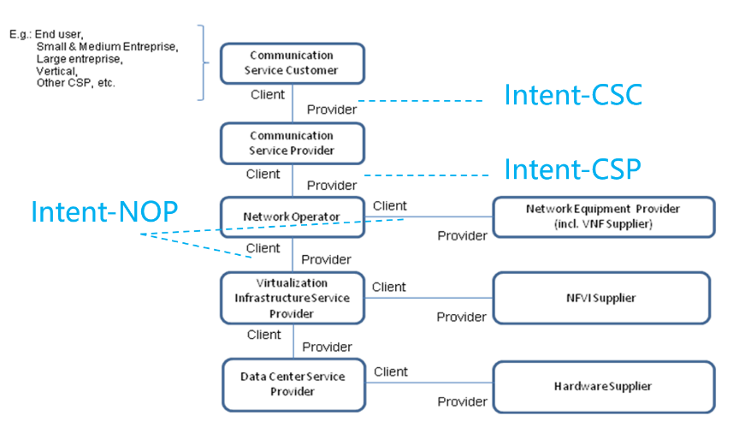
Questions
3GPP identified three types of intent (i.e. intent-CSC, intent-CSP and intent-NOP), what’s main focus of ZSM on intent?
Do 3GPP and ZSM align on Intent definition and concepts?
Does ZSM have specific use case for intent?
Regarding interfaces (as shown on right) where and how, does ZSM see its potential solution fitting in?
Does ZSM have any requirements regarding preferred modeling and/or implementation that need to be considered?
Is ZSM also collaborating with others to define intent mgmt? If so, on which aspects?

Slide 26
3GPP proposals
3GPP is open for collaborating with ZSM on intent driven management based on selected use cases.
The collaboration shall take 3GPP time plan into account. R18 WI started from March 2023 and will be finished in March 2024.

Slide 27
Thanks

Slide 28
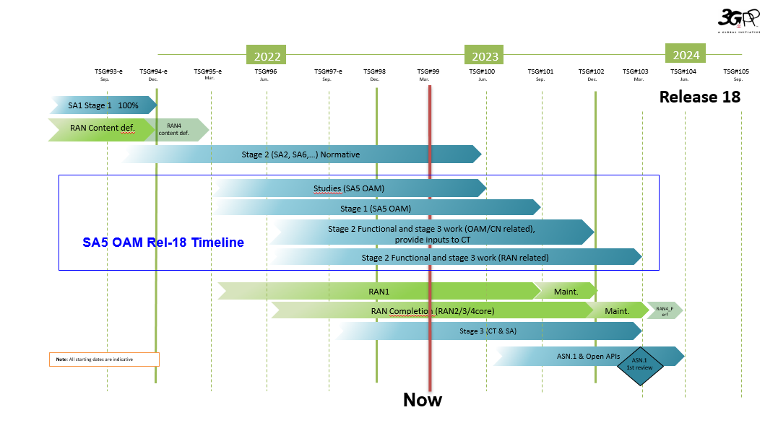
3GPP SA5/OAM R18 timeline
Source: S5-221173

