Slide 1
3GPP-TMF call
23 February,2022

Slide 2
Proposed agenda
This is a proposed agenda for the meetings:
Share views on intent concept, model progress from both groups
Open discussion on benefits from Model federation and obstacles
  Division of responsibilities and eliminating dependencies
  Model versions handling, compatibility rules, etc
Open discussion on cooperation mechanism
  Coordinate the work plan: align the time plan of relevant intent project stage 2 (IG1253 suite) and stage 3 (TMF921) in TM Forum, with work plan in 3GPP R17 (TS 28.312, including stage2 and stage3) and R18 intent study item (TR 28.912) .
  Mechanisms on alignment/collaboration between 3GPP and TM Forum: open discussion
  How can 3GPP influence definition of Intent Common Model if it is administrated by TM Forum
AOB
Source: S5-221493 (Reply to TM Forum Liaison AN LS22)

Slide 3
Share views on intent concept, model progress from both groups

Slide 4
Outcome from 3GPP R17 work on intent driven management
TR 28.812 Telecommunication management; Study on scenarios for Intent driven management services for mobile networks.
Status: Published in Sep 2020, started from June 2018.
TS 28.312 Management and orchestration; Intent driven management services for mobile networks.
  Status: Ongoing (Current completion rate is 95%, and planned to be completed and published in June in line with 3GPP R17 timeline)

Slide 5
3GPP R17 Intent definition and concept
Intent Definition:
Intent: the expectations including requirements, goals and constraints given to a 3GPP system, without specifying how to achieve them.
General Concept of Intent:
An intent is typically understandable by humans, and also needs to be interpreted by the machine without any ambiguity.
An intent focuses more on describing the "What" needs to be achieved but less on "How" that outcomes should be achieved…
The expectations expressed by an intent is agnostic to the underlying system implementation, technology and infrastructure…
An intent needs to be quantifiable from network data so that the fulfilment result can be measured and evaluated.
Source: TS 28.312 v 0.8.0 (S5-221747)

Slide 6
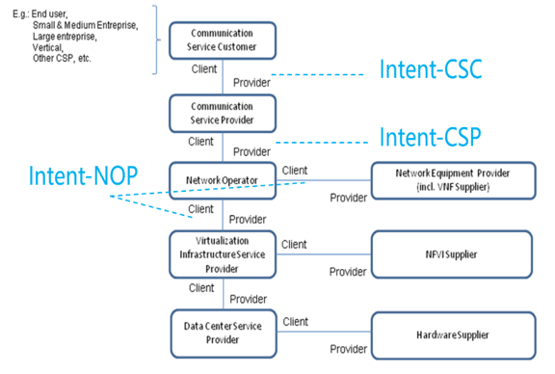
3GPP R17 Intent categories
Intent categories based on user types:
Based on roles related to 5G networks and network slicing management, different kinds of intents are applicable for different kinds of standardized reference interfaces.
- Intent from Communication Service Customer (Intent-CSC): Intent from Communication Service Customer enables Communication Service Customer (CSC) to express which properties of a communication service the CSC may request from CSP without knowing how to do the detailed management for communication service. For example, Intent-CSC can be 'Enable a V2X communication service for a group of vehicles in certain time'.
- Intent from Communication Service Provider (Intent-CSP): Intent from Communication Service Provider enables Communication Service Provider (CSP) to express an intent about what CSP would like to do for network without knowing how to do the detailed management for network. For example, Intent-CSP can be 'Provide a network service supporting V2X communications for highway-417 to support 500 vehicles simultaneously'.
- Intent from Network Operator (Intent-NOP): Intent from Network Operator enables Network Operator (NOP) to provide what NOP would like to do for group of network elements (i.e. subnetwork) management and control without knowing how to do the detailed management for the network elements. For example, Intent-NOP can be 'Provide a radio network service to satisfy the specified coverage requirements and UE throughput requirement in certain area'.
Source: TS 28.312 v 0.8.0 (S5-221747)

Slide 7
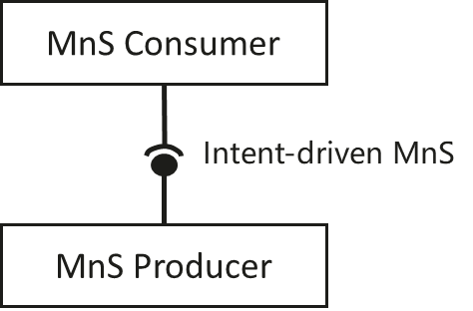
3GPP R17 intent driven MnS concept
Concept of Intent driven MnS
An Intent driven MnS allows its consumer to express intents for managing the network and services and obtain the feedback of intent evaluation result. An Intent driven MnS includes the following management capabilities to support intent lifecycle management:
- Create an intent, a MnS Consumer request to create a new intent on the MnS producer.
- Activate an intent, MnS Consumer request to activate an intent on the MnS producer when the intent is suspended.
- De-activate an intent, MnS consumer request to de-activate an intent on the MnS producer for a temporary suspension.
- Delete an intent, MnS Consumer request to remove an intent on the MnS producer.
- Modify an intent, MnS Consumer request to modify the content of the intent (e.g. optimization goal) on the MnS producer.
- Query an intent, MnS Consumer request to return the content and state (e.g. active, inactive) of the intent on the MnS producer.
Source: TS 28.312 v 0.8.0 (S5-221747)

Slide 8
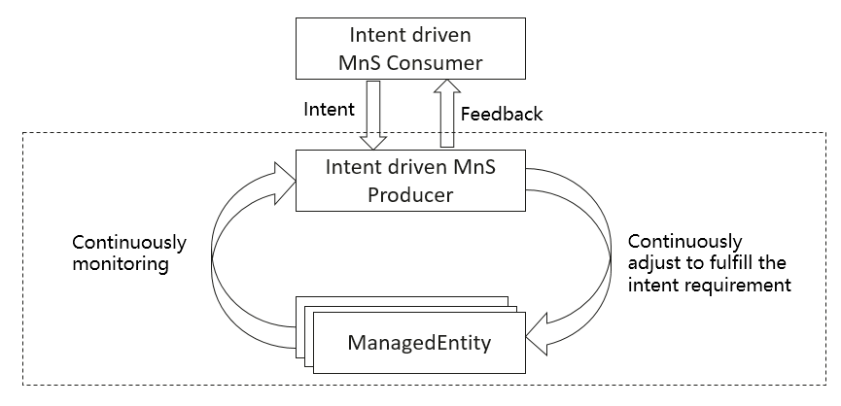
3GPP R17 Intent driven closed loop concept
Intent driven closed-loop
Intent can be used for management and control of closed-loop automation (e.g. intent can be used to specify the goals for the closed-loop), which means the intent can be translated to policies and management tasks that the MnS producer needs to execute for the closed-loop automation. In the intent driven management approach, the mechanisms that the MnS producer using closed-loop automation mechanisms to satisfy the intent is the implementation of the MnS producer and shall not be standardized.
Source: TS 28.312 v 0.8.0 (S5-221747)

Slide 9
3GPP R17 Intent driven Use cases
Intent containing an expectation for delivering radio network
Intent containing an expectation for delivering a radio service
Intent containing an expectation for delivering a service
Intent containing an expectation on coverage performance to be assured
Intent containing an expectation on RAN UE throughput performance to be assured
Source: TS 28.312 v 0.8.0 (S5-221747)

Slide 10
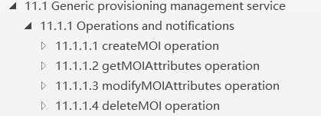
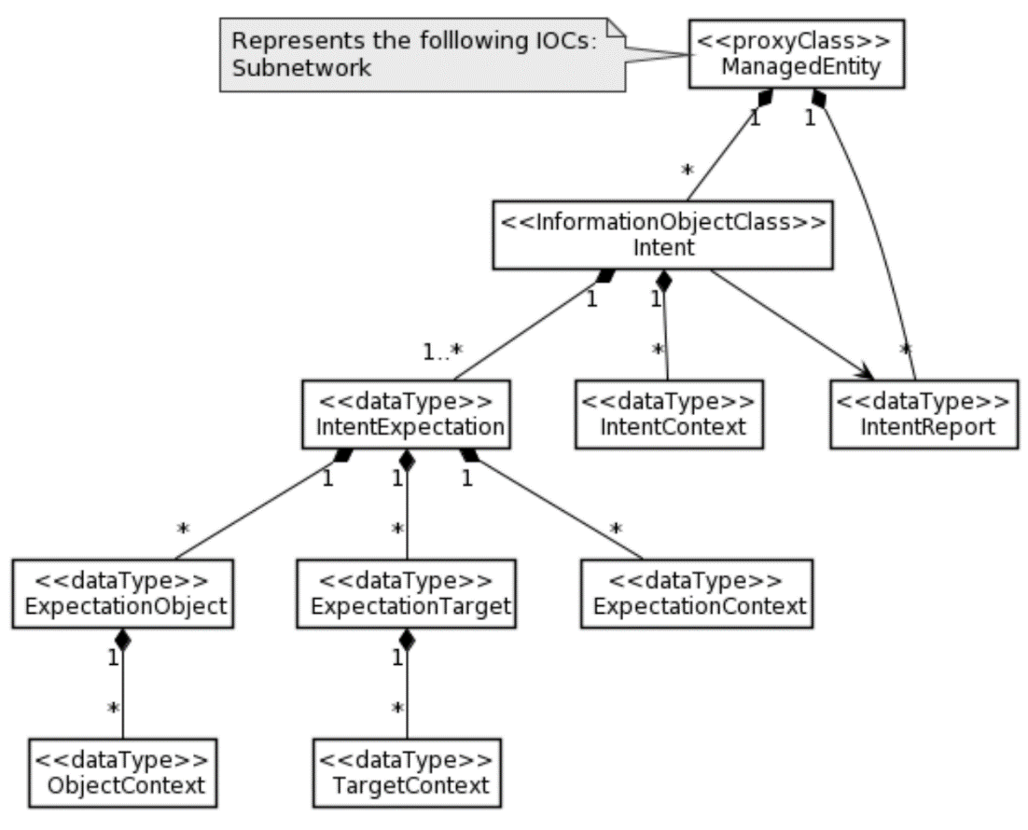
3GPP R17 Intent Driven MnS Stage2 and Stage3 definition
Management operations for intent (MnS component type A)
Intent Information Model(MnS component type B)
Generic Intent model
Two scenario specific intent expectation (Radio Network Expectation and ServiceSupport Expectation)
OpenAPI:
https://forge.3gpp.org/rep/sa5/MnS/-/blob/Rel17-draft/OpenAPI/provMnS.yaml
https://forge.3gpp.org/rep/sa5/MnS/-/blob/TS_28.312_intent_NRM_For_merge/OpenAPI/intentNrm.yaml
The stage2 and corresponding openAPI(stage3) have been specified in TS 28.532 and TS 28.312
Source: TS 28.312 v 0.8.0 (S5-221747) and TS 28.532

Slide 11
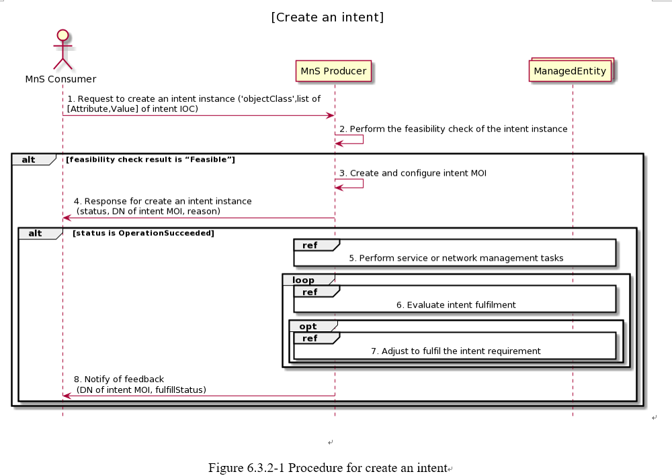
Workflow example of creating Intent containing an expectation for delivering radio network
Implemented by createMOI operation +Radio Network Intent
Implemented by notifyMOIAttributeValueChanges operation+ Radio Network Intent feedback information
Figure Source: TS 28.312 v 0.8.0 (S5-221747)

Slide 12
3GPP R18 intent way forward
3GPP R18 intent related study items
R18 Study on enhanced intent driven management services for mobile networks (the outcome will be documented in TR 28.912)
Status: new SID agreed in Dec 2021 and to be start in April 2022.
R18 Study on intent-driven management for network slicing (the outcome will be documented in TR XXXX)
Status: new SID agreed in Jan 2022 and to be start in April 2022.

Slide 13
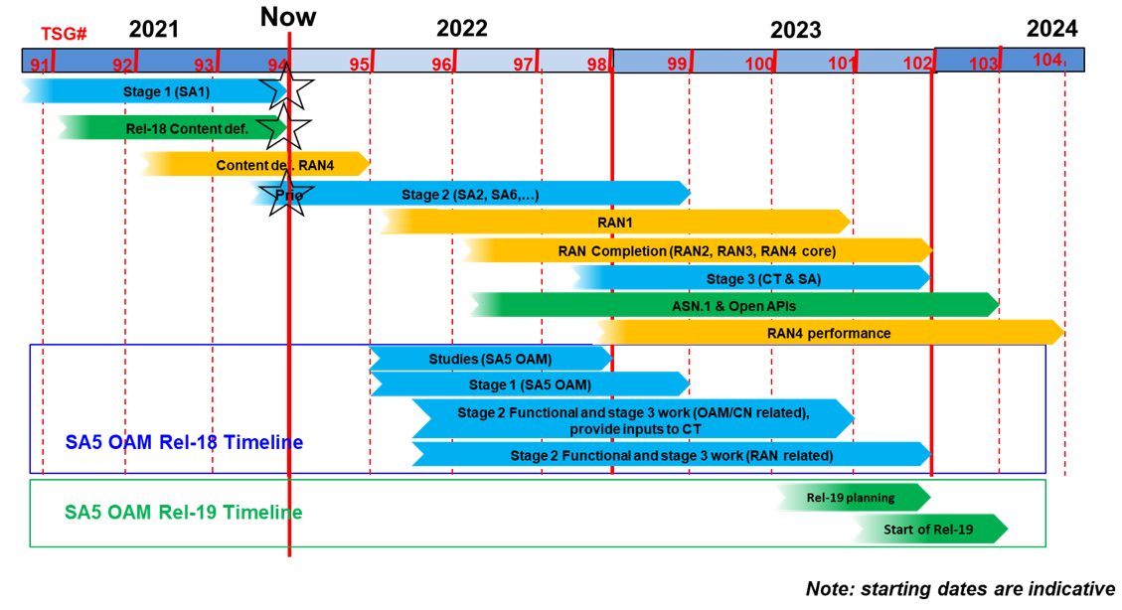
3GPP SA5/OAM R18 timeline
Source: S5-221173

Slide 14
Open discussion on benefits from Model federation and obstacles
  Division of responsibilities and eliminating dependencies
  Model versions handling, compatibility rules, etc

Slide 15
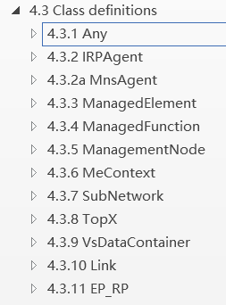
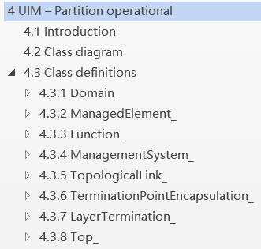
3GPP practice with TM Forum: Fixed Mobile Convergence (FMC) Federated Network Information Model (FNIM) Umbrella Information Model (UIM)
The purpose is that, by de-coupling different domain/technical specific models with umbrella model (as much as possible), the technologies may evolve independently and yet retain compatibility. In this case, each SDO can develop its own concrete intent information model, but still being semantically consistent.
UIM introduces a number of classes, which are represented in UML and are implementation neutral views in that they only capture the semantics of the model from both a purpose neutral and purpose specific perspective.
Various SDOs and organizations are expected to use the UIM classes for definition of Domain/Technology-specific model classes. This procedure will maximize the probability of the domain/technology specific concrete classes (from various SDOs) being semantically consistent, a necessary characteristic for FMC NM purposes.
The UIM cannot be used directly for implementation. Implementation classes must be derived from those in the UIM by Inheritance or some other appropriate mechanism.
3GPP specific model which realized from the UIM
Joint developed by 3gpp and TM Forum
Source: TS 28.620 and TS 28.622
TM Forum specific model which realized from the UIM

Slide 16
Open discussion on cooperation mechanism
  Coordinate the work plan: align the time plan of relevant intent project stage 2 (IG1253 suite) and stage 3 (TMF921) in TM Forum, with work plan in 3GPP R17 (TS 28.312, including stage2 and stage3) and R18 intent study item (TR 28.912) .
  Mechanisms on alignment/collaboration between 3GPP and TM Forum: open discussion
  How can 3GPP influence the definition of Intent Common Model if it is administrated by TM Forum

Slide 17
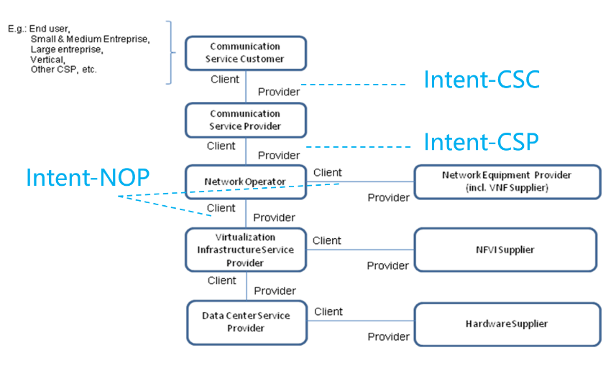
Questions
3GPP intent-CSC, intent-CSP and intent-NOP, what’s TM Forum scope of work?
Whether 3GPP and TM Forum Intent concepts have the same semantics?
Can the 3GPP-TMForum collaboration approach for FMC (introduced in P15) be reused for intent collaboration? If such collaboration reused, which group will provide/maintain the generic/umbrella intent models
How can a 3GPP defined UML model for intent and a TM Forum RDF model for intent be federated?
Is there any other SDO planning to collaborate with TM Forum on intent model federation for intent driven management?

Slide 18
3GPP proposals
3GPP is open for collaborating with TM Forum on intent driven management.
The collaboration shall take 3GPP time plan into account.
The collaboration shall follow 3GPP working procedures and IPR policy.

