Slide 1
Preparation of 3GPP-TMF call
23 February,2022

Slide 2
Proposed agenda in S5-221493 Reply to TM Forum Liaison AN LS22
This is a proposed agenda for the meetings:
Share views on intent concept, model progress from both groups
Open discussion on benefits from Model federation and obstacles
  Division of responsibilities and eliminating dependencies
  Model versions handling, compatibility rules, etc
Open discussion on cooperation mechanism
  Coordinate the work plan: align the time plan of relevant intent project stage 2 (IG1253 suit) and stage 3 (TMF921) in TM Forum, with work plan in 3GPP R17 (TS 28.312, including stage2 and stage3) and R18 intent study item (TR 28.912) .
  Mechanisms on alignment/collaboration between 3GPP and TM Forum: open discussion
  How 3GPP can influence definition of Intent Common Model if it is administrated by TM Forum
AOB
Source: S5-221493

Slide 3
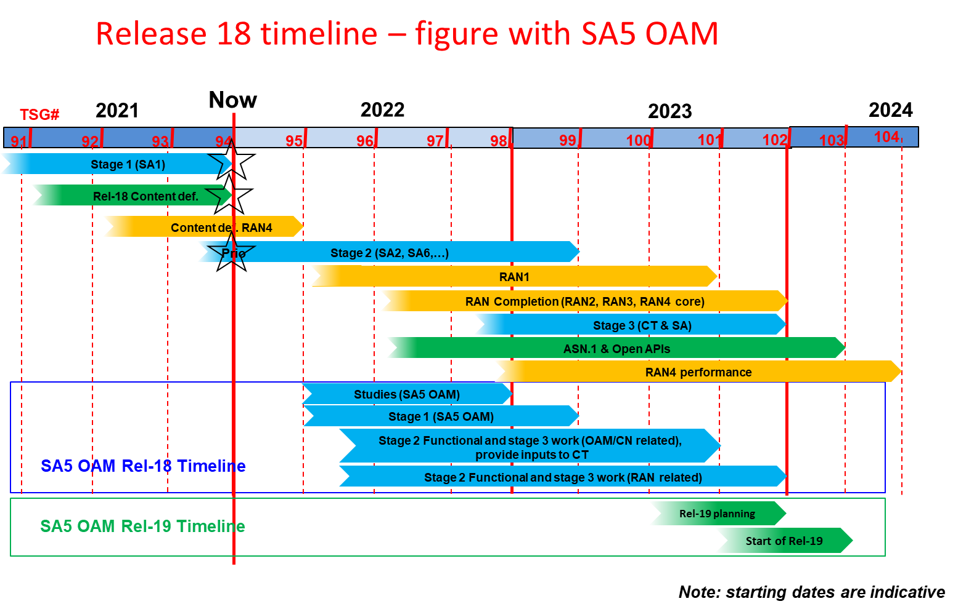
Source: S5-221173

Slide 4
Share views on intent concept, model progress from both groups

Slide 5
Overview on intent progress in 3GPP R17
3GPP R17 IDMS_MN progress
TR 28.812 Telecommunication management; Study on scenarios for Intent driven management services for mobile networks.
Status: Published in Sep.2020, started from June.2018.
TS 28.312 Management and orchestration; Intent driven management services for mobile networks.
  Status: Ongoing (Current completion rate is 95%, and planed to be completed and published in June.2022 followed by 3GPP R17 timeline)

Slide 6
3GPP R17 Intent definition and concept
Intent Definition:
Intent: the expectations including requirements, goals and constraints given to a 3GPP system, without specifying how to achieve them.
General Concept of Intent:
An intent is typically understandable by humans, and also needs to be interpreted by the machine without any ambiguity.
An intent focuses more on describing the "What" needs to be achieved but less on "How" that outcomes should be achieved…
The expectations expressed by an intent is agnostic to the underlying system implementation, technology and infrastructure…
An intent needs to be quantifiable from network data so that the fulfilment result can be measured and evaluated.
Source: TS 28.312 v 0.8.0

Slide 7
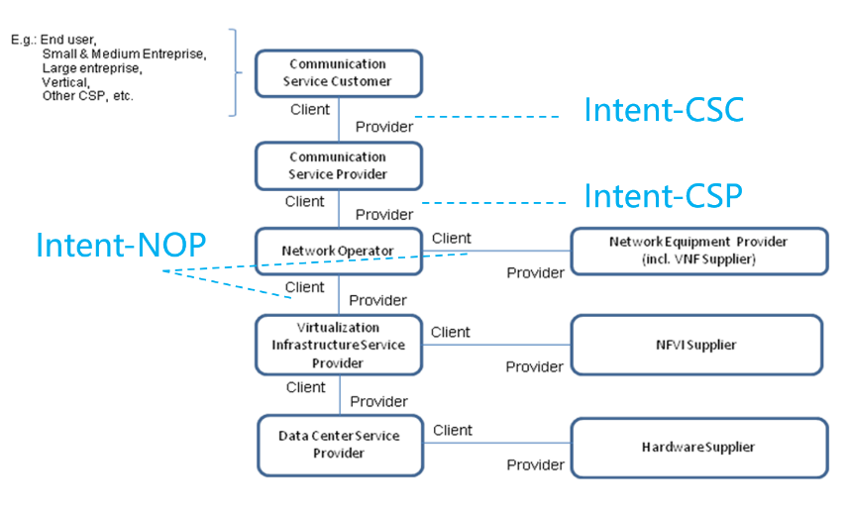
3GPP R17 Intent categories
Intent categorizes based on user types:
Based on roles related to 5G networks and network slicing management, different kinds of intents are applicable for different kinds of standardized reference interfaces.
- Intent from Communication Service Customer (Intent-CSC): Intent from Communication Service Customer enables Communication Service Customer (CSC) to express which properties of a communication service the CSC may request from CSP without knowing how to do the detailed management for communication service. For example, Intent-CSC can be 'Enable a V2X communication service for a group of vehicles in certain time'.
- Intent from Communication Service Provider (Intent-CSP): Intent from Communication Service Provider enables Communication Service Provider (CSP) to express an intent about what CSP would like to do for network without knowing how to do the detailed management for network. For example, Intent-CSP can be 'Provide a network service supporting V2X communications for highway-417 to support 500 vehicles simultaneously'.
- Intent from Network Operator (Intent-NOP): Intent from Network Operator enables Network Operator (NOP) to provide what NOP would like to do for group of network elements (i.e. subnetwork) management and control without knowing how to do the detailed management for the network elements. For example, Intent-NOP can be 'Provide a radio network service to satisfy the specified coverage requirements and UE throughput requirement in certain area'.
Source: TS 28.312 v 0.8.0

Slide 8
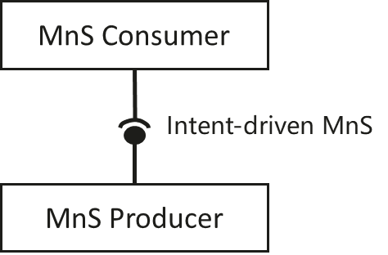
3GPP R17 intent driven MnS concept
Concept of Intent driven MnS
An Intent driven MnS allows its consumer to express intents for managing the network and services and obtain the feedback of intent evaluation result. An Intent driven MnS includes the following management capabilities to support intent lifecycle management:
- Create an intent, a MnS Consumer request to create a new intent on the MnS producer.
- Activate an intent, MnS Consumer request to activate an intent on the MnS producer when the intent is suspended.
- De-activate an intent, MnS consumer request to de-activate an intent on the MnS producer for a temporary suspension.
- Delete an intent, MnS Consumer request to remove an intent on the MnS producer.
- Modify an intent, MnS Consumer request to modify the content of the intent (e.g. optimization goal) on the MnS producer.
- Query an intent, MnS Consumer request to return the content and state (e.g. active, inactive) of the intent on the MnS producer.
Source: TS 28.312 v 0.8.0

Slide 9
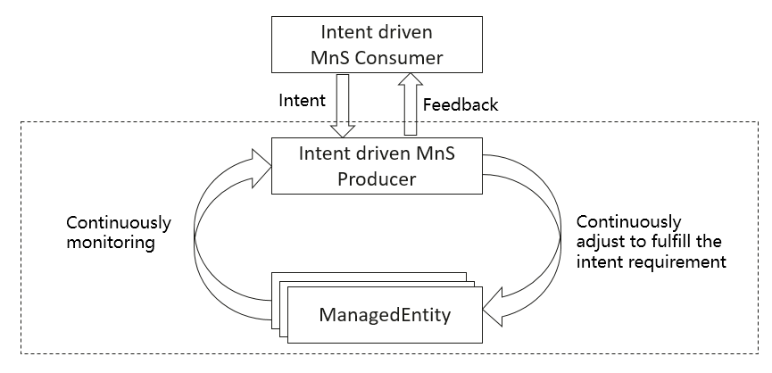
3GPP R17 Intent driven closed loop concept
Intent driven closed-loop
Intent can be used for management and control of closed-loop automation (e.g. intent can be used to specify the goals for the closed-loop), which means the intent can be translated to policies and management tasks that the MnS producer needs to execute for the closed-loop automation. In the intent driven management approach, the mechanisms that the MnS producer using closed-loop automation mechanisms to satisfy the intent is the implementation of the MnS producer and shall not be standardized.
Source: TS 28.312 v 0.8.0

Slide 10
3GPP R17 Intent driven Usecase
Intent driven use case
Intent containing an expectation for delivering radio network
Intent containing an expectation for delivering a radio service
Intent containing an expectation for delivering a service
Intent containing an expectation on coverage performance to be assured
Intent containing an expectation on RAN UE throughput performance to be assured
Source: TS 28.312 v 0.8.0

Slide 11
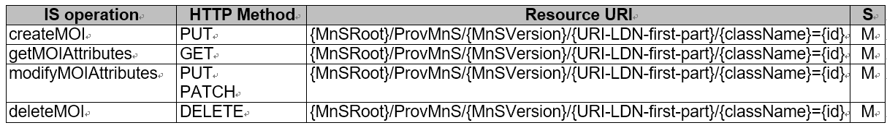
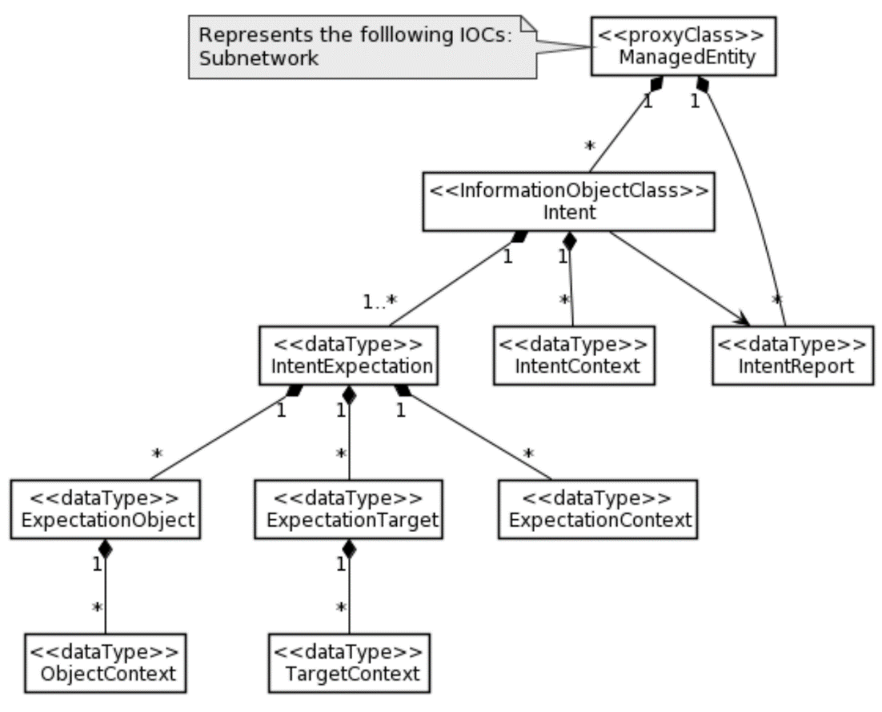
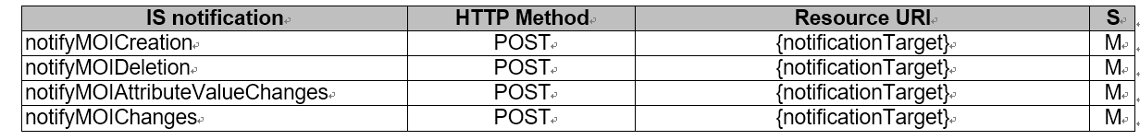
3GPP R17 Intent Driven MnS Stage2 and Stage3 definition
Management operation for intent (MnS component type A)
Intent Information Model
Generic Intent model
Two scenario specific intent expectation (Radio Network Expectation and ServiceSupport Expectation)
OpenAPI:
https://forge.3gpp.org/rep/sa5/MnS/-/blob/Rel17-draft/OpenAPI/provMnS.yaml
https://forge.3gpp.org/rep/sa5/MnS/-/blob/TS_28.312_intent_NRM_For_merge/OpenAPI/intentNrm.yaml
The stage2 and corresponding openAPI(stage3) has been specified in TS 28.532 and TS 28.312
Source: TS 28.312 v 0.8.0 and TS 28.532

Slide 12
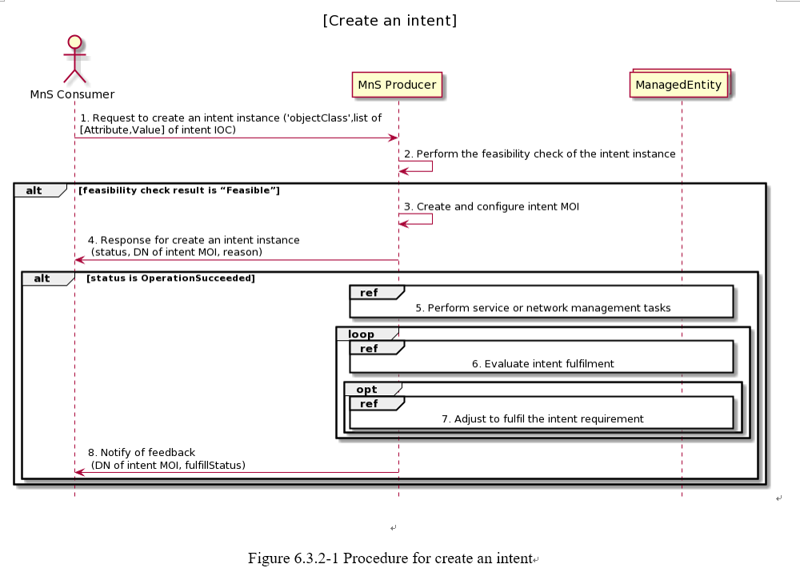
Workflow example of creating Intent containing an expectation for delivering radio network
Implemented by createMOI operation +Radio Network Intent
Implemented by notifyMOIAttributeValueChanges operation+ Radio Network Intent feedback information
Figure Source: TS 28.312 v 0.8.0

Slide 13
3GPP R18 intent way forward
3GPP R18 FS_eIDMS_MN progress
R18 Study on enhanced intent driven management services for mobile networks (the outcome will be documented in TR 28.912)
Status: new SID agreed in Dec.2021 and to be start in April.2022.
3GPP R18 FS_IDNSMN progress
R18 Study on intent-driven management for network slicing (the outcome will be documented in TR XXXX)
Status: new SID agreed in Jan.2022 and to be start in April.2022.

Slide 14
Open discussion on benefits from Model federation and obstacles
  Division of responsibilities and eliminating dependencies
  Model versions handling, compatibility rules, etc

Slide 15
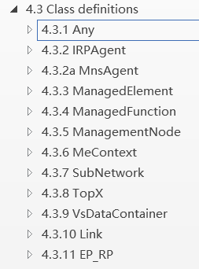
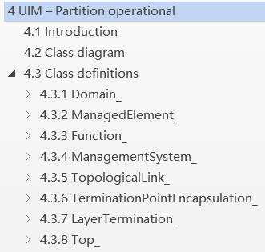
3GPP practice with TM Form: Fixed Mobile Convergence (FMC) Federated Network Information Model (FNIM) Umbrella Information Model (UIM)
The purpose is that, by de-coupling different domain/technical specific models with umbrella model (as much as possible), the technologies may evolve independently and yet retain compatibility. In this case, each SDO can develop its own concrete intent information model, but still being semantically consistent.
UIM introduces a number of classes, which are represented in UML and are implementation neutral views in that they only capture the semantics of the model from both a purpose neutral and purpose specific perspective.
Various SDOs and organizations are expected to use the UIM classes for definition of Domain/Technology-specific model classes. This procedure will maximize the probability of the domain/technology specific concrete classes (from various SDOs) being semantically consistent, a necessary characteristic for FMC NM purposes.
The UIM cannot be used directly for implementation. Implementation classes must be derived from those in the UIM by Inheritance or some other appropriate mechanism.
3GPP specific model which realized from the UIM
Joint developed by 3gpp and TM Forum
Source: TS 28.620 and TS 28.622
TM Forum specific model which realized from the UIM

Slide 16
Open discussion on cooperation mechanism
  Coordinate the work plan: align the time plan of relevant intent project stage 2 (IG1253 suit) and stage 3 (TMF921) in TM Forum, with work plan in 3GPP R17 (TS 28.312, including stage2 and stage3) and R18 intent study item (TR 28.912) .
  Mechanisms on alignment/collaboration between 3GPP and TM Forum: open discussion
  How 3GPP can influence definition of Intent Common Model if it is administrated by TM Forum

Slide 17
Questions
Regarding the intent-CSC, intent-CSP and intent-NOP, what’s the scope in TM Forum?
Whether Intent in 3GPP have the same semantics with Intent in TM Forum?
Whether the 3GPP-TMForum collaboration approach for FMC (introduced in P15) can be reused for intent collaboration? If such collaboration reused, which group will provide/maintain the generic/umbrella intent models
Currently 3GPP use UML as general modeling approach, is there any issue to use UML for intent modelling?

Slide 18
3GPP proposals
3GPP open for the collaboration with TM Form for intent.
The collaboration shall take into account of 3GPP time plan.
The collaboration shall follow 3GPP working procedures and IRP rules.

