Slide 1
Discussion paper on Asynchronous interactions design pattern
Nokia, Nokia Shanghai Bell

Slide 2
Rationale
Certain interactions may take a long time, from minutes over hours to even days. It is inappropriate for the REST client to keep the HTTP connection open (in a single synchronous call) to wait for the result of the response - the connection will time out before a result is delivered
For these cases, asynchronous interactions are used
  The operation immediately returns the provisional response "202 Accepted" to indicate that the request was understood, and processing has started
  The client can check the status of the operation by polling (with or without a monitor resource)
  Alternatively, the subscribe-notify mechanism can be used to provide the result once available. The progress of the operation is reflected by a monitor resource

Slide 3
Asynchronous interactions: Major Aspects to address
For a typical Asynchronous interactions, there are three type of information (Request, Monitoring, Results information) to be captured
A discussion is needed in SA5 to agree (a) common design pattern(s) for Asynchronous interaction for the following two aspects:
  Modeling the different types of information in NRM
  Define common Asynchronous Procedures aligned with the NRM model
    With polling,
    With subscribe/notify, or
    Polling without a monitor resource

Slide 4



Modeling the information
Taking FeasibilityCheckJob NRM Attribute design as an example. Request, Monitoring, Results information mapped as table below:
Information contents | Information Type | Notes
SliceProfile | Request Information | One of Attribute to be used
ServiceProfile
fCJobStatus | Monitoring Information | Used to monitor job status
fCJobProgress
feasibilityResult | Results Information
unFeasibleReason
NRM IOC Modeling Alternatives:
Agreement is needed: how to model the information (i.e., evaluating the alternatives)
Alternatives | Pro | Cons
One IOC: One IOC to include all information | Straightforward, all information included in one IOC | Common IOC (especially for monitoring, possible for results) could not be shared, hence redundant information shall be modeled & created every time
Three IOC: Define one IOC for each type of information | Common IOC could be modeled and shared for similar use cases; systematic design for all asynchronous operations | A bit heavier IOC designed and more IOC to be maintained; more procedures shall be introduced to maintain the IOC instances, might be too lengthy for simple scenario
Two IOC: One IOC for Job (Requests or Results), one IOC for monitoring (Monitoring or Results) | Monitor IOC could be common for different asynchronous interactions | One more IOC to be maintained comparison to One IOC alternative

Slide 5
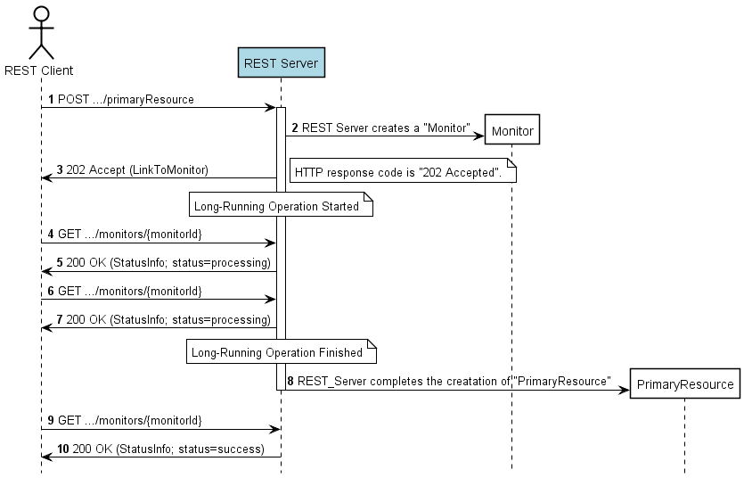
Asynchronous pattern(1/3): With polling (generic)
The representation of the monitor shall contain at least the following information:
  Resource URI of the primary resource
  Status of the operation (at least "processing", "success", "failure")
  Additional information about the result or the error(s) occurred, if applicable.
Housekeeping for both resource

Slide 6
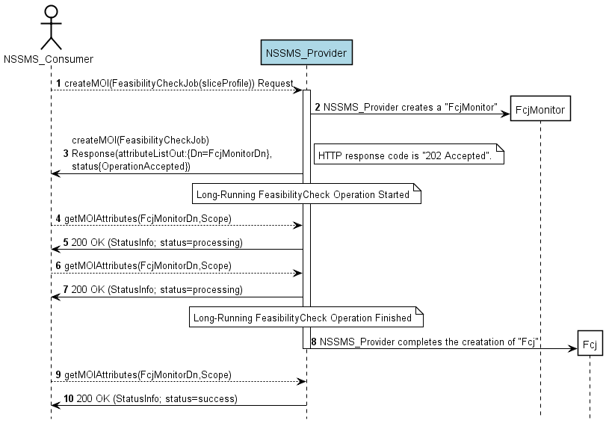
Asynchronous pattern (1/3): With polling for Fcj (createMOI)
Housekeeping for both resource

Slide 7
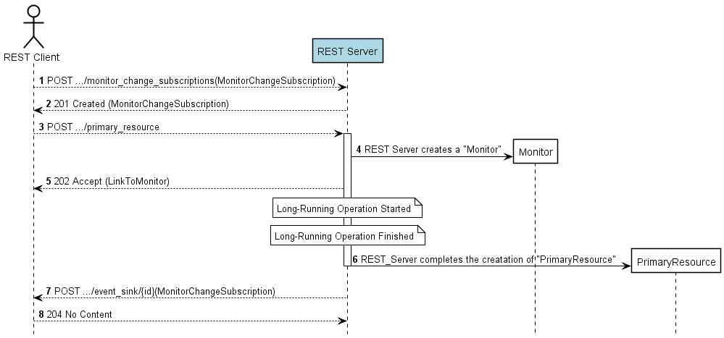
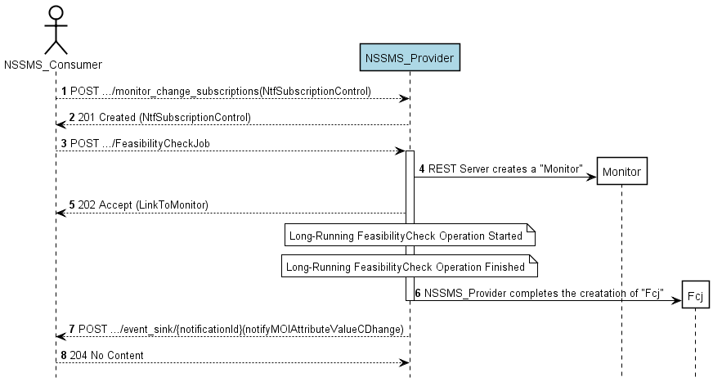
Asynchronous pattern (2/3): with subscribe/notify
Generic Example with subscription / notification
Housekeeping for both resource
Note:
The monitor change notification shall include the status of the operation and the resource URI of the monitor and shall include the resource URI of the affected primary resource.
Example with FCJ (simple procedure)
Housekeeping for both resource

Slide 8
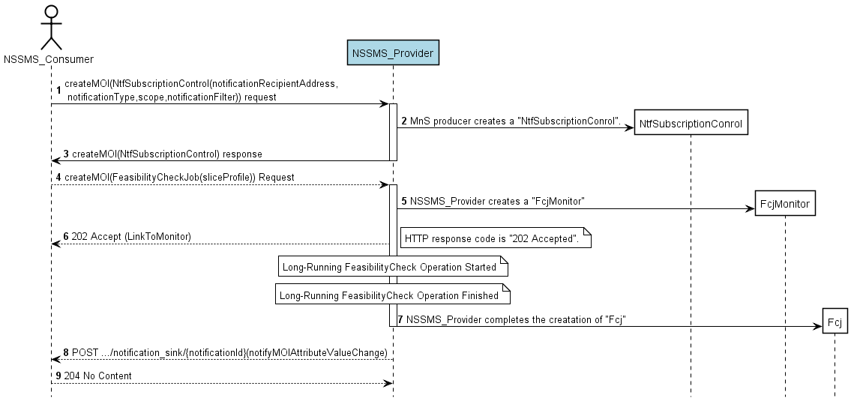
Asynchronous pattern (2/3): with subscribe/notify for Fcj (with createMOI)
Housekeeping for both (or three) resource

Slide 9
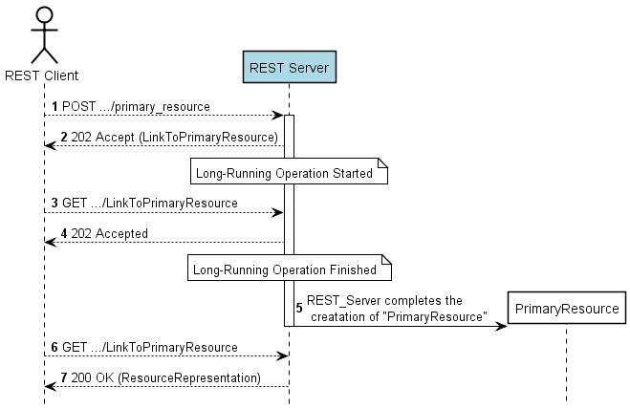
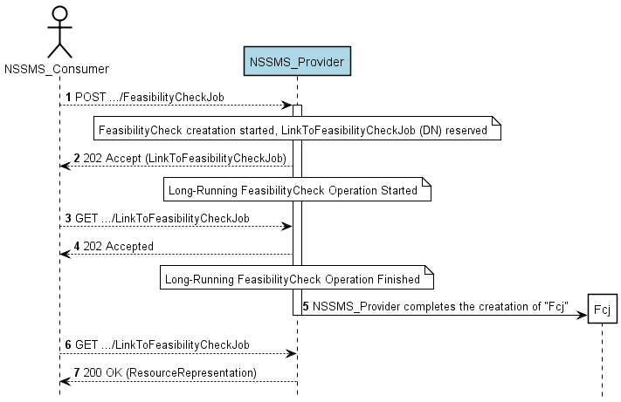
Asynchronous pattern (3/3): without monitor
Example with FCJ (simple)
Housekeeping for PrimaryResource
Housekeeping for PrimaryResource

Slide 10
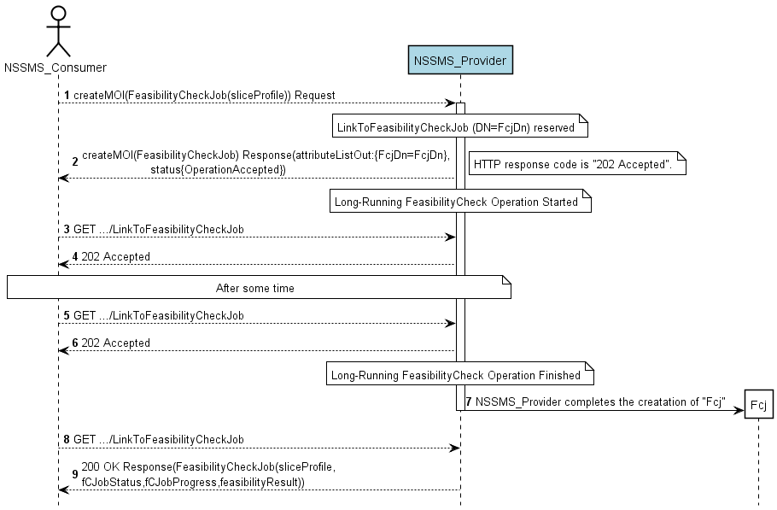
Asynchronous pattern (3/3): without monitor for Fcj (with createMOI)
GET used directly
Housekeeping for PrimaryResource

Slide 11
Procedure FFS
If using multiple IOC, how to model the relation of those IOC
To cancel an ongoing job
Poll the job status in regular intervals, how to define the interval
Timer to control the timeout, how to define the timer
Housekeeping of Job if it lasts very long time

Slide 12
Summary
  There are multiple options to model different types of information in NRM
  Three type of Asynchronous interactive Procedures introduced
    With polling
    With subscribe/notify
    Polling without a monitor resource

Slide 13
Reference
https://github.com/WhiteHouse/api-standards
Github API
Web API Design, by Brian Mulloy, Apigee
Fieldings Dissertation on REST
HTTP status codes cheat sheet
ETSI
  http://www.etsi.org/deliver/etsi_gs/MEC/001_099/009/01.01.01_60/gs_MEC009v010101p.pdf (ETSI GS MEC009: General principles for Mobile Edge Service APIs)
    6.13 Pattern: Asynchronous operations
  https://nfvwiki.etsi.org/images/NFVSOL%2817%29000050r4_ETSI_NFV_SOL_REST_API_Conventions.pdf (ETSI NFV API guidelines)
    6.8/6.9

Slide 14
Thank you!

Slide 15
Backup

Slide 16
Example Async Procedure based on the NRM model:
XyzJob
The “XyzJob" represents a job on a MnS producer that performs an action Xyz (or create a Xyz MOI) from a MnS consumer. It can be name-contained by "ManagedElement" or "SubNetwork".
A "XyzJob“ MOI is created by a MnS consumer on a MnS producer. The MOIcreation requests the MnS producer to perform a job. Upon completion of the XyzJob, the MnS consumer shall delete the "XyzJob".
The creation request contains the job information required by the MnS producer to fully perform the job.
The response to "XyzJob" creation response will be HTTP 202, where the body of the response provides a link to the resource being created / updated (this requires that the ID of the resource is reserved even if the resource is not yet fully created) (support either polling or notification)
  The “XyzJob" creation response shall include a link to the created "XyzMonitor“ (refer to next chart)
  The link allows for simple deployments not relying on notifications for reporting the status of the “XyzJob”, where the MnS consumer can poll the job in regular intervals.
  MnS consume queries the status with getMOIAttributes (GET)
  MnS consumer gets notification with notifyMOIAttributeValueChanges when value of attribute concerning status changes (i.e. to DONE) (assumed the notification subscription done beforehand)
FFS:
To cancel an ongoing job
Poll the job status in regular intervals, how to define the interval
Timer to control the timeout, how to define the timer, create HeartBeatControl
Housekeeping of Job if it lasts very long time
Notes:
202 Accepted The request has been accepted for processing, but the processing has not been completed. The request might or might not eventually be acted upon, as it might be disallowed when processing actually takes place. There is no facility for re-sending a status code from an asynchronous operation such as this.
The 202 response is intentionally non-committal. Its purpose is to allow a server to accept a request for some other process (perhaps a batch-oriented process that is only run once per day) without requiring that the user agent's connection to the server persist until the process is completed. The entity returned with this response SHOULD include an indication of the request's current status and either a pointer to a status monitor or some estimate of when the user can expect the request to be fulfilled

Slide 17
Example Async Procedure based on the NRM model:
XyzMonitor
Procedures
A "XyzMonitor" represents the status of an asynchronous job.
  It is name-contained by the "XyzJob" whose status is represented by the monitor.
A "XyzMonitor" is created by the MnS producer together with the associated “XyzJob" upon receiving a “XyzJob" creation request.
  Attributes of a "XyzMonitor" are populated and updated by the MnS producer as the job completing progresses.
  The MnS producer shall delete the monitor shortly after the job terminated (completed or cancelled) and the "status" attribute is either "SUCCESS, "FAILURE" or "CANCELLED".
The “XyzJob" creation response shall include a link to the created "XyzMonitor".
FFS:
Housekeeping of Monitor

Slide 18
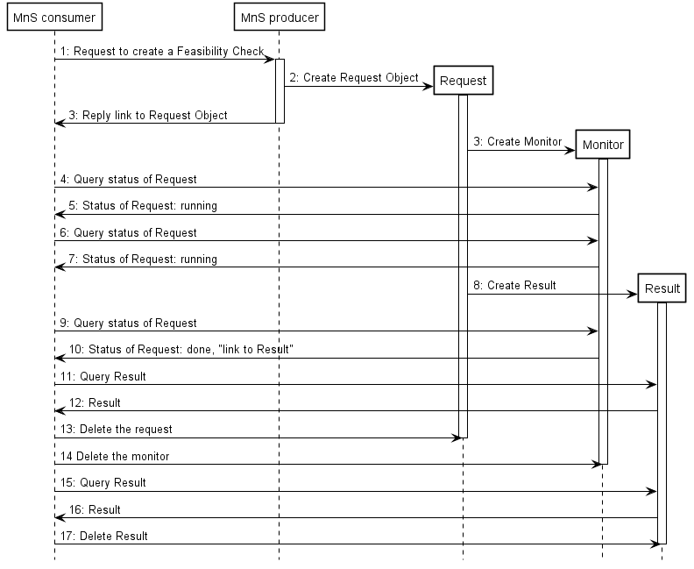
A more generic interactive
FFS:
How to merge different resource to simply procedure
Housekeep resource

