Slide 1
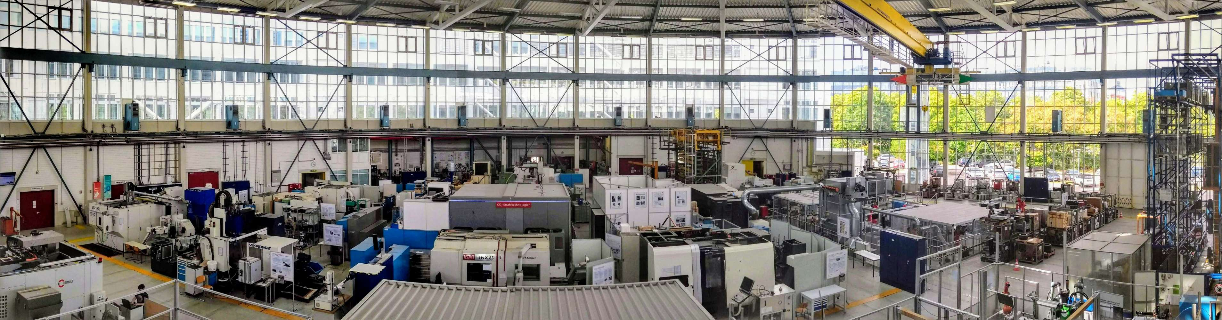
Directional Wideband Channel Measurements at
28 GHz in an Industrial Environment

Slide 2
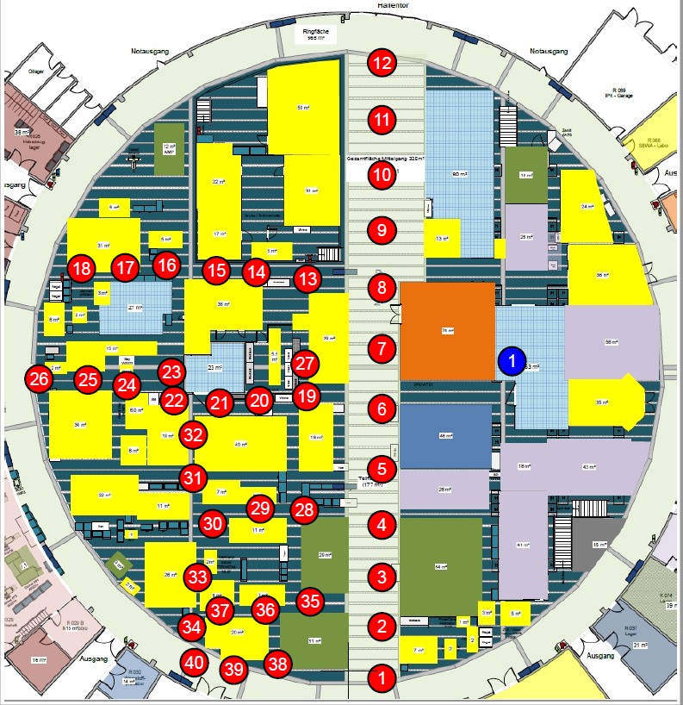
Measurement Scenario
Circle-shaped machine hall
  63m diameter, 16-18.5m height
  Glass walls, concrete pillars supporting roof
  Balcony over half of hall
BS-like position on balcony
40 UE-like positions on the floor
  Two heights: 1.5 and 4m above ground
Tx and Rx at both BS and UE positions
  Directional information on both sides

Slide 3
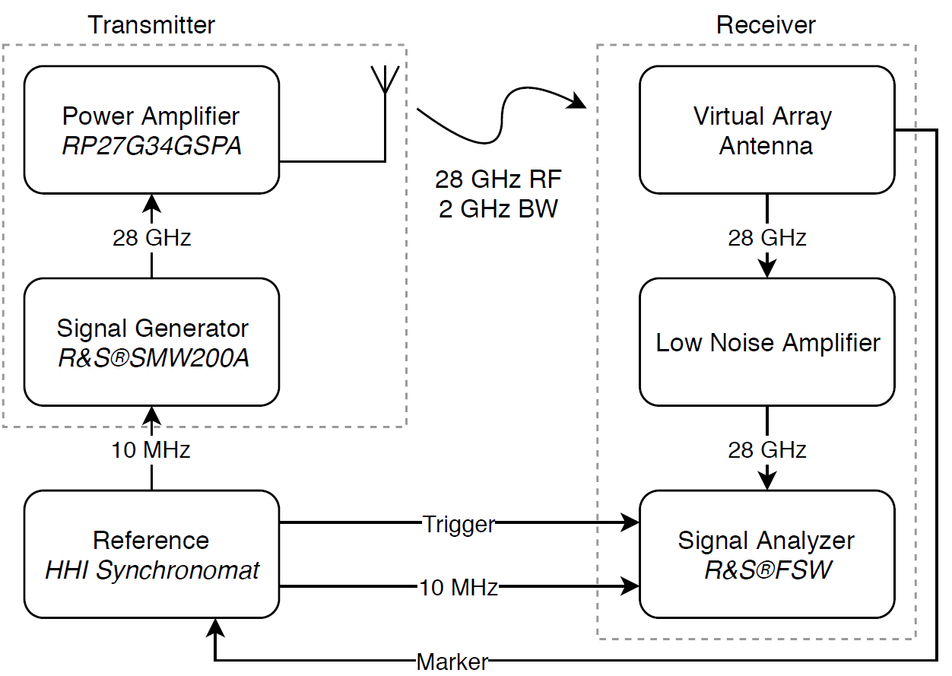
Measurement Setup
Instrument-based channel sounder
Carrier frequency 28 GHz, 2 GHz bandwidth
Frank-Zadoff-Chu sounding sequence
Virtual Circular Array Antenna with 1000 virtual antenna elements used at receiver
RB-MUSIC algorithm used to extract directional information

Slide 4
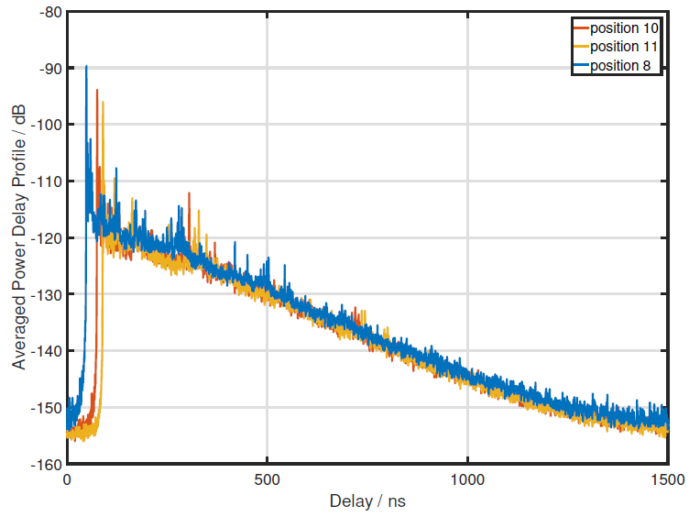
Measurement Result: Power Delay Profile

Slide 5
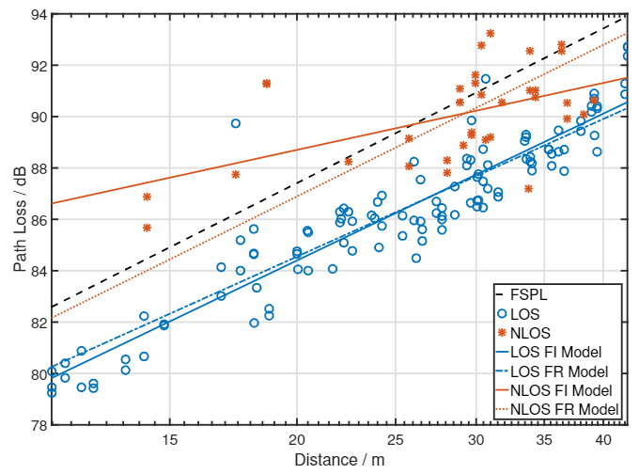
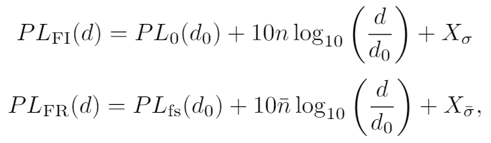
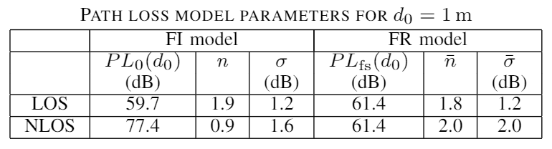
Measurement Results: Path Loss

Slide 6
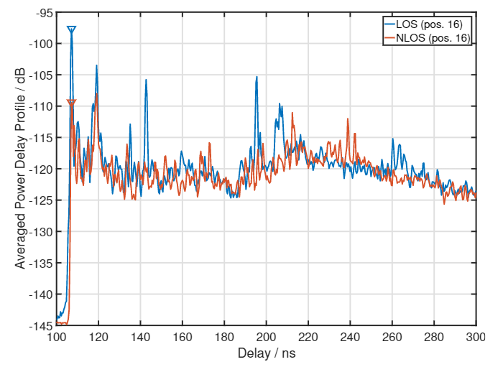
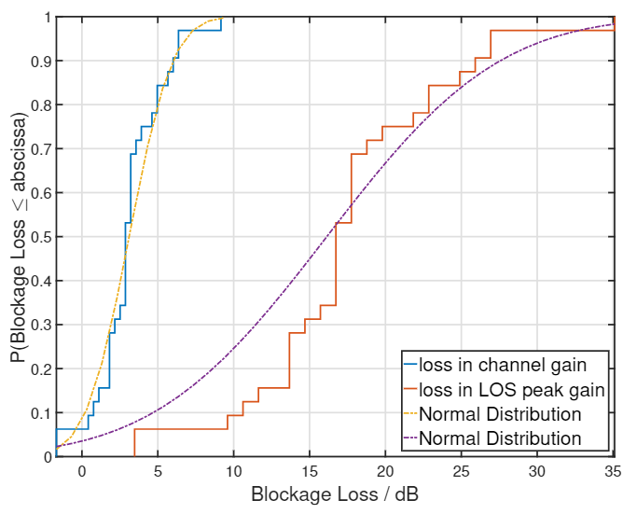
Measurement Results: Blockage Loss

Slide 7
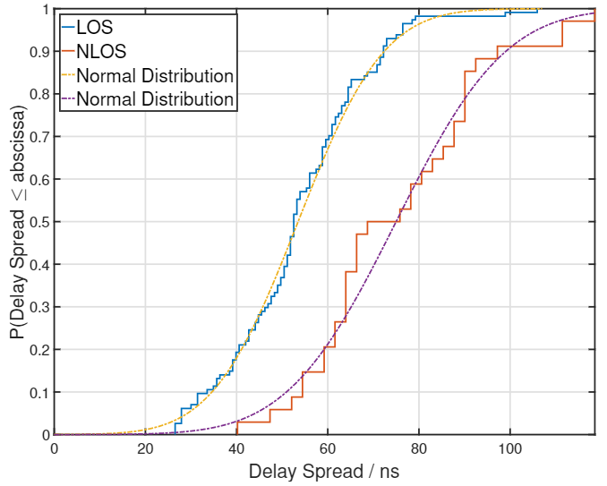
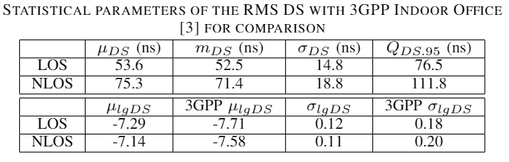
Measurement Results: Delay spread

Slide 8
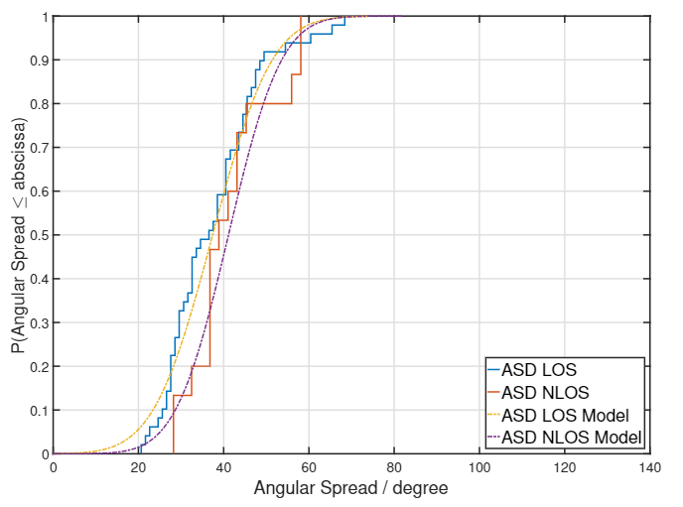
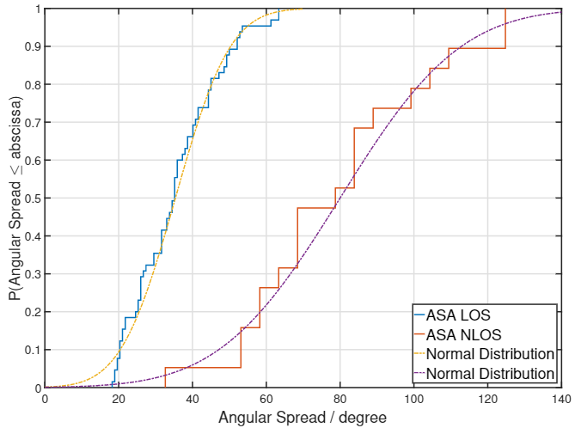
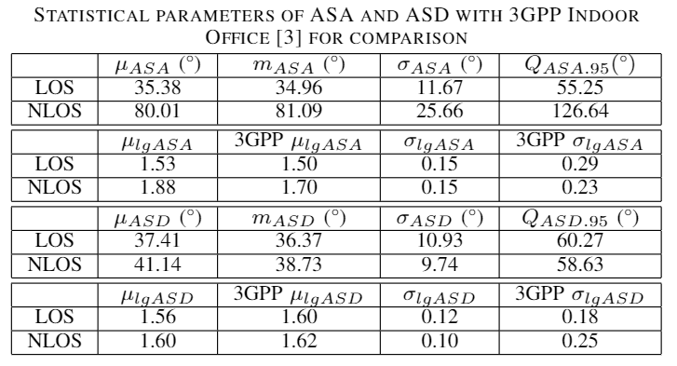
Measurement Result: Angular Spread

Slide 9
Further hall pictures

Slide 10
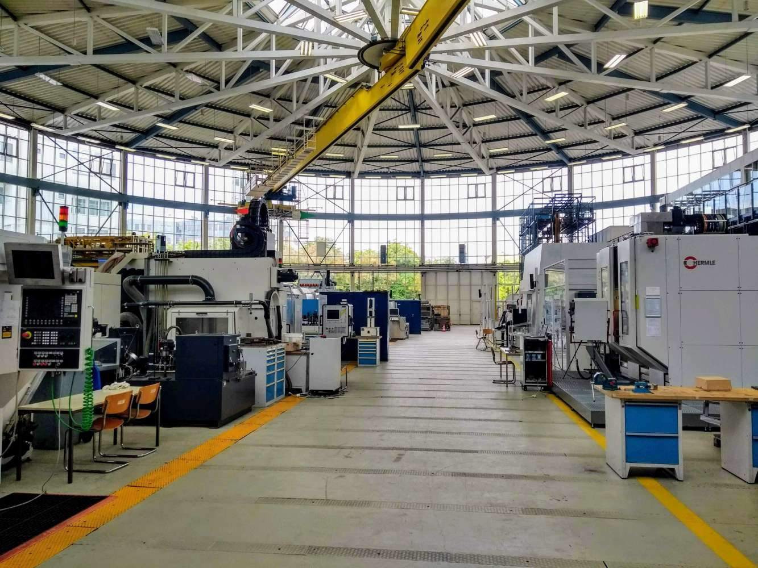
Further hall pictures

Slide 11
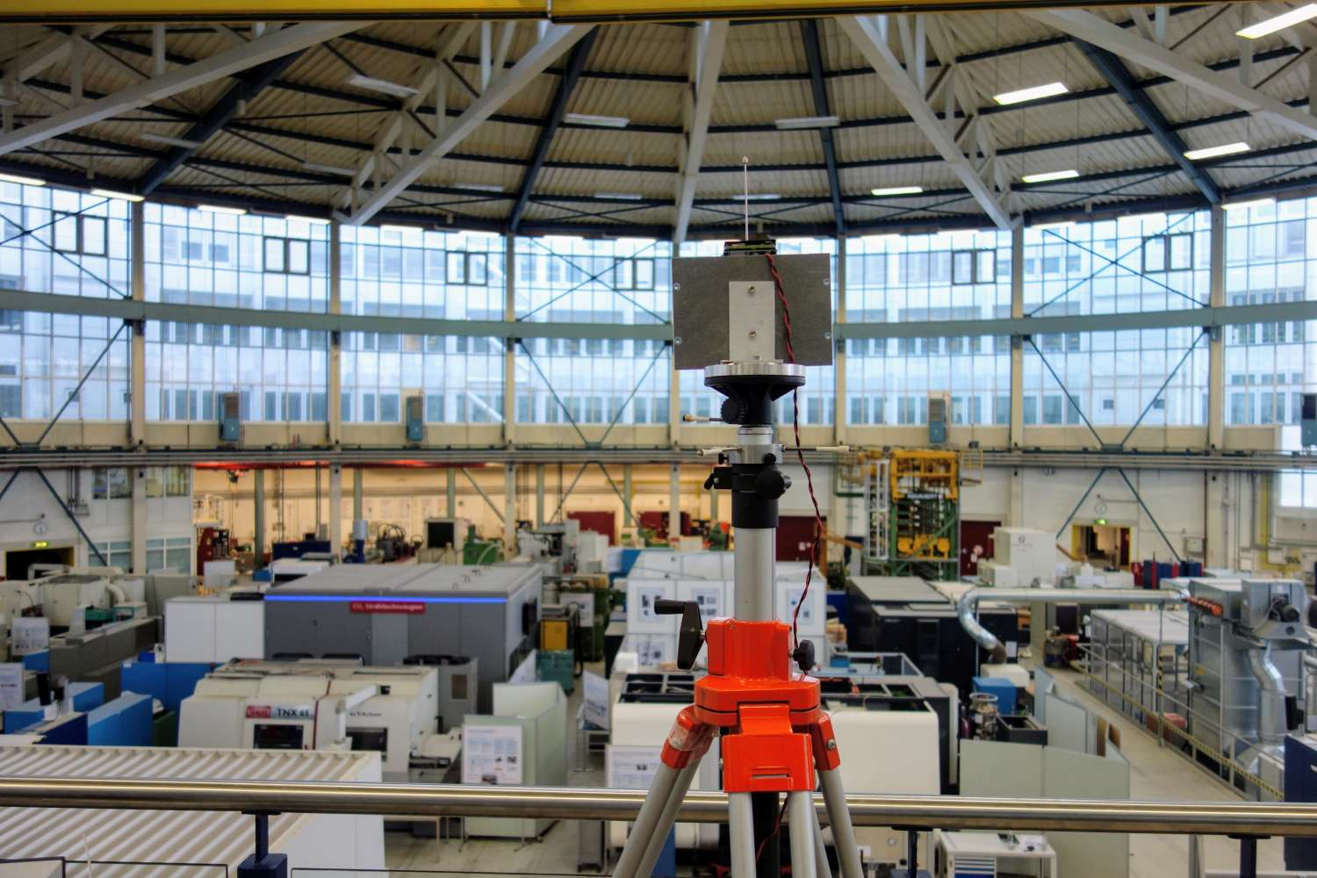
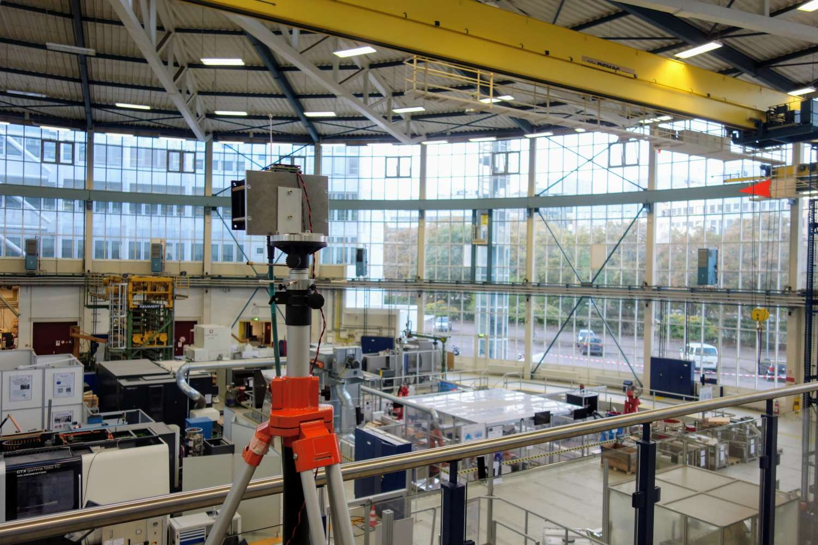
Further hall pictures

Slide 12
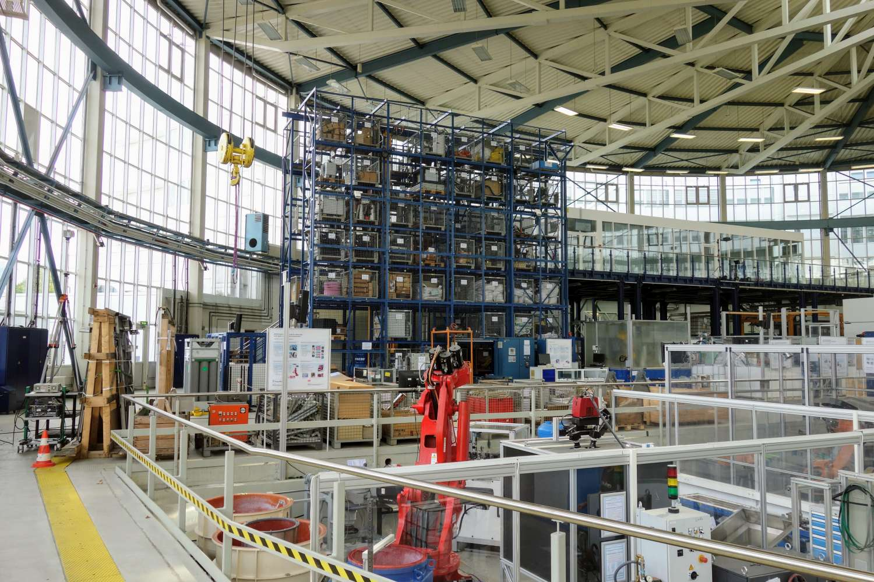
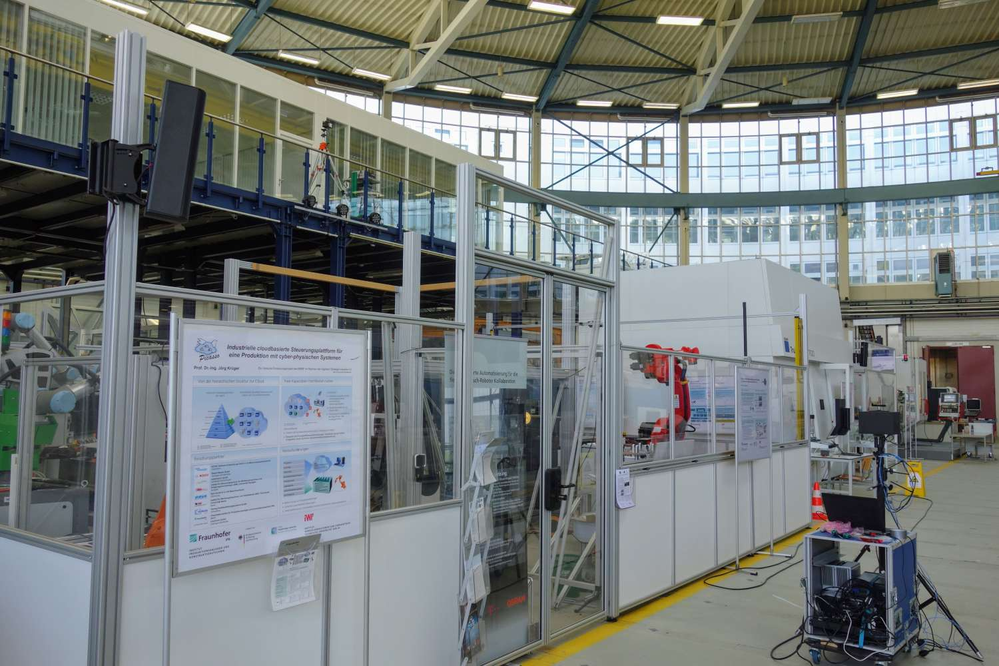
Further hall pictures

