Slide 1
Way-forward for
UAS parameter transport in EPS
Sunghoon Kim
CT1 delegate, Qualcomm Incorporated

Slide 2
Issue summary
UUAA/C2 authorization parameter needs to be sent to network during Attach procedure or PDN connectivity request procedure
UUAA/C2 authorization parameter may exceed 255 byte so that two octets length is required: ePCO needs to be used
CT1 has discussed the issue since last Aug. 2021 meeting, and it hasn’t been converged so far.
  Several approaches were discussed: 1) explicit indication in PCO for two octet lengths UAS parameter, 2) allowing to send ePCO in the first uplink NAS signaling, 3) sending parameters which is smaller than 255 byte in the first uplink NAS signaling
  Other alternatives were also discussed but not enough support
CT1 sent LS to SA2 to ask EPS requirement, and SA2 has replied.

Slide 3
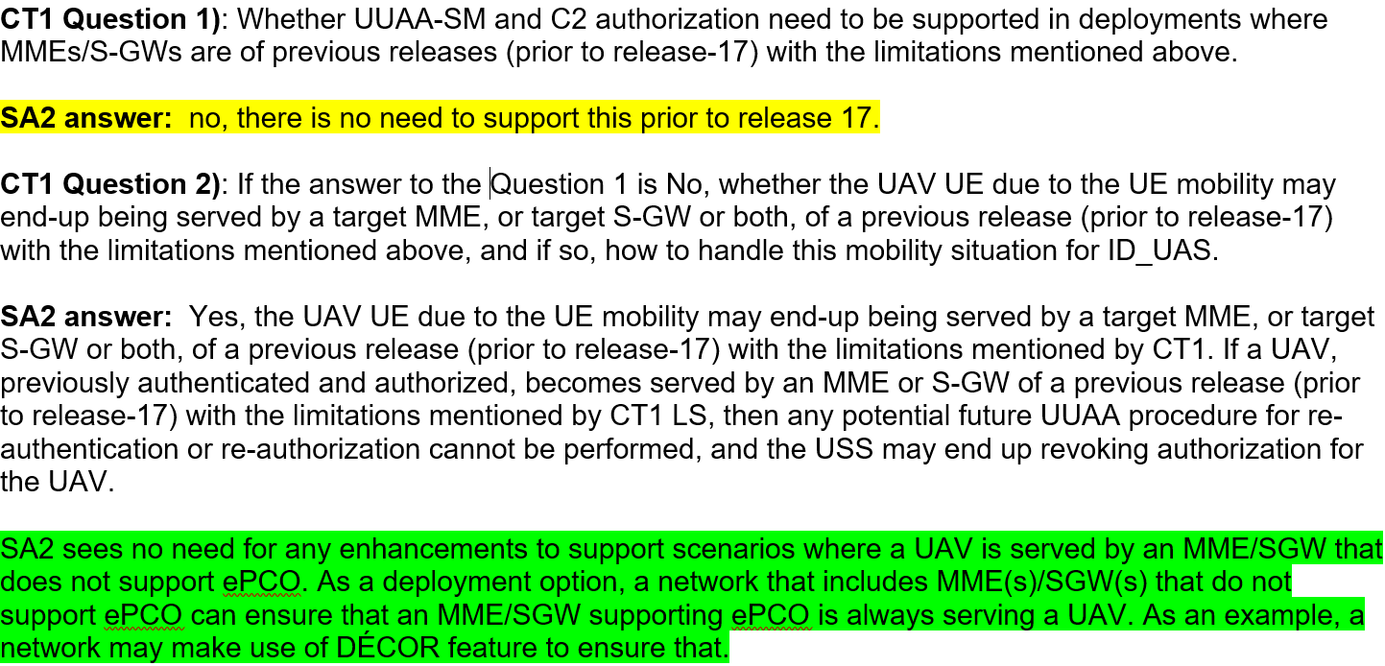
Response from SA2 (S2-2109342)

Slide 4
Discussion on reply LS from SA2
SA2 has confirmed that there is no need that UUAA/C2 auth features need to be supported by MME/S-GW prior to rel-17
  Qualcomm view: It does not have to keep avoiding MME impact any longer. Rel-17 MME requirement for supporting ePCO in the first uplink NAS signalling can be implemented by stage-3, which is simpler way than others.
SA2 has confirmed that the mobility scenario (where a UE may end up being served by a target MME/SGW not supporting ID_UAS) has no need to support.
  Qualcomm view: CT1 does not have to consider this scenario any longer. In addition, as SA2 mentioned, USS may end up revoking UUAA for the UAV, which does not have MME/SGW impact (merely it ends up with PDN connection release)

Slide 5
Way-forward Proposal
Proposal
  Adding UE/MME requirement to support ePCO end-to-end if it supports ID_UAS
  → changes on 6.6.1.1 General section of TS 24.301
  UAV UE shall send UAS parameters (as a Service-level-AA container) in ePCO
  → Changes on procedure section for UUAA/C2 authorization

